Slide 1

How enhanced oil recovery may perpetuate the climate crisis instead of helping address it
Toly Rinberg
HEJC 10/9/20

Slide 2
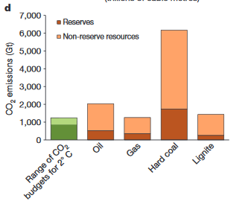

Global cumulative emission bound to stay below 2C warming:
₍₂₀₁₁₋₂₀₅₀₎
~1000 GtCO₂
Fossil resources
11,000 GtCO₂
Reserves
3000 GtCO₂
McGlade & Ekins (2015)

Slide 3
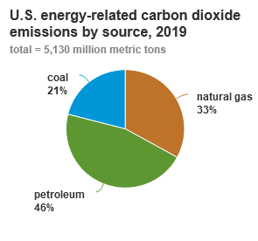
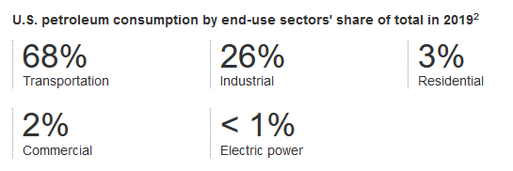
Focus on emissions and oil in the U.S.
In 2019, U.S. petroleum emissions = 2.4 GtCO₂ / year
Current U.S. emissions = 6.7 GtCO₂ / year
Cumulative U.S. emissions = 400 GtCO₂
https://www.eia.gov/energyexplained/oil-and-petroleum-products/use-of-oil.php
Notes:
which included about 1.1 million b/d of biofuels.
7.5 billion barrels of oil consumed in 2018 - https://www.eia.gov/tools/faqs/faq.php?id=33&t=6

Slide 4
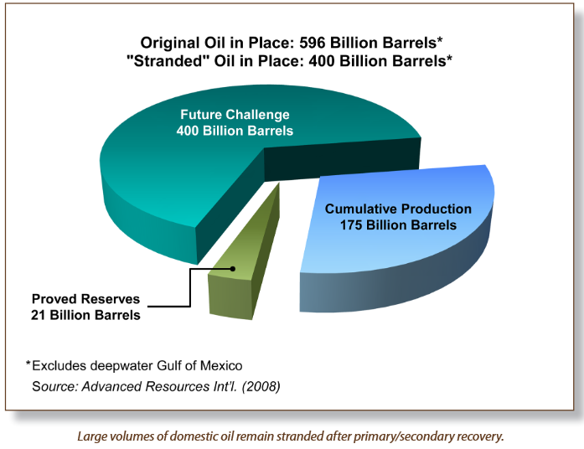
Original oil in place, production, and reserves
Some rough CO₂ accounting:
Original oil in place: 300 GtCO₂
Cumul. Production: 86 GtCO₂
Reserves: 11 GtCO₂
Remaining: 200 GtCO₂
Recall: Cumul. U.S. emissions = 400 GtCO₂
Note: 1 barrel of oil ~= 0.5 lifecycle tCO2 emissions
(2008)
https://www.netl.doe.gov/sites/default/files/netl-file/CO2_EOR_Primer.pdf

Slide 5
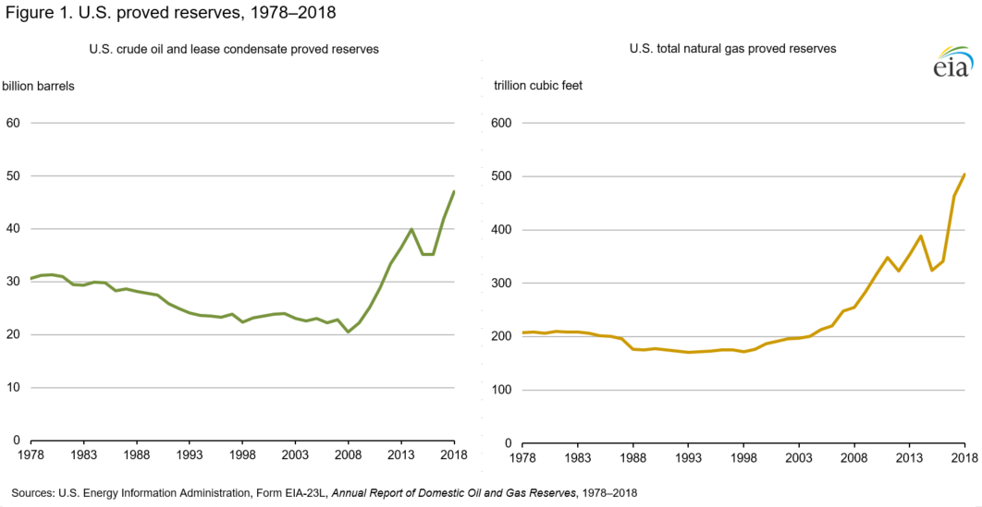

Where is this going!?
What the frack
“I am not banning fracking”

Slide 6
Fossil fuels unlocked through EOR?
~85 billion barrels of oil are technically recoverable through CO₂-EOR
(=43 GtCO₂)
*Note: this doesn’t count next gen EOR that adds +40 billion barrels
Proved Reserves
43.8 billion barrels (2018)
(2008)
https://www.netl.doe.gov/sites/default/files/netl-file/CO2_EOR_Primer.pdf

Slide 7
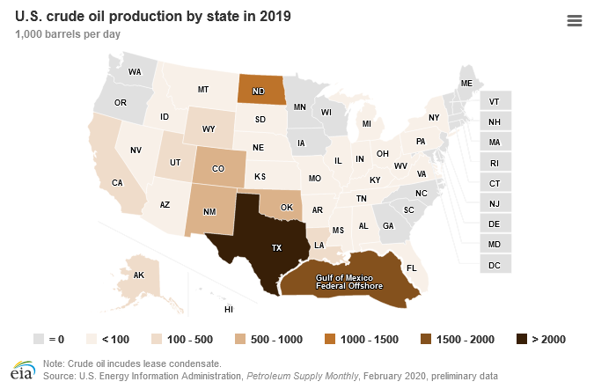
Oil production in the U.S. today
Total oil produced:
~4.5 billion barrels / year
Oil from EOR (~2%):
~100 million barrels/year
https://www.eia.gov/dnav/pet/PET_CRD_CRPDN_ADC_MBBLPD_A.htm
https://www.eia.gov/energyexplained/oil-and-petroleum-products/where-our-oil-comes-from.php

Slide 8
U.S. emissions from consumed oil
34.5 GtCO2
=
~70 billion barrels of oil
Compare to:
Proven U.S. reserves = 44 billion barrels of oil (22 GtCO2)
Oil unlocked with EOR = 85 billion barrels of oil (43 GtCO2)
2.3
GtCO2
0
2020
2050
https://www.eia.gov/outlooks/steo/report/renew_co2.php?src=Environment-b1
Notes:
7.5 billion barrels of oil consumed in 2018 - https://www.eia.gov/tools/faqs/faq.php?id=33&t=6
Which number is right?
https://en.wikipedia.org/wiki/Oil_reserves_in_the_United_States
https://www.statista.com/statistics/236687/proven-crude-oil-reserves-in-the-usa-since-1980/

Slide 9
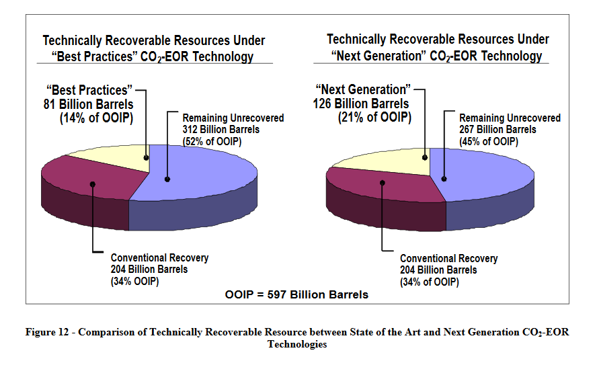
http://large.stanford.edu/courses/2013/ph240/salehi2/docs/netl-2010-1417.pdf

Slide 10
Oil production and EOR

Slide 11
The phases of oil well production
Primary recovery - Pop open the well and let internal pressure and processes drive extraction.
Secondary recovery – External energy applied to increase well pressure, typically by injecting water or gas
Tertiary (or enhanced) recovery - Increase the mobility of the oil in order to increase extraction (CO2-EOR 60%, Thermal-EOR 40%, Chemical-EOR 1%)

Slide 12
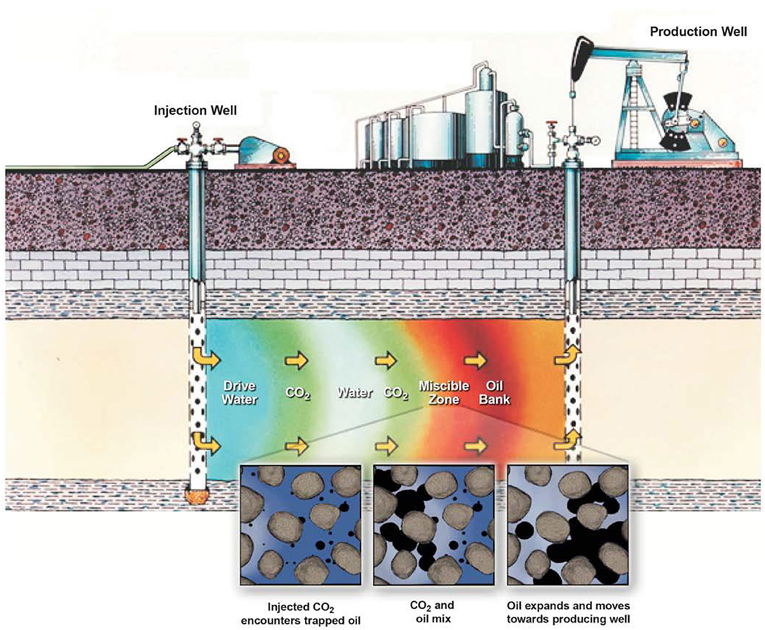
https://www.frontiersin.org/articles/10.3389/fclim.2019.00005/full

Slide 13
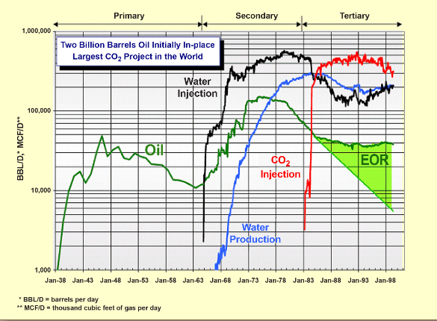
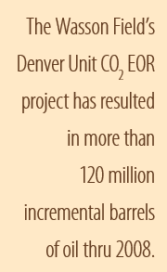
Case study: Shell Oil’s Denver Unit in the Wasson Field in West Texas
Initial oil in place: 2 billion barrels
Field started producing oil in 1938!
https://www.netl.doe.gov/sites/default/files/netl-file/CO2_EOR_Primer.pdf

Slide 14
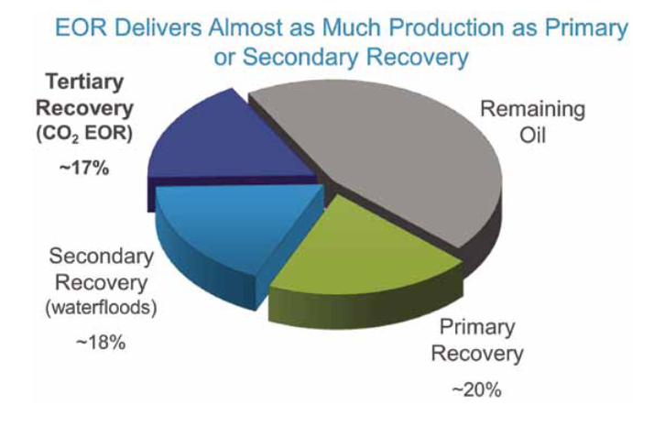
https://www.globalenergyinstitute.org/sites/default/files/020174_EI21_EnhancedOilRecovery_final.pdf

Slide 15
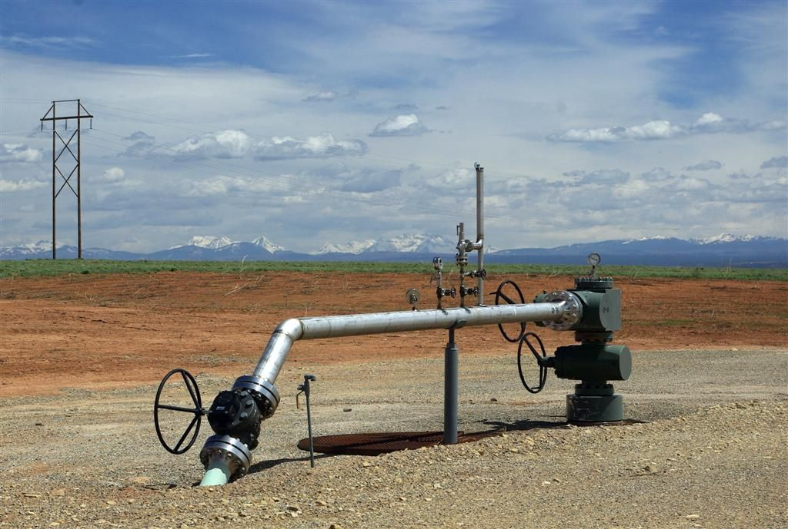
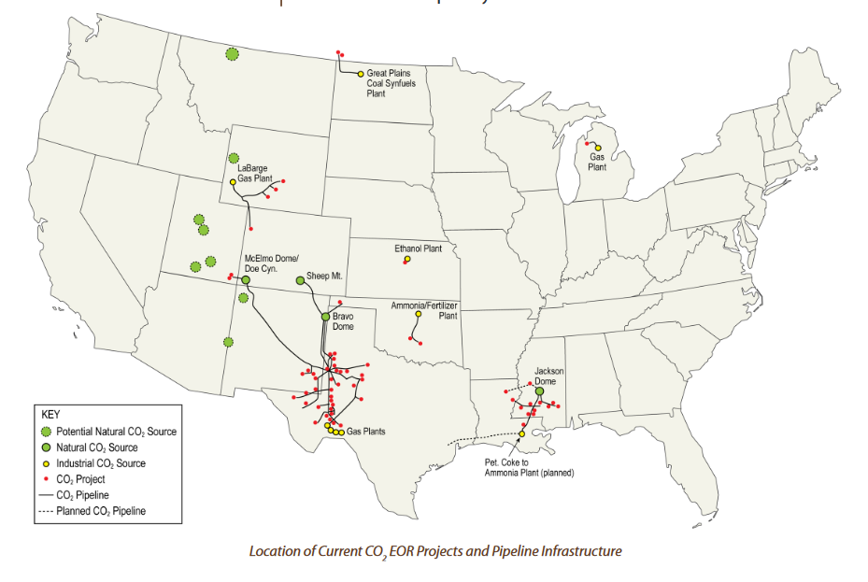
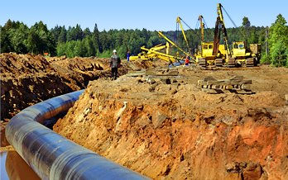
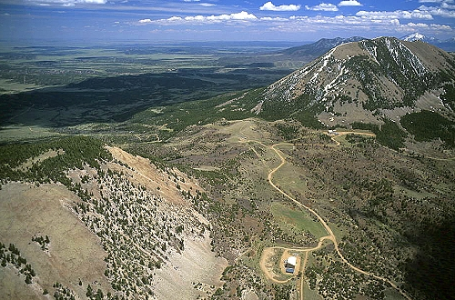
Current EOR infrastructure
CO2 Domes in Colorado:
https://www.netl.doe.gov/sites/default/files/netl-file/CO2_EOR_Primer.pdf
Notes:
+4000 miles of pipeline

Slide 16
How to think about sequestration and EOR?

Slide 17
What happens with the CO2 that is injected during EOR?
Most of CO2 injected during EOR ends up getting trapped in the subsurface
Amount of CO2 needed per barrel of oil over time is highly variable [see back up slide]
Historical average is ~0.5 tCO2 stored / barrel of oil produced
  Careful: ***Big caveat on this number***
  Recall: 1 barrel of oil combusted = 0.5 lifecycle tCO2 emissions
  Note: don’t forget about legacy emissions from oil recovered from the well
But to evaluate the significance of these numbers, we have to ask where the CO2 comes from…

Slide 18
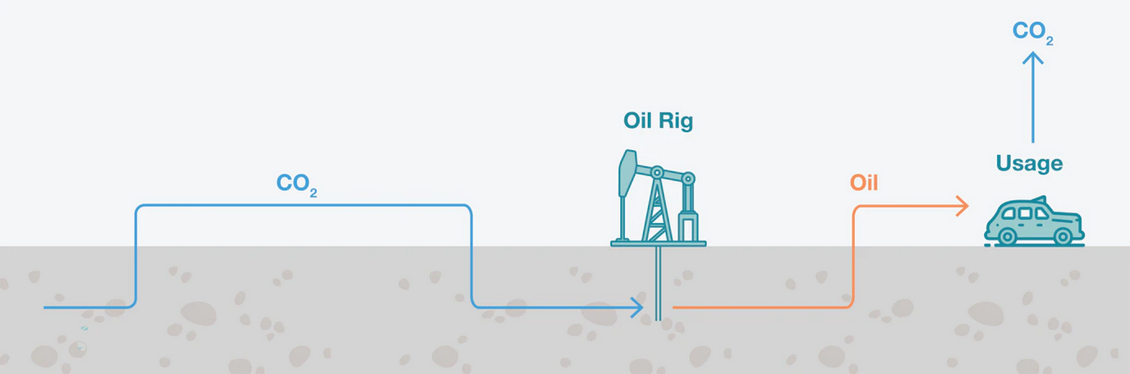
Underground CO2 (re)sequestered
*Almost all EOR is done this way today
Today, comes from: underground domes, mostly in Colorado
https://www.iea.org/commentaries/can-co2-eor-really-provide-carbon-negative-oil

Slide 19
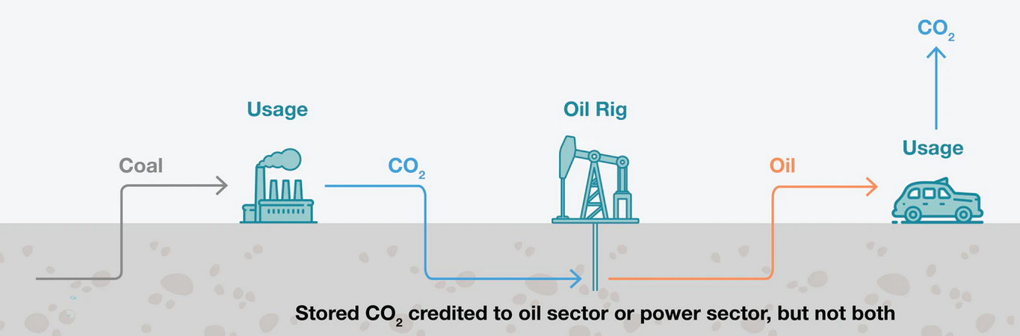
Anthropogenic CO2 sequestered
Small % of EOR done this way
Today, comes from: Ammonia, ethanol production, natural gas
Fossil fuel
https://www.iea.org/commentaries/can-co2-eor-really-provide-carbon-negative-oil

Slide 20
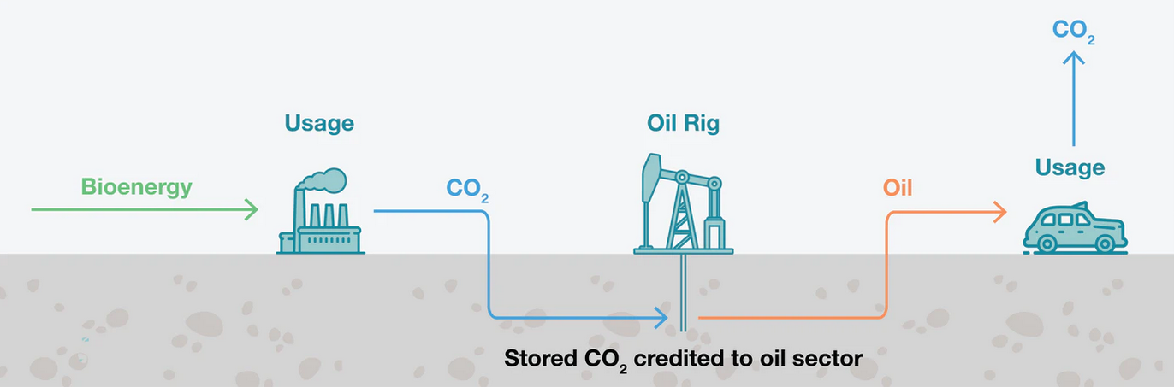
Atmospheric CO2 sequestered
No EOR done this way (some projects under development)
https://www.iea.org/commentaries/can-co2-eor-really-provide-carbon-negative-oil

Slide 21
Back of the envelope on:
Sequestration and EOR costs
Cost of:
  Sequestration: $10-20 / tCO2
  EOR: $15-25 / barrel oil out: ~$30-50 / tCO2
+ cost of CO₂
  Underground CO2 : ~15 t/CO2
  CCS: +$40 t/CO2
  DAC: +$500 t/CO2
https://www.netl.doe.gov/sites/default/files/netl-file/CO2_EOR_Primer.pdf
Notes:
NAS 2019 Negative Emissions Report
EOR project example: http://large.stanford.edu/courses/2013/ph240/salehi2/docs/netl-2010-1417.pdf
https://web.archive.org/web/20191231185457/http://cornerstonemag.net/understanding-the-national-enhanced-oil-recovery-initiative/

Slide 22
What would it take to even out the costs?
Rough balance:
  Sequestration: $10-20 / tCO2
  EOR: $30-50 / tCO2
  - tax/subsidy
  - oil sale - tax/subsidy
+ cost of CO₂
45Q Tax Credits
  $50/ton for anthropogenic CO2 sequestered outside of EOR
  $35/ton for anthropogenic CO2 sequestered by EOR
Note: no modest tax/subsidy could close the DAC gap given current CO2 DAC costs of +$500 t/CO2
https://www.netl.doe.gov/sites/default/files/netl-file/CO2_EOR_Primer.pdf
Notes:
NAS 2019 Negative Emissions Report
EOR project example: http://large.stanford.edu/courses/2013/ph240/salehi2/docs/netl-2010-1417.pdf
https://web.archive.org/web/20191231185457/http://cornerstonemag.net/understanding-the-national-enhanced-oil-recovery-initiative/

Slide 23

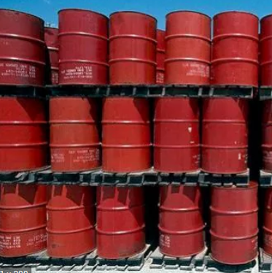

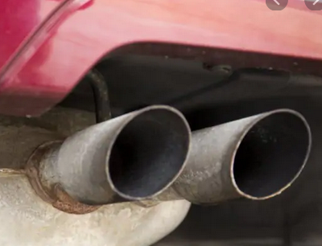
The EOR operator’s choice determines everything about carbon balance
Underground CO2 [~$15/tCO2]
Anthropogenic (CCS) [+$40/tCO2]
Direct air capture [+$500/tCO2]
CO2-EOR Rig
https://www.nap.edu/catalog/25259/negative-emissions-technologies-and-reliable-sequestration-a-research-agenda
Notes:
NAS 2019 Negative Emissions Report - https://www.nap.edu/catalog/25259/negative-emissions-technologies-and-reliable-sequestration-a-research-agenda

Slide 24
Three main arguments being put forward supporting EOR
EOR enables CO2 sequestration
EOR enables “learning by doing” for CCS and Direct Air Capture, even without a sequestration benefit (or with net emissions)
Isn’t “lower carbon” oil better?

Slide 25
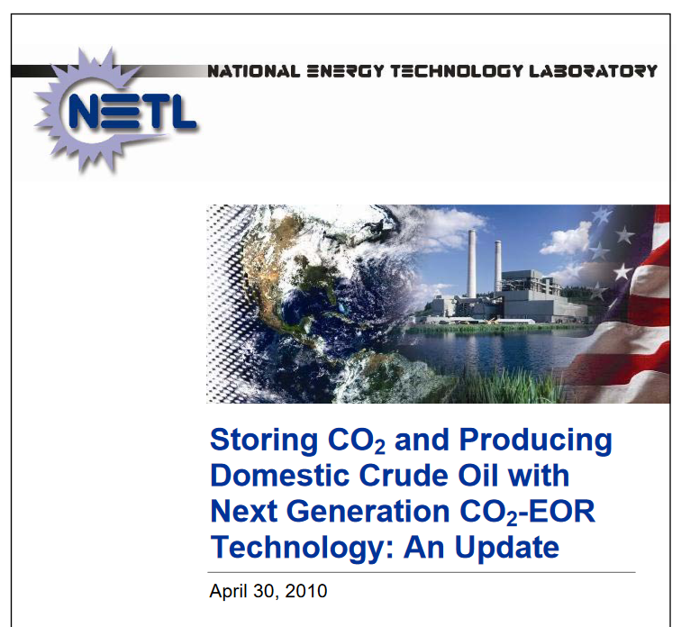
How much does EOR enable CO2 sequestration
“Employing “next generation” CO2-EOR technology would create CO2 storage capacity in domestic oil fields of over 28 gigatons, equal to captured CO2 emissions from 151 GWs of coal-fired power plants (for 30 years)”
http://large.stanford.edu/courses/2013/ph240/salehi2/docs/netl-2010-1417.pdf

Slide 26

Storage capacity with and without EOR
Without EOR
  DOE's Carbon Utilization and Storage Atlas Estimates at Least 2,400 Billion Metric Tons of U.S. CO2 Storage Resource
With EOR
  👏this👏 is👏 irrelevant 👏 the current capacity is already so massive
  Note: Cumulate global emissions = 1,500 GtCO₂
https://www.energy.gov/fe/articles/does-carbon-utilization-and-storage-atlas-estimates-least-2400

Slide 27
CO2-EOR and
“learning by doing”

Slide 28
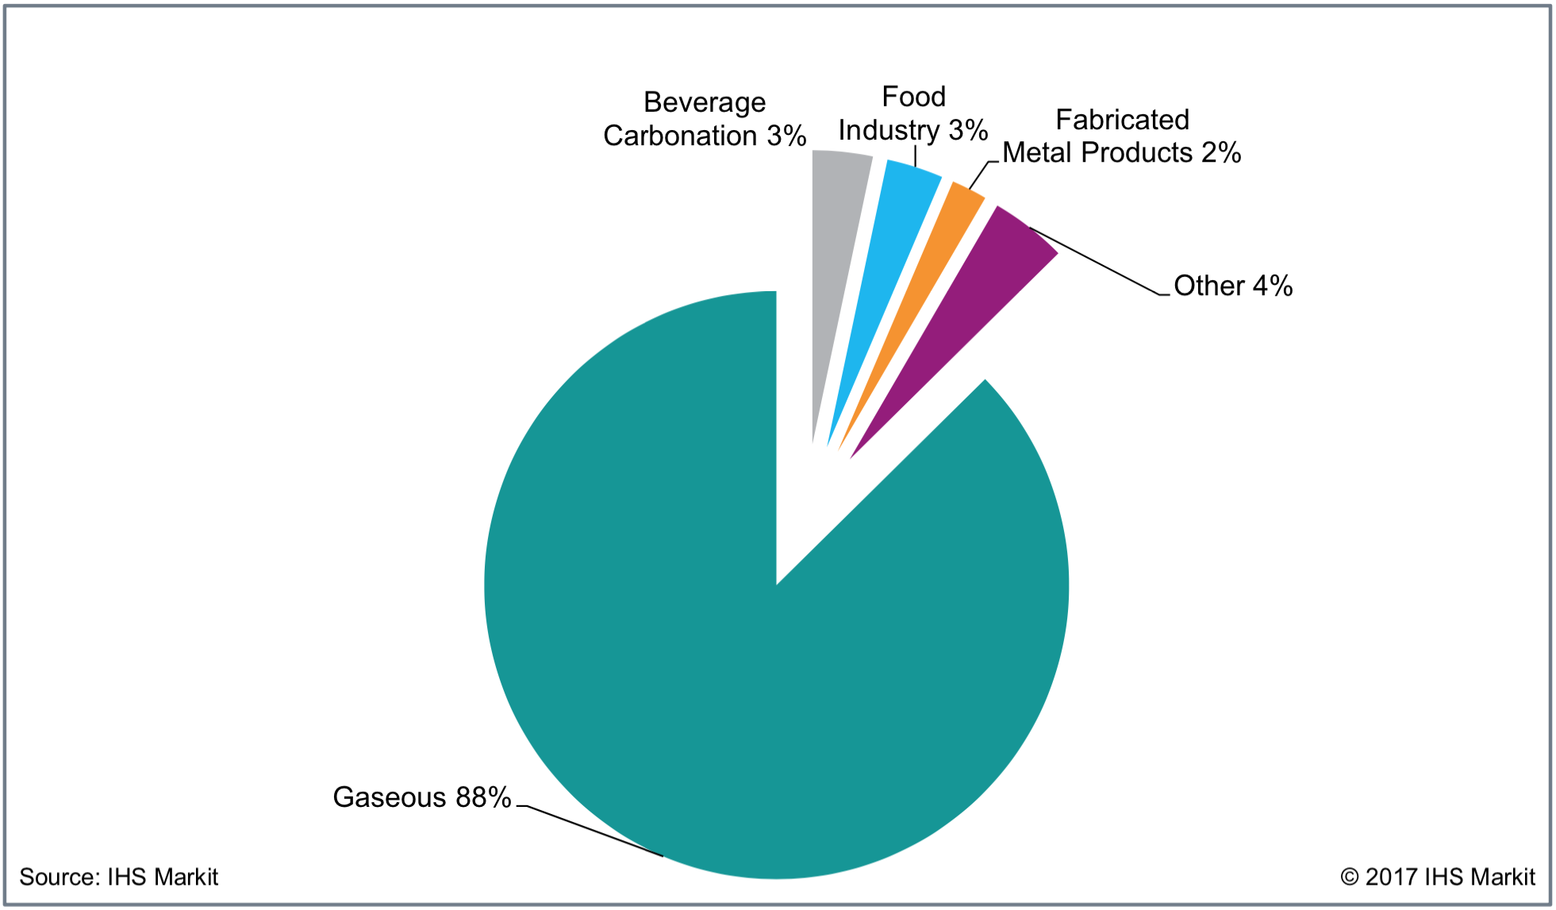
EOR is the largest industrial use of CO2
Total market size: ~100 MtCO2

Slide 29
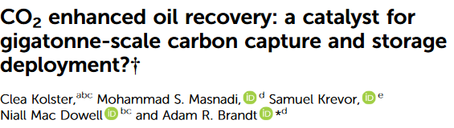
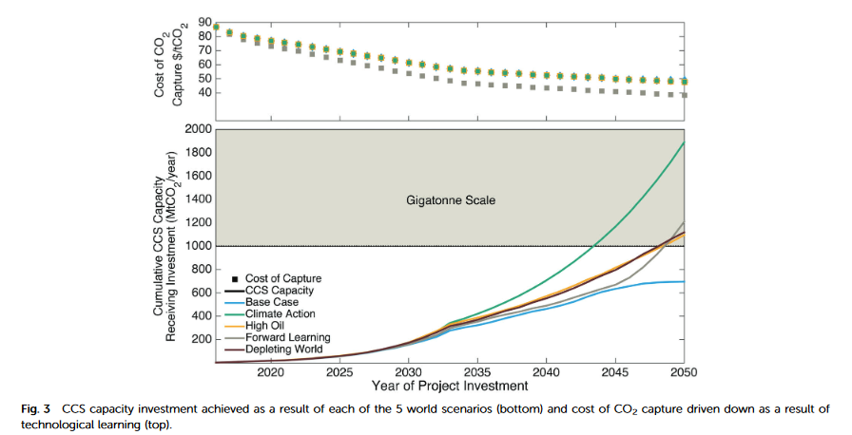
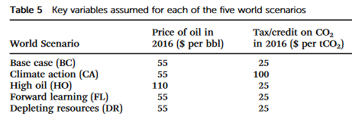

Slide 30
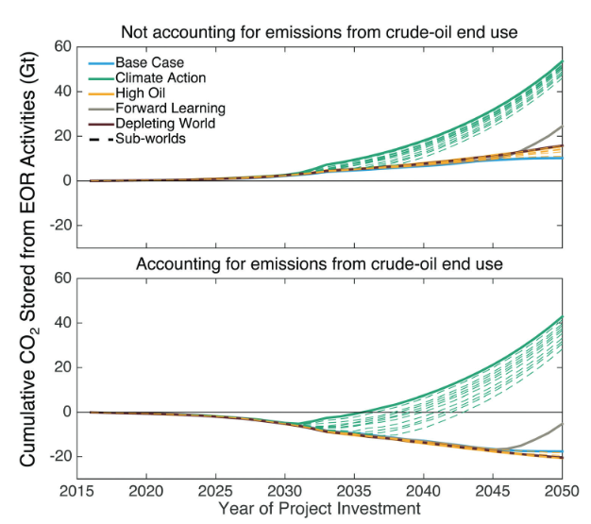
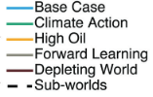

Slide 31
This study does not evaluate the scenario where CO2 sequestration is treated as waste management (also no discussion of technological lock-in)
What if you pay people to just put (CCS or DAC) CO2 in the ground?
Notes:
On average, ~$150/ton is spent on managing waste, which is globally produced at approximately ~2Gt/year (growing to 3.4 by 2050). Still need to figure out financing and revenue models.
$205 billion (2012) to $375 billion (2025)

Slide 32
Isn’t “lower carbon” oil better?

Slide 33
Why shouldn’t we care about “lower carbon” oil?
The climate target is: atmospheric CO2
The decision to decarbonize society is a political one
If we need a certain amount of oil – great, let’s produce that oil
  Current policy instruments are designed not to change the price of oil
  So, we can just ask how much oil can be consumed (given the particular emissions reduction rate we enforce and rate of societal change we permit)
If we need to sequester a certain amount of CO2 – great, let’s sequester that much
  We could set up a waste management system for the CO2 to be removed

Slide 34
Current EOR market policies and their failures

Slide 35
Current U.S. market-based policy landscape
45Q Tax Credits
  $35/ton for CO2 sequestered by EOR
  $35/ton for other beneficial uses of CO2 (e.g., synthetic fuels or plastics — my next article will be on this)
  $50/ton for CO2 sequestered outside of EOR.
California’s Low Carbon Fuel Standard
  Credit traded at an average around $175/tCO2

Slide 36
Issues with regulating market-policy:
A tax fraud case study
U.S. Treasury Inspector General for Tax Administration (TIGTA) revealed in April 2020: fossil fuel companies improperly claimed nearly $1 billion in clean air 45Q tax credits
  Reason: noncompliance with EPA’s monitoring, reporting, and verification (MRV) requirements
“Of the ten companies claiming 99.9 percent of the 45Q credits, TIGTA found that only three had the required plans in place with the EPA … hundreds of millions of improperly claimed taxpayer dollars remain unchallenged by the IRS.”
https://www.menendez.senate.gov/imo/media/doc/TIGTA%20IRC%2045Q%20Response%20Letter%20FINAL%2004-15-2020.pdf

Slide 37
What worlds lie ahead?
Market world
Pedal on the break, pedal on the gas:
  CO2 is a large cost, so operators will minimize its use as much as possible
  EOR unlocks >85 billion barrels of oil (>43 GtCO2 emissions) and creates big incentive for profit
  Fraud is already evident
“Learning by doing” for DAC isn’t feasible; for CCS must be evaluated with CO2 waste management counterfactual
Currently almost all CO2 for EOR comes from domes, NOT anthropogenic/atmospheric sources
EOR operator decisions extremely sensitive to price of oil
Technological lock-in not accounted for
Reasonable world
Decouple sequestration targets from oil production targets
Does not muddy incentive for oil and drive for sequestration
Allows for targeting DAC if necessary, rather than setting up competition between CCS and traditional oil production
Avoids technological lock-in problem

