Slide 1
Nuclear Batteries
HEJC
Sep 25, 2020
Eric Fell

Slide 2
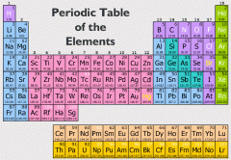
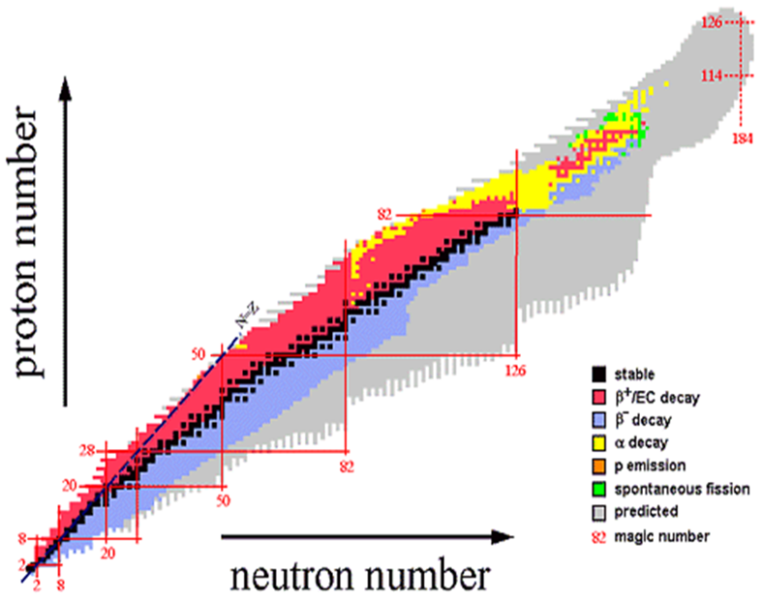
Fundamentals of Nuclear Reactions
All elements have isotopes, large range of stabilities
Radioactive decay occurs in unstable isotopes, resulting in spontaneous emission of particles and/or electromagnetic radiation
Repulsive force between protons must be balanced by a strong attractive force for nuclei stability
http://fys246.nuclear.lu.se/topics.asp

Slide 3
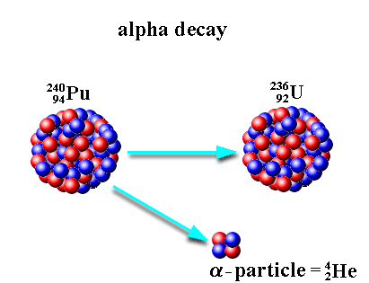
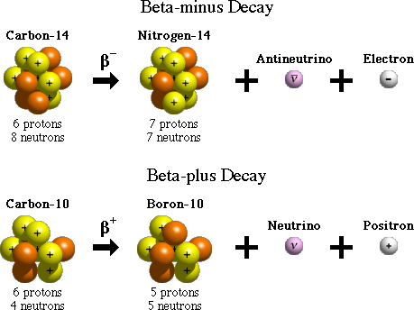
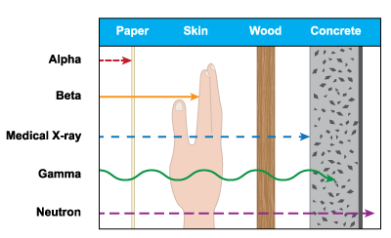
Types of Nuclear Decay
Other decay processes include
Gamma decay
Neutron emission
Electron capture
Internal conversion
Cluster decay / fission

Slide 4
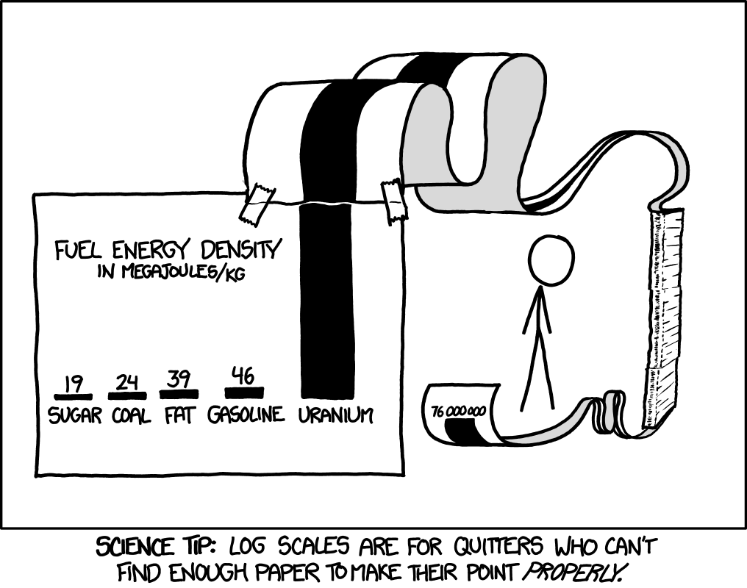

Mass-Energy Equivalence
$$E_{0}=mc^{2}$$
Energy of nuclear decay comes from mass conversion, on the energy scale of MeV (1.6⨯10⁻¹³ J) released for every nuclear reaction

Slide 5
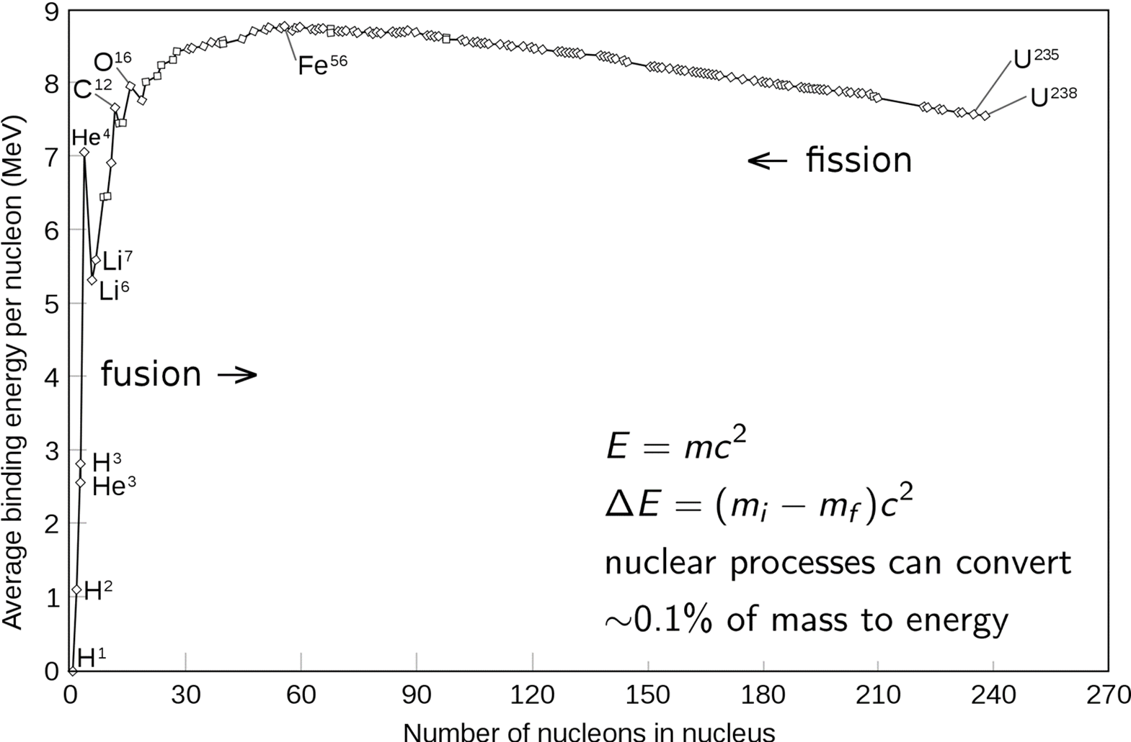
Binding Energy
Nuclear transmutations release energy equal to the difference between binding energy of nuclei in final and initial states

Slide 6
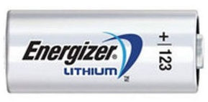
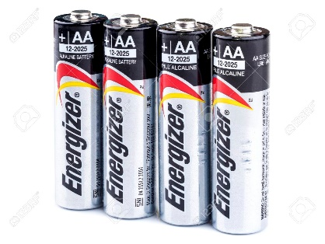
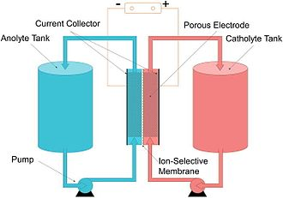
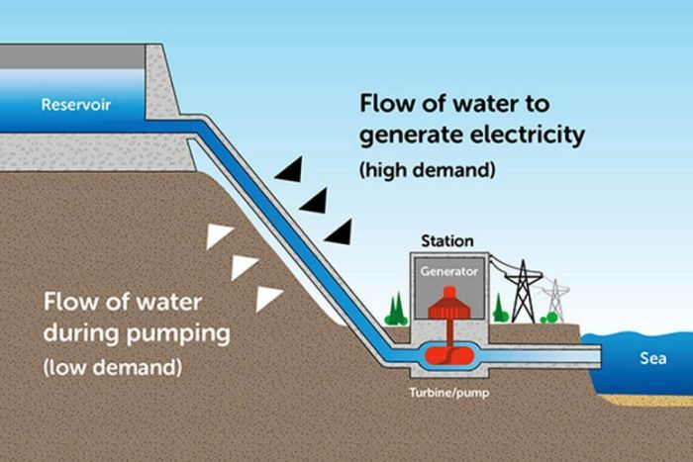
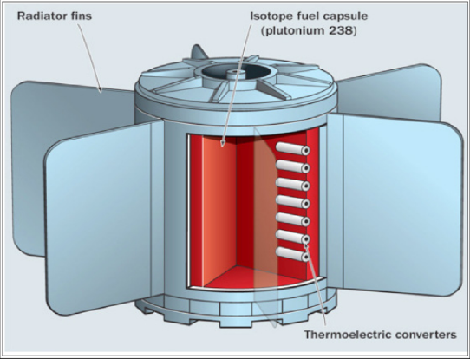
Battery/Energy Storage Device
 |  | Rechargeable?
 |  | Yes | No
Electrochemical? | Yes
 | No

Slide 7
Nuclear Batteries
Generate electricity from nuclear decay, without chain reactions
Thermal Conversion
Thermoelectric
  Radioisotope thermoelectric generators (RTG)
Thermionic
  Radioactive ‘hot’ electrode emits electrons over space-carrier barrier to a cooler electrode
Non-Thermal Conversion
Electrostatic
  Charged particle buildup on a conductor
Radiovoltaic
  Alpha/beta/gamma/neutron ionizing radiation through semiconductors
Optoelectric
  Radioluminescent material used, light converted to electricity

Slide 8
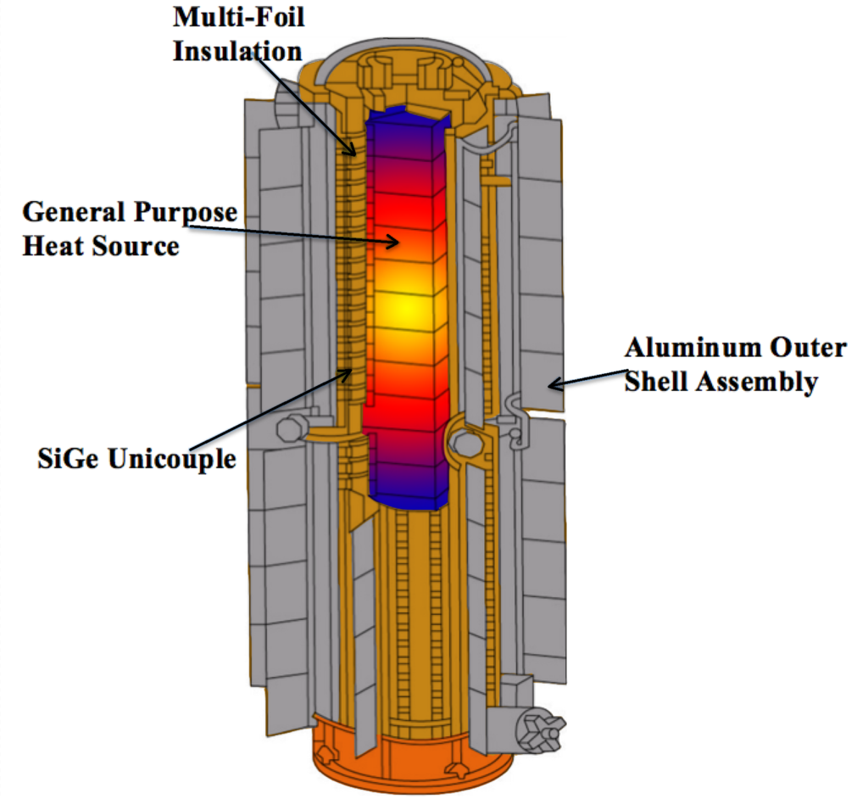
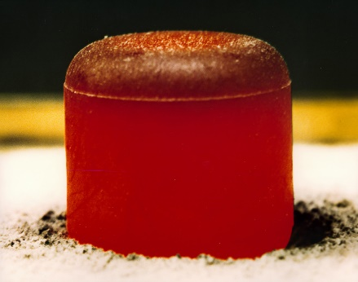
Radioisotope Thermoelectric Generators (RTGs)
Convert heat from radioisotope decay into electricity, using thermocouples.
Isotope | Primary decay | Shielding required | Power density (W/g) | Half-life (years)
²³⁸Pu | α | Low | 0.54 | 88
⁹⁰Sr | β⁻ | High | 0.46 | 29
²¹⁰Po | α | Low | 140 | 0.4
²⁴¹Am | α | Medium | 0.11 | 432
SiGe semiconductor thermocouples typically used due to their low sensitivity to radiation damage
1 g of ²³⁸Pu generates 0.6 W
Overall efficiency typically <10%
²³⁸PuO₂ pellet, initially 62 W
https://en.wikipedia.org/wiki/Radioisotope_thermoelectric_generator

Slide 9
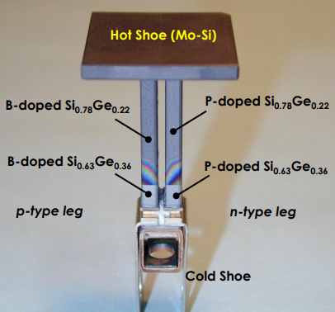
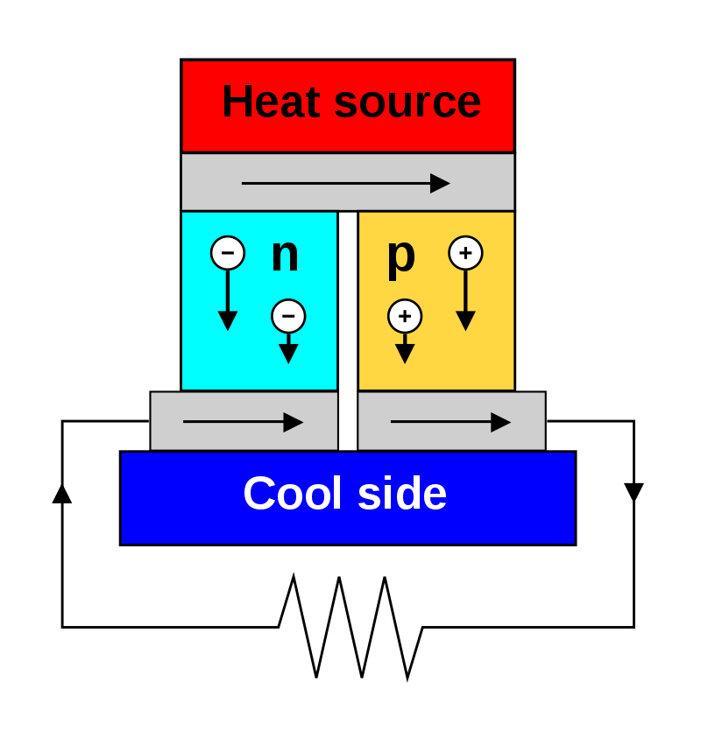
Radioisotope Thermoelectric Generators (RTGs) cont.
²³⁸PuO₂
Electric potential build up across a temperature gradient
→Seebeck effect
Atmosphere/coolant
RTGs use many thermocouples in series to get a usable voltage

Slide 10
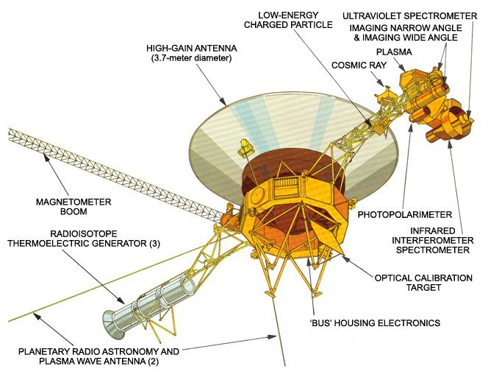
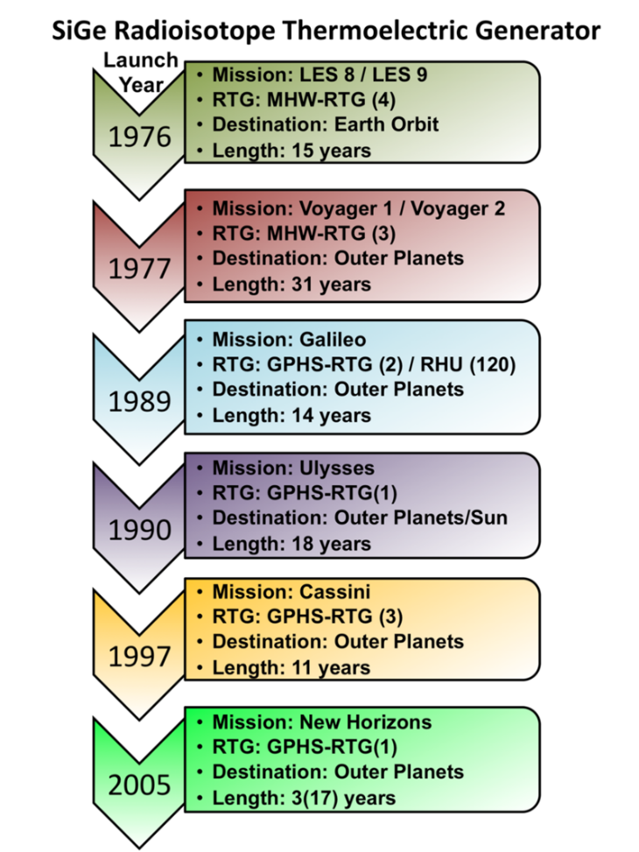
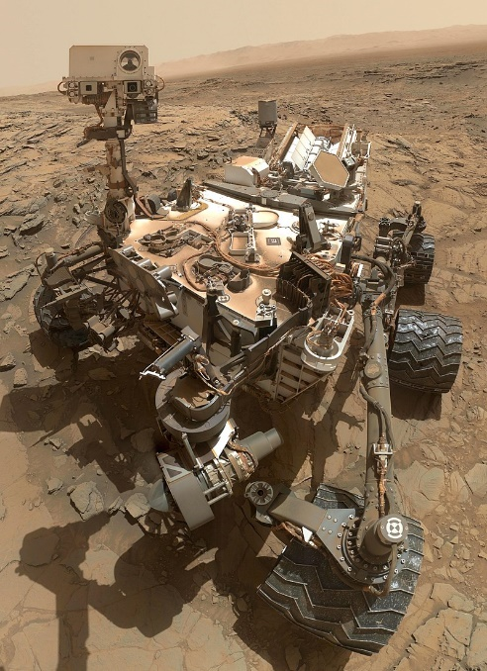
Radioisotope Thermoelectric Generators (RTGs) cont.
Voyager 1,2 use 3 RTGs @157 W each
Curiosity rover uses an RTG with 11 lbs of ²³⁸PuO₂

Slide 11
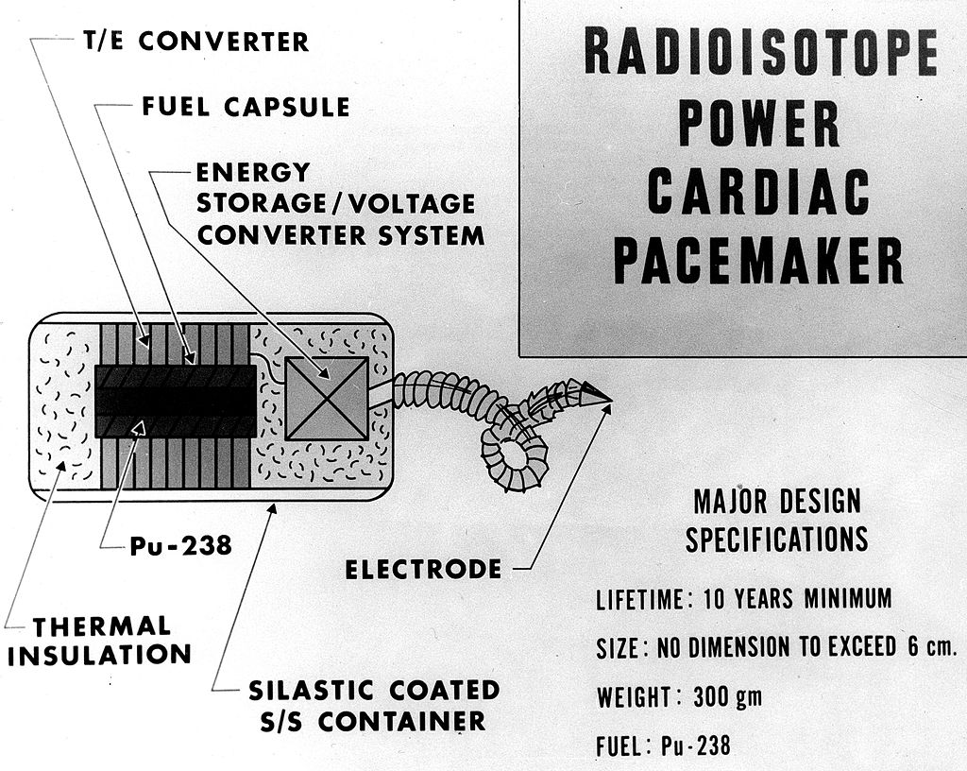
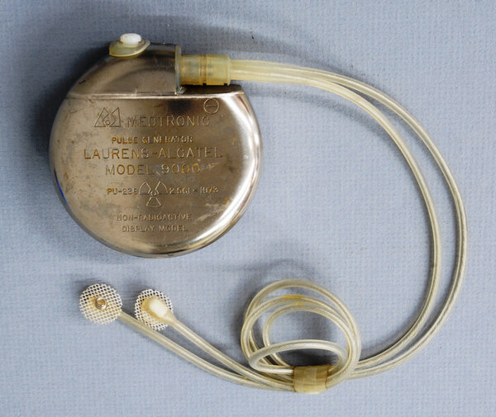
Pacemakers
1967, Atomic Energy Commission
Also an RTG design using ²³⁸PuO₂
Quickly replaced by lithium batteries once they became available
Some designs used ¹⁴⁷Pm in Betavoltaic device

Slide 12
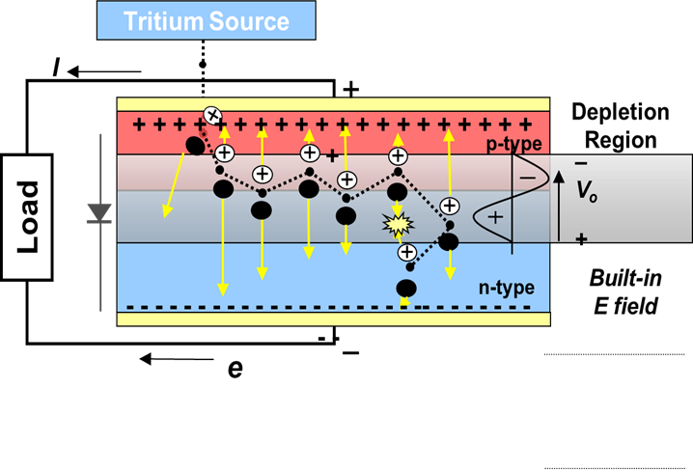
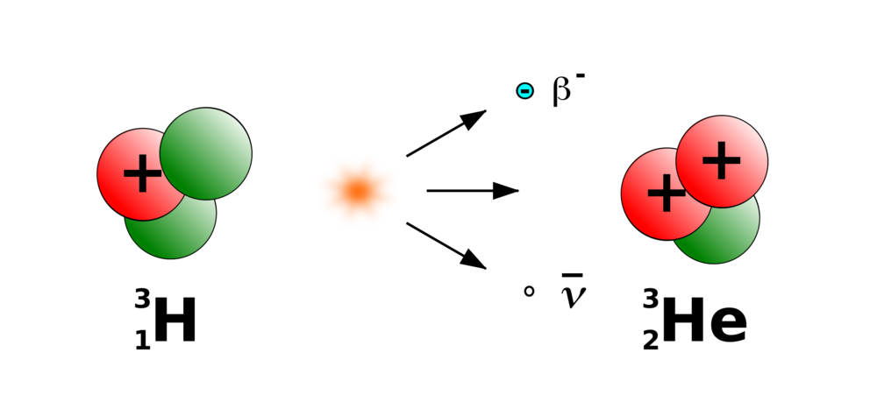
Betavoltaics
Generate electric current from beta particle emission, using semiconductor junctions.
Tritium is often used as it produces less radiation, half-life ~12.3 years
Beta emission generates electron-hole pairs which separate due to built-in electric field. Accumulation of separated charge across np-junction leads to current flow through external circuit
Similar to photovoltaics, except much smaller currents

Slide 13
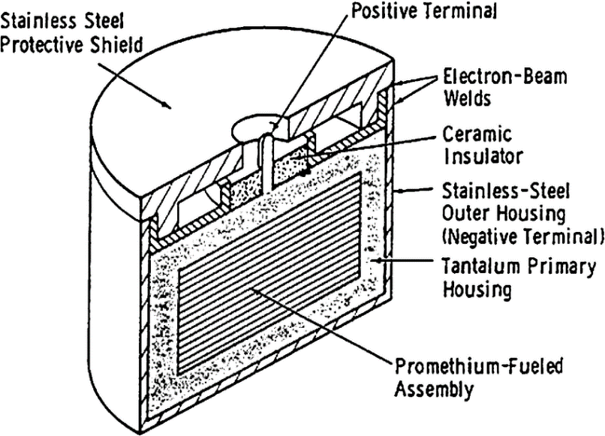
Betavoltaics cont.
Because radiation damage of the semiconductor is a concern, β energy typically needs to be <300 keV
Isotope | Average β Energy (keV) | Maximum β Energy (keV) | Half-life (years)
³H | 5.7 | 18 | 12.3
⁶³Ni | 18 | 67 | 92
¹⁴⁷Pm | 62 | 225 | 2.6
Betavoltaics have niche low-power applications:
Medical implants (pacemakers, pre ~1980s)
Outer space
IOT devices, electronics
Trickle-charging
Commercialized ‘Betacel’ 1970s
‘High’ efficiency betavoltaic is typically 6-8%

Slide 14

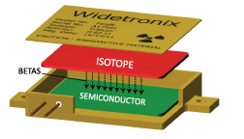

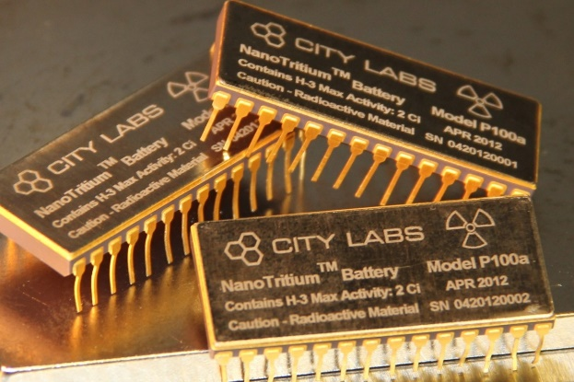
Who’s currently working on Betavoltaics?
Spinout from Cornell, founded 2008
Still early stage commercialization, with VC funding from Lockheed and support from DOD
Tech is silicon carbide betavoltaic, tritium or nickel, 2-6 V @ 1μW max
Miami-based, founded 2005
All betavoltaic products use tritium
1-2.4 V @ 100μW max

Slide 15


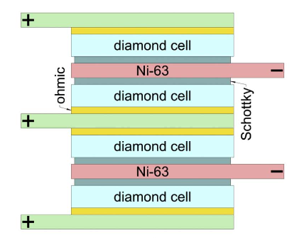
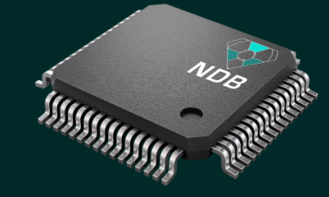
Betavoltaic “Diamond Battery”
Instead of using silicon as a semiconductor, replace it with doped diamond (5.5eV bandgap) which has a much higher resistance to radiation damage.
Younger startup out of the Bay Area
Advertise devices that are diamond-based, alpha/beta/neutron voltaic batteries
No actual product reported yet
Using low-enriched ⁶³Ni, 10μW/cm³ can be achieved
https://www.sciencedirect.com/science/article/pii/S0925963517307495?via%3Dihub

Slide 16
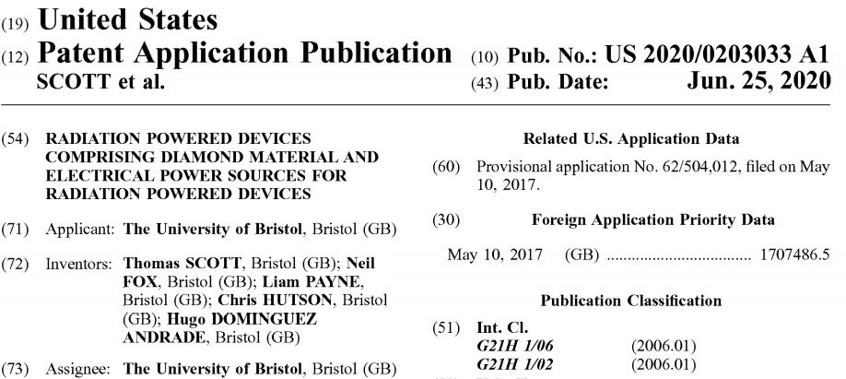

Betavoltaic “Diamond Battery” part 2
Idea is to turn radioactive graphite (waste from decommissioned fission reactors, UK has a bunch), into diamond for battery active material
→Remove ¹⁴C from graphite and synthesize artificial diamond structure
→ Half-life is 5730 years so this would not be a high power density device

Slide 17
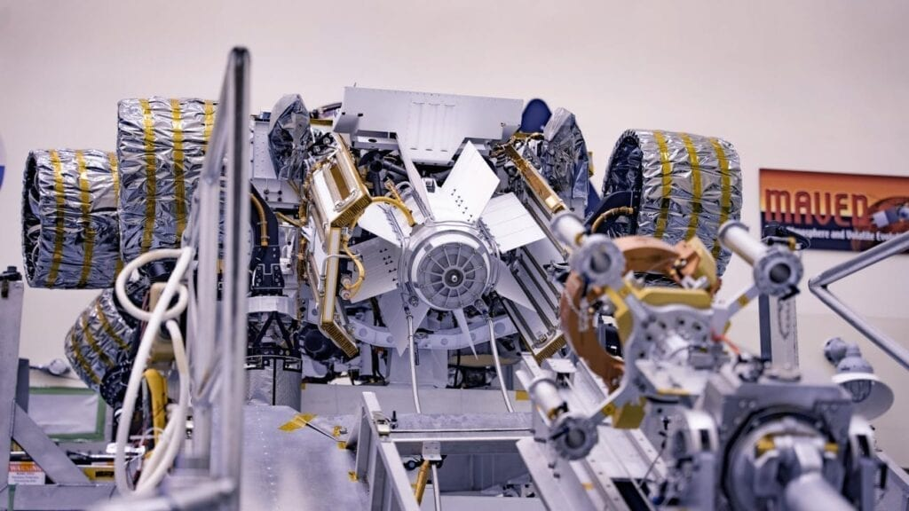

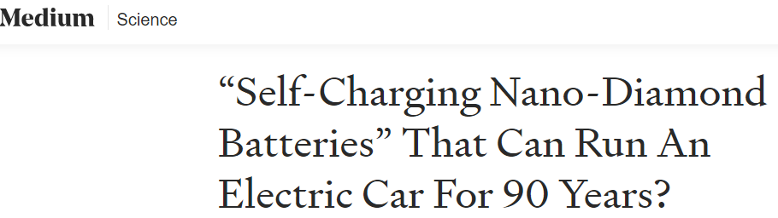
Future of Nuclear Batteries?
RTG tech is very much developed, next-gen continually being researched by academia, industry etc.
Developed Betavoltaic tech does have a significant avenue in the low-power device market. Will likely continue to grow as interest in IOT, MEMS, trickle-charging develops
RTG onboard Mars rover Perseverance, currently en route to Mars
Ignore the hype: we won’t see nuclear batteries in cars. Ever. And we don’t need millennia-lasting devices

Slide 18
Further Reading
Choppin, Liljenzin, Rydberg, Ekberg, Radiochemistry and Nuclear Chemistry
Chart of Nuclides
City labs
Widetronix
NDB inc.

