Slide 1
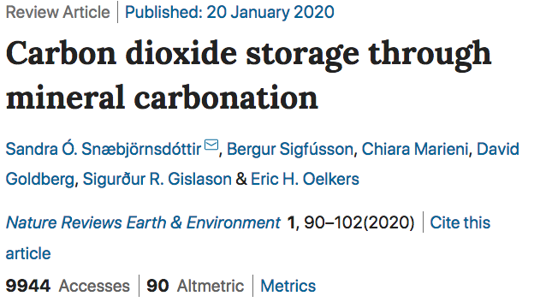
In-situ CO2 mineralization to flatten the (emissions) curve
Amos Meeks
HEJC
5/1/20

Slide 2
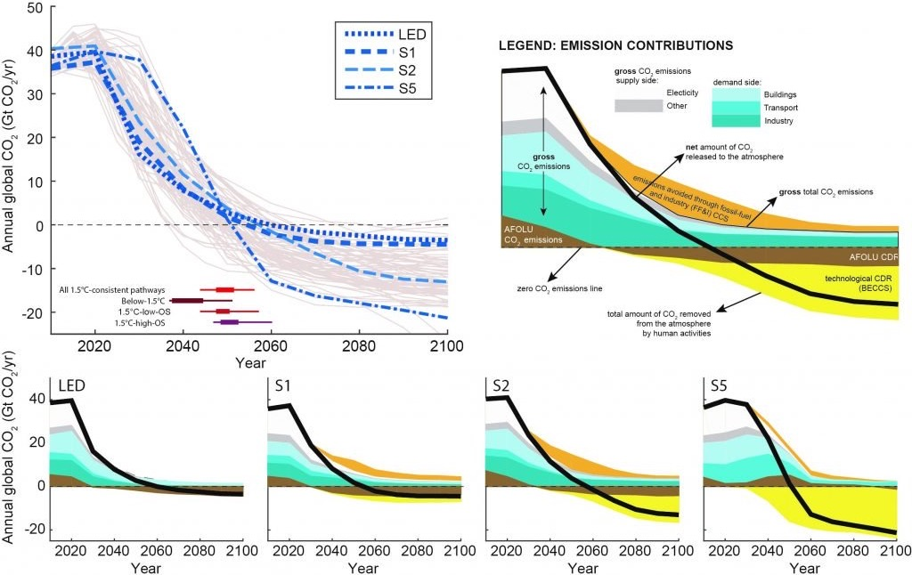
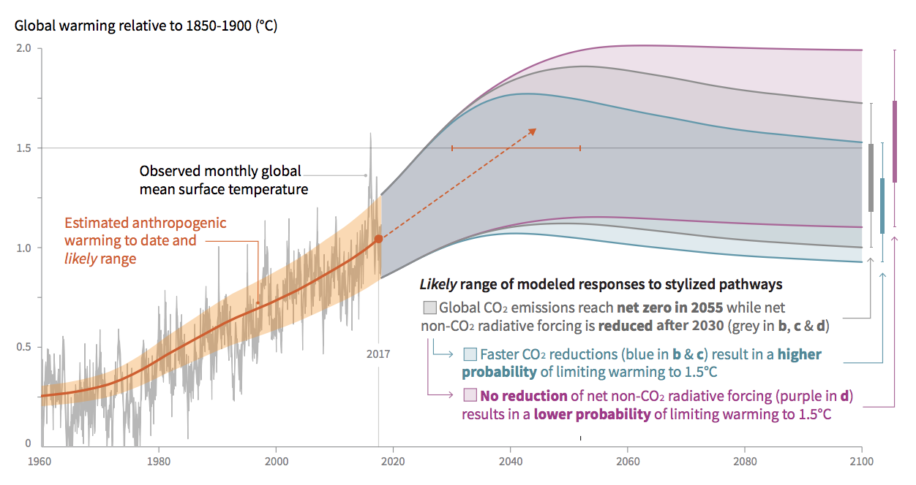
All 1.5˚C pathways require negative emissions
Rogelj, J., et al. 2018: Mitigation Pathways Compatible with 1.5°C in the Context of Sustainable Development [Masson-Delmotte, V., et al. (eds.)].
Notes:
AFOLU=Agriculture, forestry, and other land use
S1 is a sustainability oriented scenario, S2 is a middle-of-the-road scenario, and S5 is a fossil-fuel intensive and high energy demand scenario. LED is a scenario with particularly low energy demand.

Slide 3
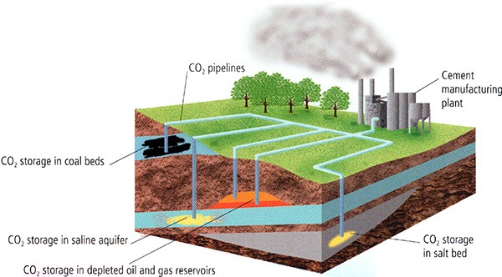
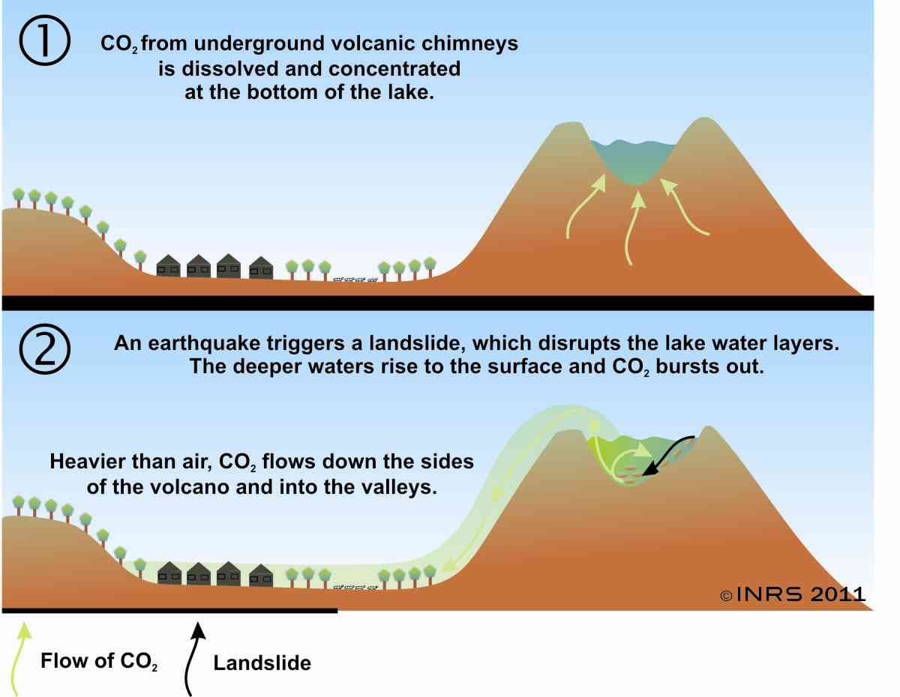
CCS today is done by injecting concentrated CO2 from point sources into the groun
Notes:
This is what current CCS looks like, also Enhanced Oil Recovery which is actually profitable but doesn’t necessarily help that much with the global CO2 problem…
Must be capped by essentially the same kinds of rocks that cap fossil fuel resevoirs
There is concern over how well it will be stored long term (~thousands of years) and potential dangers of sudden release (See lake Nyos)
In 1986, possibly as the result of a landslide, Lake Nyos suddenly emitted a large cloud of CO
2, which suffocated 1,746 people^{[3]} and 3,500 livestock in nearby towns and villages.

Slide 4
Pre-dissolved CO2 is safely mineralized orders of magnitude faster than pure CO2
Injecting pure supercritical CO2
Injecting dissolved CO2 in water
Structural (under an impermeable capping rock)
Residual (in small pores)
Solubility (dissolved in water)
Mineral (forms carbonate minerals)
Snæbjörnsdóttir, S.Ó., Sigfússon, B., Marieni, C. et al. Carbon dioxide storage through mineral carbonation. Nat Rev Earth Environ 1, 90–102 (2020).
Notes:
Several key challenges face the storage of CO₂ in sedimentary basins. First, mineral trapping may be limited by the absence of the silicate-bound divalent metals needed for carbonate formation and can take thousands of years, owing to low rock reactivity⁷ (Fig. 1a). Second, the large volume of carbon that needs to be stored to achieve the climate goals requires the identification and characterization of many new storage reservoirs. Third, as most of the injected CO₂ will likely remain in the gaseous, liquid or supercritical phase long term, it will tend to migrate back to the surface if not adequately stored. Even though the likelihood of such leakage from a well-regulated site is predicted to be negligible⁸, the lack of long-term storage feasibility has inhibited the broader application of sedimentary storage of CO₂.

Slide 5
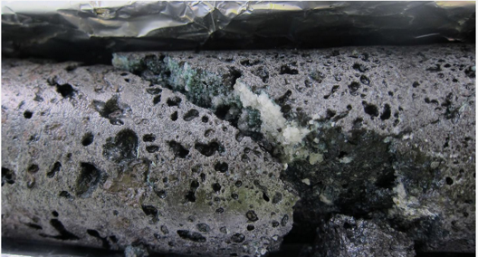
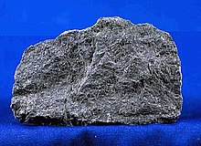
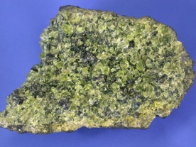
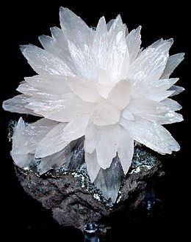
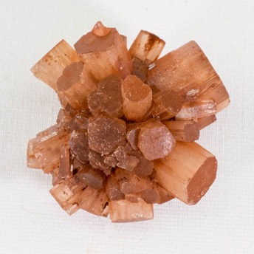
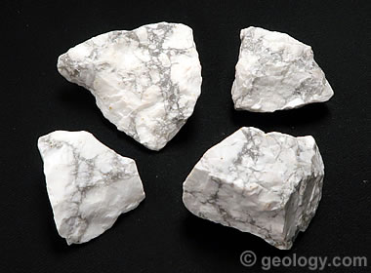
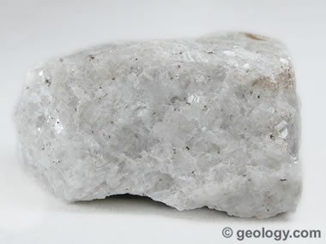
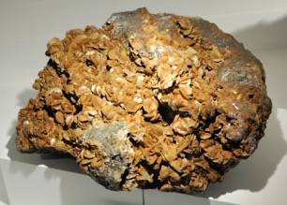
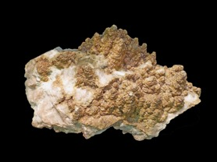
How CO2 turns into rocks
Mafic
Ultramafic
Basalt
Olivine
2H⁺ + H₂O + (Ca,Mg,Fe)SiO₃ ⇋ Ca²⁺,Mg²⁺,Fe²⁺ + H₄SiO₄
CO₃²⁻ + Ca²⁺,Mg²⁺,Fe²⁺ ⇋ (Ca,Mg,Fe)CO₃
CaCO₃
MgCO₃
CaMg(CO₃)₂
FeCO₃
CaFe(CO₃)₂
Siderite
Ankerite
Magnesite
Dolomite
Calcite
Aragonite
Notes:
Carbonated water is acidic (pH 3-5). Acidic water dissolves silicates. This consumes protons and makes the water less acidic, which promotes carbonate precipitation. It also releases divalent cations, which react with carbonate to form solid mineral precipitates.
Calcium is best, forming stable calcite and aragonite below 300C.
Mg is note great. Below 65C it can’t form magnesite or dolomite, instead either being taken up by clays, for forming less stable hydrous-Mg minerals.
Fe is unclear. Oxidizes quickly when oxygen is present. Siderite is not commonly found, but ankerite could be found in some conditions (moderate temperatures and low enough pH to prevent oxidization of Fe).
The orthosilicic acid (H4SiO4 or Si(OH)4) either stays in solution or dissociates to silica (SiO2) and water (2H2O).
Mafic and ultramafic basically mean lower concentrations of silica.
Mineral carbonation proceeds through the reaction of water containing dissolved CO₂ with rocks, notably mafic or ultramafic rocks. Water charged with CO₂ is acidic, with a typical pH of 3–5, depending on the partial pressure of CO₂, water composition and temperature of the system. This acidic solution promotes the dissolution of silicate minerals, such as pyroxene, a common mineral in basalt and peridotite:
2H++H2O+(Ca,Mg,Fe)SiO3⇋Ca2+,Mg2+,Fe2++H4SiO42H++H2O+(Ca,Mg,Fe)SiO3⇋Ca2+,Mg2+,Fe2++H4SiO4
(1)
Such reactions promote CO₂ mineralization in two ways: first, protons are consumed, neutralizing the acidic gas-charged water and facilitating the precipitation of carbonate minerals as the pH of the water increases; and, second, they provide cations (Eq. 1) that can react with the dissolved CO₂ to form stable carbonate minerals. The degree to which the released cations form minerals depends on the element, pH and temperature.
Dissolved calcium readily reacts with CO₂ in aqueous solution at temperatures below ~300 °C, forming calcite (CaCO₃) and/or aragonite once the solutions are supersaturated^{15,16}. Dissolved magnesium precipitates as the carbonates magnesite (MgCO₃) and dolomite (CaMg(CO₃)₂) at temperatures above ~65 °C (refs^{17,18,19}); at lower temperatures, the precipitation of these minerals is kinetically inhibited. Under such conditions, less stable hydrous Mg-carbonate minerals, such as hydromagnesite (Mg₅(CO₃)₄(OH)₂·4H₂O), dypingite (Mg₅(CO₃)₄(OH)₂·5H₂O) and nesquehonite (MgCO₃·3H₂O), can form²⁰. Dissolved Mg²⁺ is also readily incorporated into clay minerals such as smectite, limiting its availability to promote carbonation. The degree to which dissolved iron (Fe²⁺) combines with dissolved injected CO₂ to form carbonates in the subsurface remains unclear. Under oxic conditions, Fe²⁺ oxidizes before it can react to form a divalent metal carbonate, and, thus, the mineral siderite (FeCO₃) is only rarely observed in modern sedimentary and basaltic rocks²¹. The formation of the mineral ankerite (CaFe(CO₃)₂), however, may be favoured under certain conditions at ambient to moderate temperatures when the pH of the solution is low enough to prevent Fe²⁺ from oxidizing to Fe³⁺ (refs^{22,23}).
Many of these studies have focused on the dissolution rates of the primary silicates that contain the divalent metals necessary for carbonate precipitation. Emphasis on mineral dissolution stems from the commonly accepted view that mineral dissolution is the rate-limiting step in the mineral-carbonation process^{47,48}.

Slide 6
Mineral dissolution is rate-limiting and highly pH dependent
Snæbjörnsdóttir, S.Ó., Sigfússon, B., Marieni, C. et al. Carbon dioxide storage through mineral carbonation. Nat Rev Earth Environ 1, 90–102 (2020).
Notes:
Many of these studies have focused on the dissolution rates of the primary silicates that contain the divalent metals necessary for carbonate precipitation. Emphasis on mineral dissolution stems from the commonly accepted view that mineral dissolution is the rate-limiting step in the mineral-carbonation process^{47,48}.

Slide 7
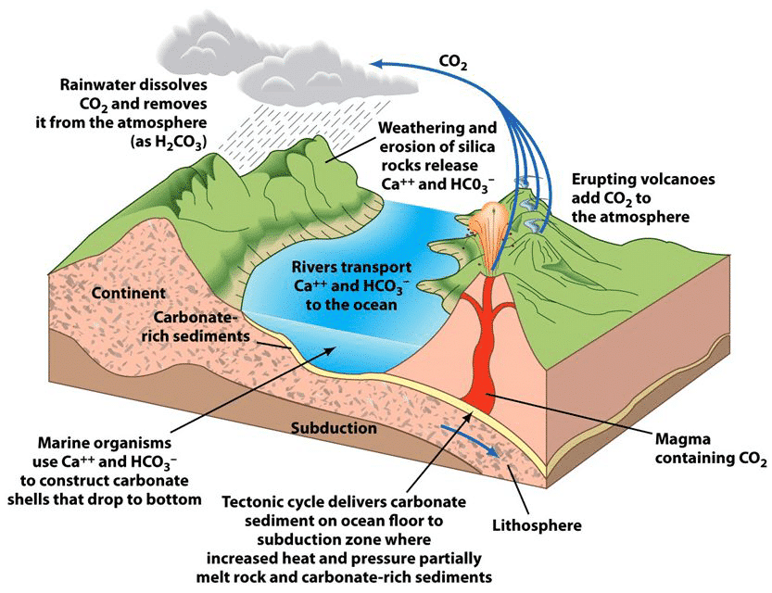
Mineralization of CO2 is how natural systems store it long-term

Slide 8

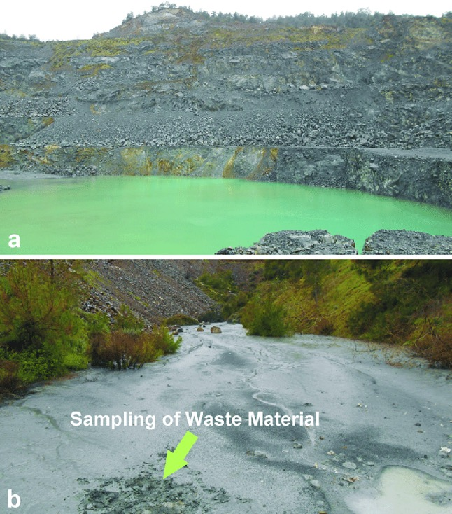
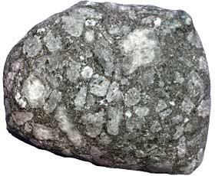
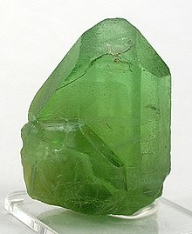
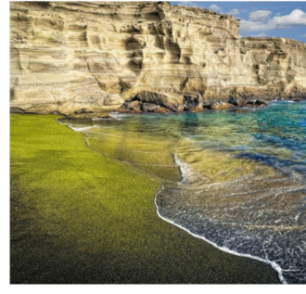
Ex-situ mineralization is being explored by may not be as feasible large-scale
Mafic/Ultramafic Mine Tailings
(Mg,Fe)₂SiO₄ - Olivine
Notes:
Doing mineralization on the surface has many costs, needing to transport and grind the rocks, and potentially needing to heat everything up to get efficient carbonation.
However, mines may already have mafic tailings that are already ground, these could be used to offset mining emissions.
In another approach, Project Vesta is trying to use wave action and CO2 in sea water to passively sequester in olivine “green beaches”.
I’m focusing in in-situ mineralization, so I won’t go much in depth into evaluating the scalability or feasibility of these approaches.
Ex situ carbon mineralization
Ex situ mineralization has been extensively considered as an option for carbon capture and storage for CO₂-intensive processes located far from potential geologic storage sites. This method is operated above ground and involves the reaction of feedstock (fly ash, waste from the steel and iron industries, ground reactive rock and mine tailings) with CO₂ in a gas stream to produce carbonate minerals, which are subsequently disposed⁴⁷.
Owing to the costs associated with grinding and transporting the feedstock material, as well as storing the carbonated products, the success of the ex situ approach is dependent on the rapid and close-to-complete carbonation of the feedstock¹⁰⁹. Thus, there have been substantial efforts to develop industrial methods to rapidly and efficiently carbonate various mafic and/or ultramafic rocks and minerals, as reviewed elsewhere¹⁰⁹. Such efforts have included increasing the reaction temperature, the use of additives, ultrafine grinding and thermal activation of the feedstock material. Under certain conditions, efficient carbonation can be achieved, but the costs of such processes may prove to be prohibitive for large-scale implementation. Indeed, the cost of ex situ mineral carbonation is much higher than that of subsurface storage⁸⁴. However, it can provide a local solution for certain activities, such as the offsetting of CO₂ emissions from mining industries, particularly if the economic viability can be increased by producing saleable resources, such as building materials¹⁰⁹.
Ex situ mineralization is being explored in many global locations. For example, ongoing research is being conducted on the carbonation of mafic or ultramafic mine waste tailings, including those from the kimberlite mines in South Africa¹¹⁰ and the brucite tailings from the Mount Keith Mine, an open-pit nickel mine in Western Australia^{45,111}. The carbonation of mine waste has the advantage that it is commonly already finely ground, increasing its reactivity. It is estimated that there are ~400 Mt of mine tailings generated per year that could be used to mineralize CO₂ (ref.¹¹²) and that these often have the benefit of being located near CO₂ point sources, reducing costs. Furthermore, ultramafic mine tailings can react with and mineralize atmospheric CO₂, and this passive mineralization occurs at several ultramafic mines^{20,45,46,110}. Increasing the rates of these mineralization processes offers the potential to offset 100% or more of the emissions produced by their associated mining activities, potentially allowing for carbon-neutral mining practices^{45,112}.

Slide 9
In-situ mineralization injects dissolved or supercritical CO2 into mafic rock formations
Snæbjörnsdóttir, S.Ó., Sigfússon, B., Marieni, C. et al. Carbon dioxide storage through mineral carbonation. Nat Rev Earth Environ 1, 90–102 (2020).
Notes:
Note that in the case of dissolved CO2 the minerals form well away from the injection site because the pH must be reduced sufficiently.
For injecting supercritical CO2 there must be an appropriate capping rock and the process takes much longer.

Slide 10
Mafic/ultramafic rock formations are abundant, most on the ocean floors
Snæbjörnsdóttir, S.Ó., Sigfússon, B., Marieni, C. et al. Carbon dioxide storage through mineral carbonation. Nat Rev Earth Environ 1, 90–102 (2020).
Notes:
Of mafic and ultramafic rocks, basaltic rocks are the most abundant: most of the ocean floor, ~70% of the Earth’s surface and >5% of the continents is basaltic (Fig. 2). Abundant flood basalt fields are found in central India, Siberia, the United States, Canada and Yemen. Although the occurrence of basalts onshore is limited, the weathering of basaltic rocks on the continents and volcanic islands is responsible for ~30% of the natural drawdown of CO₂ from the atmosphere attributable to continental silicate weathering, demonstrating the relative advantage of these rocks compared with other terrestrial rocks for mineral carbonation³³.

Slide 11
Different possible schemes for in-situ mineralization
Snæbjörnsdóttir, S.Ó., Sigfússon, B., Marieni, C. et al. Carbon dioxide storage through mineral carbonation. Nat Rev Earth Environ 1, 90–102 (2020).
Notes:
Note how pH balances as minerals form away from injection
Note how seawater can effectively cap pure CO2 from escaping.
We will talk more about water later, but water usage is potentially high. However, seawater can be used to dissolve, and for fresh water, water can be drawn from same aquifer it is pumped in to, so net effect is small.

Slide 12
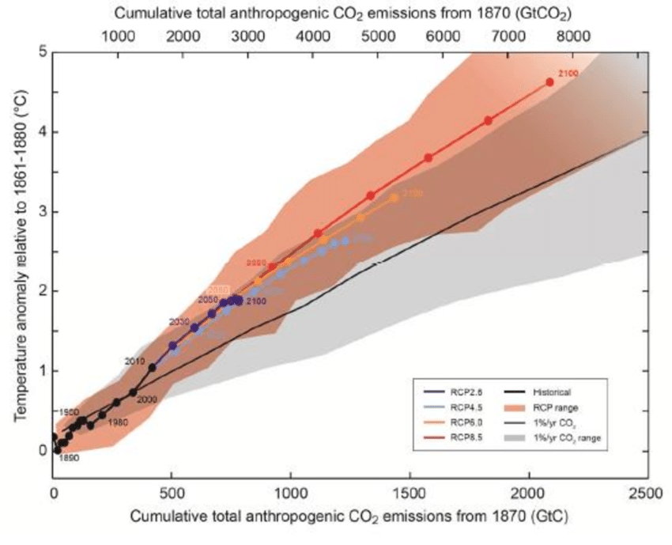
Total possible storage capacity is muchgreater than total possible emissions
Total possible fossil fuel emissions are on the order of 5x10⁴ Gt CO²
Archer D. Fate of fossil fuel CO2in geologic time. J. Geophys. Res. 2005; 110(C9): C09S05
Young, fresh basalts can store
~100 kg CO₂ per m³
Wiese, F., Fridriksson, T. & Ármannsson, H. CO ₂ Fixation by calcite in high-temperature geothermal systems in Iceland (ÍSOR, 2008).
Oceanic ridges have a length of ~6x10⁴ km and heights of over 1 km. Total storage on the order of 10⁵ Gt CO₂
Snæbjörnsdóttir, S. Ó. et al. CO₂ storage potential of basaltic rocks in Iceland and the oceanic ridges. Energy Procedia 63, 4585–4600 (2014).
Notes:
The storage potential of hydrothermally active geothermal systems located onshore in Iceland, the largest land mass above sea level along the mid-oceanic ridges, has been estimated by direct measurements of CO₂ bound in carbonates in drill cuttings from three basalt-hosted geothermal fields. Although these carbonates are precipitated over long timescales (10,000–300,000 years), the results provide insight into the permeability and active porosity of natural systems and indicate that young and fresh basalts can naturally store >100 kg of CO₂ per m³ (ref.³⁸). On the basis of this estimate, the theoretical storage capacity of the ocean ridges is on the order of 100,000–250,000 GtCO₂ — orders of magnitude larger than the amount of CO₂ that would be derived from the burning of all fossil fuel²⁴. This value agrees with other estimates that verify the enormous storage capacity of both sub-ocean^{13,14,39} and onshore^{40,41} basalts.

Slide 13
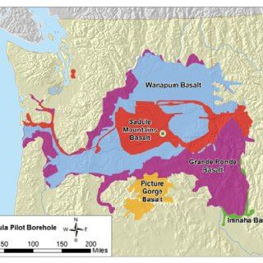
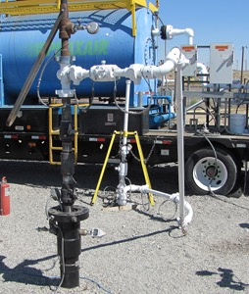

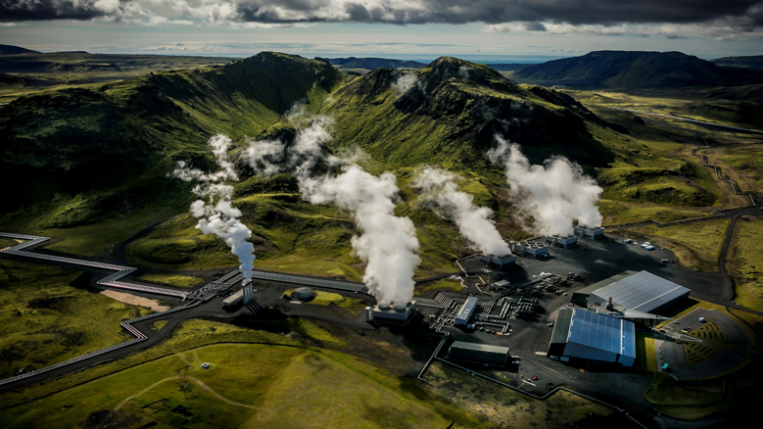
Two existing in-situ CO2 mineralization projects
Wallalu Basalt Pilot Project
65,000 tonnes of dissolved CO2 injected since 2014
Demonstrated >95% mineralization within 2 years.
Also mineralizing H2S.
1,000 tonnes of liquid CO2 injected in 2013
Some mineralization within 2 years but no quantitative analysis
Confirmed no substantial leakage since injection
Notes:
https://vimeo.com/187966586 Start at 1:17
The CarbFix project
The pilot phase of the CarbFix project, funded by the European Union, was undertaken in 2012 near the Hellisheiði geothermal power plant in southwest Iceland. A total of 230 tonnes of pure CO₂ and a CO₂–H₂S gas mixture from the geothermal plant were fully dissolved in locally sourced groundwater during their injection to a depth of ~500 m into basaltic rocks (Fig. 4a). The temperature of the target basaltic reservoir was 20–50 °C. The method requires large amounts of water: ~25 tonnes of water for each tonne of gas injected to fully dissolve the CO₂ at depth. However, as the gas-charged water is denser than fresh water, solubility trapping occurs immediately¹¹. Injection of the acidic gas-charged water accelerates metal release from the bedrock and, hence, the formation of carbonate minerals^{12,77}. The carbonation process was quantified using reactive and non-reactive tracers and isotopes, which revealed the rapid mineralization of the injected CO₂ (refs^{12,78}), with >95% of the injected gas mineralized within 2 years (Fig. 1b). The injection also led to an increase in the mass of the subsurface biota⁷⁹, but carbon isotope measurements demonstrate that this biota increase contributed negligibly to the subsurface carbon fixation.
Following the success of the initial CarbFix project in Hellisheiði, the project was upscaled starting in 2014 in a hotter, deeper reservoir, with a stepwise increase in the amount of gases injected^{80,81}. The acidic gases (CO₂ and H₂S) were captured directly from the power plant exhaust stream by their dissolution into pure water (condensed steam from the power plant turbines) in a scrubbing tower. The resulting gas-charged water was injected to a depth of ~800 m into the basaltic reservoir at temperatures of ~250 °C. Owing to the acidity of the injected solution, it is strongly undersaturated with respect to the primary and secondary minerals of the basaltic reservoir near the injection well³¹. Mineral dissolution gradually increases the pH of the gas-charged fluid to a range suitable for carbon mineralization, which occurs at a distance from the injection well. As a consequence, there is no sign, to date, of a decrease in the system injectivity since the initiation of the carbon injection in 2014. At present, >50% of the injected carbon is fixed as carbonate minerals within months of its injection in this upscaled system⁸⁰.
The CarbFix project currently captures and stores ~33% of the CO₂ emissions from the Hellisheiði power plant⁸¹, or ~12,000 tonnes annually, with the aim to increase injection to ~90% of the CO₂ from the plant before 2030. Moreover, injection of CO₂ from a second geothermal plant operated in the area will begin in 2021.
The Wallula basalt pilot demonstration project
In 2013, nearly 1,000 tonnes of pure liquid CO₂ were injected into the Columbia River flood basalts near Wallula, Washington, USA⁸². The CO₂ was provided in tanks, and the gas stream heated and pressurized before injection. The resultant liquid CO₂ stream was injected into two brecciated basalt zones at a depth of 800–900 m and the reactions between the CO₂, formation waters and basaltic subsurface were monitored (Fig. 4b).
Geophysical surveys indicated that a portion of the injected CO₂ was trapped as free-phase CO₂ in the interflow zones below the massive basalt cap rock. However, side-wall cores retrieved from the storage formation 2 years post-injection revealed the presence of carbonate nodules, composed primarily of ankerite, located in pores and fractures of the basalts^{23,83}, confirming that some of the CO₂ was mineralized within 2 years of injection.
Mass-balance calculations to determine the quantity of the injected CO₂ that had been carbonated could not be performed and no quantitative data have been reported to date to evaluate what fraction of the injected CO₂ was mineralized or remained as free-phase CO₂ (ref.⁸²). Nevertheless, carbon and oxygen isotope analysis of the ankerite nodules collected after the injection confirmed that the carbon in these minerals originated from the injected CO₂ (refs^{23,83}). Energy-dispersive X-ray spectroscopy of the side-wall cores also showed a progressive enrichment in Fe from the centre of the ankerite nodules, indicating that the mineralization derives material from the dissolution of the host basalt as the nodules form, rather than from reprecipitated carbonates. Extensive surface and well-bore monitoring several years after injection confirmed that no substantial leakage of CO₂ has occurred from the storage formation since its injection⁸⁴.

Slide 14
Possible issues:
Water consumption
Energy consumption
Induced seismicity
Groundwater contamination
Financial incentives

Slide 15
Water dissolution is energetically competitive with other methods
Atm. conc.
Atmospheric CO2 about 0.04vol%
@30 bar
liquid CO2
Snæbjörnsdóttir, S.Ó., Sigfússon, B., Marieni, C. et al. Carbon dioxide storage through mineral carbonation. Nat Rev Earth Environ 1, 90–102 (2020).
@30 bar
Notes:
Note that amine comparison is not necessarily fair, amine is actually a method of concentrating CO2 gas, but does not actually capture and store long-term.
a | The estimated energy and cost (in US$) of CO₂ capture from a flue gas stream for two capture methods as a function of the CO₂ content of the flue gas. Capture is either through dissolution into water at a capture pressure of 30 bar or by amine capture^{104,120} and subsequent compression to supercritical conditions¹²¹. b | The water demand for the water-capture method as a function of CO₂ content. For water capture, the calculation is based on first pressurizing both the flue gas and sufficient water for dissolution of the CO₂ to 30 bar and then mixing to form an equilibrated water–CO₂ phase. The calculation was performed assuming ideal gas behaviour, 80% capture efficiency and 80% compressor efficiency. Ideal gas behaviour was assumed to obtain a general approximation for any gas mixture. The energy-demand values used for capturing CO₂ from air are for a direct air capture unit¹²⁰. The energy demand values used for other CO₂ concentrations are based on those for a conventional amine capture unit¹⁰⁴. The amine-capture calculation was performed assuming 90% capture efficiency, 90% compressor efficiency and the use of electric boilers as the heat supply for CO₂ desorption. An average global energy price of US$0.13 kWh⁻¹ was used in both calculations. Part a is adapted with permission from ref.¹⁰⁴, Elsevier.
The energy demand for pressurizing pure CO₂ gas is far greater than that for water pressurization (Fig. 5b). However, the energy demand of any capture process and, thus, the energy cost depends on the purity of the CO₂ stream. This issue is less significant for the amine-capture process, because most of the energy demand is for supplying heat for CO₂ recovery, rather than the compression of the gas stream¹⁰⁴.
The estimated energy required to capture CO₂ from air and from a gas stream containing ≤20% CO₂ by water capture is compared with that required using an amine solvent in Fig. 7a. In this example, the efficiency of the water-capture process, assuming inefficient compression (80% efficiency) and that some CO₂ (20 vol%) remains in the gas phase after passing through the capture plant, was set at 64%. This is approximately the efficiency of the ongoing injection operations at Hellisheiði, Iceland. The energy cost is based on an average global electricity price of US$0.13 kWh⁻¹.
These cost estimates depend on the specific infrastructure requirements and energy prices at potential storage sites and, thus, could vary considerably from site to site. However, the energy cost of the capture process is by far the largest share of the operational cost of any CCS activity. Therefore, these comparisons serve to illustrate the applicability of the different capture processes for dilute CO₂ streams (<20 vol%).
The energy cost of the amine-capture method is highly dependent on the energy supply for the heat used to recover the CO₂. For gas streams containing <20 vol% CO₂, the energy costs of amine capture are, to date, less than those for water capture when the energy can be supplied for free (waste heat) or by using natural gas. However, when electricity is the only source of energy for the amine-capture process, the cost of energy for water capture is less than that for amine capture for gas streams containing ≥15 vol% CO₂ (Fig. 7a).
The water demand for the water-capture process at 30 bar is presented in Fig. 7b. At low CO₂ concentrations, the water demand is high but decreases with increasing CO₂ concentration. Owing to the low partial pressure of CO₂ in air, ~55,000 tonnes of water would be needed to capture 1 tonne of CO₂ from the atmosphere (which contains ~400 ppm CO₂) at 30 bar, whereas only 22 tonnes are needed to capture 1 tonne of pure (100%) CO₂.
These analyses demonstrate the feasibility of the water-capture method: for CO₂ streams containing <15 vol% CO₂, amine capture might be a more suitable method, owing to the lower energy cost and the high water demand of the alternative capture method. However, the water-capture method could be a better option for more concentrated (≥15 vol%) CO₂ gas streams. The high demand for water and how it is sourced should be considered; in some cases, waste water from other processes at a site could be used. A great advantage of this method is the direct injection of the CO₂-charged water into the subsurface without requiring additional separation or purification steps. Moreover, this approach enables the co-injection of other environmentally important gases, such as H₂S (ref.⁸⁰).
the injection of liquid CO₂ is less energy-intensive than the injection of CO₂ dissolved in water at pressures greater than 25 bar

Slide 16
While water use is high, net consumption is low
Ratio of 25:1 water per CO2 at about 25 bar.
Current annual water use is about 4 trillion metric tons.¹
We emit about 40 billion metric tons of CO2.²
Thus to sequester all of those emissions with this method means 25*40=1 trillion metric tons of water, or about 2.5% of total global use.
¹ https://www.worldometers.info/water/
² https://ourworldindata.org/co2-and-other-greenhouse-gas-emissions
Notes:
However, this water could be sourced from the target reservoir, therefore providing access for monitoring the chemistry of the injected gas-charged fluid and preventing pressure build-up in the reservoir owing to injection. As an example, during the CarbFix pilot injections, the amount of water pumped continuously from the two nearest monitoring wells was equal to the amount of water co-injected with the CO₂ and, hence, no net change in water pressure was observed in the storage formation. The mass of water needed to dissolve 1 tonne of CO₂ is a function of the capture pressure, as shown in Fig. 5a; the mass required decreases from >100 tonnes of water per tonne of CO₂ at a pressure of 3 bar to <35 tonnes of water at a CO₂ pressure of 25 bar. Abundant fresh water is not readily available for this process in many parts of the world, but in such cases, seawater may provide an adequate alternative.
Although dissolving CO₂ in water prior to its injection limits the risk of leakage, injecting supercritical CO₂ may offer advantages in sub-ocean and/or other environments, because fewer wells may be needed to inject an equivalent volume of CO₂ for storage. The low-permeability sediment cover of sub-ocean reservoirs also provide primary seals to trap CO₂ injected in a buoyant, supercritical state¹⁴. However, this environment also offers vast seawater resources for the dissolution of CO₂ prior to injection and could, thus, increase the efficiency of this alternative approach and minimize energy needs for CO₂ capture. The optimal approach at potential sites likely depends on factors such as the location and depth of the target reservoir, as well as the economics and efficiency of an ocean-based storage system; thus, site-specific feasibility studies are required. Safety is also a consideration, and as offshore sites are far from inhabited areas, the risk posed to humans from potential CO₂ leaks and other related liabilities is reduced¹³.

Slide 17
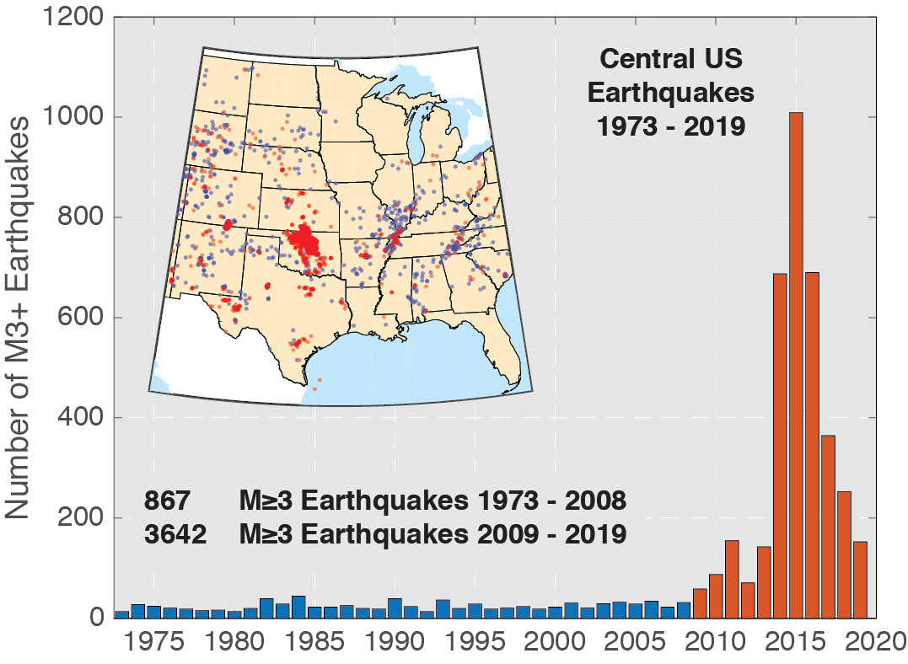
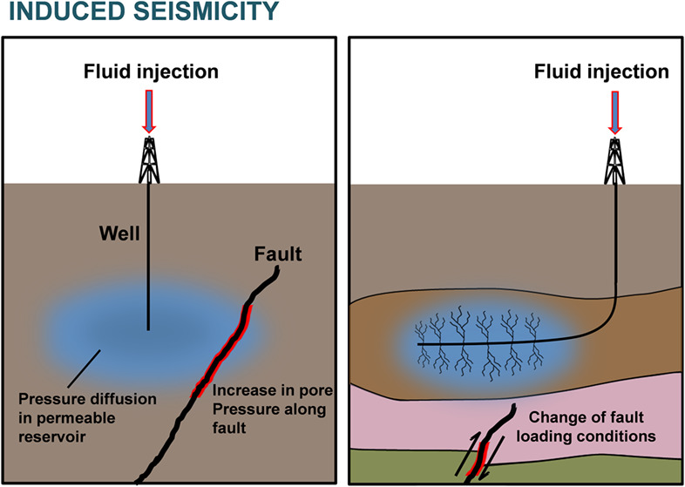
Induced seismicity can be reduced by controlling injection rates
Notes:
Induced seismicity is clearly seen from wastewater injection in the US. Two main reasons.
Carbfix site previously had induced seismicity before the project from wastewater injection, including 2 magnitude 4 earthquakes. Lower injection rates and pressures reduced earthquakes dramatically.
Risk will need to be studied before projects. However, risk can be minimized by using water from the same resevior to reduce pressure buildup, or by injecting offshore far from any populated areas or infrastructure.
Induced seismicity
One of the main risks of CO₂ injection of any kind is induced seismicity. The potential for damage to infrastructure and public concern over seismic events can result in CCS projects being shut down. Therefore, utmost care should be taken to minimize these risks.
There are >180,000 active or formerly active injection wells in the United States for both waste-water disposal and enhanced oil recovery. Induced seismic events have been associated with ~10% of these wells, with high injection rates being the dominant trigger for induced seismicity⁸⁶. High injection rates also seem to have triggered the induced seismicity observed during commissioning at the Hellisheiði power plant in Iceland⁸⁷.
Three years prior to the scaled-up gas injection, the CarbFix target reservoir was taken into service as a reinjection zone for waste water from the power plant. Reinjection started on 1 September 2011 with a high flow rate of ~500 kg s⁻¹, resulting in an excess injection pressure of ~28 bar. Microseismicity increased immediately in the area north of the injection sites, with the largest seismic events being a sequence that included two magnitude 4 earthquakes on 15 October 2011 (ref.⁸⁸). This problem was addressed by introducing a workflow through which preventive steps, including the adjustment of the injection rates, are taken to minimize the risk of induced seismicity^{87,89}. The CarbFix project applies this framework and, following its implementation, the annual number of seismic events greater than magnitude 2 in the area has decreased from 96 in 2011 to one in 2018 (ref.⁹⁰), which is considered satisfactory and demonstrates that the project is being operated within its regulatory boundaries.
The CarbFix example suggests that, prior to injection, a site-specific study of the regional seismicity must be performed to determine the seismic risk and should include a thorough characterization of depths, times, locations and magnitudes of seismic events. The risk of induced seismicity might be greater when injecting dissolved CO₂, owing to the large volume of fluid that would need to be injected into the subsurface. For example, the injection of 1 MtCO₂ per year (which is approximately the injection rate of CO₂ into a single well at the Sleipner CCS project)⁹¹ as a dissolved water form would require ~20 injection wells with depths of ~500 m and injection rates of ~50 l s⁻¹, which is a common injection rate for such shallow wells. Such a project could be fed with water from the target injection reservoir to prevent excessive pressure build-up in the system and to minimize the need for an additional water source. The risk of induced seismicity affecting infrastructure and the general public can also be mitigated by injecting CO₂ into offshore reservoirs, away from populated areas and infrastructure that could be affected⁹².

Slide 18
Initial mineral dissolution can release potentially harmful dissolved metals
Ni²⁺, Al³⁺, Cr³⁺
Notes:
Initial dissolution can release potentially harmful levels of dissolved metals.
However, after mineralization Carbonates can scavenge heavy metals, making the water cleaner.
This is also not a problem for offshore locations.
Groundwater contamination
Another potential risk of injecting CO₂ is groundwater contamination. During the initial phase of CO₂ injection — prior to substantial carbon mineralization — a metal-rich plume can form, causing the concentrations of certain elements to exceed proposed drinking-water limits. The main metals of concern are Ni, Al and Cr, but other metals, such as Fe and Mn, can become toxic to biota at high concentrations⁹³. This risk is highest before the precipitation of carbonate and other secondary minerals, such as clays, Al-oxide and Fe-oxide, and hydroxides, which can scavenge potentially toxic metals. The potential of carbonates to scavenge a metal plume has been described in detail in studies of natural carbonation during volcanic eruptions^{94,95}. Ground contamination is not a major concern at offshore locations, given the lack of underground drinking-water sources.

Slide 19
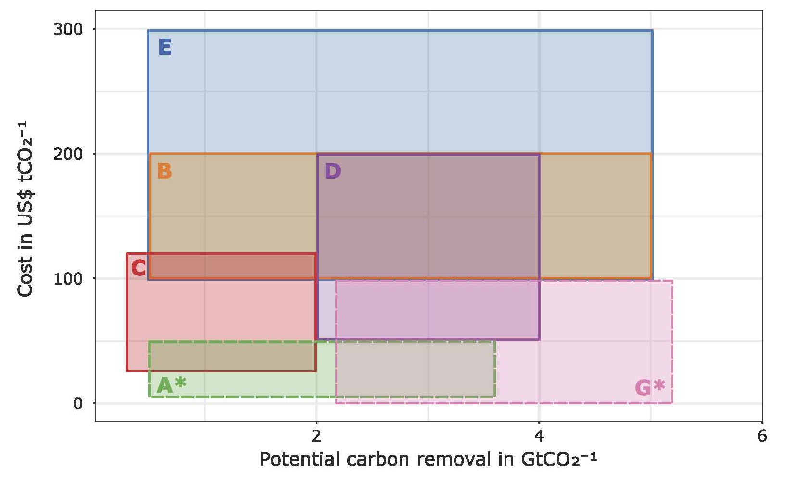
In-situ mineralization is financially on-par or better than other CCS options
Afforestation & reforestation
Bioenergy CCS
Biochar
Enhanced Weathering
Direct air capture
Ocean fertilization
Soil carbon sequestration
CarbFix: <$25/ton CO2
EU ETS ~$30/ton in 2019
US tax incentives of $50/ton saline aquifer injection and $35/ton EOR
Sabine Fuss et al 2018 Environ. Res. Lett. 13 063002
Notes:
“the cost of industrial scale application of the CarbFix method at Hellisheidi power plant is less than $25/ton”
The biggest hurdle in applying in situ carbon mineralization on a greater scale is not technological, but the financial incentive for CCS. The current cost of capturing, injecting and storing CO₂ still exceeds the cost of emitting, leading to the shutdown of many projects before they were in operation. For example, since the launch of the European Union’s carbon trading scheme in 2005, the cost of the rights to emit CO₂ in Europe has been too low to motivate the development and application of CCS¹⁰⁶. This lack of incentive rather than scientific and technical barriers has resulted in the slow deployment of CCS technologies.
The rising prices of CO₂ emission quotas over the past 2 years (from ~€4.5 in May 2017 to ~€27 per tonne of CO₂ as of 31 June 2019)¹⁰⁶ are likely to change the CCS environment in the near future; the quota price of €27 in June 2019, for example, is higher than the current on-site costs of the CarbFix injection. In the United States, recent tax legislation provides financial incentives for CO₂ storage of up to US$50 per tonne for saline aquifer injection and up to US$35 per tonne for enhanced oil-recovery injection¹⁰⁷. Nevertheless, this financial incentive may still be too low to motivate many new carbon-storage projects.
The competitive cost of in situ mineral carbonation, when operated under favourable conditions, compared with other CCS methods may, however, lead to increased implementation in the future. In cases in which CO₂ is captured from emission gases by dissolution into water at the source and the resulting gas-charged water directly injected into reactive subsurface rocks, the energy costs may be substantially reduced compared with alternative technologies (Fig. 7a). This approach could also provide additional value by co-capturing and storing other acidic gases, such as H₂S and SO₂, through subsurface mineralization, as demonstrated at Hellisheiði.

Slide 20
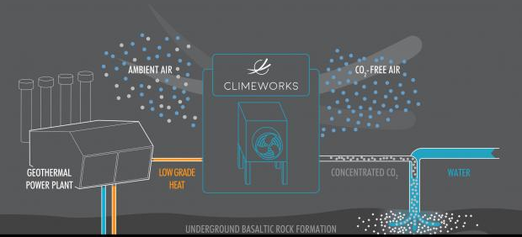
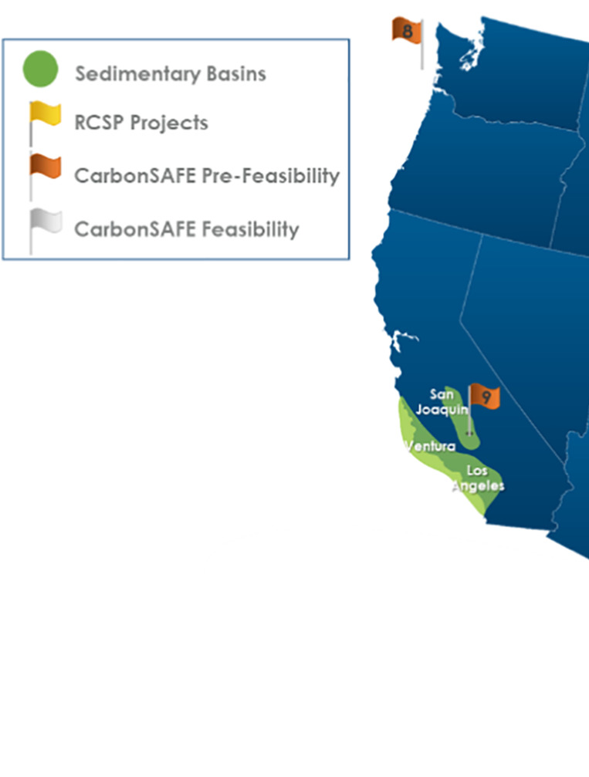
Current projects are demonstrating direct air to mineralization and offshore mineralization
CarbFix2
US DOE CarbonSAFE program
Notes:
Climeworks uses amines for DAC
The coupling of DAC and mineral carbonation is being explored in the CarbFix2 project (which started in August 2017), and a DAC unit has been installed at Hellisheiði. The air-derived CO₂ gas stream is then dissolved into water, injected and mineralized, achieving a negative emission pathway⁹⁸. Scale-up of this DAC technology in combination with the CarbFix injection technology is being explored at various sites in Iceland. Looking towards the future, the Solid Carbon project in British Columbia is assessing DAC technologies with a similar in situ mineralization approach at an offshore site in the Cascadia Basin on the Juan de Fuca plate⁹⁹.
Two projects are currently exploring offshore injection for carbon mineralization. In the north-eastern Pacific Ocean, the potential of injecting CO₂ into oceanic basalts below marine sediments is being assessed offshore from Washington state and British Columbia. A pre-feasibility study was conducted under the US Department of Energy’s CarbonSAFE programme to evaluate technical and non-technical aspects of storing ~50 million tonnes of CO₂ at an offshore storage complex located in the Cascadia Basin⁹⁹. The study concluded that there are sufficient reservoir storage capacity, transport options and CO₂ sources to meet such targets. A total of ~40 MtCO₂ is generated per year onshore from nearby stationary sources; this could provide a steady stream of CO₂ to the offshore reservoir, and DAC technology could be added to these carbon sources. Conditions at the Cascadia Basin site might favour CO₂ injection as a supercritical fluid, owing to the low risk of degassing at ocean depths of >800 m.
The CarbFix2 project is preparing for the injection of CO₂ dissolved in seawater into submarine basalts. Initial results indicate that seawater, despite its high concentration of dissolved elements, is a suitable medium for carbon mineralization. Its applicability is, however, more limited than that of fresh water in terms of its temperature and pH range, owing to the formation of various secondary minerals that could affect the efficiency of the injection^{100,101}.

Slide 21

You can buy personal CO2 mineralization right now!
https://climeworks.shop/

