Slide 1
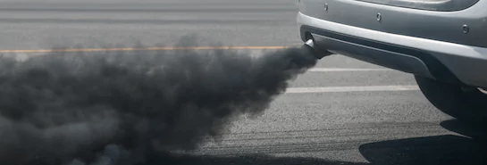
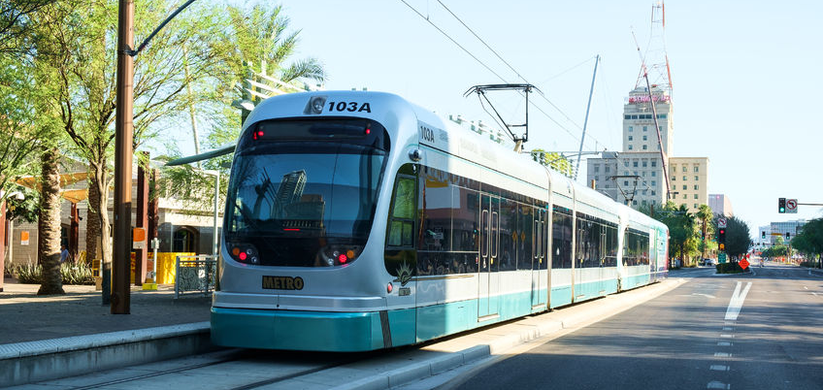
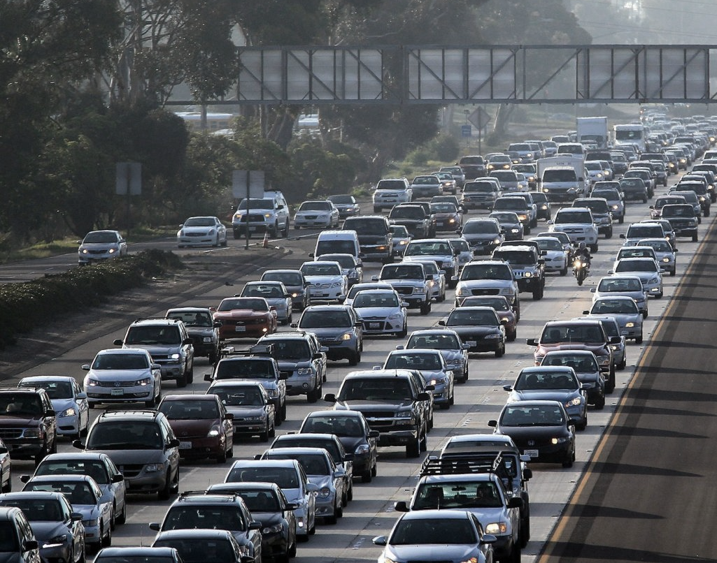
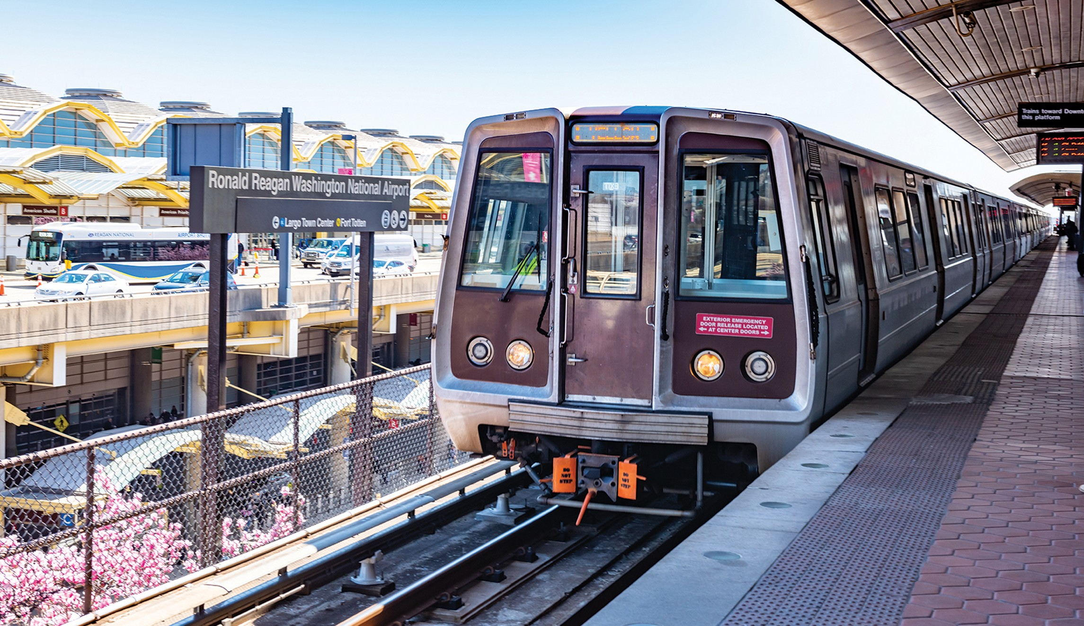
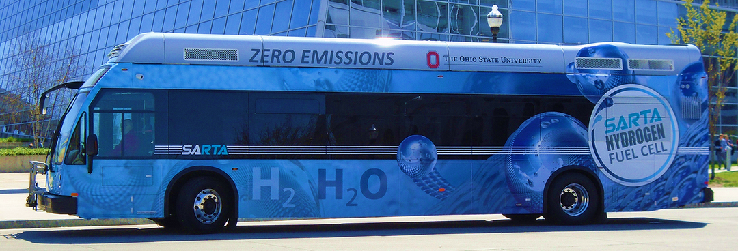
The Role of Public Transit
in a
Sustainable Future
HEJC 4/24/2020
Tommy George
https://phoenix.org/light-rail/
https://www.washingtonexaminer.com/business/mass-transit-is-making-gridlock-worse
https://www.sartaonline.com/hydrogen-fuel-cell
https://www.sandiegouniontribune.com/news/watchdog/story/2019-04-24/sd-me-air-quality

Slide 2

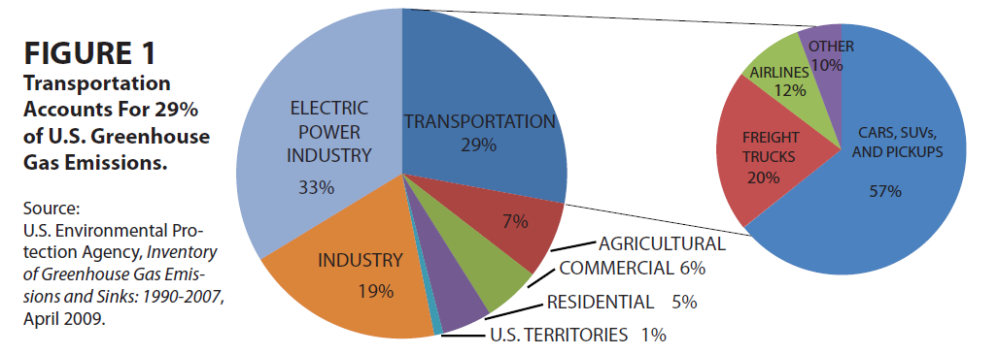

Slide 3


“In 2017, light-duty vehicles in the United States […] produced 1,098 million metric tons of carbon dioxide equivalents.
A 10 percent cut, therefore, would be roughly 110 million metric tons of carbon dioxide, or the same as taking about 28 coal-fired power plants offline for a year.”

Slide 4

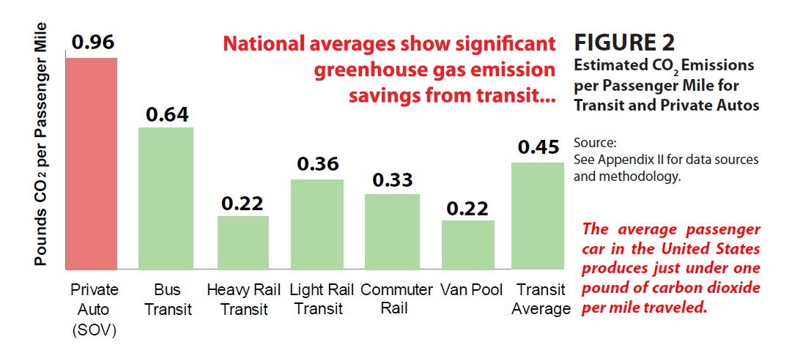
SOV =
single
occupant
vehicle

Slide 5

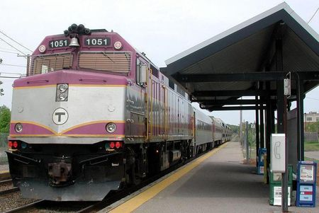
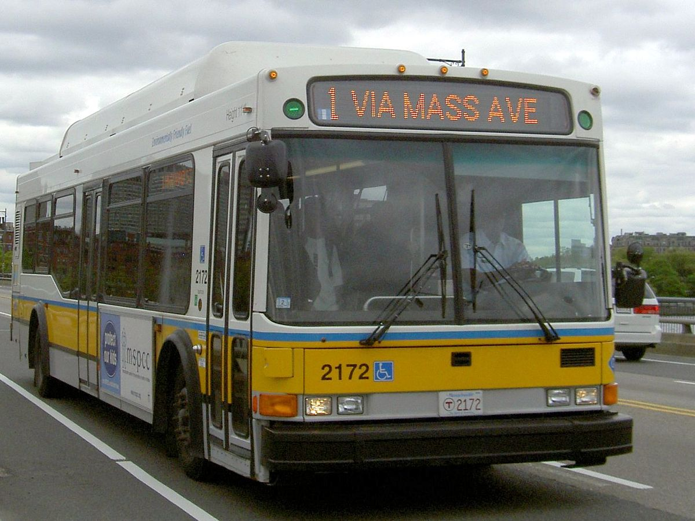
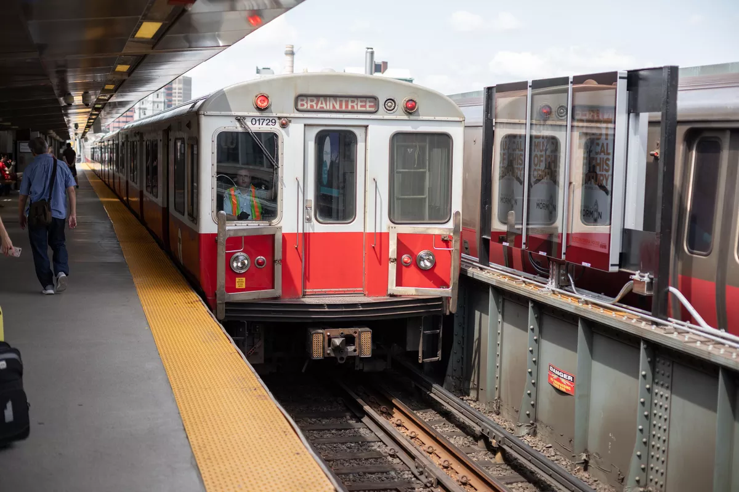
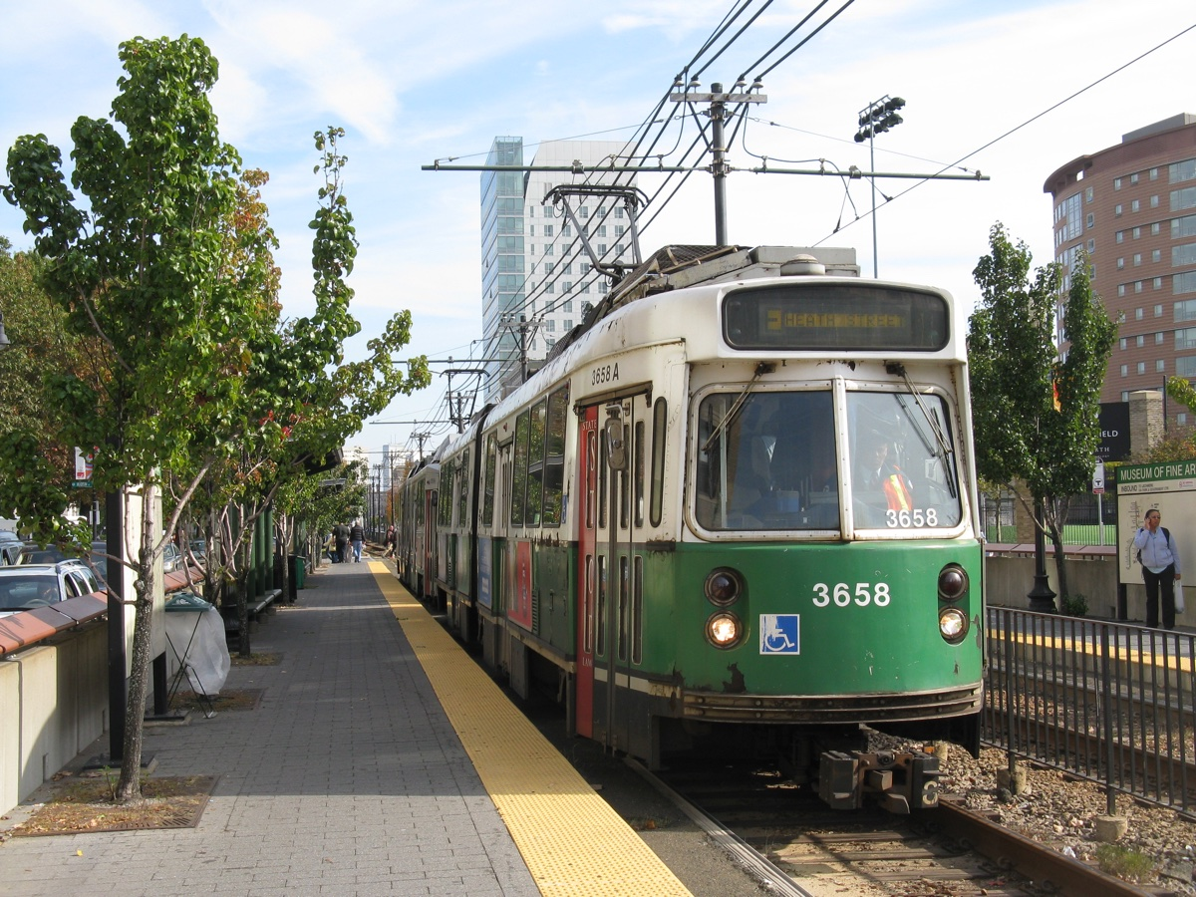

Slide 6
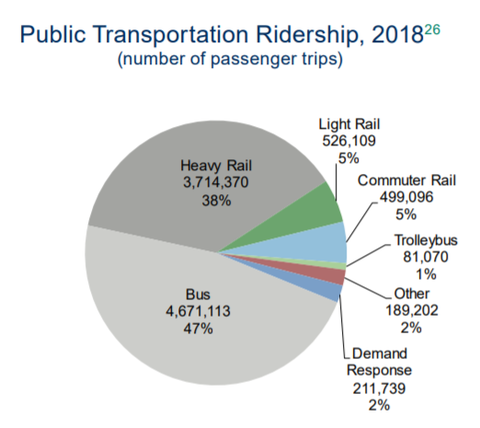
SOV =
single
occupant
vehicle

Slide 7
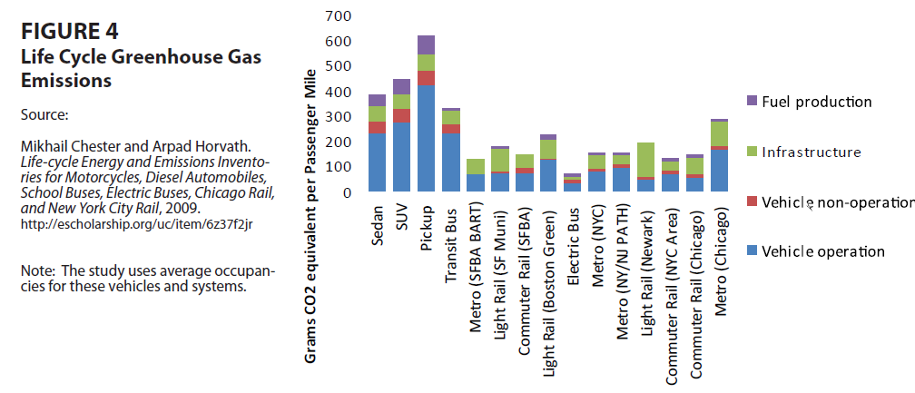

Slide 8
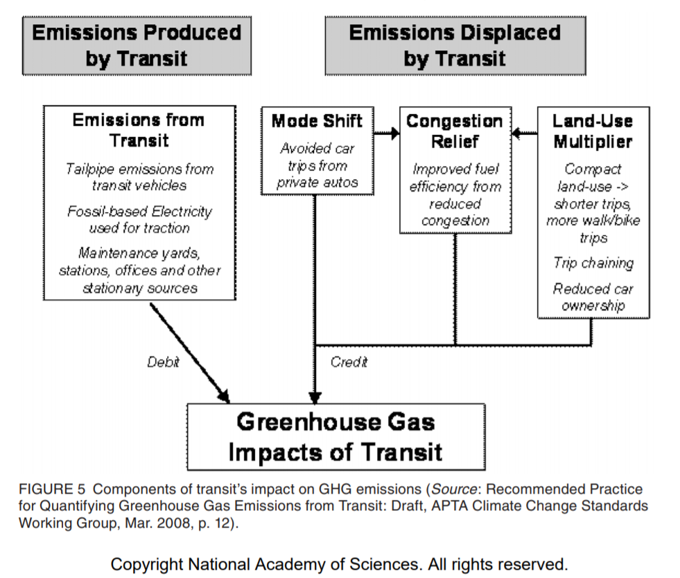

Slide 9
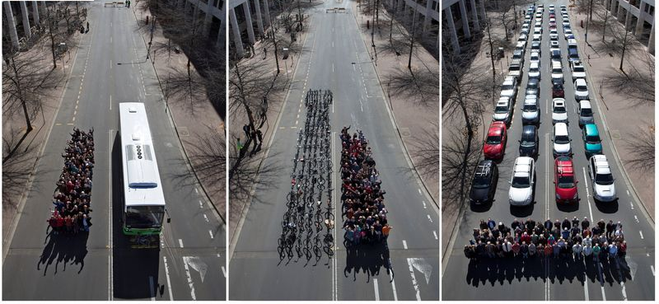
http://blog.cellbikes.com.au/2012/09/australia-re-creates-world-famous-transport-photo/

Slide 10
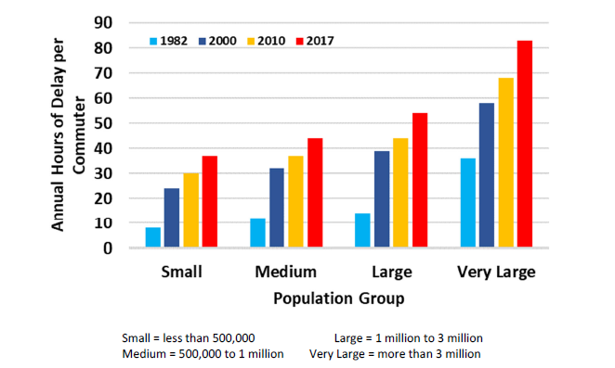

https://mobility.tamu.edu/umr/congestion-data/

Slide 11
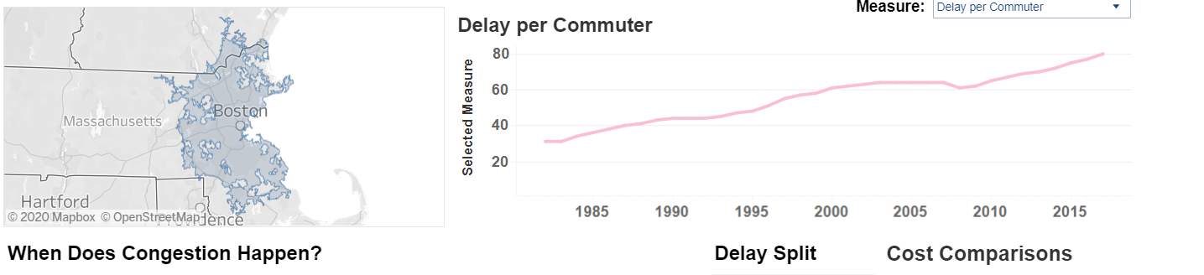
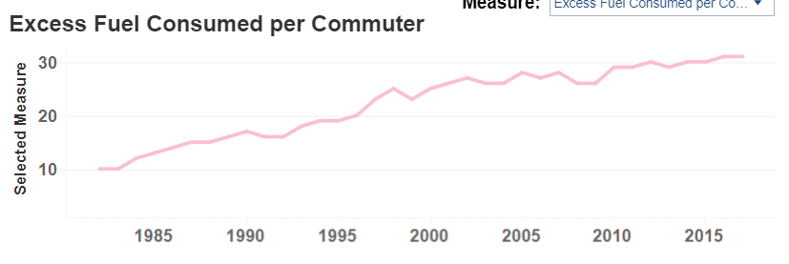
80 hours per commuter in 2017
31 gallons per commuter in 2017
https://mobility.tamu.edu/umr/congestion-data/

Slide 12
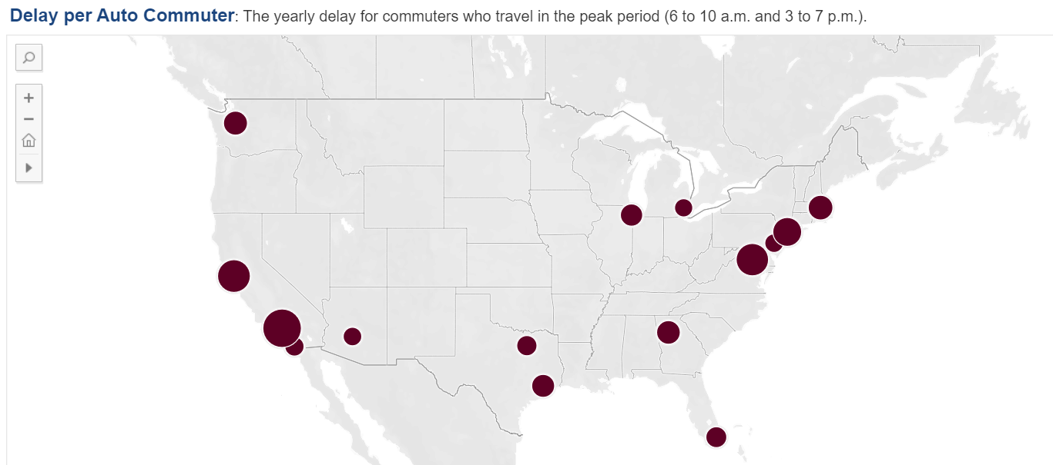
Seattle – 78 hr
Chicago – 73 hr
Detroit – 61 hr
Boston – 80 hr
New York – 92 hr
San Francisco – 103 hr
Philadelphia – 62 hr
Washington – 102 hr
Phoenix – 62 hr
Dallas – 67 hr
Atlanta – 77 hr
Los Angeles – 119 hr
San Diego – 64 hr
Houston – 75 hr
Miami – 69 hr
https://mobility.tamu.edu/umr/congestion-data/

Slide 13

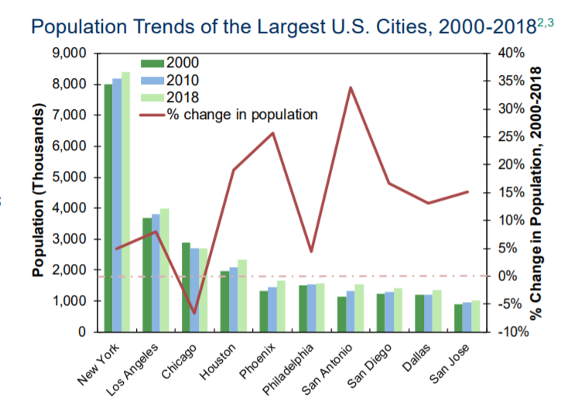

Slide 14
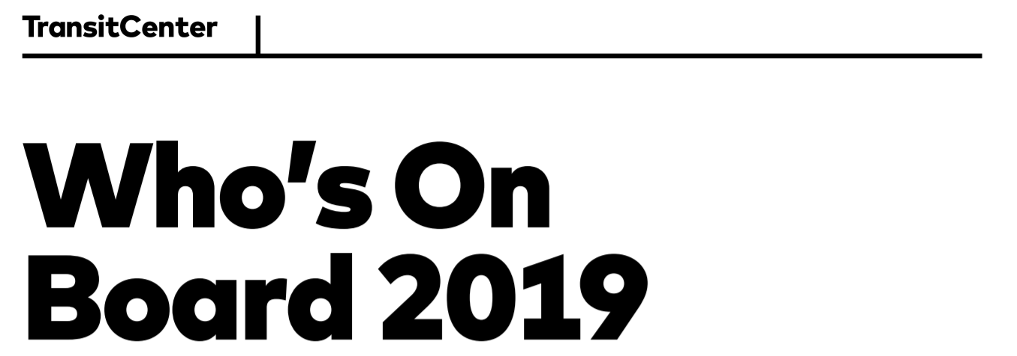
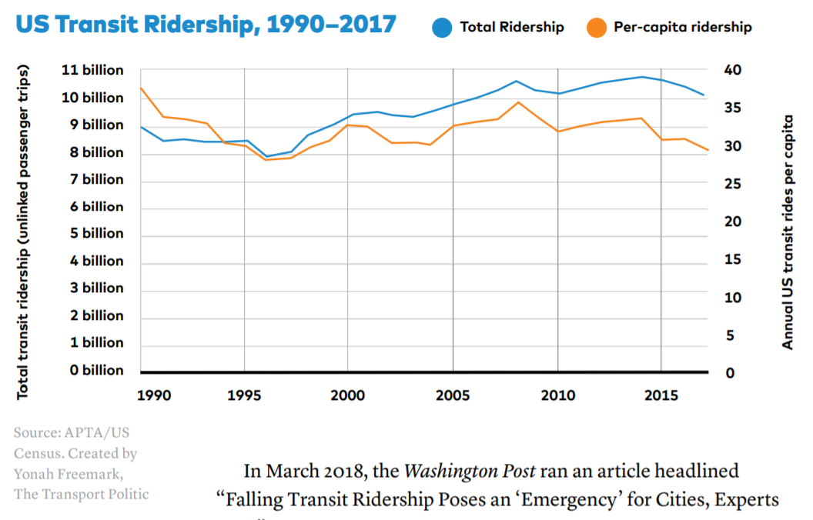
Unlinked passenger trips means passengers are counted each time they enter a vehicle
Decline in U.S. per capita ridership since 2014

Slide 15
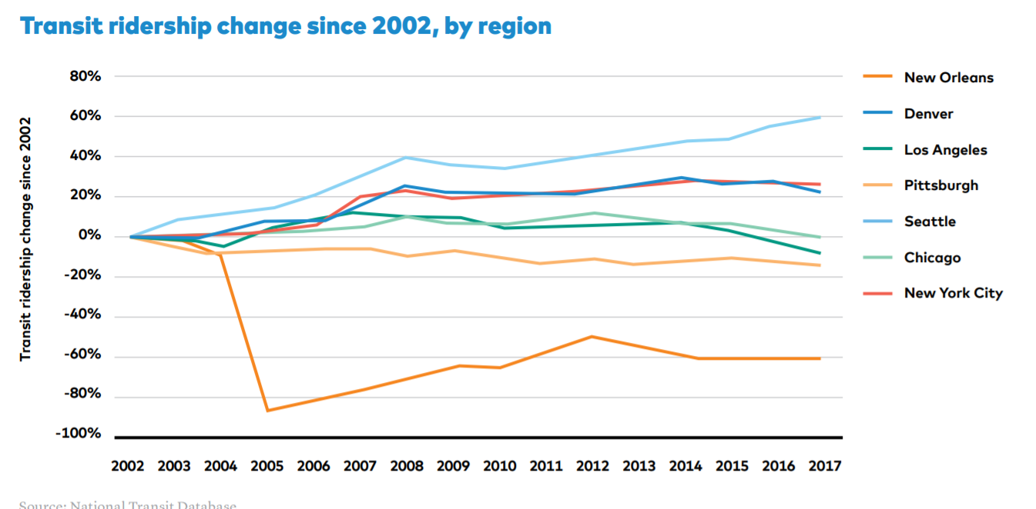

Slide 16
Seattle – investment in transit infrastructure
Recent declines – more rideshares, old systems needing repairs, other factors
New Orleans – natural disaster

Slide 17
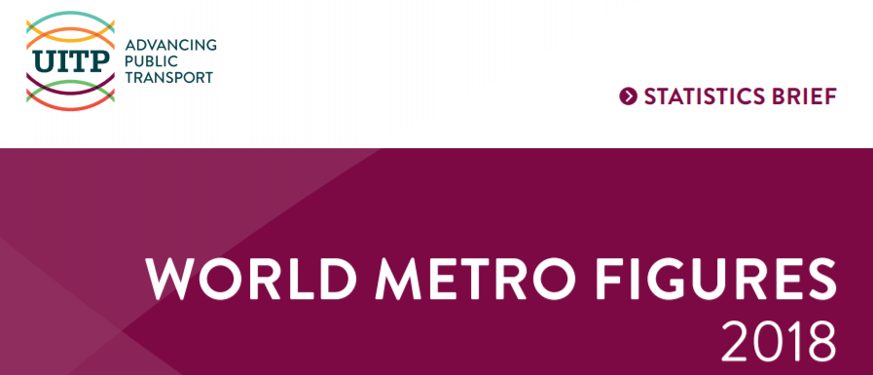
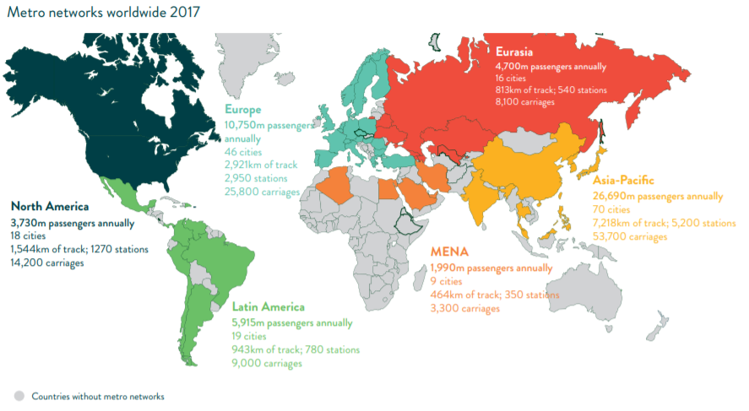
Metro: “Metros are high capacity urban rail systems, running on
an exclusive right-of-way. Metro lines included in the […]
statistics run with trains composed of a minimum of two cars
and with a total capacity of at least 100 passengers per train.”
– so this includes light and heavy rail (e.g. red and green lines)

Slide 18
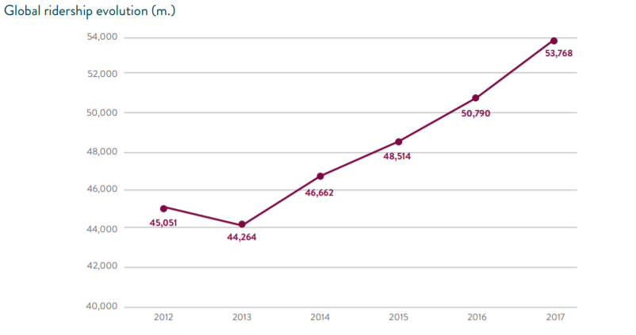
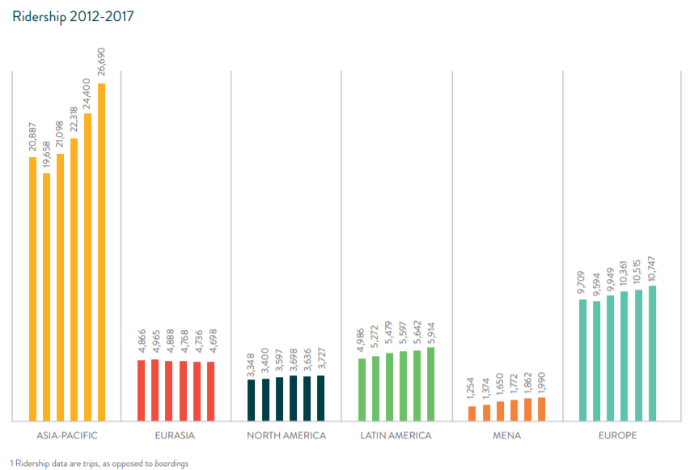

1 ride = 1 trip, not necessarily 1 boarding

Slide 19
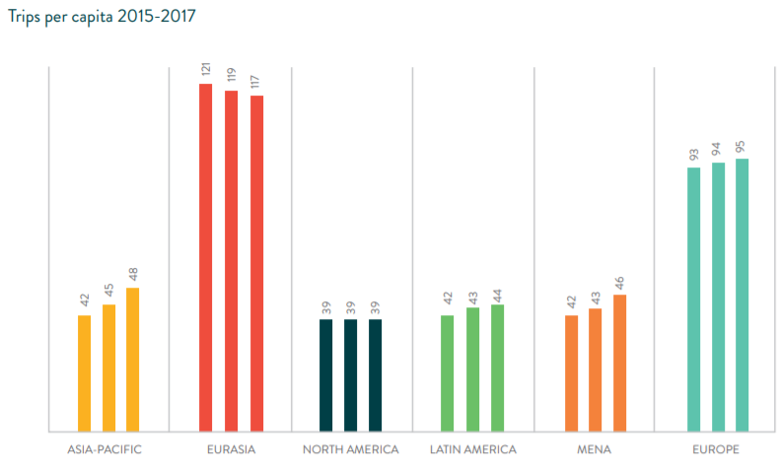
1 ride = 1 trip, not necessarily 1 boarding
Not really increasing in North America
but increasing in Canada…
…decreasing in the U.S.

Slide 20
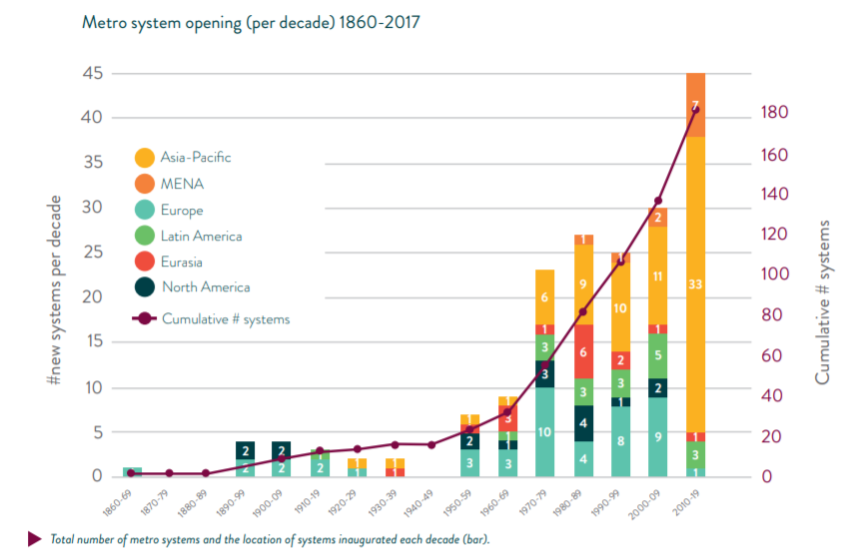

Slide 21
BaltimoreMetro (1983)
Miami
Metro (1984)
VancouverSkyTrain (1985)
San Juan
Tren Urbano
(2004)
SF Bay BART (1972)
DC
Metro (1976)
Atlanta MARTA (1979)
LA
Metro (1993)
Toronto
Subway
(1954)
Cleveland
RTA
(1955)
Montreal
Metro
(1966)
Boston MBTA (1901)
NY Subway (1904)
Chicago “L” (1892)

Slide 22
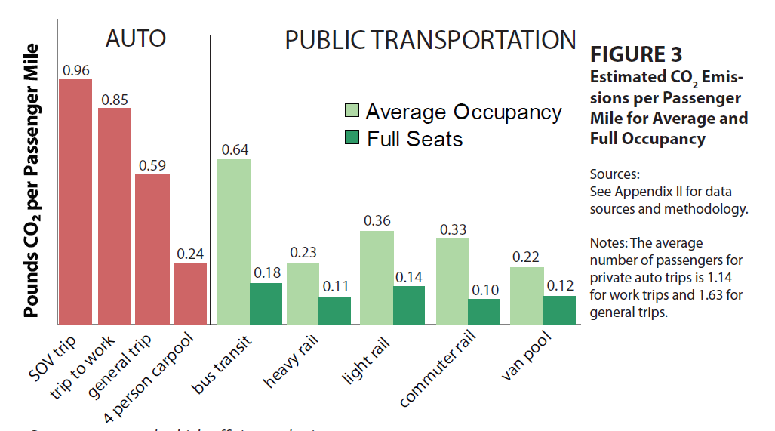
(diesel bus)
Ridership is helpful for lowering emissions!

Slide 23
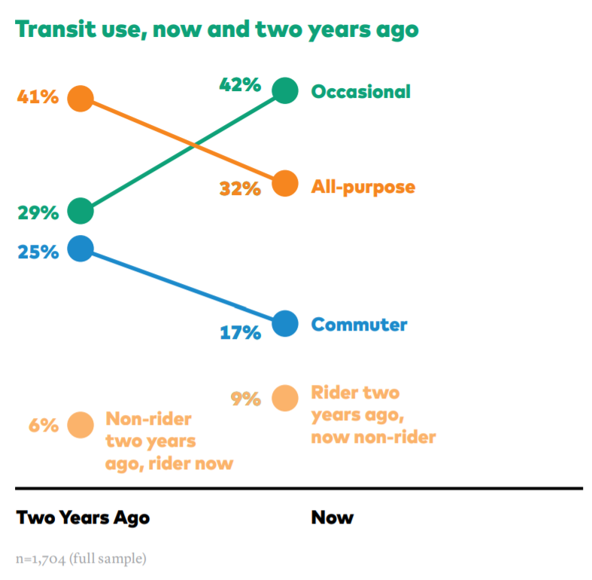
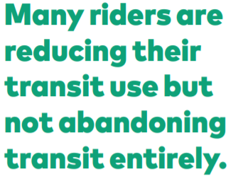

Slide 24
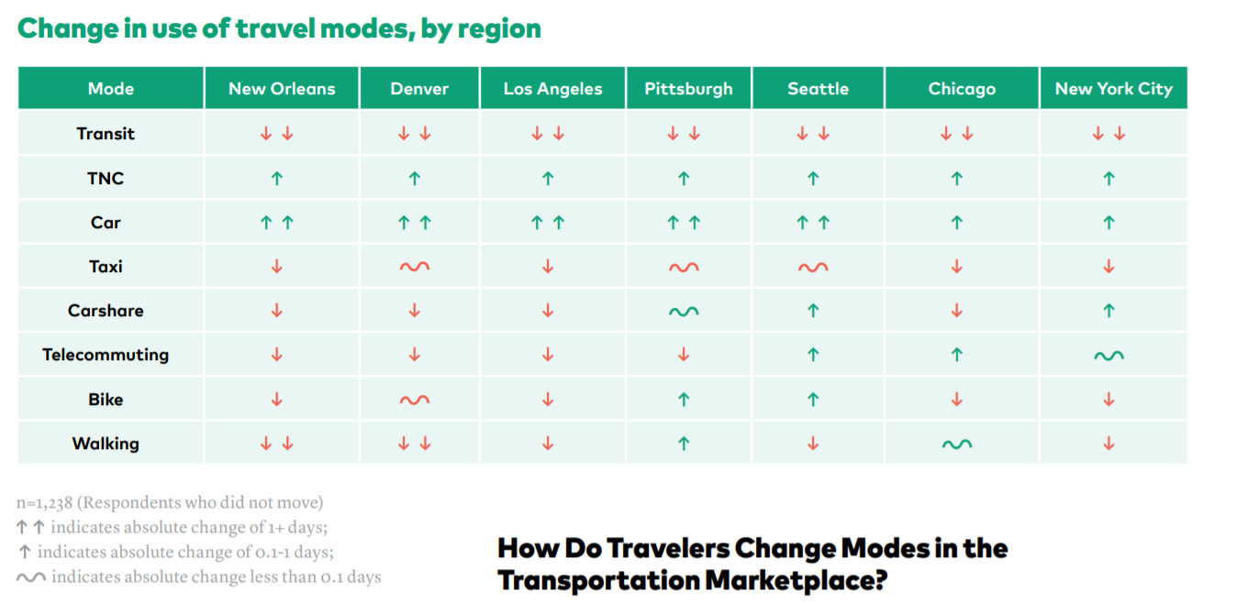

Slide 25
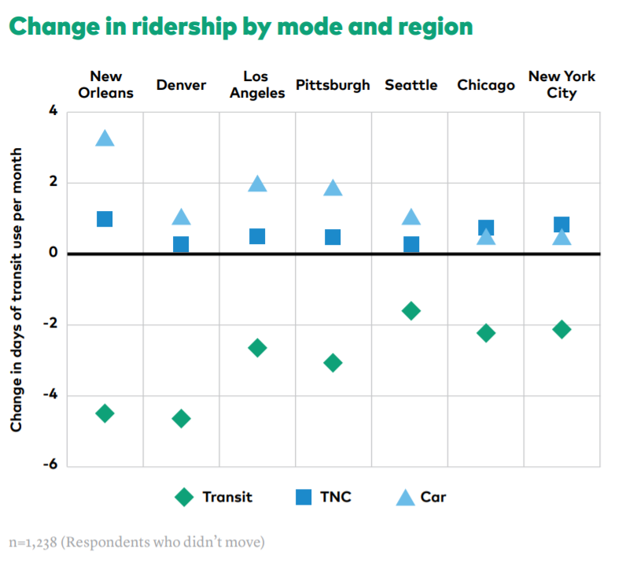
TNC – Transport Network Company, like Uber and Lyft

Slide 26
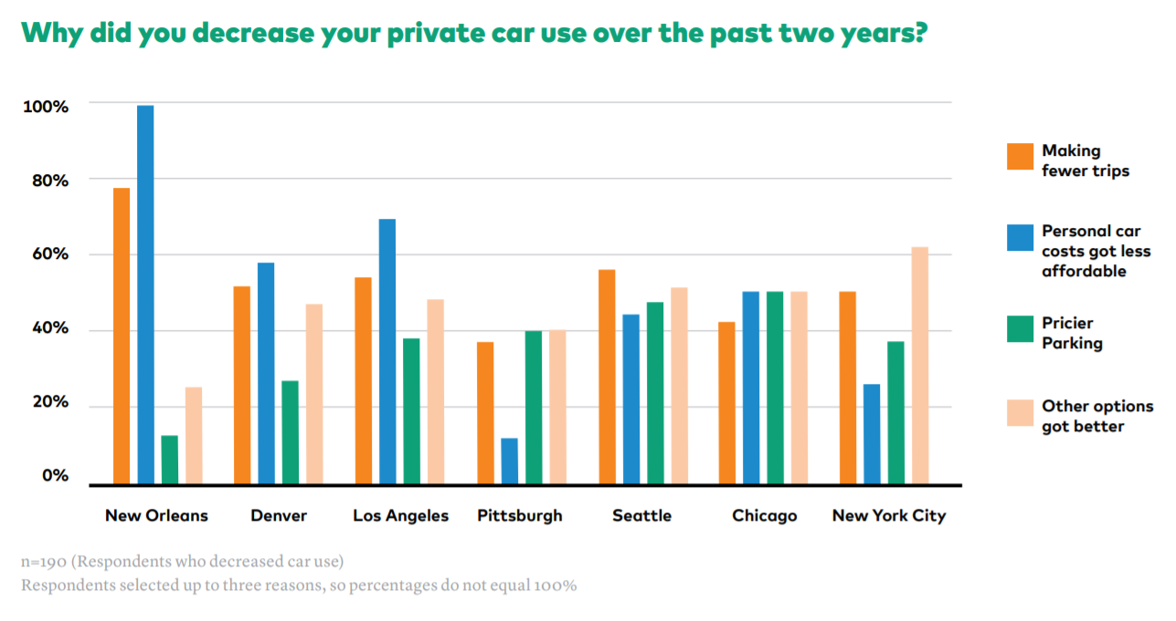

Slide 27
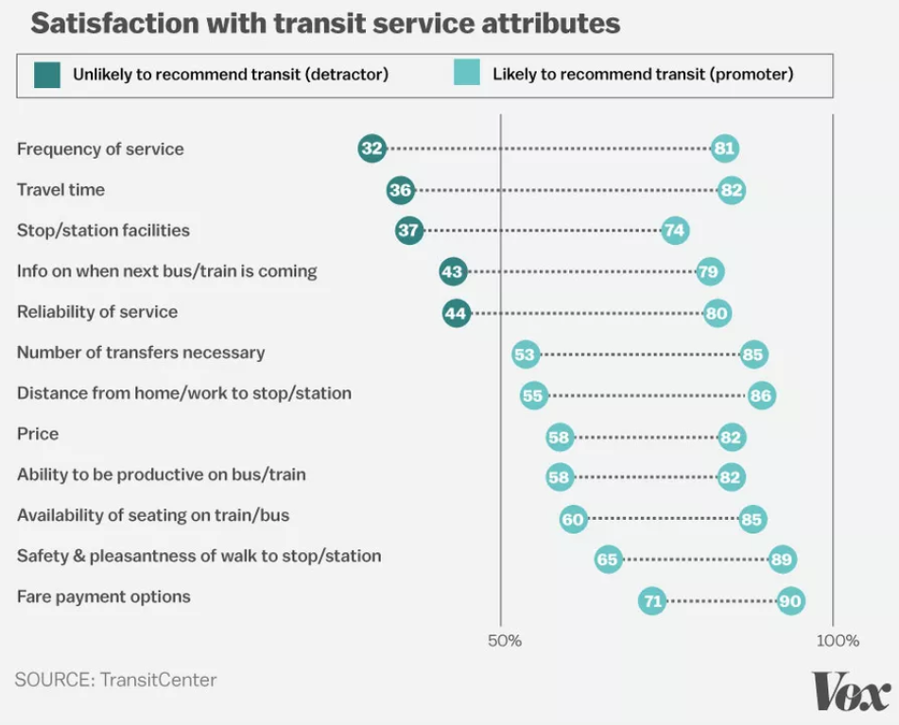

Slide 28

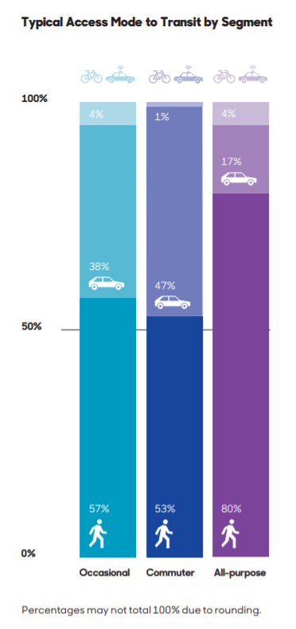
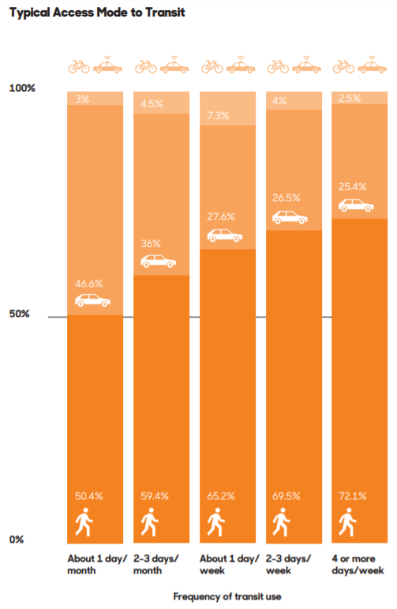

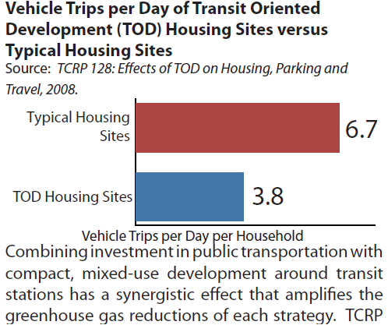

Slide 29
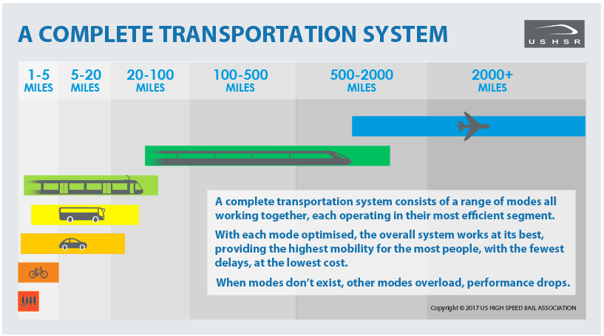

Slide 30
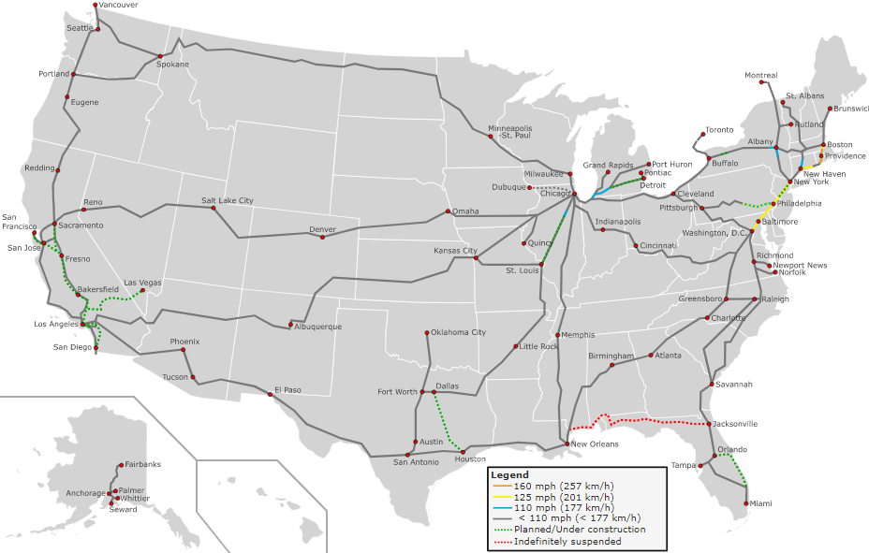
https://upload.wikimedia.org/wikipedia/commons/e/ec/High_Speed_Railroad_Map_of_the_United_States_2013.svg

Slide 31
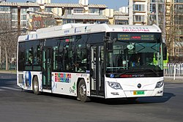
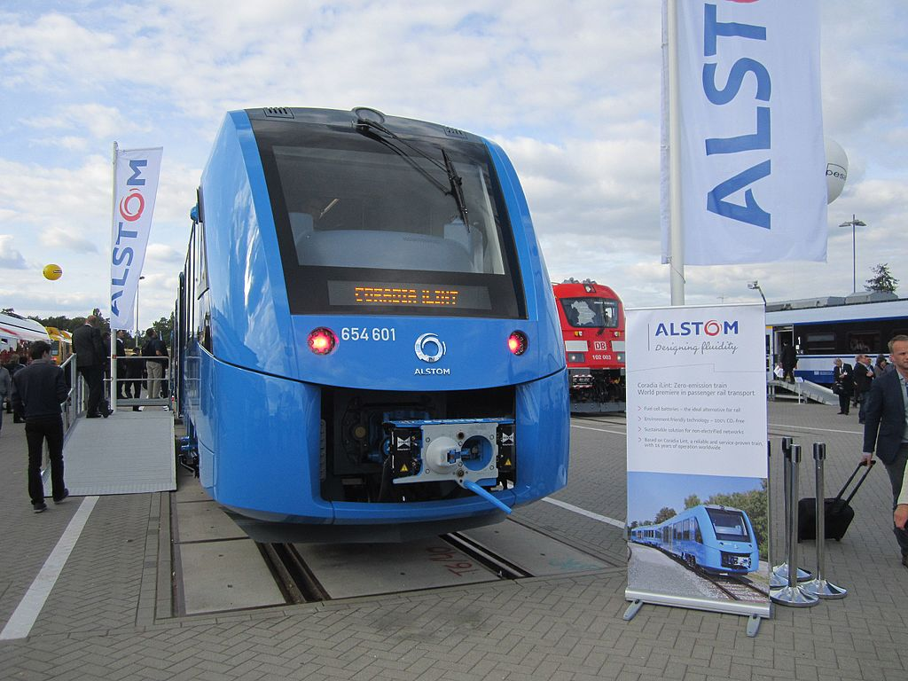
The Coradia iLint Announced at InnoTrans 2016, the new model is the world's first production hydrogen-powered trainset. The Coradia iLint is able to reach 140 kilometres per hour (87 mph) and travel 600–800 kilometres (370–500 mi) on a full tank of hydrogen. On 16 September 2018, the first Coradia iLint entered service on the Buxtehude-Bremervörde-Bremerhaven-Cuxhaven line in Lower Saxony, Germany
Foton BJ6123FCEVCH-1 fuel cell bus in Beijing, China
Fuel cell busses in Beijing on experimental basis in 2006
3 busses in Sao Paulo in 2009
2010-2015 Whistler, BC (Canada) had the largest fleet, put in place for the winter Olympics
Japan was planning something similar for 2020 Olympics
United Technologies Corportation (Hartford, CT) produces busses in operation in California

Slide 32
The Coradia iLint Announced at InnoTrans 2016, the new model is the world's first production hydrogen-powered trainset. The Coradia iLint is able to reach 140 kilometres per hour (87 mph) and travel 600–800 kilometres (370–500 mi) on a full tank of hydrogen. On 16 September 2018, the first Coradia iLint entered service on the Buxtehude-Bremervörde-Bremerhaven-Cuxhaven line in Lower Saxony, Germany
Foton BJ6123FCEVCH-1 fuel cell bus in Beijing, China
17 % of the bus fleet in China (421,000 busses) are electric busses. This is 99% of the world’s electric busses!
2,250 in Europe
Fuel cell busses in Beijing on experimental basis in 2006
3 busses in Sao Paulo in 2009
2010-2015 Whistler, BC (Canada) had the largest fleet, put in place for the winter Olympics
Japan was planning something similar for 2020 Olympics
United Technologies Corportation (Hartford, CT) produces busses in operation in California
300 in USA
as of 2019…

Slide 33
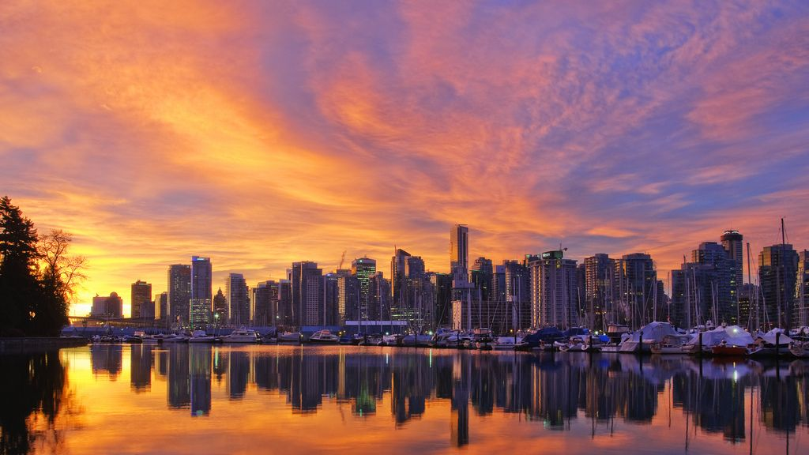
Improve ridership:
Frequent, reliable service with easy (walkable) access
Expand Infrastructure:
Transit-oriented development, a complete/connected transit system
Carbon Neutrality:
Electrify/hydrogenify
Time, complexity, difficulty
https://i.pinimg.com/originals/f3/40/f6/f340f65b12d2333844b29d8e12f72629.jpg

Slide 34
Improve ridership:
Frequent, reliable service with easy (walkable) access
Expand Infrastructure:
Transit-oriented development, a complete/connected transit system
Carbon Neutrality:
Electrify/hydrogenify
Time, complexity, difficulty
Thanks, HEJC!
Questions?
https://i.pinimg.com/originals/f3/40/f6/f340f65b12d2333844b29d8e12f72629.jpg

