Slide 1
Transportation in the US: Effect and Responses on Climate Change

Slide 2
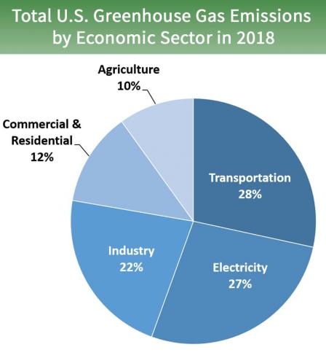
Transportation accounts for the plurality of American GHG Emissions
https://www.epa.gov/ghgemissions/sources-greenhouse-gas-emissions
Notes:
https://www.epa.gov/ghgemissions/sources-greenhouse-gas-emissions

Slide 3
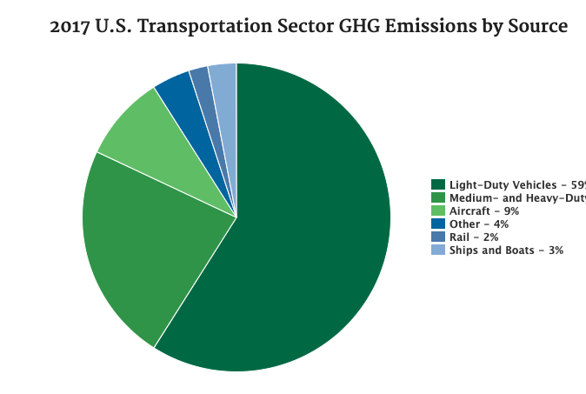
The majority of greenhouse gas emissions are from road-travel
https://www.epa.gov/greenvehicles/fast-facts-transportation-greenhouse-gas-emissions
Notes:
https://www.epa.gov/greenvehicles/fast-facts-transportation-greenhouse-gas-emissions

Slide 4
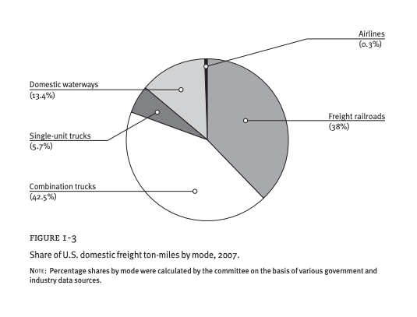
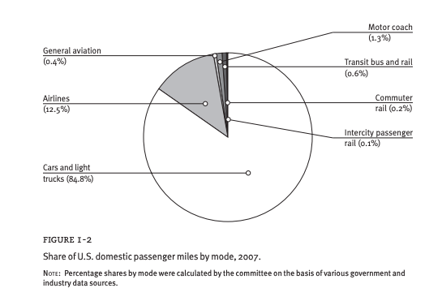
Policy options for reducing energy use and ghg emissions in united states transportation
Breakdown by domestic and freight modes

Slide 5
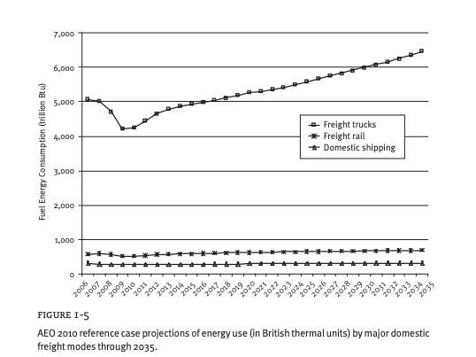
Amount of energy needed for freight transportation is likely to increase over time
Policy options for reducing energy use and ghg emissions in united states transportation
Notes:
Policy options for reducing energy use and ghg emissions in united states transportation

Slide 6
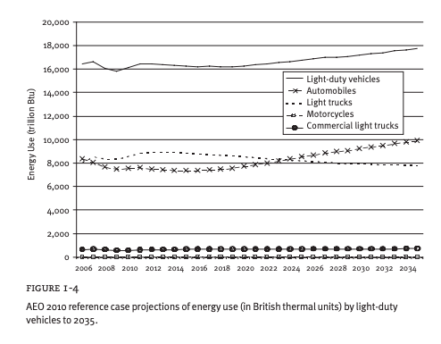
Amount of energy needed for individual transportation is likely to increase over time
Policy options for reducing energy use and ghg emissions in united states transportation
Notes:
Policy options for reducing energy use and ghg emissions in united states transportation

Slide 7


Ways to Decrease Transportation Related GHG emissions
1. Use less transportation
2. Use less energy intensive transportation
3. Increase energy efficiency of transportation
4. Decrease the carbon intensity of energy
Advancing the Science of Climate Change
Notes:
file:///Users/emily/Downloads/12782.pdf
Advancing the Science of Climate Change

Slide 8
Possible policy tools
“Transportation fuel taxes,
Vehicle efficiency standards and feebates (and other financial incentives to motivate interest in vehicle efficiency),
Low-carbon standards for transportation fuels,
Land use controls and travel demand management measures aimed at curbing private household vehicle use, and
Public investments in transportation infrastructure to increase vehicle operating efficiencies.”
Policy Options for Reducing Energy Use and Greenhouse Gas Emissions from U.S. Transportation
Notes:
Policy Options for Reducing Energy Use and Greenhouse Gas Emissions from U.S. Transportation

Slide 9

Reducing the Volume of Transport Activity
“Since 1980, the number of light-duty vehicle passenger-miles has grown at an average rate of 2.3 percent per year”
“Reduction over time in the average number of people traveling in each automobile and light truck. In 1977, the average vehicle carried 1.9 people; by 2001, this had declined by 14 percent, to 1.6 people. For travel to and from work, the average declined from 1.3 to 1.1”
Advancing the Science of Climate Change
Notes:
file:///Users/emily/Downloads/12782.pdf
Advancing the Science of Climate Change

Slide 10
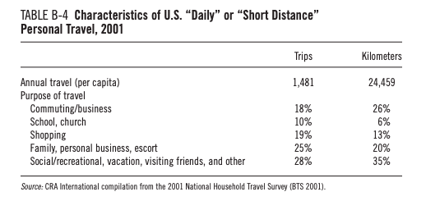
Reducing Volume of Transport Activities
Potential Impacts of Climate Change on U.S. Transportation: Special Report 290
Notes:
Potential Impacts of Climate Change on U.S. Transportation: Special Report 290

Slide 11
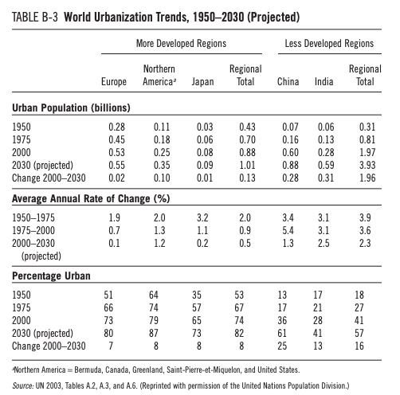
Use less energy intensive populations—the world is urbanizing
Potential Impacts of Climate Change on U.S. Transportation: Special Report 290
Notes:
Potential Impacts of Climate Change on U.S. Transportation: Special Report 290

Slide 12
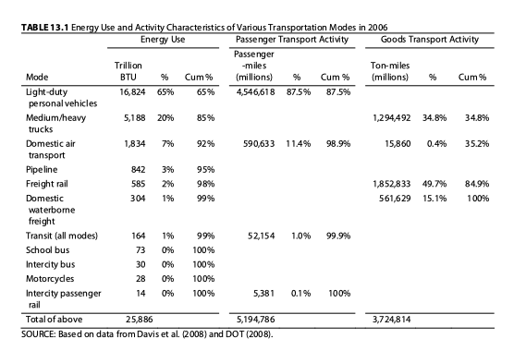
Public Transit is only lightly used
Advancing the Science of Climate Change
Notes:
file:///Users/emily/Downloads/12782.pdf
Advancing the Science of Climate Change

Slide 13
Use less energy intensive transportation
“For public transportation to be an energy efficient alternative to the private vehicle, however, requires that the services be heavily used. At present, except in a few very dense urban areas such as New York City, public transportation load factors are not high enough to make these services more energy- and GHG-efficient than driving.”
Advancing the Science of Climate Change (2010)
Notes:
file:///Users/emily/Downloads/12782.pdf
Advancing the Science of Climate Change

Slide 14
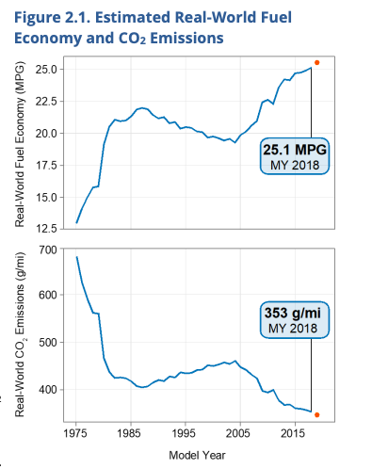
Increasing the Energy Efficiency of Transportation: Fuel Efficiency of Cars has Generally Increased over time
2019 EPA Automotive Trends Report

Slide 15
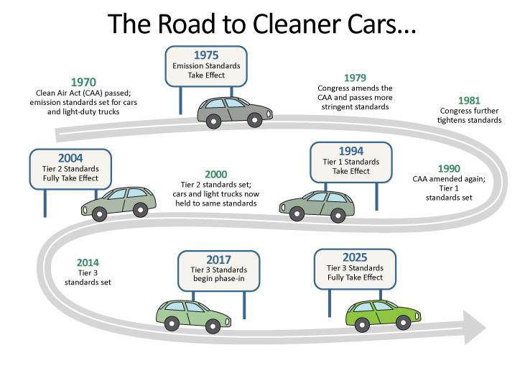
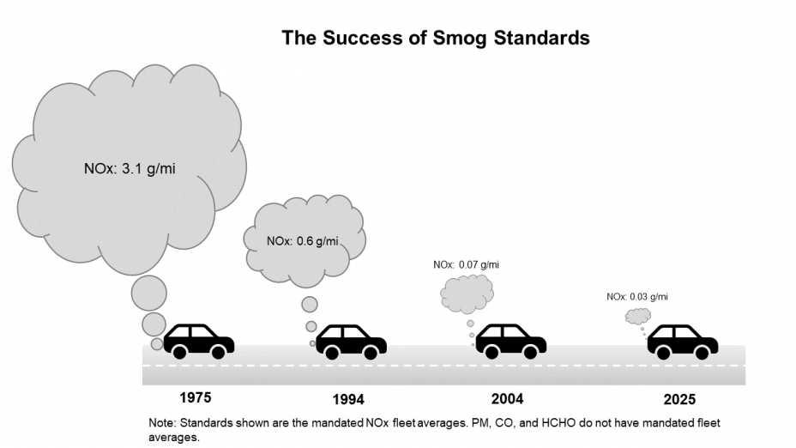
There are both Smog Causing Emissions Standards and GHG Emission Standards
https://www.epa.gov/greenvehicles/light-duty-vehicle-emissions
Notes:
https://www.epa.gov/greenvehicles/light-duty-vehicle-emissions
https://calmatters.org/explainers/california-auto-emissions-standards-fight-with-donald-trump-explained/?gclid=Cj0KCQjw4dr0BRCxARIsAKUNjWS4YLBFxN-ty7wKHcyWvKgrJSh6C7iJmCz_WvOACphsnmvnopUvR08aAtqVEALw_wcB
By 2030, EPA air quality emissions standards for vehicles are projected to annually prevent:
40,000 premature deaths
34,000 avoided hospitalizations
4.8 million work days lost
https://www.epa.gov/transportation-air-pollution-and-climate-change/smog-soot-and-local-air-pollution#about

Slide 16
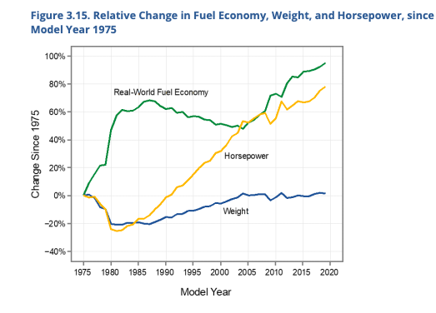
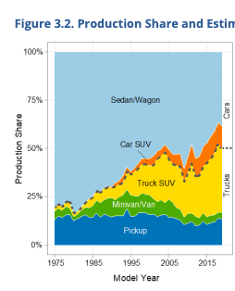
Fuel Efficiency Had Largely Increased, although size of cars has not decreased
2019 EPA Automotive Trends Report
Notes:
“This section of the report focuses on three separate technological areas of a vehicle: the engine, transmission, and driveline. The engine (or motor) of an automobile is at the heart of any vehicle design and converts energy stored in fuel (or a battery) into rotational energy. The transmission converts the rotational energy from the relatively narrow range of speeds available at the engine to the appropriate speed required for the driving conditions.
The driveline transfers the rotational energy from the transmission to the two or four wheels being used to move the vehicle. Each of these components has energy losses, or inefficiencies, which ultimately increase vehicle CO2 emissions and decrease fuel economy. A basic illustration of the energy flow through a vehicle is shown in Figure 4.1. Hybrid vehicles, electric vehicles (EVs), and plug-in hybrid electric vehicles (PHEVs) may have somewhat different configurations than shown in Figure 4.1.”

Slide 17
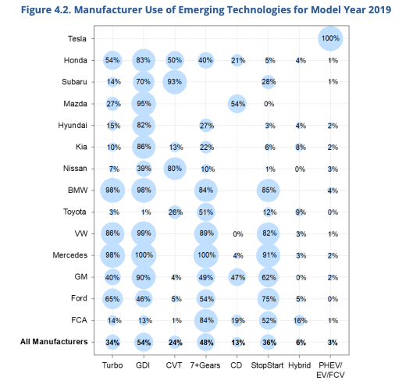
Car Manufacturers Have increased use of technologies to increase engine, transmission and driveline efficiency
2019 EPA Automotive Trends Report
Notes:
Engine technologies such as turbocharged engines (Turbo) and gasoline direct injection (GDI) allow for more efficient engine design and operation. Cylinder deactivation (CD) allows for only using part of the engine when less power is needed, and stop/start can turn off the engine entirely when the vehicle is stopped to save fuel. Hybrid vehicles use a larger 39 battery to recapture braking energy and provide power when necessary, allowing for a smaller, more efficiently-operated engine. Transmissions that have seven or more speeds, and continuously variable transmissions (CVTs), allow the engine to more frequently operate near its peak efficiency, providing more efficient average engine operation and a reduction in fuel usage.

Slide 18
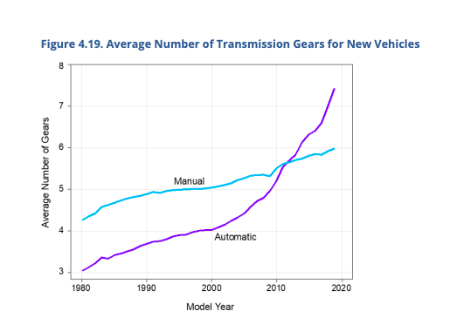
The number of transmission gears has been increasing over time
2019 EPA Automotive Trends Report

Slide 19
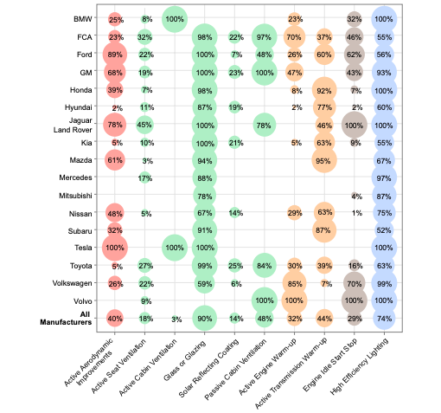
Non-Engine Efficiency Improvements have also been widely used
2019 EPA Automotive Trends Report

Slide 20
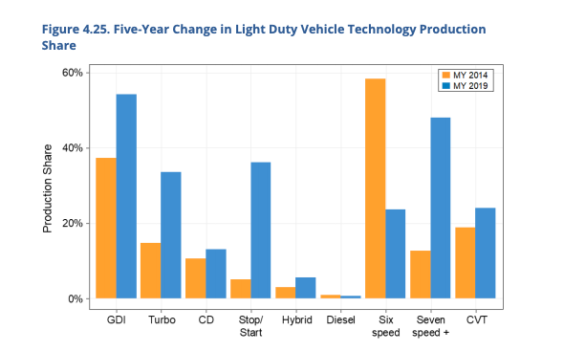
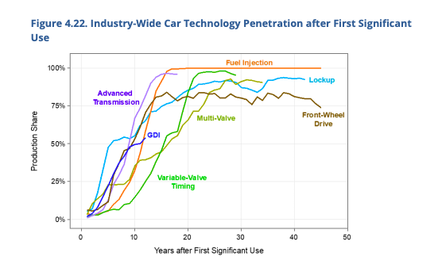
It takes about 10 –15 years for engine technology to go from first-use to ubiquitous.
2019 EPA Automotive Trends Report

Slide 21
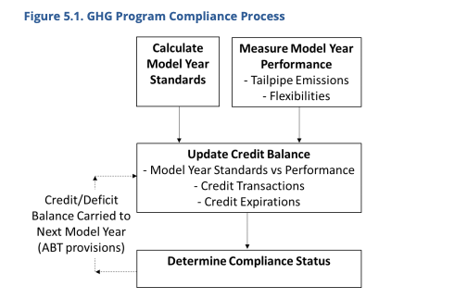
Car manufacturers get credits for having cars that are more fuel efficient than the target
2019 EPA Automotive Trends Report
Notes:
On May 7, 2010, the Environmental Protection Agency (EPA) and the National Highway Traffic Safety Administration (NHTSA) established the first phase of a National Program to reduce greenhouse gas (GHG) emissions and improve fuel economy for 2012 to 2016 model year light-duty vehicles. On October 15, 2012, EPA and NHTSA established the second phase of the joint National Program for model years 2017–2025. These standards apply to passenger cars, light-duty trucks, and medium-duty passenger vehicles. This section of the report is designed to provide as much information as possible about how the manufacturers are performing under EPA’s GHG program.
Finally, manufacturers must determine their compliance status. If a manufacturer ends the model year with a positive credit balance, it is in compliance with the GHG program, and its credit balance will be carried forward to the next model year. If a manufacturer ends the model year with a negative credit balance that it is unable to offset, it is considered to have a credit deficit. A deficit does not immediately result in non-compliance with EPA’s GHG program, but manufacturers must offset the deficit within three years to avoid noncompliance. For example, a manufacturer with a deficit remaining from model year 2015 77 after the 2018 model year would be considered out of compliance with the 2015 model year standards. Manufacturers may not carry forward any credits unless all deficits have been offset.
The more stringent model year 2018 targets resulted in a reduction of the car standard by 10 g/mi and of the truck standard by 9 g/mi. The increase in stringency for trucks in 2018 was considerably more than the 1 g/mi change seen from model year 2016 to model year 2017
e. All manufacturers are required to test their vehicles on the Federal Test Procedure (known as the “City” test) and the Highway Fuel Economy Test

Slide 22
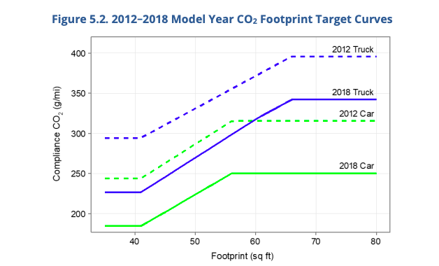
Targets are based on the footprint of a vehicle
2019 EPA Automotive Trends Report
Notes:
The final rule will increase stringency of CAFE and CO2 emissions standards by 1.5% each year through model year 2026, as compared with the standards issued in 2012, which would have required about 5% annual increases.
This is a change from the proposal issued in 2018. The majority of automakers are not meeting the 2012 standard without resorting to the use of credits. The final rule can be found here:

Slide 23
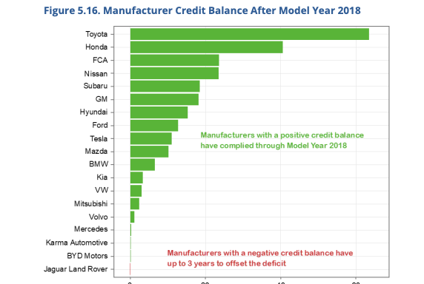
Most car manufacturers had a positive credit balance in 2018
2019 EPA Automotive Trends Report

Slide 24
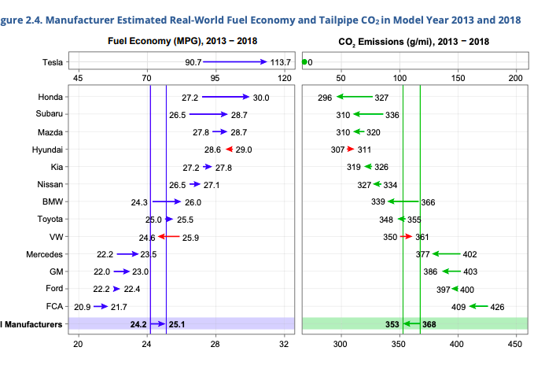
Real Performance of Major Automakers
2019 EPA Automotive Trends Report
Notes:
https://www.epa.gov/sites/production/files/2020-03/documents/420r20006.pdf

Slide 25

Freight Emissions
https://www.epa.gov/smartway/learn-about-smartway
“Between 1990 and 2013, freight activity grew by over 50 percent and is projected to nearly double again by 2040.
Experts project that by 2050, global freight transport emissions will surpass those from passenger vehicles.”
Notes:
https://www.epa.gov/smartway/learn-about-smartway

Slide 26
Freight Emissions Smartway
EPA partners with private trucking companies to help identify more efficient supply chains and research emission-limiting technology.
https://www.epa.gov/smartway/learn-about-smartway

Slide 27
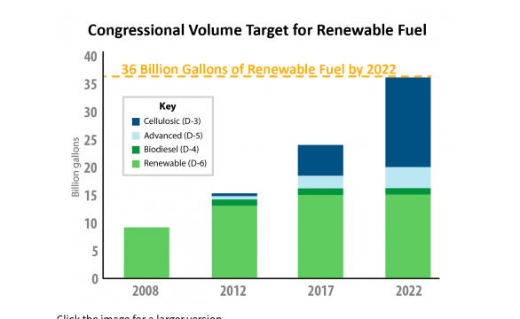
Decrease the carbon intensity of energy: Renewable Fuel Standard Program
https://www.epa.gov/renewable-fuel-standard-program/overview-renewable-fuel-standard
Notes:
https://www.epa.gov/renewable-fuel-standard-program/overview-renewable-fuel-standard

Slide 28
Reducing the GHG Intensity of Transportation Fuels
Corn ethanol potentially a poor choice
Cellulosic fuels potentially better
Battery and fuel cell feedstocks matter
Advancing the Science of Climate Change (2010)

Slide 29
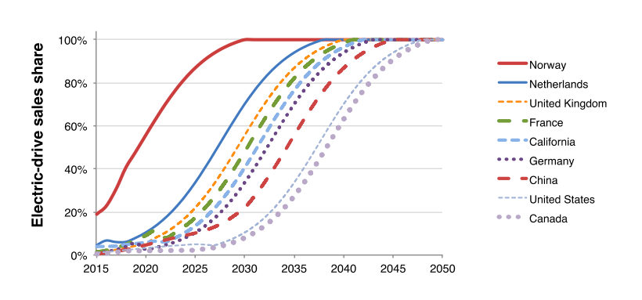
EV Goals tend to favor complete conversion by mid century
https://www.epa.gov/sites/production/files/2019-11/documents/webinar-ev-trends-2019-10-24.pdf
International ZEV Alliance Announcement
Notes:
https://www.epa.gov/sites/production/files/2019-11/documents/webinar-ev-trends-2019-10-24.pdf
International ZEV Alliance Announcement
California Connecticut Germany Maryland Massachusetts The Netherlands New York Norway Oregon Québec Rhode Island United Kingdom Vermont

Slide 30
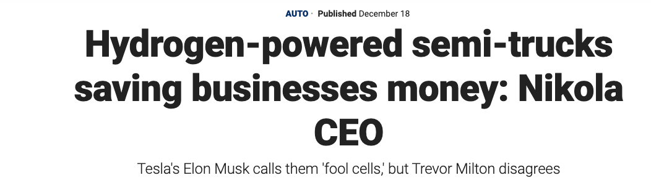
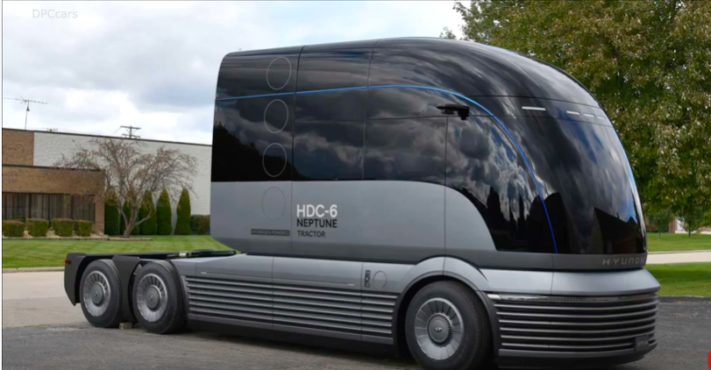
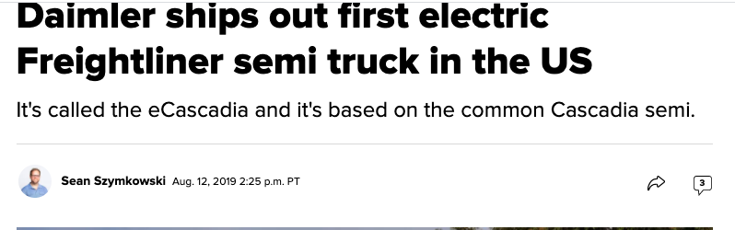
https://www.youtube.com/watch?v=B98la3IimRg

Slide 31
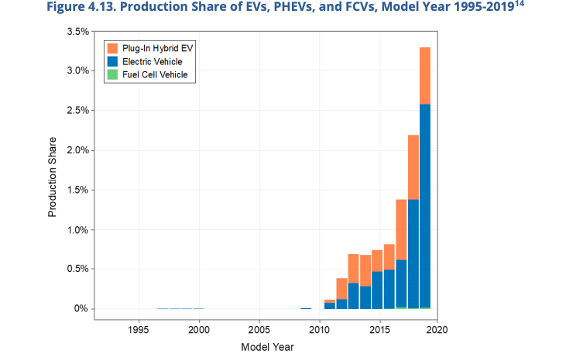
Electric vehicles have a small but rapidly growing market share
2019 EPA Automotive Trends Report

Slide 32
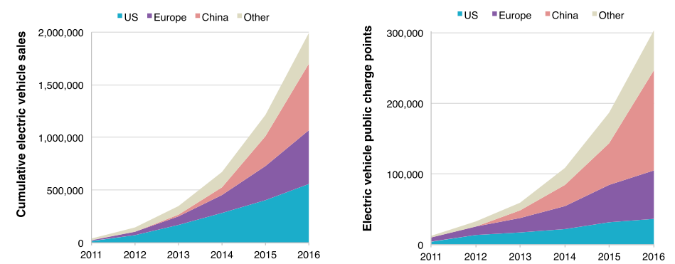
In absolute numbers, there were about 2 million electric cars worldwide in 2016.
https://www.epa.gov/sites/production/files/2019-11/documents/webinar-ev-trends-2019-10-24.pdf
Notes:
https://www.epa.gov/sites/production/files/2019-11/documents/webinar-ev-trends-2019-10-24.pdf

Slide 33
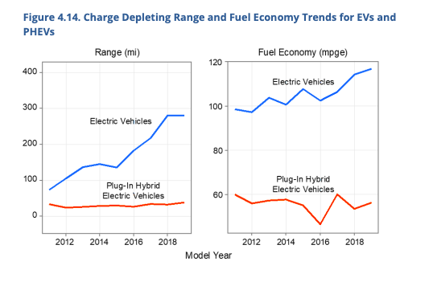
Range and fuel economy of electric vehicles has improved over the last decades
2019 EPA Automotive Trends Report

Slide 34
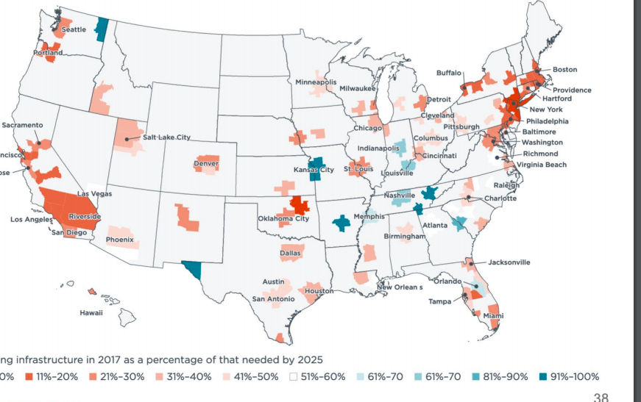
EV Charging Stations are growing, but not in a homogenous manner
https://www.epa.gov/sites/production/files/2019-11/documents/webinar-ev-trends-2019-10-24.pdf
Notes:
https://www.epa.gov/sites/production/files/2019-11/documents/webinar-ev-trends-2019-10-24.pdf

Slide 35
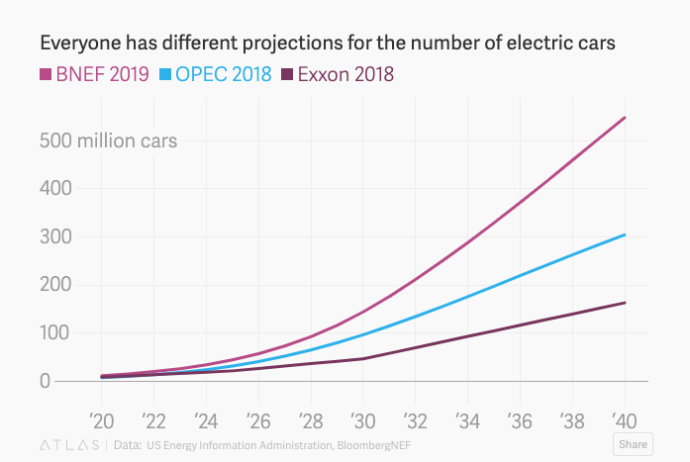
Electric Car Projections are all over the place
https://qz.com/1620614/electric-car-forecasts-are-all-over-the-map/
Notes:
https://qz.com/1620614/electric-car-forecasts-are-all-over-the-map/

Slide 36

Effects of Climate Change on Transportation Networks

Slide 37
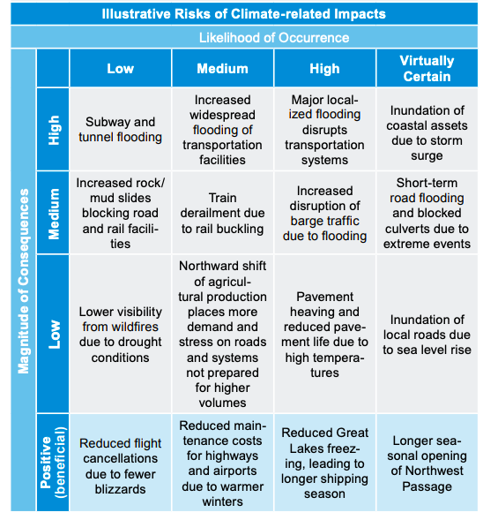
There are both positive and negative changes that climate change will cause the transportation network
Climate Change Impacts on the United States

Slide 38
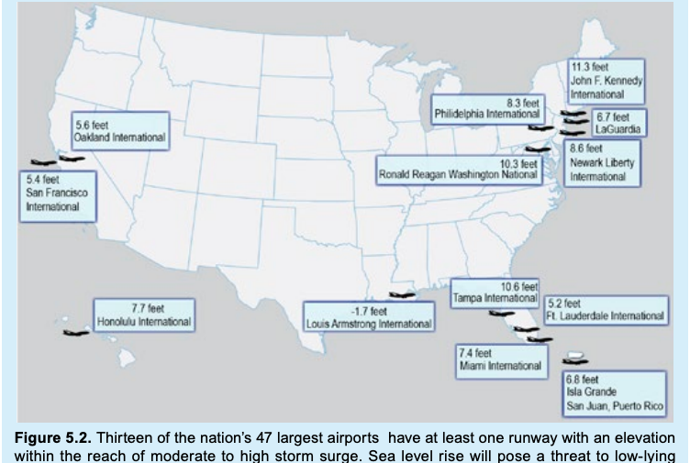
Flooding will effect costal transport in particular
Climate Change Impacts on the United States
Notes:
file:///Users/emily/Downloads/NCA3_Full_Report_05_Transportation_LowRes%20(1).pdf
https://nca2014.globalchange.gov/report/sectors/transportation#statement-10194

Slide 39
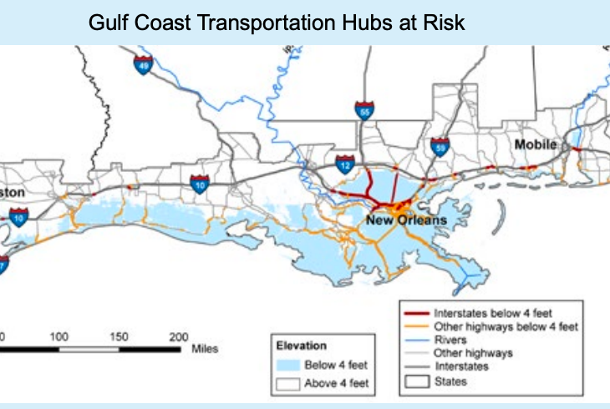
Flooding will effect costal transport in particular
Climate Change Impacts on the United States
Notes:
file:///Users/emily/Downloads/NCA3_Full_Report_05_Transportation_LowRes%20(1).pd
https://nca2014.globalchange.gov/report/sectors/transportation#statement-10194f

Slide 40
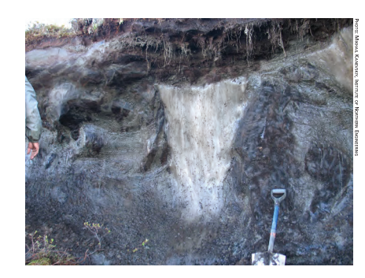

Permafrost melting strains transportation networks in cold areas
How Vulnerable Is Alaska’s Transportation to Climate Change?

Slide 41
Infrastructure Tools for Dealing with Climate Change
“Transportation and land-use planning: deciding what infrastructure to build and where to build it, as well as planning for vulnerable areas of the community and impacts on specific population groups.
Vulnerability and risk assessment: identifying existing vulnerable facilities and systems, together with the expected consequences.
New infrastructure design: adapting new infrastructure designs that anticipate changing environmental and operational conditions.
Asset management: adapting existing infrastructure and operations that respond to current and anticipated conditions, including changed maintenance practices and retrofits.
Emergency response: anticipating expected disruptions from extreme weather events, and developing emergency response capability.”
https://nca2014.globalchange.gov/report/sectors/transportation#statement-10194
Notes:
https://nca2014.globalchange.gov/report/sectors/transportation#statement-10194

Slide 42
Thank you!

