Slide 1
Energy Subsidies in the United States
Harvard Energy Journal Club
April 3rd, 2020
Jordan Sosa

Slide 2

Energy Subsidies in the United States
Harvard Energy Journal Club April 3rd, 2020
Jordan Sosa

Slide 3
Outline
Climate Change
Background on Subsidies
History of Subsidies in US
Current distributions and their Effects
Future possibilities

Slide 4
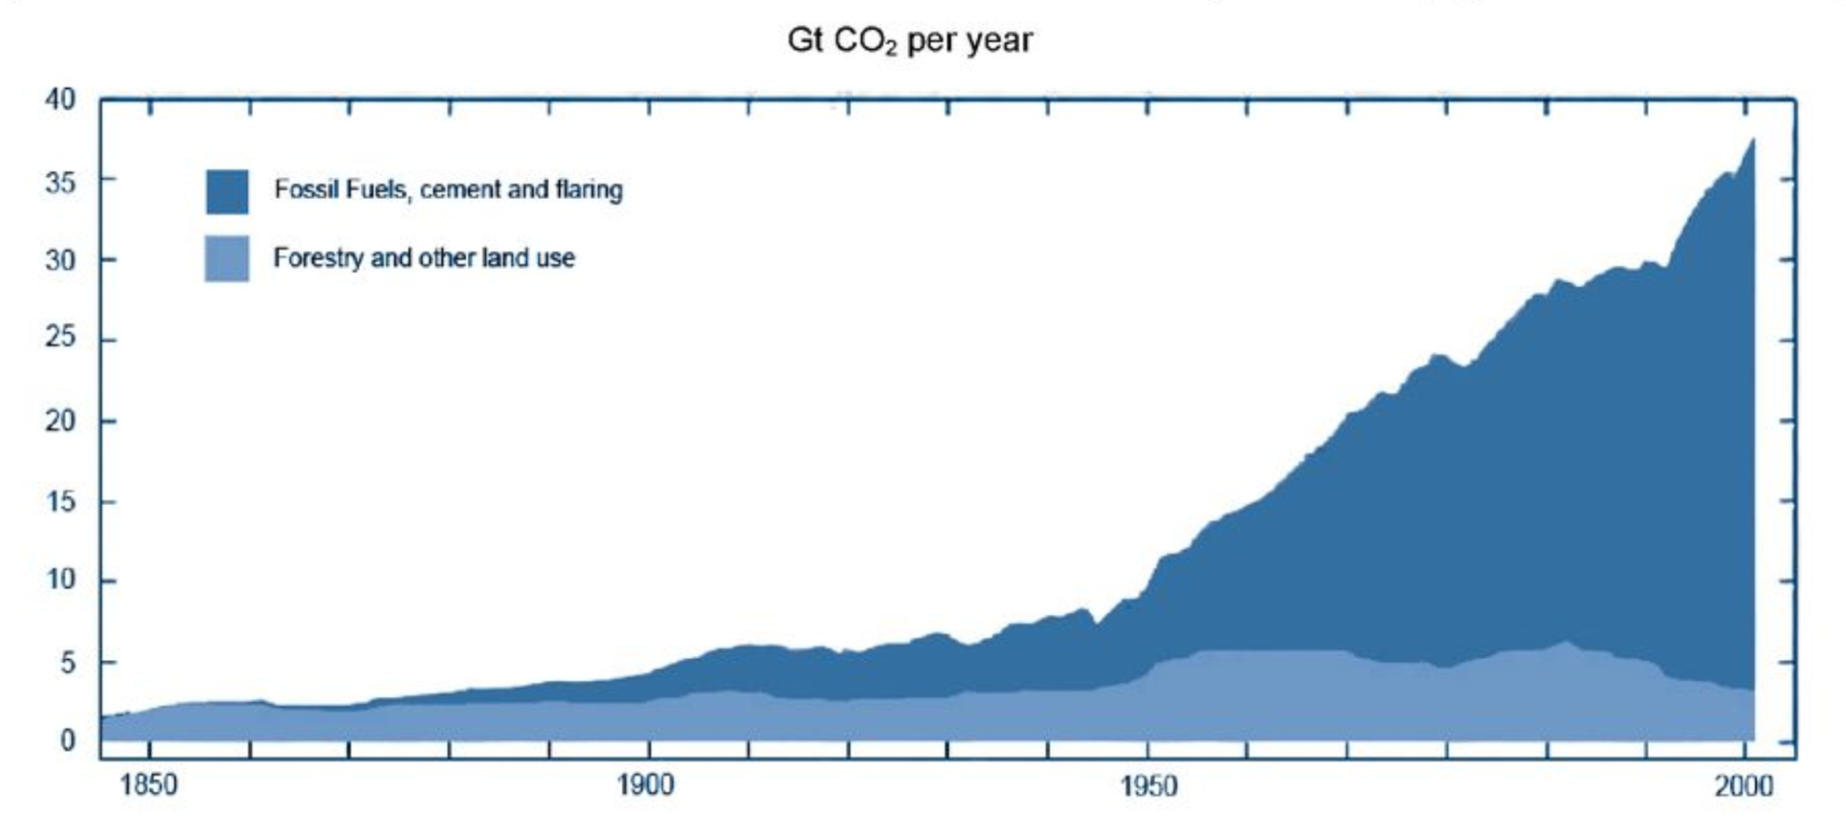
Climate Change and Energy
Climate change and greenhouse gases, specifically CO₂
For US, 84% of emissions from energy sector
  94% CO₂ (97% of CO₂ from fossil fuel combustion)
Global numbers, Reference #2
Notes:
As of 2019, CO2 contributed ¾ of greenhouse gas emissions. Next is methane, then nitrous oxides and others. These gases called greenhouse gases because they trap heat in the earth like the roofs of greenhouses of plants; radiation from the sun enters but cannot reflect back out into space because the gases absorb that energy.
With 84% of emissions from energy sector, there have been a lot of recent interest in addressing energy’s contributions to climate change. The US relatively recently began more heavy analysis on energy (as did a strong portion of the rest of the world). However, the energy sector also has become a prominent component of the US economy, with companies like Exon Mobile making it #2 on the Forbes’ 500 list.
To address this issue of economic prosperity vs concerns with emissions, the US needs to incentivize markets to compete with the current energy sector.

Slide 5
Subsidies
Price
Supply
Goals
  Keep prices above market price for producers or
  Keep prices below market price for consumers
Direct examples ($$$)
  Grants, loans
Indirect examples
  Tax exemptions, competition limitations, lowered service costs, limiting legislation
    Percentage depletion deduction
Market
Price
Demand
Quantity
Notes:
Before talking about introducing new markets, first I’ll talk about a significant component of energy markets: Subsidies

Slide 6

Positive Influences of Fossil Fuel Subsidies
Maintain economic strength
  Ideally for consumers and producers
Maintain energy system in place
Impact emissions positively
$
Notes:
By not completely getting rid of fossil fuel energy sources, the US can maintain a very strong economy. Ideally, subsidies will make production less tax burdensome for producers and make the price of energy decrease for the consumer more than the taxes they paid to aid in subsidies
Also, the US is already strong dependent on fossil fuels up through recent times, so by supporting the system in place, it can be seen as providing access to energy.
Lastly, by subsidizing processes that are supposed to increase fuel and production efficiency, emissions should go down for the same amount of resource used.

Slide 7
Negative Influences of Fossil Fuel Subsidies
Make investments preferable to energy production and other industries requiring high energy usage
Slow down growth of other industries
Burden the tax payer
Can increase public debt and decrease public spending
Environmentally and economically impact parties typically not involved in profits
Currently written as permanent funding
Notes:
Taxes are guaranteed, and for an infrastructure that’s large and its growth is favored over other markets, the investment in that infrastructure has less risk because of the guaranteed maximum losses and government support

Slide 8
History of Documentation on Subsidies
No official economic analysis before 2010, only estimated numbers by IEA based on market prices
Starting this year, countries are expected to individually track and report fossil-fuel subsidies and their economic impacts
Historically difficult to track because of disagreement and ambiguity in definitions
Notes:
There’s no official, comprehensive economic analysis before 2010; until then, there are only estimated numbers based on market prices determined by the International Energy Agency. Later on, we’ll see that data for policies that began in the early 1900’s don’t have any data until 1985.
Not until this year, 2020, will countries be expected to individually track and report fossil-fuel subsidies and their economic impacts.
Historically, subsidies are difficult to track in the first place because of federal and international disagreement and ambiguity in definitions. Because of this reason, terms like subsidies, tax preferences, credits, and investments are used to describe similar types of federal financial allocations.

Slide 9
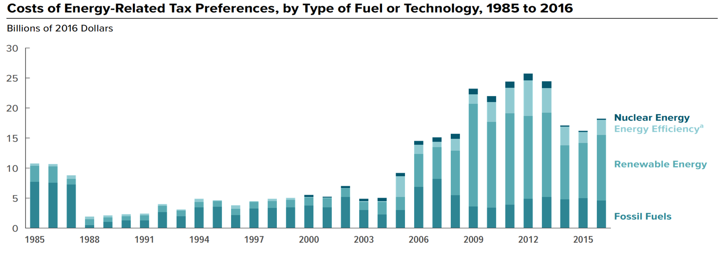
US Subsidizing History
Reference #5
Notes:
1916 to 2005: Oil producers most of federal funding in energy (2/3 average)
In 2005 see increase in overall funding, significant in renewables because of Energy Policy Act
2008: oil is less than 1/3 of tax preferences; this year The Emergency Economic Stabilization Act extended and expanded tax preferences for renewable energy and efficiency improvement technology R&D
2009: American Recovery and Reinvestment Act of 2009 gave temporary increase in effiency programs’ tax preferences, in addition to Section 1603 grants for onetime cash payments instead of future tax deductions, in an effort to expedite tech progress
2012: comparing here to 2004 is a five-fold increase!
2013: Funding to alleviate stress from the 07-09 recession runs out
2016: amount has fallen to steady level; notable that recent decade has less funding on average than earliest funding records (85) and through first decade

Slide 10
Recent Progress on “Wasteful Subsidies”
Pittsburgh summit for G-20 in ’09
  “rationalize and phase out over the medium term inefficient fossil fuel subsidies that encourage wasteful consumption”
  Similar statement in ‘09 from Asia-Pacific Economic Cooperation (APEC) forum
Peer review starting with US & China in ’14
  Extended through many partnerships, outside of G-20 as well
Paris Trade Agreement ‘15 ☹
G7 pledges to end fossil fuel subsidies by 2025 in ’16
Burea of Land Management rules to reduce waste from production & replace 30 y/o policies

Slide 11
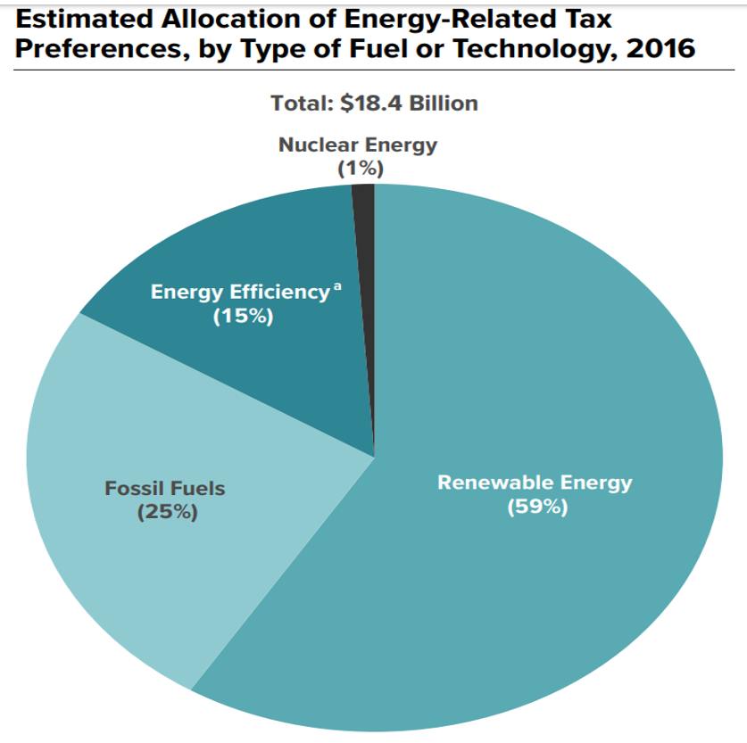
Recent US Subsidies
Spends 2nd most in the world (likely historically)
  2010: Energy sector 2nd least of tax revenues (3% of total)
    Correspondingly, had second lowest tax rate on gasoline and diesel
  2016: $18.4 billion in tax preferences towards energy sector
    See image to right ---------------->
    For reference, total is in 100’s of billions
Reference #5

Slide 12
Recent US Subsidies & Usage
Notes:
Breaking down renewables, biomass produced most with 5.9% of energy, then hydroelectric at 3.1, wind 2.7, solar .9, and geothermal .2 %.
BUT half the energy from biofuels was used to create more biofuels

Slide 13
Impacts of Federal Investments
Federal policy for domestic oil since 70’s
2006: Production significantly increased, but not due to federal preferences
  Simultaneously, carbon taxing proposed
  NAS: renewables investments $250 per ton CO₂; need $45-60
2004-2014
  Preferences increase oil production .4-.8 %, but cost $90-200 per barrel before market price of barrel
  NAS: No effect on production
Overall, DOE investments in renewables -> higher rate of privatization
  However, still no large returns
Notes:
Since the disruption of the global supply chain in 1970’s, the US federal policy has desired for increasing the domestic oil production.
Analysis from the Congressional Budget Office show ineffective funding influences despite growth in oil production. This economic analysis to explain the phenomena is beyond the scope of this talk / my understanding
The National Academy of Sciences agreed though with an even more complex analysis, stating federal spending had virtually no impact on the oil production growth; growth could be more due to external or purely market factors and none with governing influence, as in they would’ve happened anyway
For renewables, the Department of Energy’s investments have shown a higher rate of privatization than other federal investment programs. However, these investments still haven’t generated enough market strength to gain the permanent funding that the fossil fuel industries get.

Slide 14
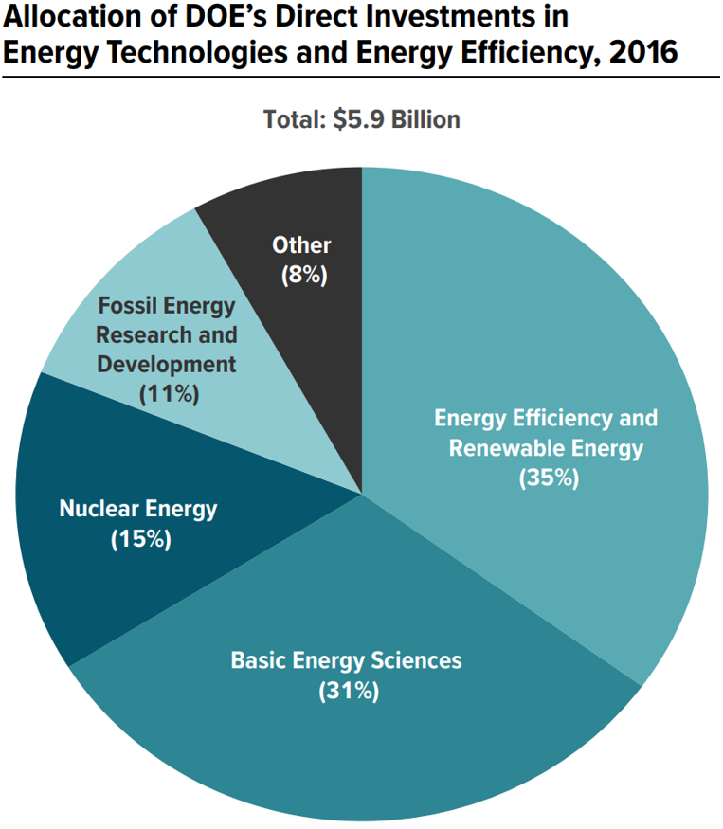
Impacts of Federal Investments

Slide 15
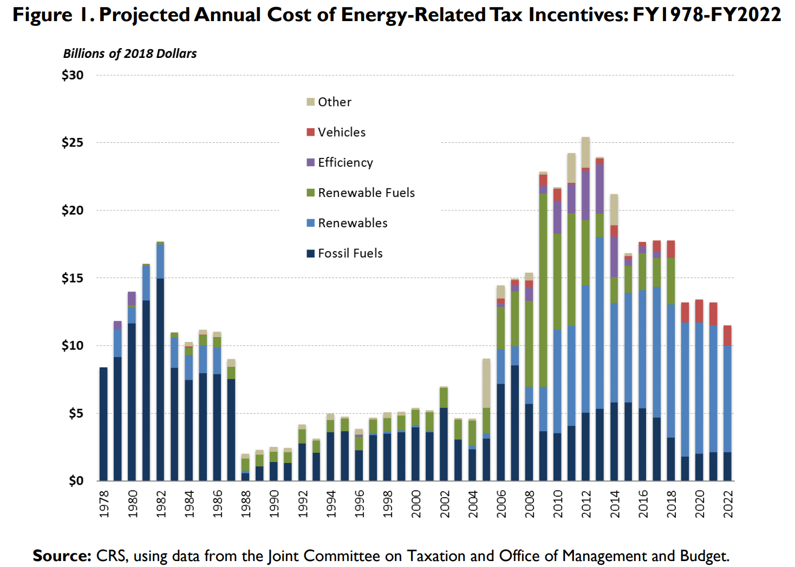
Future of Subsidies
Notes:
Joint Committee on Taxation and OMB use shorter term investment periods in their models (5 years)

Slide 16
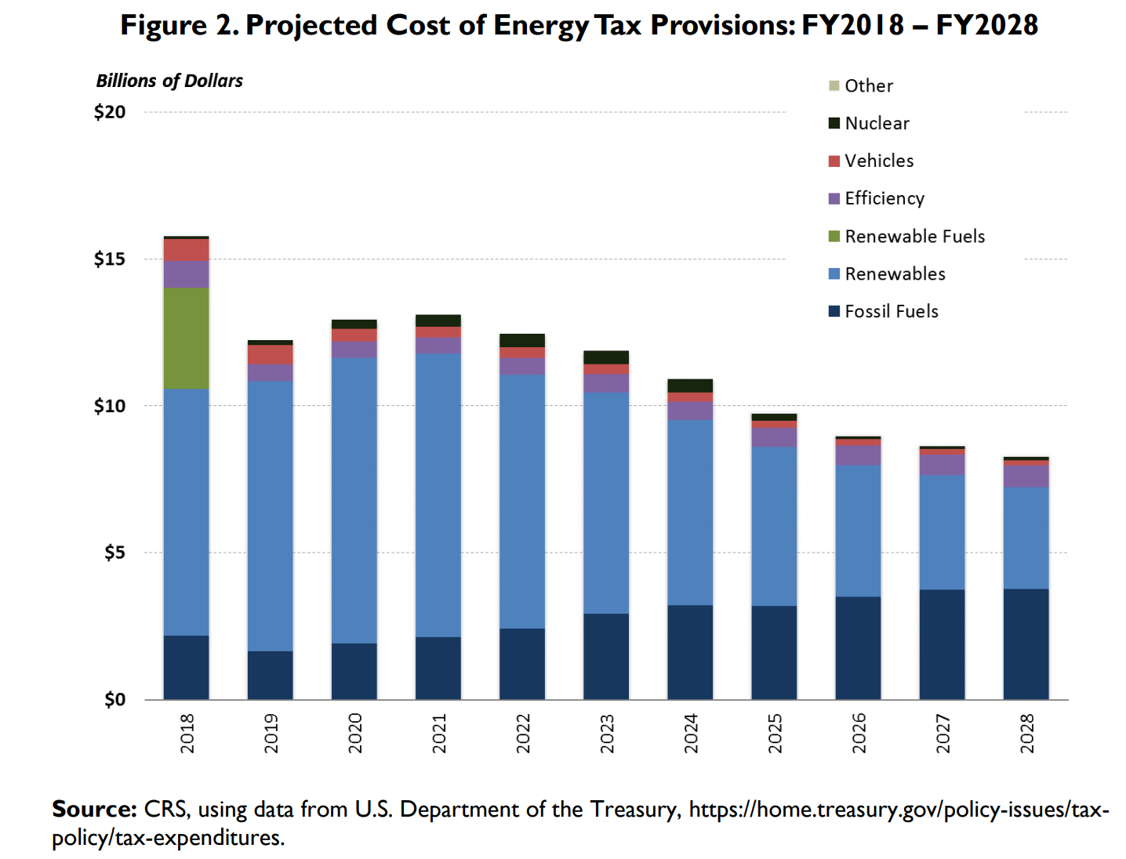
Future of Subsidies
Notes:
DOT use models planning on 11-year budget windows to show longterm trends and shifts of funding. It can be seen that fossil fuels gain subsidies again in the future on the current model. Solar panels are expected to decrease notably in preferences.
It’s also noted that tax provisions different in definition between DOT and Joint Committee on Taxation and Office of Budget Management

Slide 17
Future of Subsidies?
Use Value Added tax
  Can refund workers, but has economic risks
Carbon tax
  H.R. 6463 – MARKET CHOICE Act (2018)
Remove guaranteed funding for fossil fuels
Hopefully not needed at all
Notes:
Carbon tax: Preferred method; reduce emissions, don’t rely price limitations; have overall weaker impact on revenue reductions; historically have larger impact on emissions; allow for market self-regulation; producers and consumers held liable
Fossil fuel industries have guaranteed funding under current policies, which many haven’t been reviewed in decades. Hopefully these can be reconsidered.
Hopefully, government help won’t be needed in these markets if emerging technologies become strong enough to stand alone.

Slide 18
References
G. Metcalf. “On-the-Economics-of-a-Carbon-Tax-for-the-United-States.” Brookings Papers on Economic Activity Meeting (2019).
OECD Companion to the Inventory of Support Measures for Fossil Fuels 2015
D. Coady, I. Parry, L. Sears, B. Shang. “How Large Are Global Fossil Fuel Subsidies?” World Development 91: 11-27 (2017).
Parry, D. Heine, E. Lis, S. Li “Getting energy prices right: From principle to practice”. International Monetary Fund, Washington (2014)
“Testimony: Federal Support for Developing, Producing, and Using Fuels and Energy Technologies.” Before the Subcommittee on Energy - Committee on Energy and Commerce - U.S. House of Representatives. Congressional Budget Office (2017).
“The Value of Energy Tax Incentives for Different Types of Energy Resources.” Congressional Research Service (2019).
115th Congress (2017-2018) H.R. 6463 – MARKET CHOICE Act
For corresponding each fact to its source, please contact me for the comprehensive reference document at Jsosa@g.Harvard.edu

Slide 19
THANK YOU

