Slide 1

Space Mining
Caroline Im

Slide 2

Why do people want to mine space?
Altruistic/ environmental reasons
Because it’s cool
Money

Slide 3
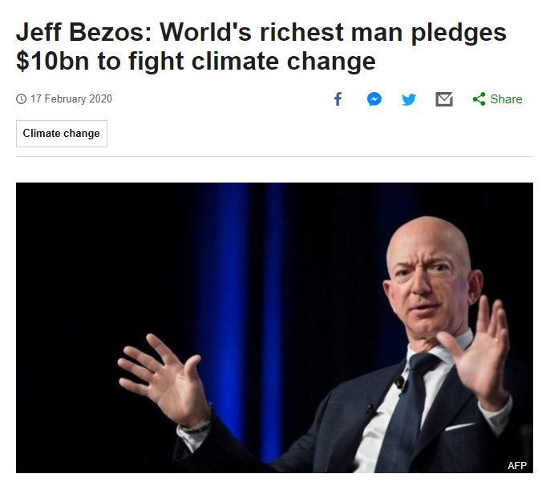
Blue Origin
Lunar settlements
Earth becomes a nature reserve
Mining is very polluting

Slide 4
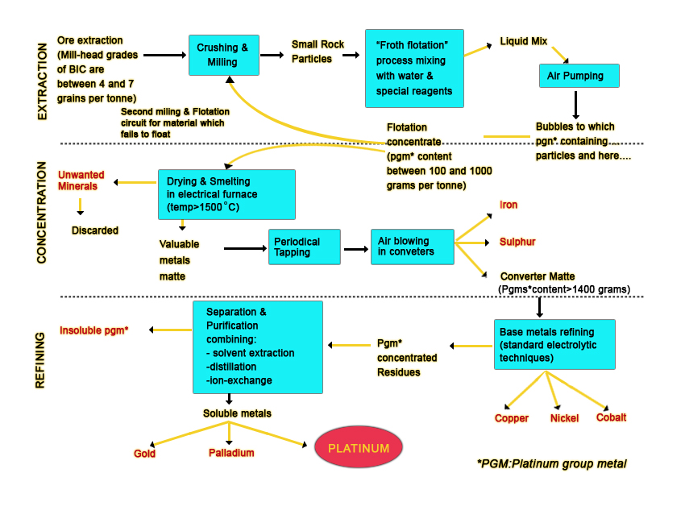
Platinum and PGM
Found in South Africa and Russia
Reduce environmental impacts of mobility and energy generation
Fuel cells, batteries, catalysts
Limited supply on earth
  5 ppb, 9400 tons total, 1 gram per metric ton of rock
Polluting industry
  SO2, CO2, chemical run offs emissions
  water

Slide 5
PGE production - 2015
Total electricity consumption of PGE production in South Africa amounted to 44.9 PJ
  95% of electricity was generated from coal.
  Electricity generation from coal 1009 t CO2-eq (a 20% of total emissions of US)
The PGE industry consumed 157 million L liquid fuels, primarily diesel.
The overall CED from fossils amounted to 177 PJ
Total 13 million t CO2-eq, 167.5 and 44.9 t CO2-eq. per 1000 t ore milled and kg PGE.
SO2 emissions were 1.73 t SO2 per 1000 t ore milled, or 463 kg per kg PGE
Water: used 1.0 million L per 1000 t ore milled corresponding to 0.272 million L per kg PGE.

Slide 6
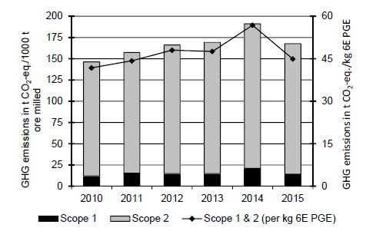
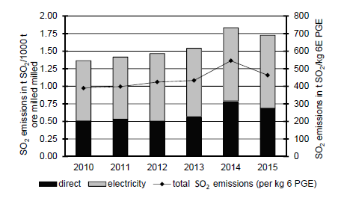
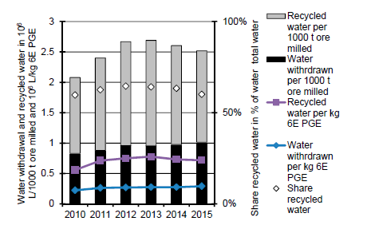
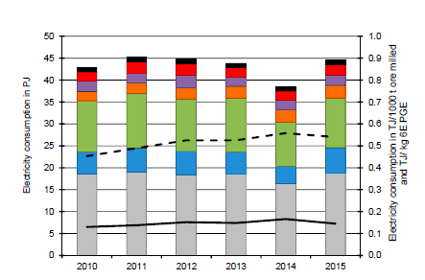

Slide 7
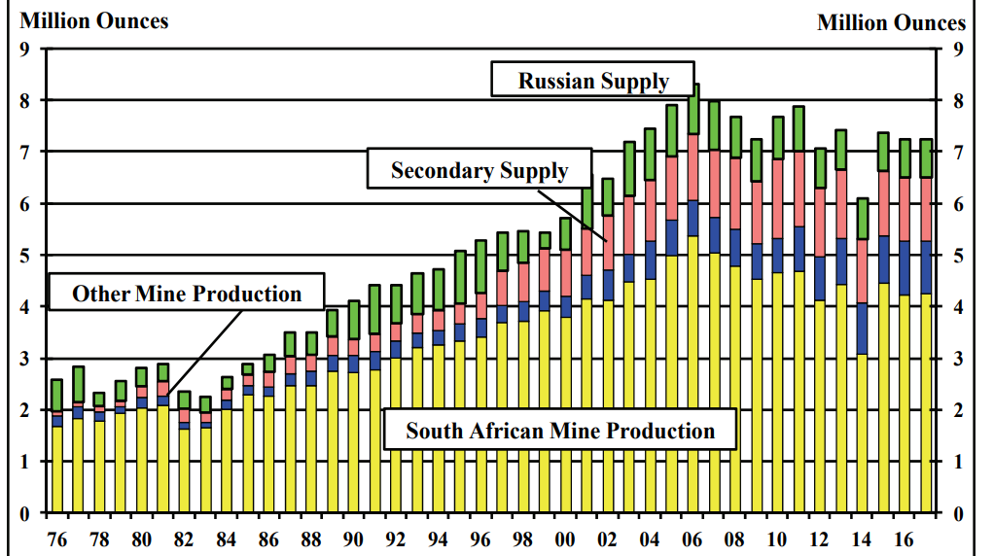

Slide 8
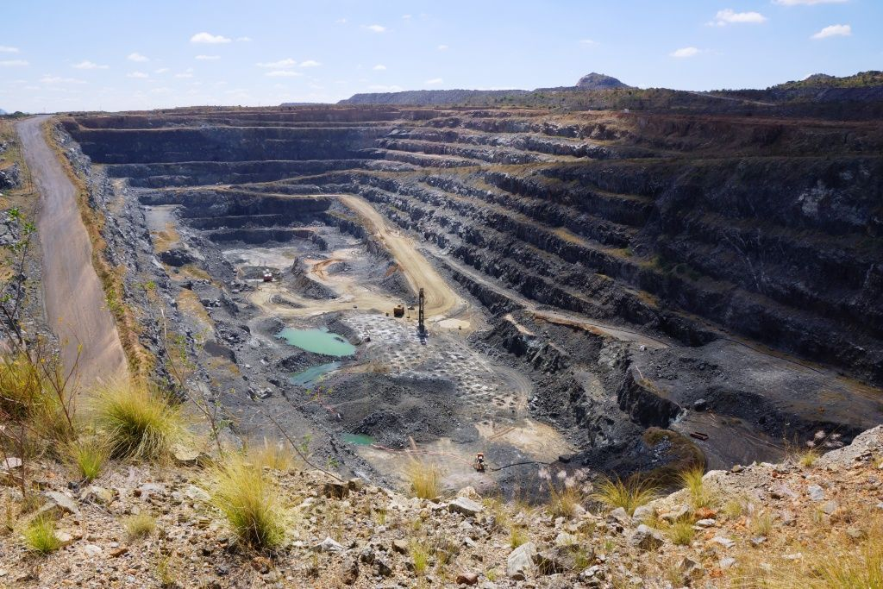

Slide 9
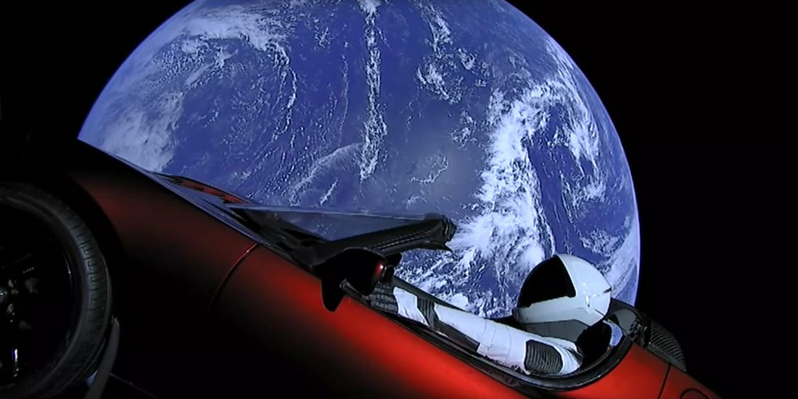
Coolness
SpaceX
Going to Mars
Not looking for a return

Slide 10
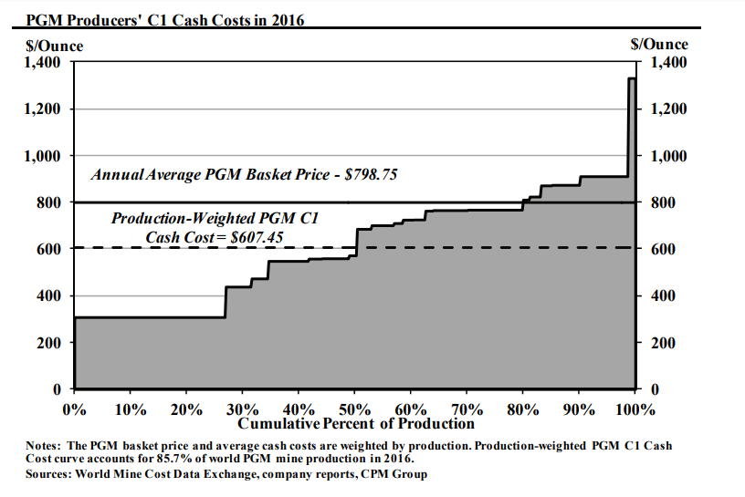

Slide 11
Highest Costs is leaving earth
hydrogen (H2), oxygen (O2)
hydrazine (N₂H₄₎ monomethylhydrazine CH₃(NH)NH₂, and nitrogen tetroxide (N₂O₄)
100:1 fuel to weight ratio
Ex. Space shuttle: The total weight is 4.3 lb, 160,000 lb shuttle
Fuel is nonrenewable
Liquid Hydrogen and Oxygen have to be kept in cryogenic tubes, no way to store them in space

Slide 12
Costs per destination
ISS (340 km)
Space Shuttle $450 million per mission
Ariane 6 $70 million euros per launch
Atlas V $110 million per launch
Moon (384,000 km)
Artemis $1.6 billion
Mars (206 million km)
Curiosity $2.5 billion
SpaceX $10 billion
Chang’e 4 $~ billion

Slide 13
Gravity required
Aqua regia

Slide 14
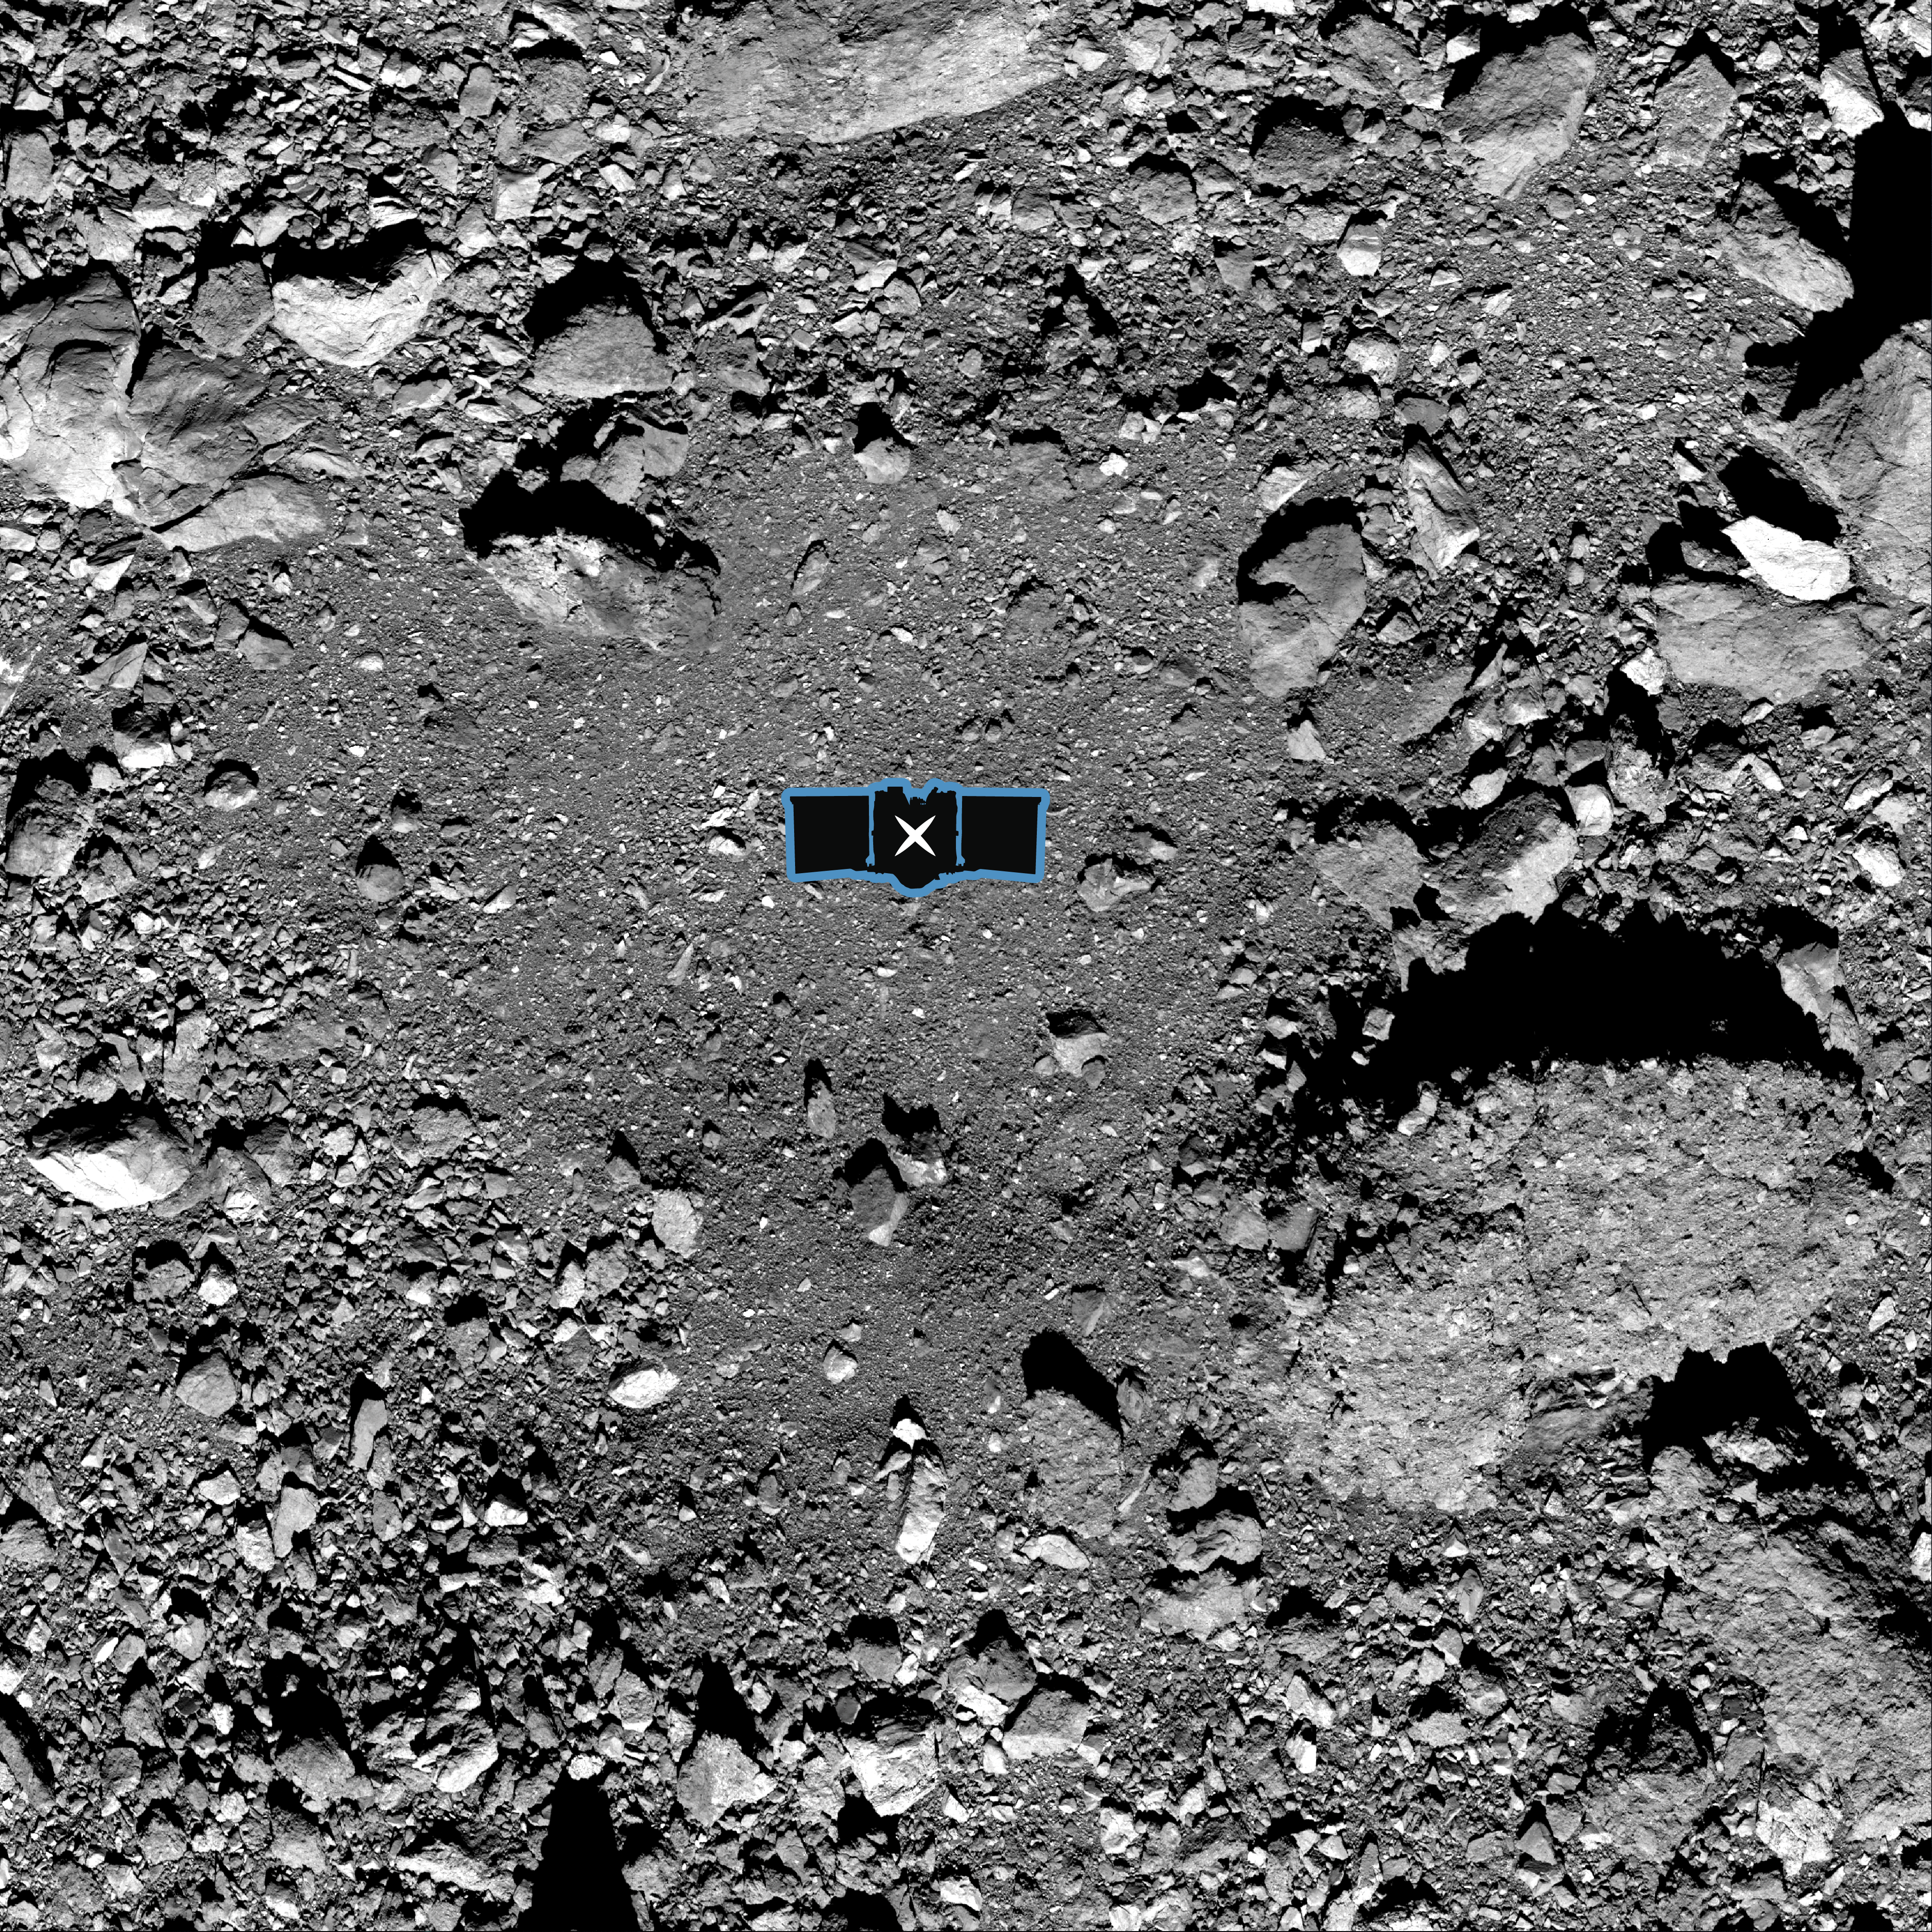
Making a profit off Platinum
Osiris-Rex
Sample of Bennu
$800 million + $183.5 million = $983.5 million
60 g- 2 kg
3-5 ppm iron meteorites, M-asteroids
1 ppm stony meteorites, S-asteroids
0.0005% of 2 kg = .01 g
Today’s price $31.59/g * .01g = $.31 of profit
Operating at a loss of $983.5 million

Slide 15
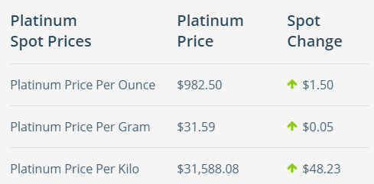
an asteroid’s return to shareholders
Asteroid 16 Psyche, largest iron meteorite in asteroid belt
200 km, 2.72 × 10^19 kg *.0005% ~ 1.36*10^14 kg
$4.29*10^18 * 76% ~ $3.26*10^18
Expected(R)=RFR+βstock​×(Rmarket​−RFR)
This is after 30-40 years
mv | $3.26*10^18
debt | 1.26E+14
beta | 2
expected risk premium | 96%
treasury bill rate | 2%
a. | er = rf + b*(mr-rfr)
 | 193.54%

Slide 16
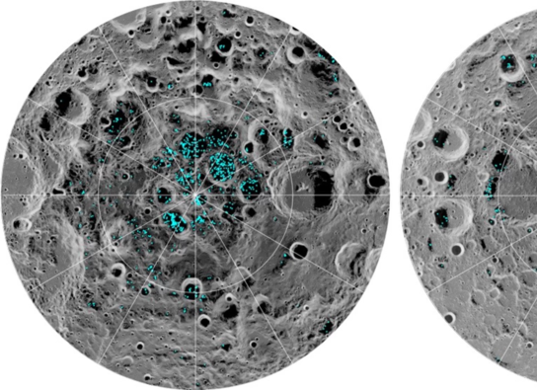
The moon
Much closer, much cheaper
Water
Helium
Jumping off point
Refuel

Slide 17
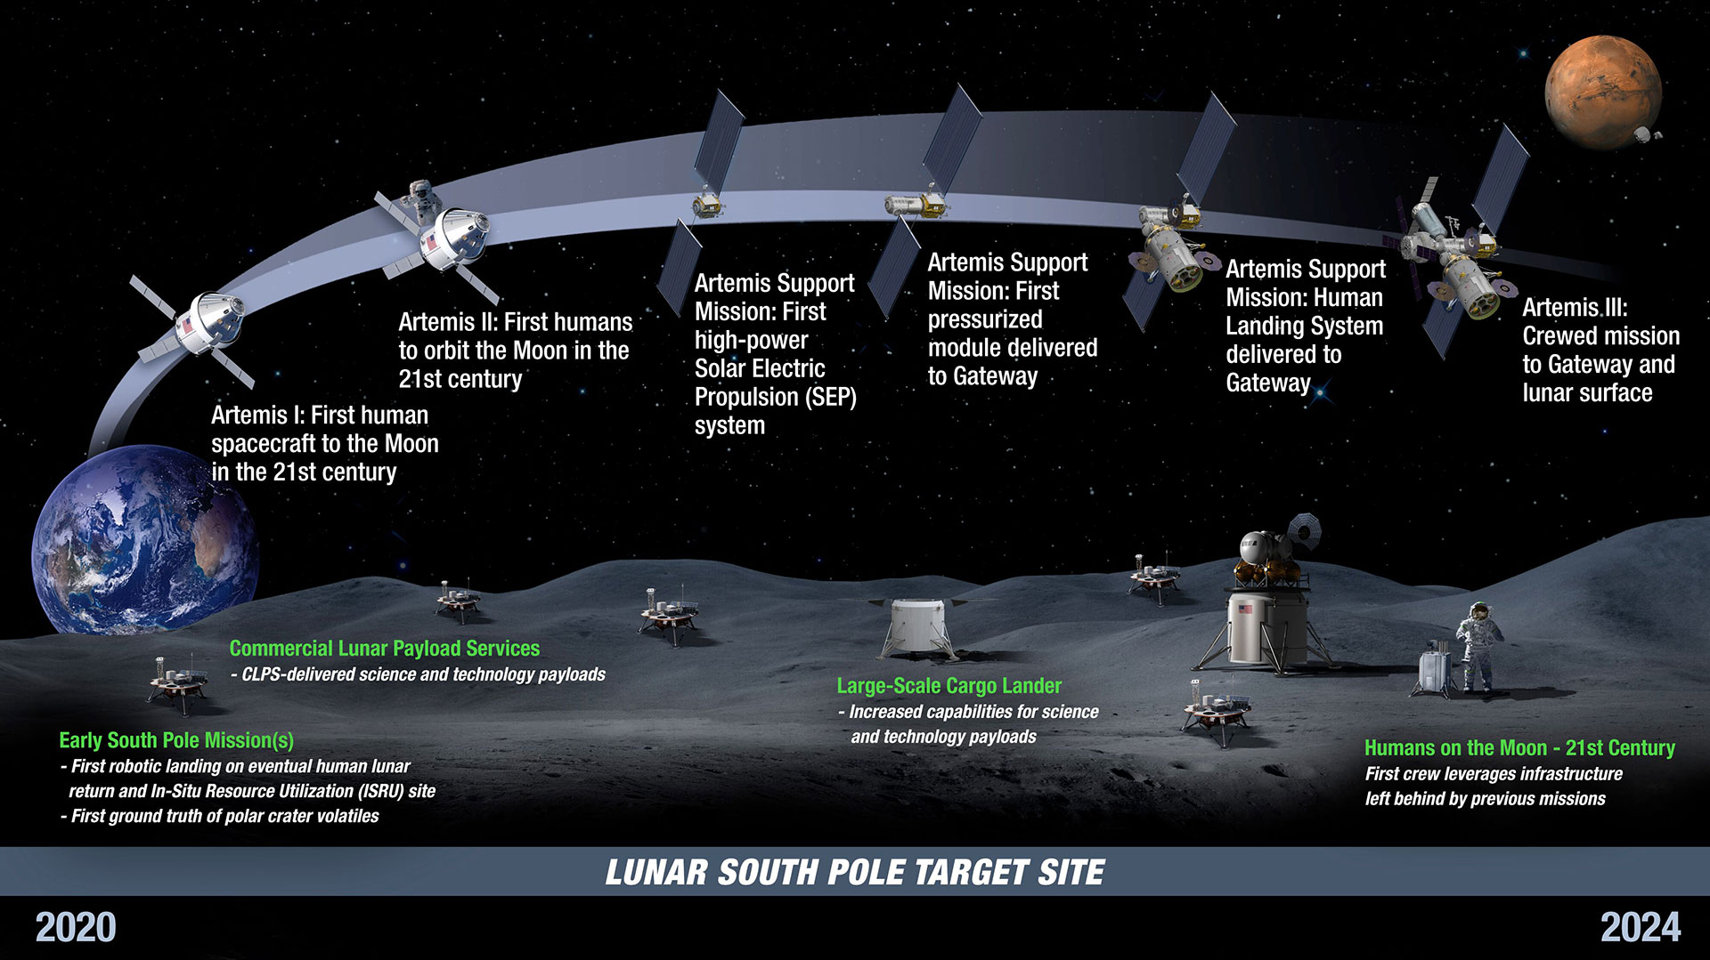

Slide 18
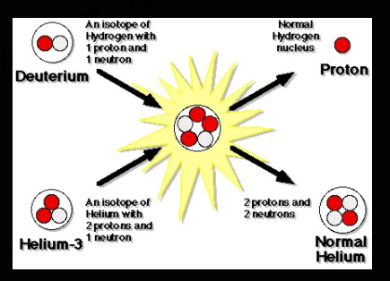
Helium - 3
Also scarce- solar winds mixed with regolith
5-80 ppb
Fusion process
Heated to 600 C
Reaction is 70% efficient

Slide 19
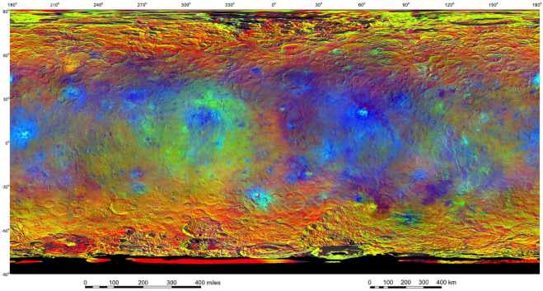
Ceres (and other C-type asteroids)
High in NH₄- and Mg-phyllosilicates and carbonates
Never heated above 20 C Salts and water-ice
Redder colors indicate places on Ceres' surface that reflect light strongly in the infrared, while bluish colors indicate enhanced reflectivity at short (bluer) wavelengths; green indicates places where albedo is strongly enhanced. Polar regions are affected by bad illumination conditions, thus photometric correction does not work properly in those areas.

Slide 20
Government vs Private

Slide 21
Socialist Space Race
There won’t be any profit from space mining for at least several more decades
Too high of an upfront cost with no profit/ high risk
European Space Agency and ISS are examples of successful international agencies making it into space

