Slide 1
Thorium-based Nuclear Power
HEJC
Feb 14, 2020
Eric Fell

Slide 2
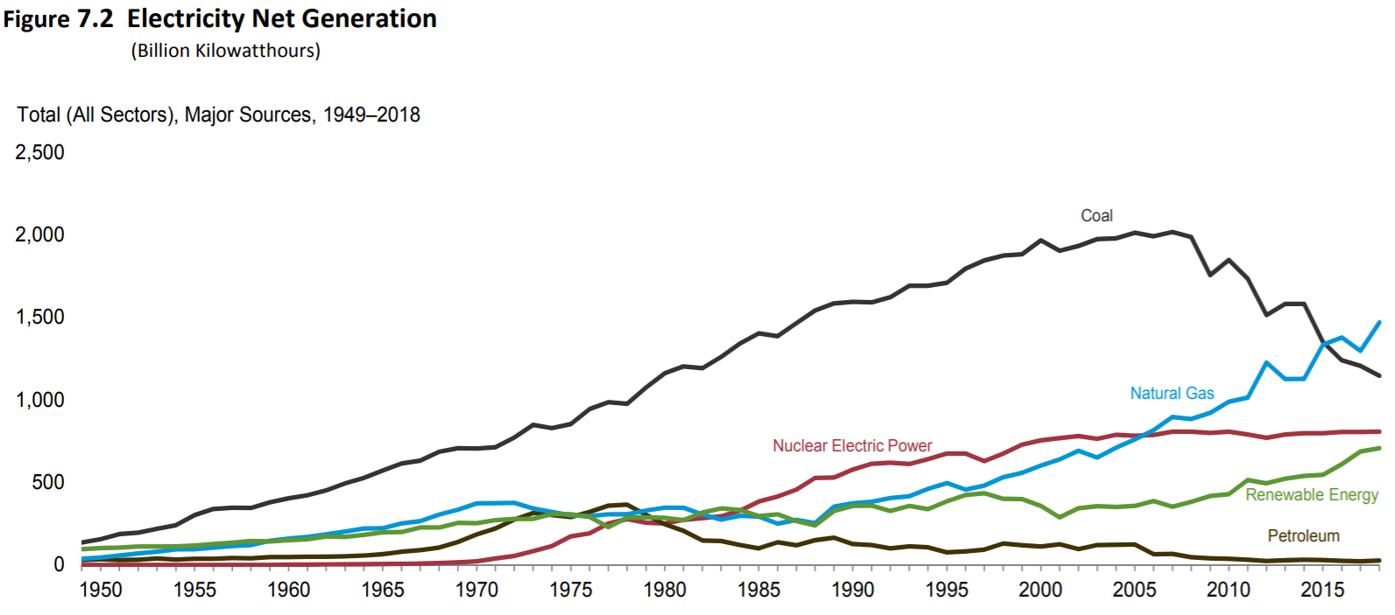
Nuclear Power in the U.S.
96 nuclear fission reactors currently operating (about 98 GW)
Around 20% of the nation’s total electric energy generation
• Nuclear accounts for ~60% of U.S. emission -free energy generation
(2020) US Energy Information Administration
https://www.eia.gov/totalenergy/data/monthly/pdf/sec8_3.pdf
https://www.eia.gov/totalenergy/data/monthly/pdf/mer.pdf

Slide 3
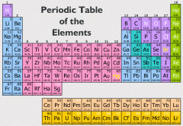
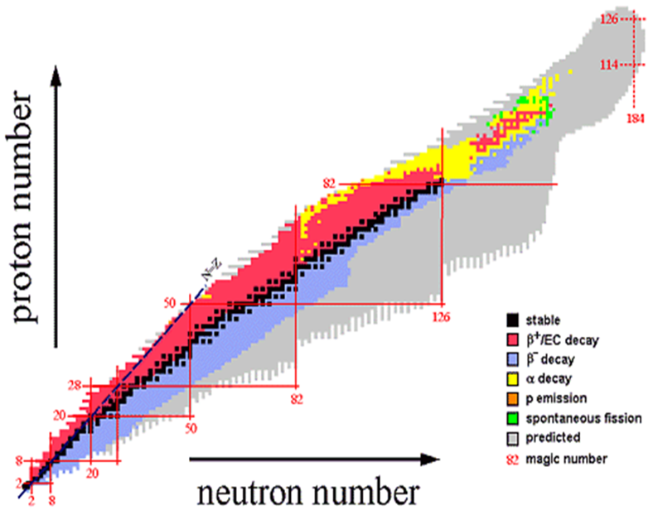
Fundamentals of Nuclear Reactions
All elements have isotopes, large range of stabilities
Radioactive decay occurs in unstable isotopes, resulting in spontaneous emission of particles and/or electromagnetic radiation
Repulsive force between protons must be balanced by a strong attractive force for nuclei stability
http://fys246.nuclear.lu.se/topics.asp

Slide 4
Barriers in Nuclear Reactions
Charged particles must overcome electrostatic potential energy barrier for nuclear reactions to occur
  Barrier scales with Z, on the order of a few MeV per proton pair
  abundance of charged reactants (e.g. protons in elements)
  Can overcome barrier with kinetic energy, propelled by electromagnetic fields of an accelerator etc.
Neutral particles have no electrostatic potential barrier
  Neutrons require less kinetic energy to initiate nuclear reactions
  Free neutron is short lived (lifetime ~15 min), therefore source is required for any use of neutrons

Slide 5
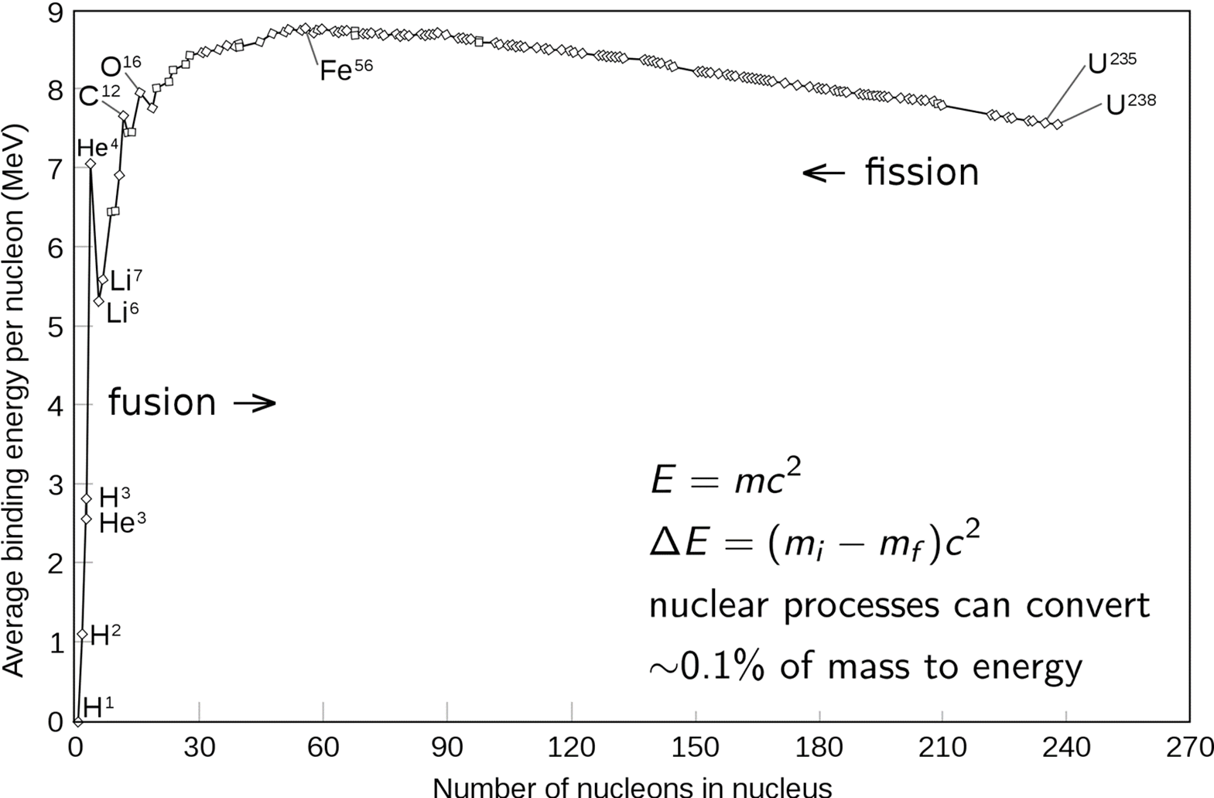
Binding Energy
Nuclear transmutations release energy equal to the difference between binding energy of nuclei in final and initial states

Slide 6
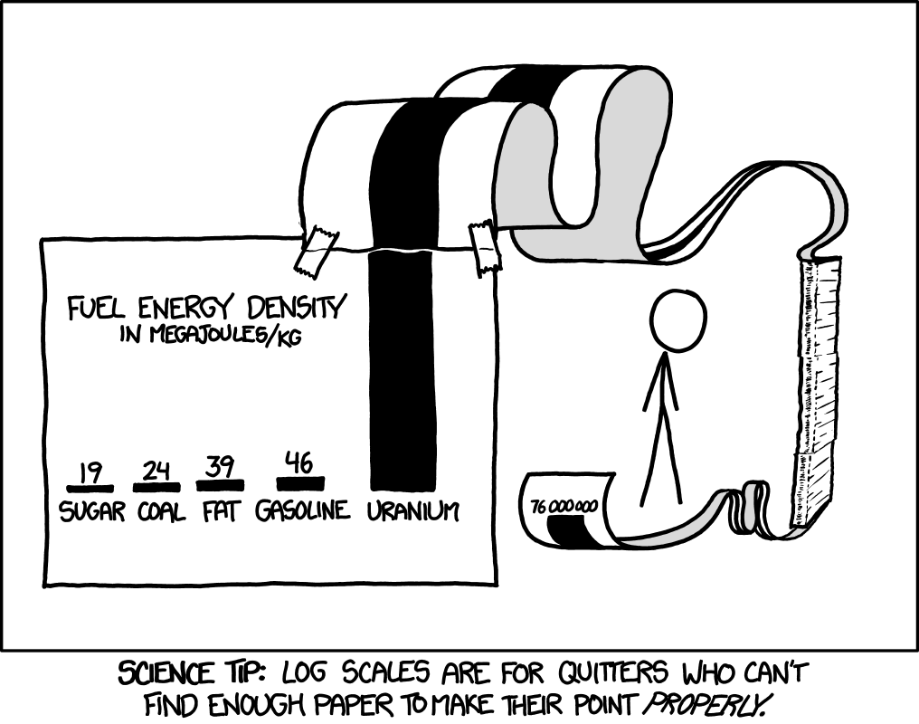

Mass-Energy Equivalence
$$E_{0}=mc^{2}$$
Energy of nuclear decay comes from mass conversion, on the energy scale of MeV (1.6⨯10⁻¹³ J) released for every nuclear reaction

Slide 7
Fission Reactor Basics
Thermal neutrons are captured by fissile fuel
Fast neutrons are slowed by the moderator
Fuel fissions, releasing fast neutrons and energy

Slide 8
Fission Reactor Fuels
Fissionable
(can fission)
Many actinide isotopes
Fertile
(can be converted to fissile fuel)
²³⁵U
²³³U
²³²Th
²³⁹Pu
²⁴¹Pu
²³⁸U
²³⁴U
Fissile
(can sustain fission chain reaction)
Notes:
Just showing naturally occurring fertile material

Slide 9
Fission Reactor Fuels
²³⁵U
  • Naturally occurring but in low abundance
  • Used in D₂O reactors (unenriched uranium) or light water reactors (enriched uranium)
  • Requires thermal (slow) neutrons for adequate fission
  • World’s primary nuclear fissile fuel
²³⁹Pu
  • Bred from ²³⁸U (which is naturally occurring, large abundance)
  • Smaller critical mass, cheaper than enriched ²³⁵U : used in nuclear weapons
²³³U
  • Bred from ²³²Th which is ~3-4 times more abundant than uranium on Earth
  • Can be bred using fast neutrons or thermal neutrons

Slide 10
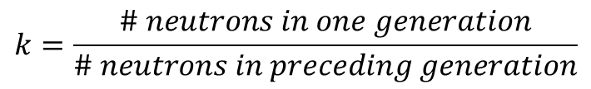
Important Reactor Parameters
Neutron energy
Thermal: 0.025 eV, typical speed after being moderated
Fast: >1 MeV, typical speed when emitted from fission
Neutron cross section
Likelihood of interaction between neutron and target nucleus
Cross sections for capture, for scattering, for fission etc.
Highly dependent on neutron energy
Neutron flux
Amount of neutrons produced per area per time
Fission reactor < fusion reactor ≤ accelerator driven system
Neutron multiplication factor k
$$k=\frac{\# neutrons in one generation}{\# neutrons in preceding generation}$$
Subcritical: k<1 Critical: k=1 Supercritical: k>1
Notes:
Tradeoffs abound: high flux, easier to burn up waste products, easier for 2 neutron capture etc.; low flux, sometimes easier for desired fission to occur

Slide 11
The Thorium Option
Fission reactors can burn ²³⁵U, ²³⁹Pu, OR ²³³U from breeder
Breeder reactors
Fast neutrons + ²³⁸U → ²³⁹Pu
Uses fertile material to produce more fissile material than it consumes.
or
Fast/Thermal neutrons + ²³²Th → ²³³U
"Thorium is like wet wood […it] needs to be turned into fissile uranium just as wet wood needs to be dried in a furnace."
Potential benefits include
-safety
-economy
-efficiency

Slide 12
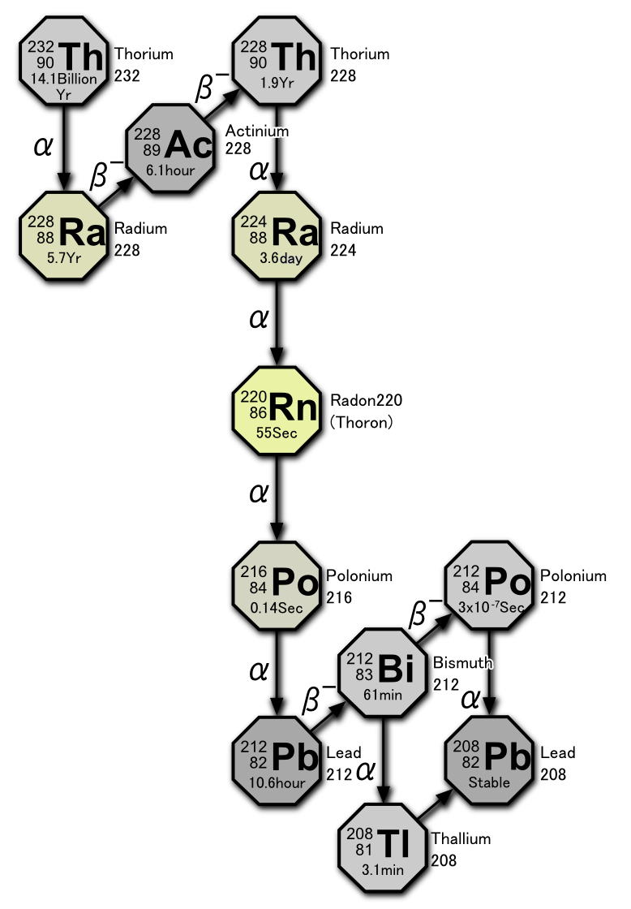
Thorium Series Decay Chain
Stable, end of series
https://en.wikipedia.org/wiki/Thorium_fuel_cycle#Fission_product_wastes

Slide 13
Thorium Fuel Cycle
Require small amount of initial fissile fuel
$${}_{90}^{232}{Th}+n→{}_{90}^{233}{Th \frac{β^{−}}{22 min}}→{}_{91}^{233}{Pa }\frac{β^{−}}{27.4 d}→{}_{92}^{233}U$$
Neutrons contribute to breeding
Fissions with thermal neutrons
Neutrons & Energy

Slide 14
Fuel Abundance: Uranium vs. Thorium
Naturally occurring isotopes
 | Isotopic Abundance on Earth | Half Life (years)
²³⁸U | 99.27% | 4.5 billion
²³⁵U | 0.72% | 0.7 billion
²³²Th | 99.98% | 14 billion
²³⁰Th | 0.02% | 75 thousand
*
*
*
Uranium must be significantly enriched in ²³⁵U for typical fission reactor, or weapon
Desired isotope is already isotopically abundant AND
~3-4 times more abundant than uranium in the Earth’s crust
*3 of the 4 heavy primordial nuclides, formed in early solar system
“One ton of thorium could produce as much energy as 200 tons of uranium”
Carlo Rubia, Obama could kill fossil fuels overnight with a nuclear dash for thorium
Notes:
237Np is the other decay series for Z>83, half life only 2 million years so it’s been completely exhausted by now

Slide 15
Radioactive Waste in Fission Reactions
In a reactor, neutrons hits fissile fuel and either split the nucleus or get captured and transmute the atom
Uranium-Plutonium Fuel Cycle
Large probability of neutron capture leading to transuranic waste (high radioactivity)
Capture-to-fission ratio for ²³⁵U is about 1:6, ²³⁹Pu and ²⁴²Pu about 1:3
Thorium Fuel Cycle
Less transuranic waste formed, generally shorter half-life waste, and minimization of plutonium creation
Capture-to-fission ratio for ²³³U (bred from thorium) is about 1:12
Additionally, thorium mining produces much less waste than uranium mining

Slide 16
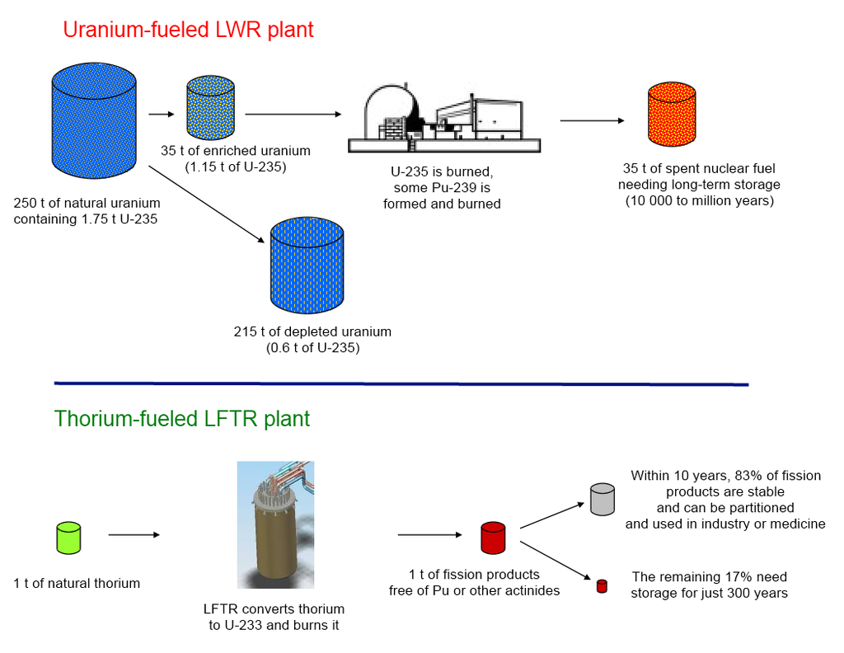
Annual Fuel Requirements for 1 GW Plant
https://thoriumenergyalliance.com/

Slide 17
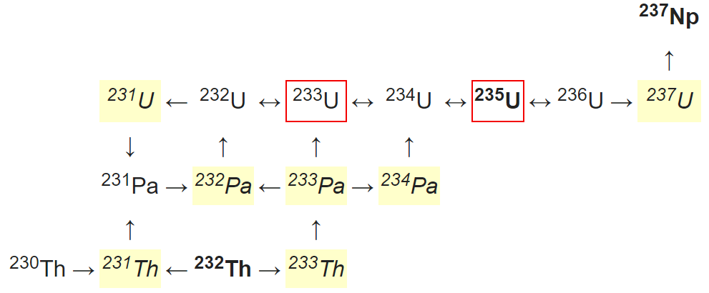
Transmutations in the Thorium Fuel Cycle
²³²U “contamination”
Can’t be separated from ²³³U but is a hard gamma ray emitter, can destroy nearby electronics → can’t be used in nukes
Contamination could be avoided by removing ²³³Pa before it can decay to ²³²U. Could be easily facilitated by a molten salt reactor
Half-lives <30 days
Half-lives >1 million years
Fissile

Slide 18
(Brief) Thorium Reactor History
Molten Salt Reactor Experiment (MSRE) at ORNL during the 1960s
  7.4 MW, graphite moderator, LiF-BeF₂-ZrF₄-UF₄ molten salt, ²³³U thorium bred
  Born out of the (failed) Aircraft Reactor Experiment, the first MSR
  MSRE was the first to use ²³³U, demonstrating a molten salt design as viable
However in 1973, US gov decides to end research on thorium reactors citing that uranium research was already well proven and understood.
The likely reason? Thorium systems lacked weapons applications
Notes:
Post-WWII, uranium reactors begin to be built for electricity production. ARE was a 2.5MW MSR

Slide 19
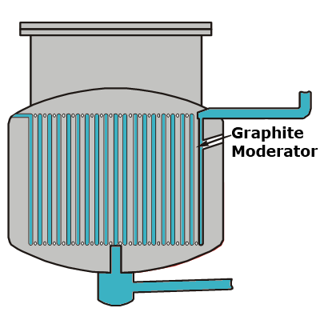
Liquid Fluoride Thorium Reactors (LFTRs)
Fluoride-based, molten liquid salt mixed with thorium
Require small initial amount of fissile material to “charge” breeding cycle
Single Fluid Reactor
Large vessel contains molten salt fuel and graphite moderator
Requires extensive fuel reprocessing and higher fissile inventory
Two Fluid Reactor
High-neutron-density core burns ²³³U
Outer blanket of thorium molten salt slowly breeds ²³³U which can be then injected into the core
A LFTR is usually designed as a breeder reactor: thorium goes in, fission products come out
No need to shutdown for refueling, just add fertile fuel on the go
Notes:
ORNL MSRE was a single fluid reactor

Slide 20
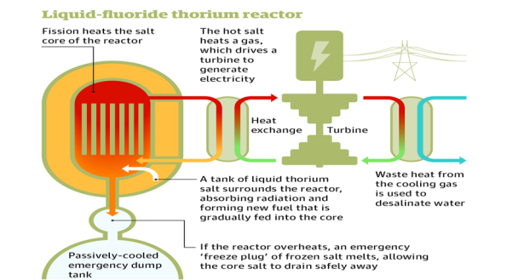
Liquid Fluoride Thorium Reactors (LFTRs)
Operating at over 700C, LFTR has higher efficiency in electricity conversion ~45%
→Rankine cycle or Brayton cycle
Thermal energy can also be used as high-grade industrial process heat
Notes:
Brayton cycle typically requires higher operating temperatures, ideal for LFTRs

Slide 21
Who’s Working on Thorium Reactors?
In North America
  Flibe Energy (U.S.A), Thorium Power inc., Moltex Energy (Canada)
  Research at ORNL, some funding through ARPA-E's MEITNER program too
R&D ongoing in multiple European countries, Russia
China
  Currently building two thorium reactors in the Gobi desert
  Likely being developed with help of American/Canadian private companies
India
  Has world’s largest supply of thorium, and very low uranium reserves
  Has detailed, government funded, plan to focus on thorium nuclear power
  Currently building multiple reactors capable of using thorium, earliest to reach criticality expected in next year
Notes:
Flibe Energy founded in 2011 by former Nasa engineer Kirk Sorensen

Slide 22
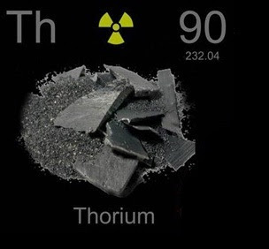
Global Sources of Thorium
3-4 times more abundant than ALL uranium isotopes
Top 5 countries by thorium reserves (estimates from USGS):
  India 960 kt
  U.S.A 440 kt
  Australia 300 kt
  Canada 100 kt
  South Africa 35 kt
U.S.A. likely has significantly more thorium deposits.
Thorium has already been produced in excess of demand from the refining of rare-earth elements
Notes:
Significant reburial of currently ‘useless’ thorium in Nevada desert

Slide 23
Issues Remain for Thorium
Nuclear energy industry already has a commercial fuel cycle developed around uranium-plutonium, which makes it cheaper to use uranium as fuel
Thermal breeder reactors and active online chemistry/waste removal in the thorium cycle is still not thoroughly vetted
Likely difficult to integrate thorium fuel cycle into majority of the world’s current reactors
Still promising due to:
Large abundance of fertile fuel, no enrichment required, efficient mining
Nuclear proliferation is difficult
Much less long-term radioactive waste formed
With LFTRs, higher reactor efficiency, non-pressurized system
Online refueling, therefore no downtime for fuel replacement. Could now also be used for load following
As of 2020, there are no operational thorium reactors in the world
Notes:
Look to the developing world to see large gains where thorium is the cheapest option. There, cost is the #1,2,3 issue.

Slide 24
References
Choppin, Liljenzin, Rydberg, Ekberg, Radiochemistry and Nuclear Chemistry
ARPA-E MEITNER program
DOE documents on thorium
Chart of Nuclides

