Slide 1

Porous Materials for
Energy Applications
Mandy Liu
HEJC
10/11/2019

Slide 2
What are Porous Materials?
Broadly define: porous materials are materials with internal voids
1 cm
1 cm
1 nm
Surface area: 6 cm²
Surface area: 6000 m²

Slide 3
Why Porous Materials?
High surface area: gas adsorption & storage
H₂ storage
CH₄ storage
CO₂ sequestration
H₂O adsorption (heat pump)
Gas molecules

Slide 4
Why Porous Materials?
Pore size/chemistry: physical & chemical separations/membrane technology
Conserve energy usage
Industrial energy consumption: 32770 TBtu/yr
Largest energy consumption sector, > 1/3 US energy use
22% of all in-plant energy use (4500 TBtu/yr) on separation technology
Harvest new energy sources
Uranium (nuclear energy source) mining from sea water (about 500 times more than land ores storage)
Materials for Separation Technologies: Energy and Emission Reduction Opportunities, US DOE
https://www.machinedesign.com/materials/uranium-extracted-seawater
Notes:
Materials for Separation Technologies: Energy and Emission Reduction Opportunities, US DOE

Slide 5
How to Generate Porosity?
Etching
(With acid/base)
Top-down approach
“extrinsic” porosity
Bottom-up approach
“intrinsic” porosity

Slide 6
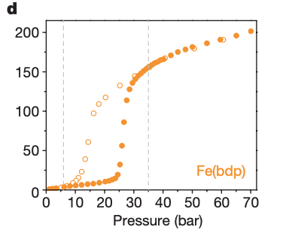
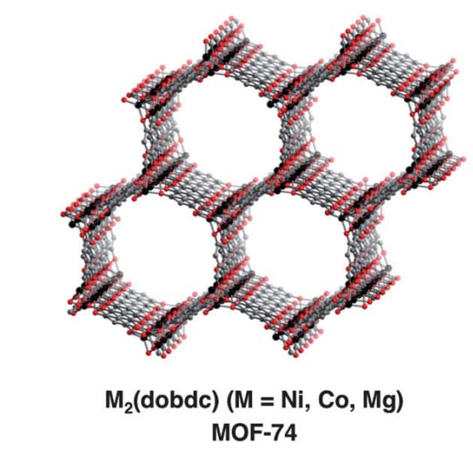
Characterization of Porous Materials
1,5 nm
Electron microscopy
Macropore (>50 nm)
Gas adsorption
Meso (> 2 nm) + micropore
Crystal structure
Micropore (< 2 nm)
http://www.atl.semtechsolutions.com/node/44/particle-pore-size-analysis
Mason, Oktawiec, Taylor, Hudson, Rodriguez, Bachman, Gonzalez, Cervellino, Guagliardi, Brown, Llewellyn, Masciocchi, Long, Nature, 2015, 527, 357
Mason, Veenstra, Long, Chem. Sci, 2014, 5, 32
Notes:
http://www.atl.semtechsolutions.com/node/44/particle-pore-size-analysis

Slide 7
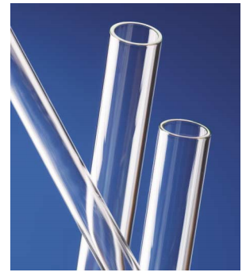
Types of Porous Materials
Elemental/atomic
Inorganic
Activated carbon
Up to 3000 m²/g
Drinking water filtration
Fuel (H₂/CH₄) storage
Corning ”thirsty” glass
250 m²/g
Water/organic contaminants absorption
Zeolites
< 1000 m²/g
Aluminosilicate, ex: Na₂Al₂Si₃O₁₀·2H₂O
Catalytic cracking for petroleum industry
Nuclear waste reprocessing
http://www.corningcn.com/docs/specialtymaterials/pisheets/Vycor%207930.pdf
Notes:
http://www.corningcn.com/docs/specialtymaterials/pisheets/Vycor%207930.pdf

Slide 8
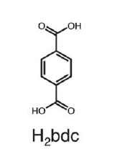
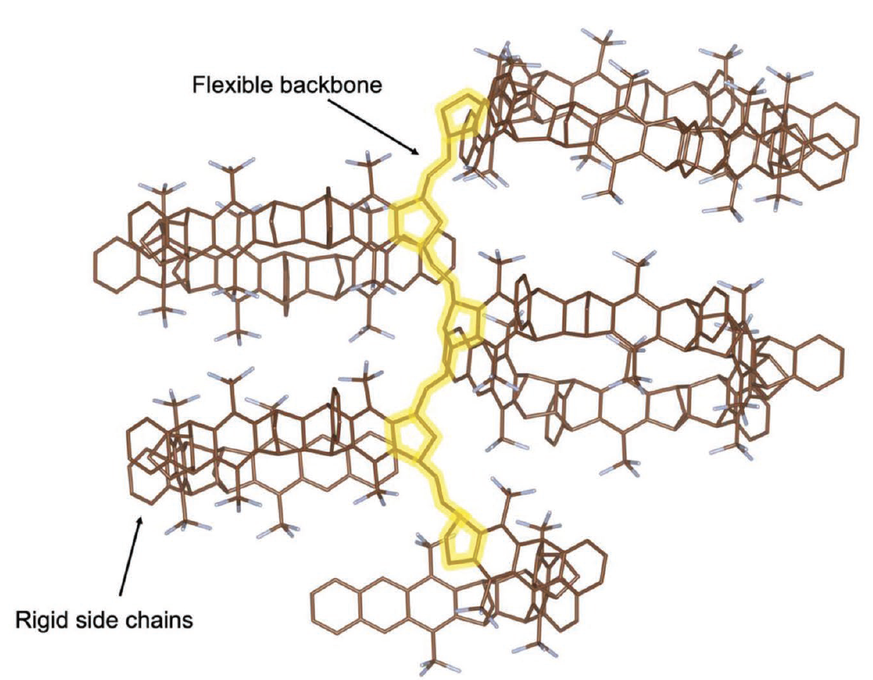
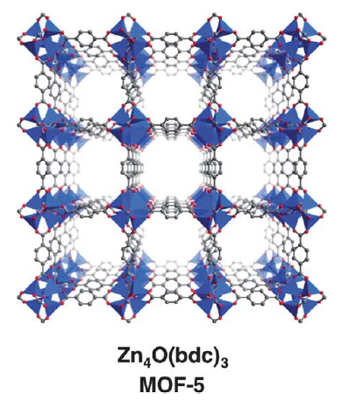
Types of Porous Materials
Organic
Metal-organic
Porous organic polymers (POPs)
Membrane applications
Gas permeability
Natural gas purification & carbon sequestration
Covalent organic frameworks (COFs)
Metal-organic frameworks (MOFs)
Metal centers introduce new chemistry (selectivity/reactivity)
Composite materials
He, Benedetti, Lin, Liu, Zhao, Ye, Voorhis, Angelis, Swager, Smith, Adv. Mater., 2019, 31, 1807871
https://phys.org/news/2015-09-exploration-stable-crystalline-porous-covalent.html
Mason, Veenstra, Long, Chem. Sci, 2014, 5, 32

Slide 9
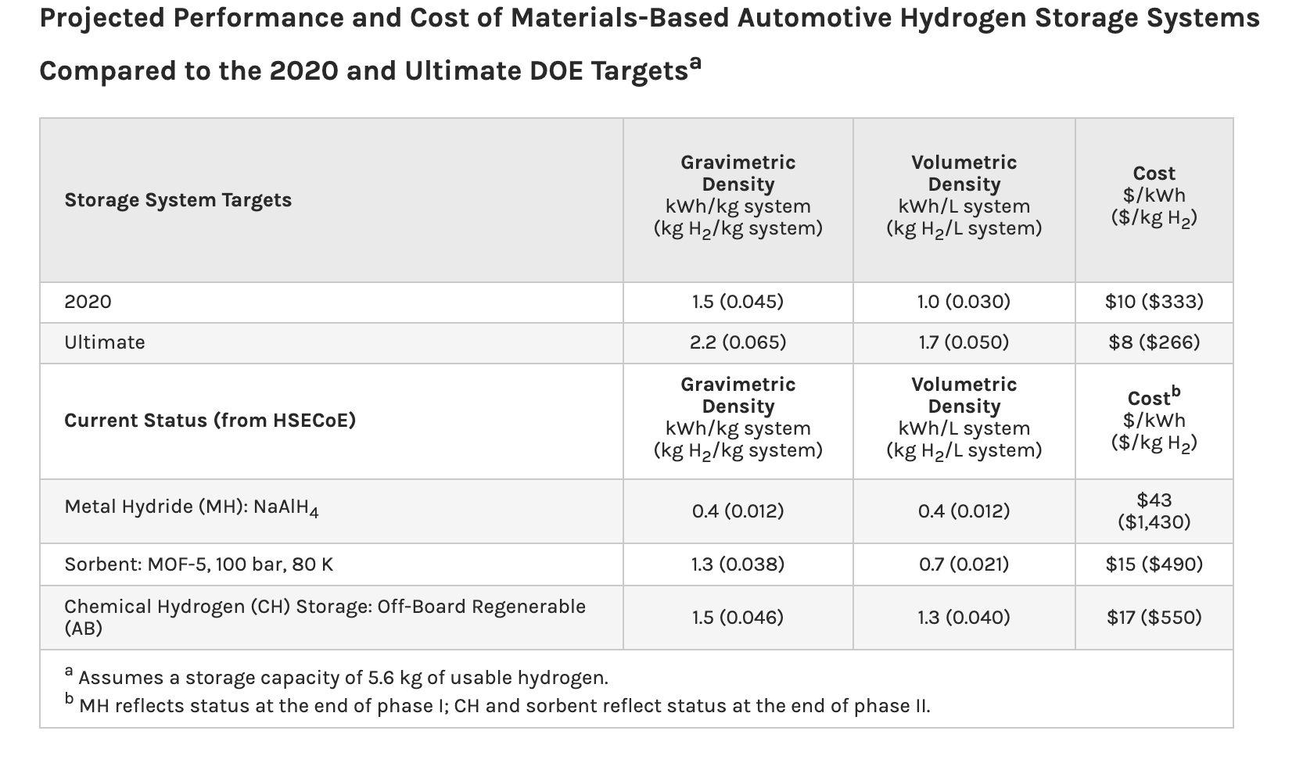
Case 1: Gas Storage with MOFs
Farha, Hupp & Snurr, Northwestern University,
https://www.youtube.com/watch?v=QaKSekjAnqY
Limitations of metal hydride/ chemical hydrogen storage: higher operational temperature
larger environmental impact
https://www.energy.gov/eere/fuelcells/materials-based-hydrogen-storage
Mason, Veenstra, Long, Chem. Sci, 2014, 5, 32

Slide 10
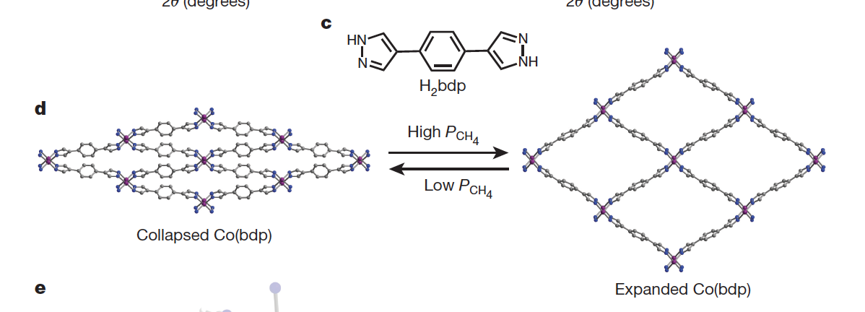
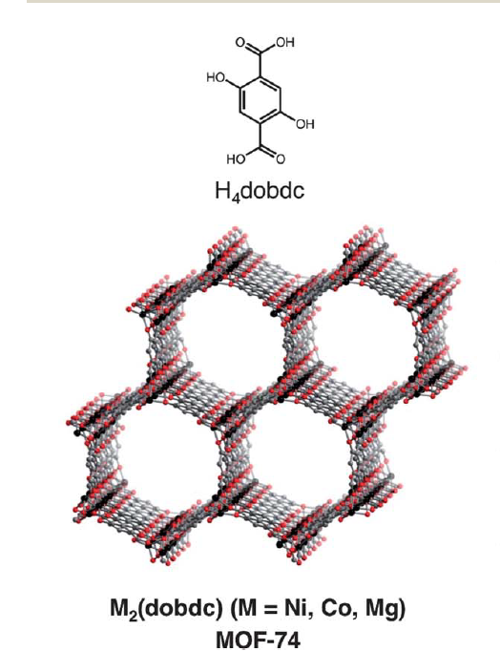
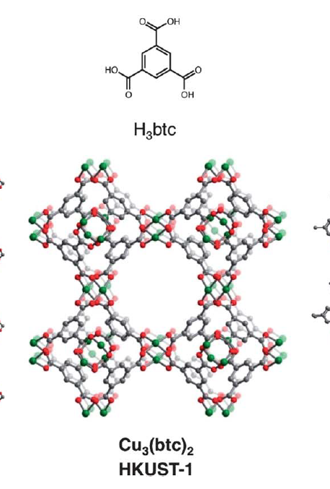
Case 1: Gas Storage with MOFs
Methane storage
2012 DOE goal: 350 cm_{STP}³cm_{adsorbent}³ (v/v)
Activated carbon: 100– 170 v/v
Zeolites lower due to lower surface area
MOFs with open active site: up to 230 v/v
Higher level of chemical design enabled by MOFs
Mason, Veenstra, Long, Chem. Sci, 2014, 5, 32
Mason, Oktawiec, Taylor, Hudson, Rodriguez, Bachman, Gonzalez, Cervellino, Guagliardi, Brown, Llewellyn, Masciocchi, Long, Nature, 2015, 527, 357

Slide 11
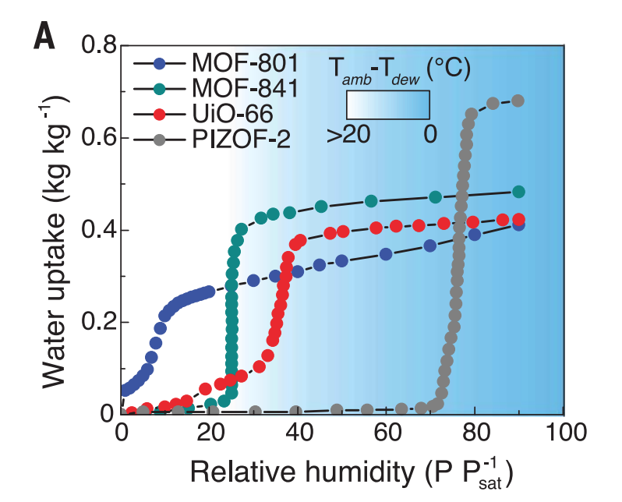
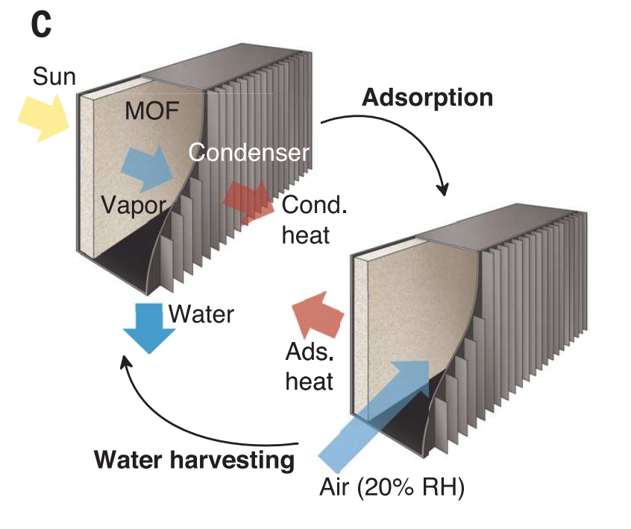
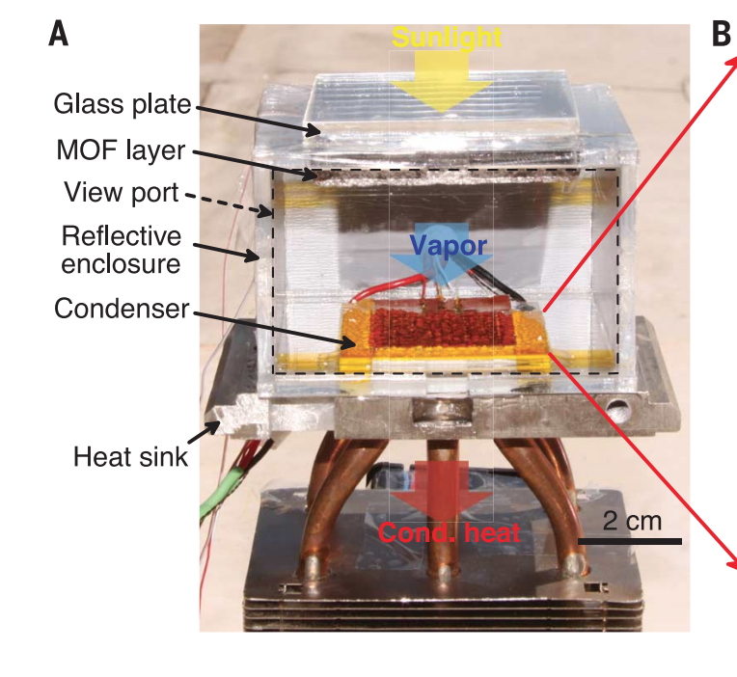
Case 2: Water-Adsorbing MOFs
Yaghi & Wang, UCB: water harvesting from desert
Uptake at low relative humidity (20% RH)
Desorption powered by the sun
Device cross section

Slide 12
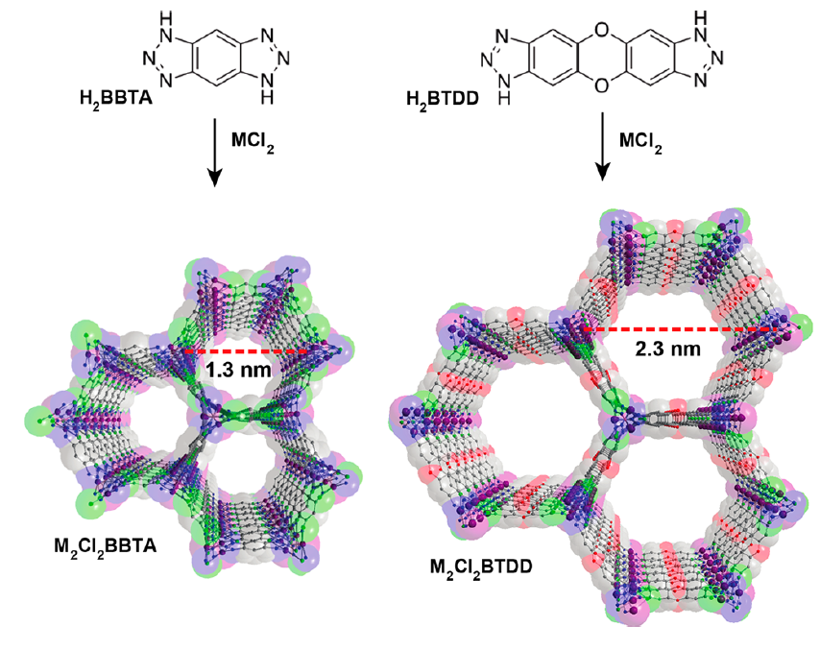
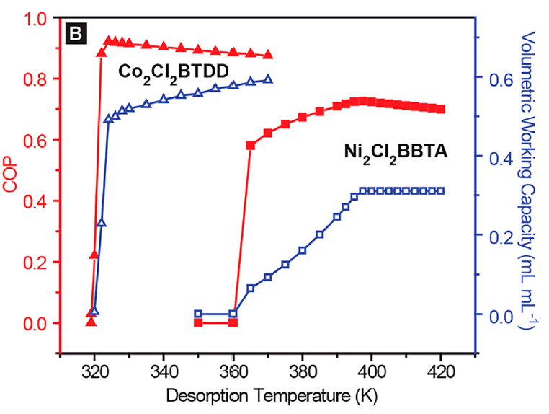
Case 2: Water-Adsorbing MOFs
Dinca, MIT
Adsorbent
Cascade heat pump
Adsorption heat pump
MOF adsorb water -> system heats up -> desorb water -> system pressurized -> water condense & absorb heat (cooling) -> T drops -> MOF adsorb water again
https://warwick.ac.uk/fac/sci/eng/research/grouplist/sustainableenergy/heatpumps/adsorption/
https://www.researchgate.net/figure/Simplified-Diagram-of-the-GHPWH-Absorption-Heat-Pump_fig2_320596506,
Rieth, Wright, Rao, Kim, LaPotin, Wang, Dinca, J. Am. Chem. Soc., 2018, 140, 17591
Notes:
Absorb water, heat up (ambient), desorb, pressurized, condense, absorb heat, cool down (ambient), absorb again
Improve efficiency
https://www.researchgate.net/figure/Simplified-Diagram-of-the-GHPWH-Absorption-Heat-Pump_fig2_320596506

Slide 13
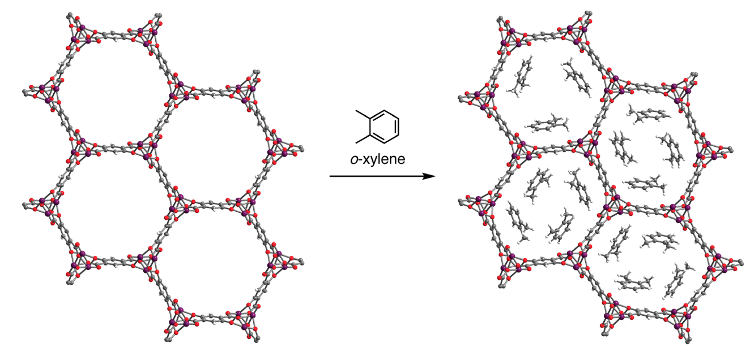
Case 3: Chemical Separation
O-xylene
P-xylene
M-xylene
Ethylbenzene
Gonzalez; Kapelewsk; Bloch.; Milner; Reed.; Hudson; Mason; Barin; Brown; Long, J. Am. Chem. Soc. 2018, 140, 3412.

Slide 14
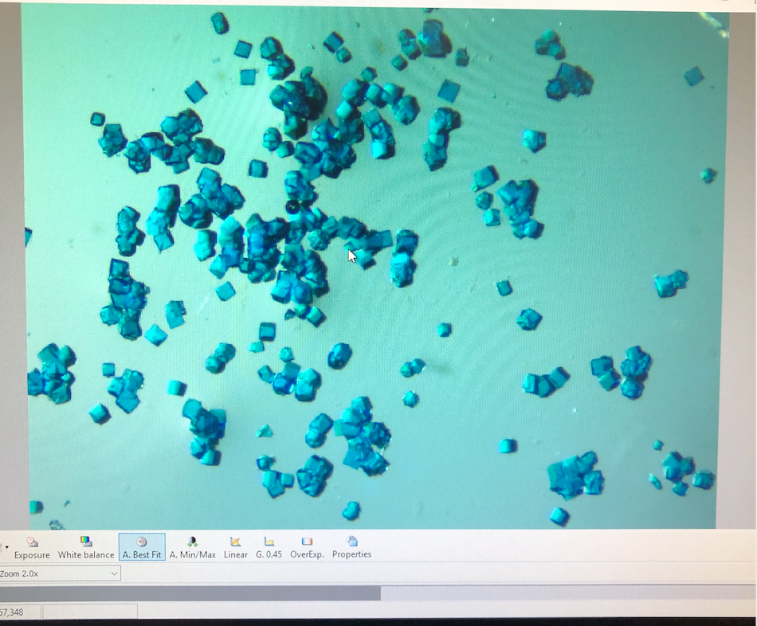
Why not more MOFs in the industry?
Nonuniformity (grain boundaries)
Undesirable mechanical property
  Fragile
  Brittle
Air/water/thermal stability
Cost (metal, synthetic)
Scalability
Better industrial future requires new chemistry & materials research
Low processability

Slide 15


Thank You! Questions?

