Slide 1
Nuclear fusion: basic physics and feasibility
Harvard Energy Journal Club
Emma Rosenfeld

Slide 2
What is nuclear fusion?

Slide 3
What is nuclear fusion?

Slide 4
What is nuclear fusion?

Slide 5
What is nuclear fusion?
Temperature condition
Electrons stripped off atoms → plasma

Slide 6
What is nuclear fusion?
Temperature condition
Confinement condition
(e.g., gravity)
Electrons stripped off atoms → plasma

Slide 7
What is nuclear fusion?
Lawson criteria:
Temperature condition
Confinement condition
(e.g., gravity)
Electrons stripped off atoms → plasma

Slide 8
Nuclear fusion reactors convert nuclear energy into heat
S. Entler et. al., Energy 152 (2018)

Slide 9
Nuclear fusion vs nuclear fission
Advantages of nuclear fusion reactors over fission reactors
https://www.iter.org/sci/Fusion

Slide 10
Nuclear fusion vs nuclear fission
Advantages of nuclear fusion reactors over fission reactors
More energy: 4 times more energy per unit mass than fission
https://www.iter.org/sci/Fusion

Slide 11
Nuclear fusion vs nuclear fission
Advantages of nuclear fusion reactors over fission reactors
More energy: 4 times more energy per unit mass than fission
Less nuclear waste: main by-product is helium. Other materials used can be recycled within 100 years
https://www.iter.org/sci/Fusion

Slide 12
Nuclear fusion vs nuclear fission
Advantages of nuclear fusion reactors over fission reactors
More energy: 4 times more energy per unit mass than fission
Less nuclear waste: main by-product is helium. Other materials used can be recycled within 100 years
More secure: you can’t make a nuclear weapon with the fuel
https://www.iter.org/sci/Fusion

Slide 13
Nuclear fusion vs nuclear fission
Advantages of nuclear fusion reactors over fission reactors
More energy: 4 times more energy per unit mass than fission
Less nuclear waste: main by-product is helium. Other materials used can be recycled within 100 years
More secure: you can’t make a nuclear weapon with the fuel
Safer: meltdowns are impossible (less fuel, no chain reaction)
https://www.iter.org/sci/Fusion

Slide 14
Nuclear fusion vs nuclear fission
Advantages of nuclear fusion reactors over fission reactors
More energy: 4 times more energy per unit mass than fission
Less nuclear waste: main by-product is helium. Other materials used can be recycled within 100 years
More secure: you can’t make a nuclear weapon with the fuel
Safer: meltdowns are impossible (less fuel, no chain reaction)
Similar cost per kWh
https://www.iter.org/sci/Fusion

Slide 15
Nuclear fusion vs nuclear fission
Advantages of nuclear fusion reactors over fission reactors
More energy: 4 times more energy per unit mass than fission
Less nuclear waste: main by-product is helium. Other materials used can be recycled within 100 years
More secure: you can’t make a nuclear weapon with the fuel
Safer: meltdowns are impossible (less fuel, no chain reaction)
Similar cost per kWh
Fuel is abundant (hydrogen, lithium and deuterium vs uranium & plutonium)
https://www.iter.org/sci/Fusion

Slide 16
Nuclear fusion vs nuclear fission
Advantages of nuclear fusion reactors over fission reactors
More energy: 4 times more energy per unit mass than fission
Less nuclear waste: main by-product is helium. Other materials used can be recycled within 100 years
More secure: you can’t make a nuclear weapon with the fuel
Safer: meltdowns are impossible (less fuel, no chain reaction)
Similar cost per kWh
Fuel is abundant (hydrogen, lithium and deuterium vs uranium & plutonium)
But: it’s hard to get to work!
https://www.iter.org/sci/Fusion

Slide 17
How does a nuclear fusion reactor compare to other energy sources?
Technology | $ / MWh (LCOE) (**)
Nuclear fusion (*) | 117
Onshore wind | 114
Solar | 162
Natural gas | 103
Coal | 93
S. Entler et. al., Energy 152 (2018)
https://ourworldindata.org/scale-for-electricity
https://www.eia.gov/todayinenergy/detail.php?id=34172#tab1
(*) For DEM02 model (ITER version 2)
(**) average costs – doesn’t include variance
Notes:
Fusion is 23% efficient (net electrical power output / (the fusion power, the power released during a tritium breeding, and the reradiated heating power)
The analysis within the used report is based on data for 181 operated plants in 22 countries (including 3 non-OECD countries) [7]. This includes 17 natural gas-fired generators (13 combined-cycle gas turbines CCGT and 4 open-cycle gas turbinesOCGT), 14 coal plants, 11 nuclear power plants, 12 solar large photovoltaic plants, and 21 onshore and 12 offshore wind plants.
LCOE= the average total cost to build and operate a power-generating asset over its lifetime divided by the total energy output of the asset over that lifetime

Slide 18
How does a nuclear fusion reactor compare to other energy sources?
Technology | $ / MWh (LCOE) (**) | External cost $ / MWh (**)
Nuclear fusion (*) | 117 | 1
Onshore wind | 114 | 4.7
Solar | 162 | 16
Natural gas | 103 | 39
Coal | 93 | 100
S. Entler et. al., Energy 152 (2018)
https://ourworldindata.org/scale-for-electricity
https://www.eia.gov/todayinenergy/detail.php?id=34172#tab1
(*) For DEM02 model (ITER version 2)
(**) average costs – doesn’t include variance
Notes:
23% efficiency is net electrical power output / (the fusion power, the power released during a tritium breeding, and the reradiated heating power)
The analysis within the used report is based on data for 181 operated plants in 22 countries (including 3 non-OECD countries) [7]. This includes 17 natural gas-fired generators (13 combined-cycle gas turbines CCGT and 4 open-cycle gas turbinesOCGT), 14 coal plants, 11 nuclear power plants, 12 solar large photovoltaic plants, and 21 onshore and 12 offshore wind plants.
external cost = cost from impact to environment from the technology’s use. damage to human health (increased risk of mortality and morbidity), effects on ecosystems and biodiversity (changes in the environment, biodiversity loss) and the impact on resources and depletion (mainly of water, metals and fuels, but also crops, buildings, etc.). The impacts include climate change, ozone depletion, soil acidification, eutrophication of freshwater and marine environments, increasing the toxicity of the environment, increasing background radiation, land appropriation, annexation of areas in cities, transforming the natural soil, depletion of water resources, depletion of mineral deposits, exploitation of energy resources and disasters and accidents [8]

Slide 19
How does a nuclear fusion reactor compare to other energy sources?
Technology | $ / MWh (LCOE) (**) | External cost $ / MWh (**) | Energy output per farm per day (MWh)
Nuclear fusion (*) | 117 | 1 | 2 x 10⁴
Onshore wind | 114 | 4.7 | 100-10⁴
Solar | 162 | 16 | 100-10⁴
Natural gas | 103 | 39 | 10-10⁵
Coal | 93 | 100 | 10³-10⁵
S. Entler et. al., Energy 152 (2018)
https://ourworldindata.org/scale-for-electricity
https://www.eia.gov/todayinenergy/detail.php?id=34172#tab1
(*) For DEM02 model (ITER version 2)
(**) average costs – doesn’t include variance
Notes:
23% efficiency is net electrical power output / (the fusion power, the power released during a tritium breeding, and the reradiated heating power)
The analysis within the used report is based on data for 181 operated plants in 22 countries (including 3 non-OECD countries) [7]. This includes 17 natural gas-fired generators (13 combined-cycle gas turbines CCGT and 4 open-cycle gas turbinesOCGT), 14 coal plants, 11 nuclear power plants, 12 solar large photovoltaic plants, and 21 onshore and 12 offshore wind plants.
Upper end of energy output are really extreme cases

Slide 20
How does a nuclear fusion reactor compare to other energy sources?
Technology | $ / MWh (LCOE) (**) | External cost $ / MWh (**) | Energy output per farm per day (MWh) | Maintenance and security
Nuclear fusion (*) | 117 | 1 | 2 x 10⁴ | Poor – disruptions, neutron damage
Onshore wind | 114 | 4.7 | 100-10⁴ | ok
Solar | 162 | 16 | 100-10⁴ | ok
Natural gas | 103 | 39 | 10-10⁵ | good
Coal | 93 | 100 | 10³-10⁵ | good
S. Entler et. al., Energy 152 (2018)
https://ourworldindata.org/scale-for-electricity
https://www.eia.gov/todayinenergy/detail.php?id=34172#tab1
(*) For DEM02 model (ITER version 2)
(**) average costs – doesn’t include variance
Notes:
23% efficiency is net electrical power output / (the fusion power, the power released during a tritium breeding, and the reradiated heating power)
The analysis within the used report is based on data for 181 operated plants in 22 countries (including 3 non-OECD countries) [7]. This includes 17 natural gas-fired generators (13 combined-cycle gas turbines CCGT and 4 open-cycle gas turbinesOCGT), 14 coal plants, 11 nuclear power plants, 12 solar large photovoltaic plants, and 21 onshore and 12 offshore wind plants.

Slide 21
How does a nuclear fusion reactor compare to other energy sources?
Technology | $ / MWh (LCOE) (**) | External cost $ / MWh (**) | Energy output per farm per day (MWh) | Maintenance and security | Investment cost up front ($1000/kWe)
Nuclear fusion (*) | 117 | 1 | 2 x 10⁴ | Poor – disruptions, neutron damage | 6
Onshore wind | 114 | 4.7 | 100-10⁴ | ok | 2.3
Solar | 162 | 16 | 100-10⁴ | ok | 1.9
Natural gas | 103 | 39 | 10-10⁵ | good | 1.1
Coal | 93 | 100 | 10³-10⁵ | good | 2.1
S. Entler et. al., Energy 152 (2018)
https://ourworldindata.org/scale-for-electricity
https://www.eia.gov/todayinenergy/detail.php?id=34172#tab1
(*) For DEM02 model (ITER version 2)
(**) average costs – doesn’t include variance

Slide 22
Where are fusion reactors currently in the world?
https://fusionforenergy.europa.eu

Slide 23

JET
-700 MW
Where are the fusion reactor labs in the world?
$> 14bn
2035
500 MW
DIII-D
R&D
Testing plasma shapes
https://fusionforenergy.europa.eu

Slide 24
Physics challenges of nuclear fusion* & how they affect implementation
AAAS public release Dec 6, 2018
(*) magnetic confinement reactors
Large size for surface area/volume heat containment
Slow R&D: multiple decades until we see one working in the field
https://www.iaea.org/newscenter/news/fusion-energy-in-the-21st-century-status-and-the-way-forward
DOI: 10.5772/intechopen.80241
Notes:
Need large magnetic field for confinement: superconducting magnets
Heating techniques:
Heating by injection of neutral beams: In this method, neutralized particles with high kinetic energy, produced in an ion source, are injected into the plasma, whereby they transfer their energy to the plasma through collisions.
Heating by high-frequency radio or microwaves: When electromagnetic waves of appropriate frequency are beamed into the plasma, the plasma particles absorb energy from the field of the wave and transfer it to the other particles through collisions.
Heating with current: When an electric current is passed through the plasma, it generates heat in the plasma through its resistance. As the resistance decreases with increasing temperature, this method is only suitable for initial heating.
These methods produce temperatures of 100 million degrees Celsius in present-day fusion devices.
(https://www.intechopen.com/books/nuclear-fusion-one-noble-goal-and-a-variety-of-scientific-and-technological-challenges/nuclear-fusion-holy-grail-of-energy)
There’s also other types of reactors like inertial confinement fusion where optical forces (high power lasers) are used instead of magnetic ones

Slide 25
Physics challenges of nuclear fusion* & how they affect implementation
AAAS public release Dec 6, 2018
(*) magnetic confinement reactors
Large size for surface area/volume heat containment
Neutron flux damage to container walls
Slow R&D: multiple decades until we see one working in the field
Need to replace parts quite often – reduces capacity
https://www.iaea.org/newscenter/news/fusion-energy-in-the-21st-century-status-and-the-way-forward
DOI: 10.5772/intechopen.80241
Notes:
Need large magnetic field for confinement: superconducting magnets
Heating techniques:
Heating by injection of neutral beams: In this method, neutralized particles with high kinetic energy, produced in an ion source, are injected into the plasma, whereby they transfer their energy to the plasma through collisions.
Heating by high-frequency radio or microwaves: When electromagnetic waves of appropriate frequency are beamed into the plasma, the plasma particles absorb energy from the field of the wave and transfer it to the other particles through collisions.
Heating with current: When an electric current is passed through the plasma, it generates heat in the plasma through its resistance. As the resistance decreases with increasing temperature, this method is only suitable for initial heating.
These methods produce temperatures of 100 million degrees Celsius in present-day fusion devices.
(https://www.intechopen.com/books/nuclear-fusion-one-noble-goal-and-a-variety-of-scientific-and-technological-challenges/nuclear-fusion-holy-grail-of-energy)
There’s also other types of reactors like inertial confinement fusion where optical forces (high power lasers) are used instead of magnetic ones

Slide 26
Physics challenges of nuclear fusion* & how they affect implementation
AAAS public release Dec 6, 2018
(*) magnetic confinement reactors
Large size for surface area/volume heat containment
Neutron flux damage to container walls
Heat conduction of walls in the presence of neutrons
Slow R&D: multiple decades until we see one working in the field
Need to replace parts quite often – reduces capacity
Hit in efficiency
https://www.iaea.org/newscenter/news/fusion-energy-in-the-21st-century-status-and-the-way-forward
DOI: 10.5772/intechopen.80241
Notes:
Need large magnetic field for confinement: superconducting magnets
Heating techniques:
Heating by injection of neutral beams: In this method, neutralized particles with high kinetic energy, produced in an ion source, are injected into the plasma, whereby they transfer their energy to the plasma through collisions.
Heating by high-frequency radio or microwaves: When electromagnetic waves of appropriate frequency are beamed into the plasma, the plasma particles absorb energy from the field of the wave and transfer it to the other particles through collisions.
Heating with current: When an electric current is passed through the plasma, it generates heat in the plasma through its resistance. As the resistance decreases with increasing temperature, this method is only suitable for initial heating.
These methods produce temperatures of 100 million degrees Celsius in present-day fusion devices.
(https://www.intechopen.com/books/nuclear-fusion-one-noble-goal-and-a-variety-of-scientific-and-technological-challenges/nuclear-fusion-holy-grail-of-energy)
There’s also other types of reactors like inertial confinement fusion where optical forces (high power lasers) are used instead of magnetic ones

Slide 27
Physics challenges of nuclear fusion* & how they affect implementation
AAAS public release Dec 6, 2018
(*) magnetic confinement reactors
Large size for surface area/volume heat containment
Neutron flux damage to container walls
Heat conduction of walls in the presence of neutrons
Maintaining temperature and confinement conditions
Slow R&D: multiple decades until we see one working in the field
Need to replace parts quite often – reduces capacity
Hit in efficiency
Cost, capacity (goal running time of ITER is ~8min)
https://www.iaea.org/newscenter/news/fusion-energy-in-the-21st-century-status-and-the-way-forward
DOI: 10.5772/intechopen.80241
Notes:
Need large magnetic field for confinement: superconducting magnets
Heating techniques:
Heating by injection of neutral beams: In this method, neutralized particles with high kinetic energy, produced in an ion source, are injected into the plasma, whereby they transfer their energy to the plasma through collisions.
Heating by high-frequency radio or microwaves: When electromagnetic waves of appropriate frequency are beamed into the plasma, the plasma particles absorb energy from the field of the wave and transfer it to the other particles through collisions.
Heating with current: When an electric current is passed through the plasma, it generates heat in the plasma through its resistance. As the resistance decreases with increasing temperature, this method is only suitable for initial heating.
These methods produce temperatures of 100 million degrees Celsius in present-day fusion devices.
(https://www.intechopen.com/books/nuclear-fusion-one-noble-goal-and-a-variety-of-scientific-and-technological-challenges/nuclear-fusion-holy-grail-of-energy)
There’s also other types of reactors like inertial confinement fusion where optical forces (high power lasers) are used instead of magnetic ones

Slide 28
Physics challenges of nuclear fusion* & how they affect implementation
AAAS public release Dec 6, 2018
(*) magnetic confinement reactors
This HEJC: Nature 568, 526-529 (2019)
Large size for surface area/volume heat containment
Neutron flux damage to container walls
Heat conduction of walls in the presence of neutrons
Maintaining temperature and confinement conditions
Disruptions
Slow R&D: multiple decades until we see one working in the field
Need to replace parts quite often – reduces capacity
Hit in efficiency
Cost, capacity (goal running time of ITER is ~8min)
Reactor breaks after ~5 disruptions → cost & energy security
https://www.iaea.org/newscenter/news/fusion-energy-in-the-21st-century-status-and-the-way-forward
DOI: 10.5772/intechopen.80241
Notes:
Need large magnetic field for confinement: superconducting magnets
Heating techniques:
Heating by injection of neutral beams: In this method, neutralized particles with high kinetic energy, produced in an ion source, are injected into the plasma, whereby they transfer their energy to the plasma through collisions.
Heating by high-frequency radio or microwaves: When electromagnetic waves of appropriate frequency are beamed into the plasma, the plasma particles absorb energy from the field of the wave and transfer it to the other particles through collisions.
Heating with current: When an electric current is passed through the plasma, it generates heat in the plasma through its resistance. As the resistance decreases with increasing temperature, this method is only suitable for initial heating.
These methods produce temperatures of 100 million degrees Celsius in present-day fusion devices.
(https://www.intechopen.com/books/nuclear-fusion-one-noble-goal-and-a-variety-of-scientific-and-technological-challenges/nuclear-fusion-holy-grail-of-energy)
There’s also other types of reactors like inertial confinement fusion where optical forces (high power lasers) are used instead of magnetic ones

Slide 29
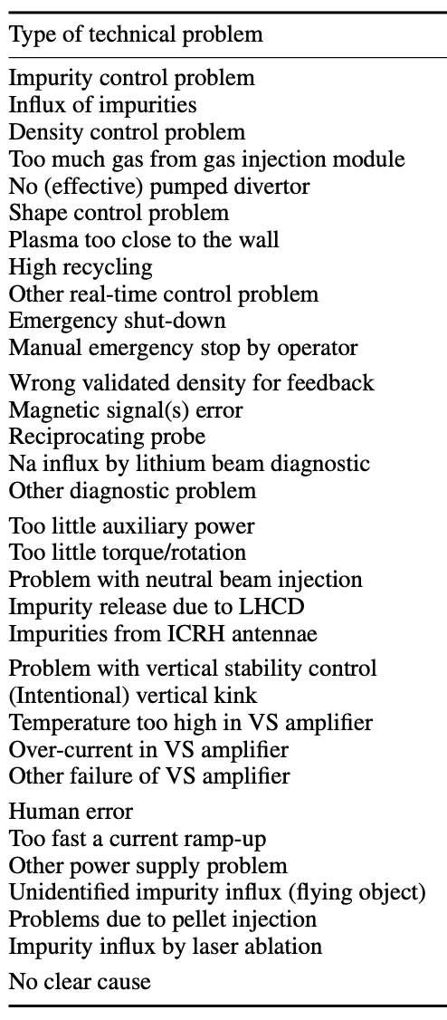
What is a disruption & why are they hard to predict?
Disruption = any plasma instability that causes the plasma to be misdirected
  Heat distribution quickly changes, adding mechanical stress and heat
  Sudden change in charged particle density introduces large current (~MA)
Causes: some physical (sometimes, magnetic field lines overlap), many technical →
Challenging to predict: highly nonlinear & complex system
  Very computationally expensive to simulate and predict
  Physics model & state must be known extremely well to simulate accurately
P.C. de Vries et al 2011 Nucl. Fusion 51 053018

Slide 30
J. Kates-Harbeck et. al., Nature 568, 2019: take-aways
Deep learning can be used to predict plasma breakdowns in a nuclear fusion reactor
Lots of high-dimensional data (e.g., magnetic profile along the plasma) is required for the accuracy & speed that makes implementation practical
One example of how deep learning models can be used to capture emergent phenomena in non-linear, highly complex systems
Possibility to scale to control of the reactor (mitigate breakdowns fully)

Slide 31
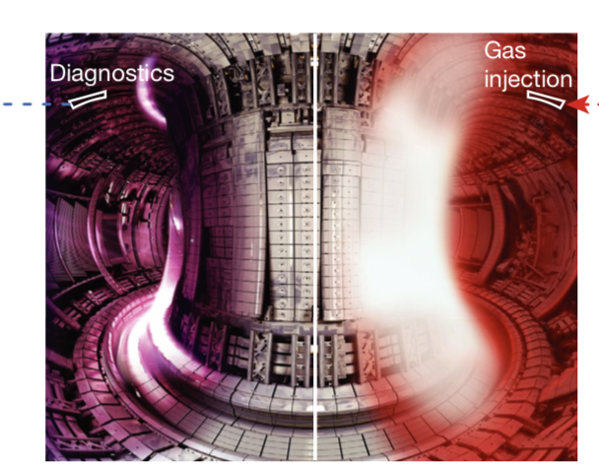
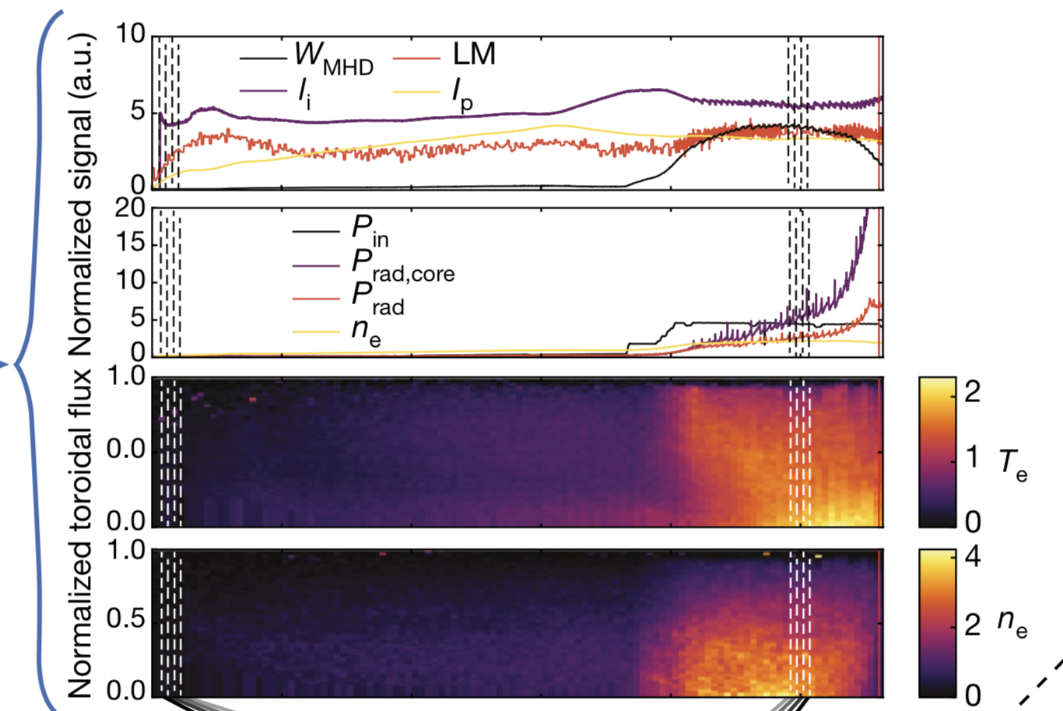
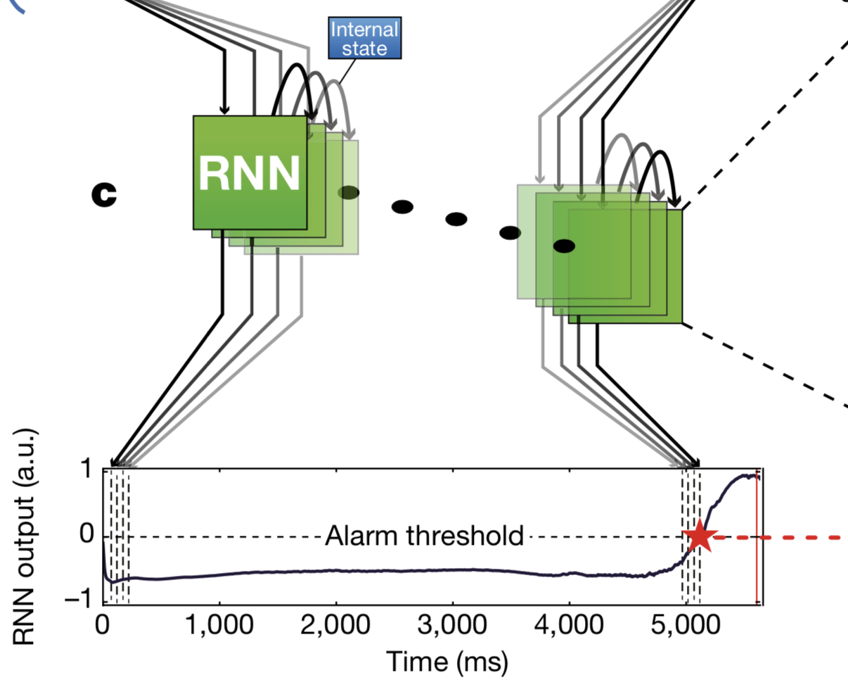
The envisioned workflow for plasma control (fig. 1)
J. Kates-Harbeck et. al., Nature 568, 2019
Sensors
Control parameter
Scalar data (e.g., temperature)
Deep learning algorithm
1D data (e.g., magnetic profile)

Slide 32
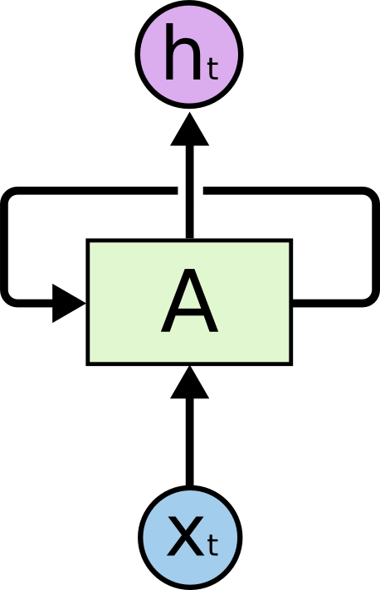
J. Kates-Harbeck et. al., Nature 568, 2019
Deep learning architectures used:
convolutional neural networks & recurrent neural networks
CNN
RNN
Pattern recognition, dealing with high dimensional data
Retaining temporal information, contextual information

Slide 33
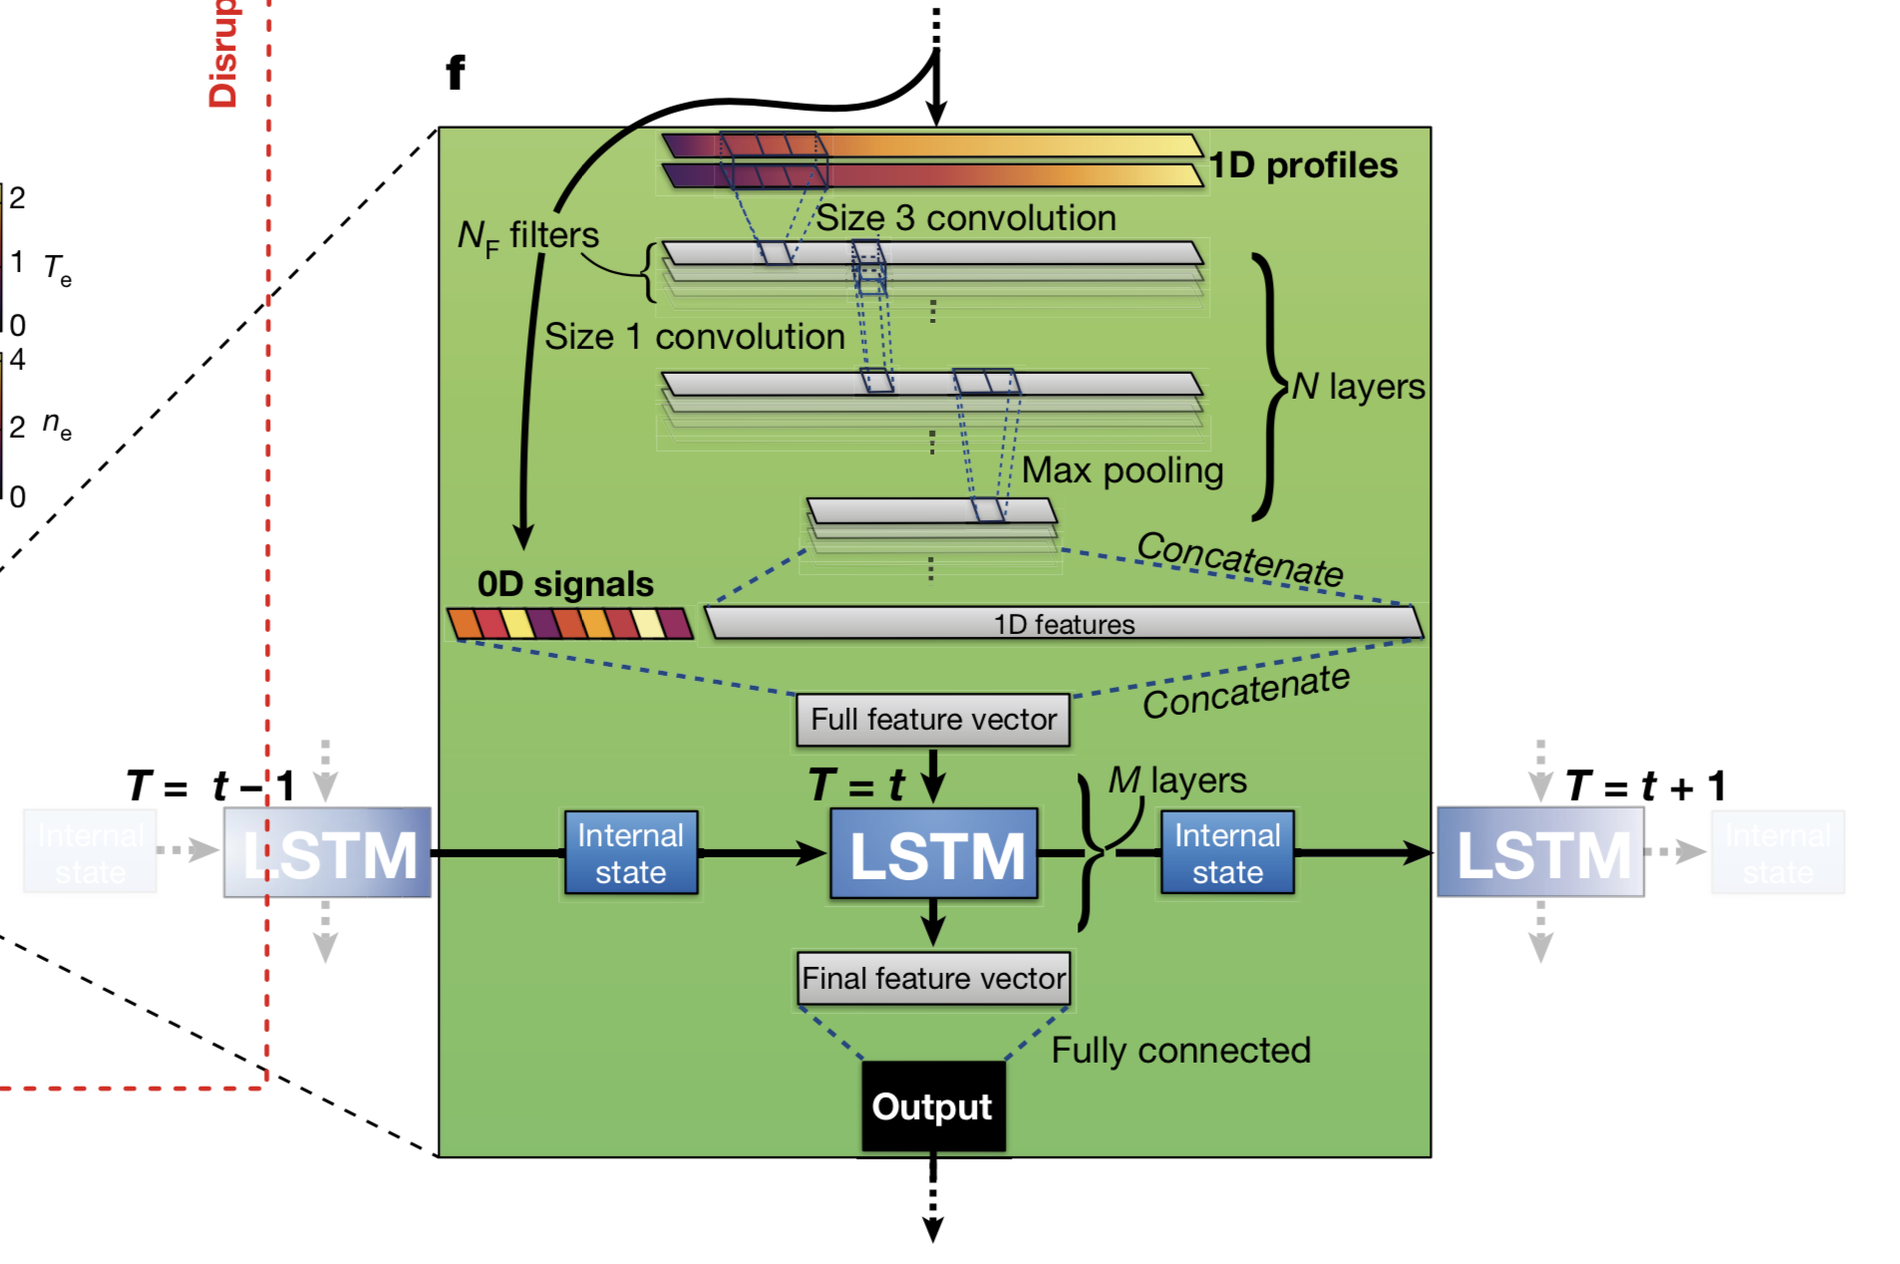
The deep learning model (fig 1f)
J. Kates-Harbeck et. al., Nature 568, 2019

Slide 34
The envisioned workflow for plasma control (fig. 1)
J. Kates-Harbeck et. al., Nature 568, 2019
Sensors
Control parameter
Scalar data (e.g., temperature)
Deep learning algorithm
1D data (e.g., magnetic profile)

Slide 35
The envisioned workflow for plasma control (fig. 1)
J. Kates-Harbeck et. al., Nature 568, 2019
Sensors
Control parameter
Scalar data (e.g., temperature)
Deep learning algorithm
Super important / main result
1D data (e.g., magnetic profile)

Slide 36
More detailed zoom-in on alarm mechanism (fig. 1)
J. Kates-Harbeck et. al., Nature 568, 2019
Alarm is raised when output hits threshold (which is pre-set)
Required time with current technology to shut down machine & mitigate disruption damage

Slide 37
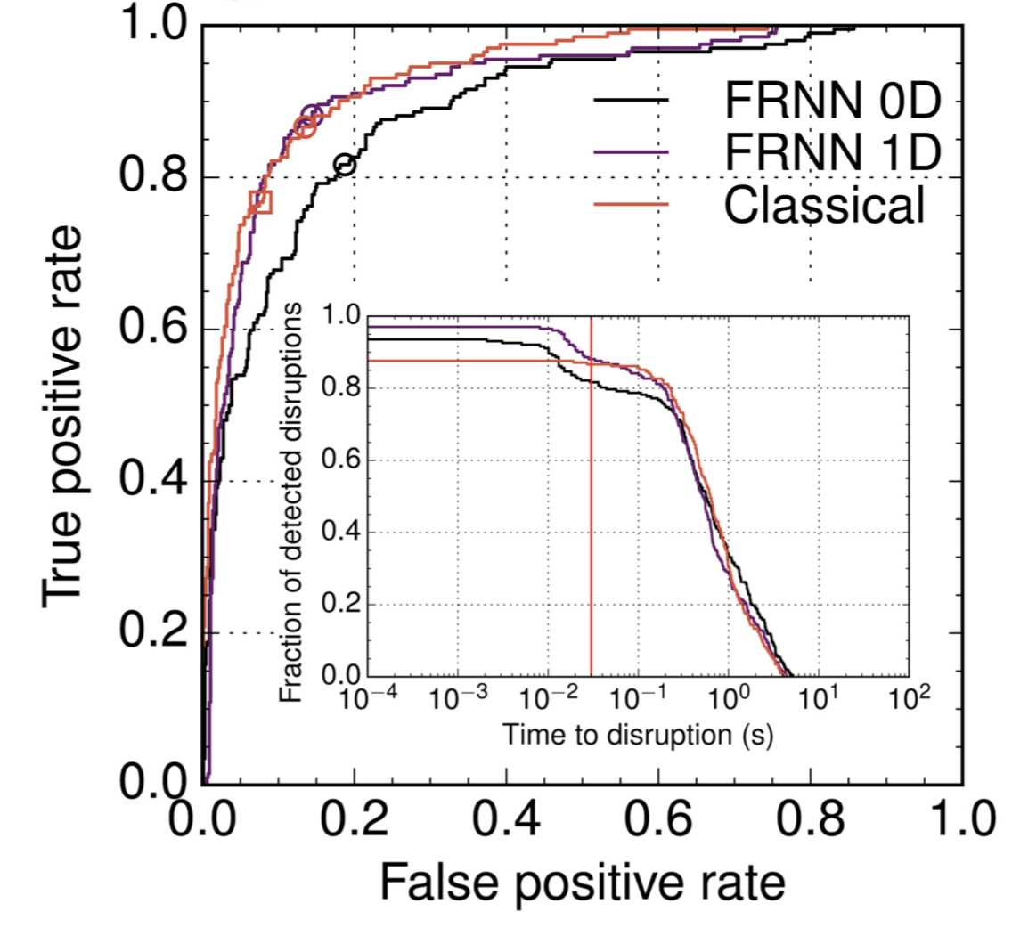
Figure of merit definition & threshold choice
J. Kates-Harbeck et. al., Nature 568, 2019
Figure of merit is the area under the curve (AUC)
  → Want high true positive rate, low false positive rate

Slide 38
Figure of merit definition & threshold choice
J. Kates-Harbeck et. al., Nature 568, 2019
Figure of merit is the area under the curve (AUC)
  → Want high true positive rate, low false positive rate
Optimal threshold is defined when (true positive rate – false positive rate) is maximized

Slide 39
Figure of merit definition & threshold choice
J. Kates-Harbeck et. al., Nature 568, 2019
Figure of merit is the area under the curve (AUC)
  → Want high true positive rate, low false positive rate
Optimal threshold is defined when (true positive rate – false positive rate) is maximized
Prediction time to disruption & threshold parameters are coupled

Slide 40
Figure of merit definition & threshold choice
J. Kates-Harbeck et. al., Nature 568, 2019
Figure of merit is the area under the curve (AUC)
  → Want high true positive rate, low false positive rate
Optimal threshold is defined when (true positive rate – false positive rate) is maximized
Prediction time to disruption & threshold parameters are coupled
For optimal thresholds, prediction time to disruption is 100s of ms (plenty of time for current technology)

Slide 41
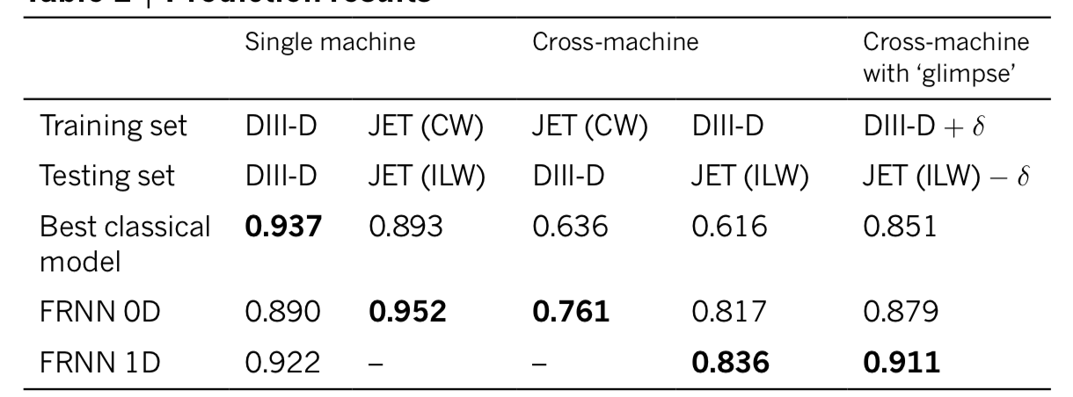
At the 30 ms deadline, how well does the model do?
J. Kates-Harbeck et. al., Nature 568, 2019

Slide 42
At the 30 ms deadline, how well does the model do?
J. Kates-Harbeck et. al., Nature 568, 2019

Slide 43
At the 30 ms deadline, how well does the model do?
J. Kates-Harbeck et. al., Nature 568, 2019

Slide 44
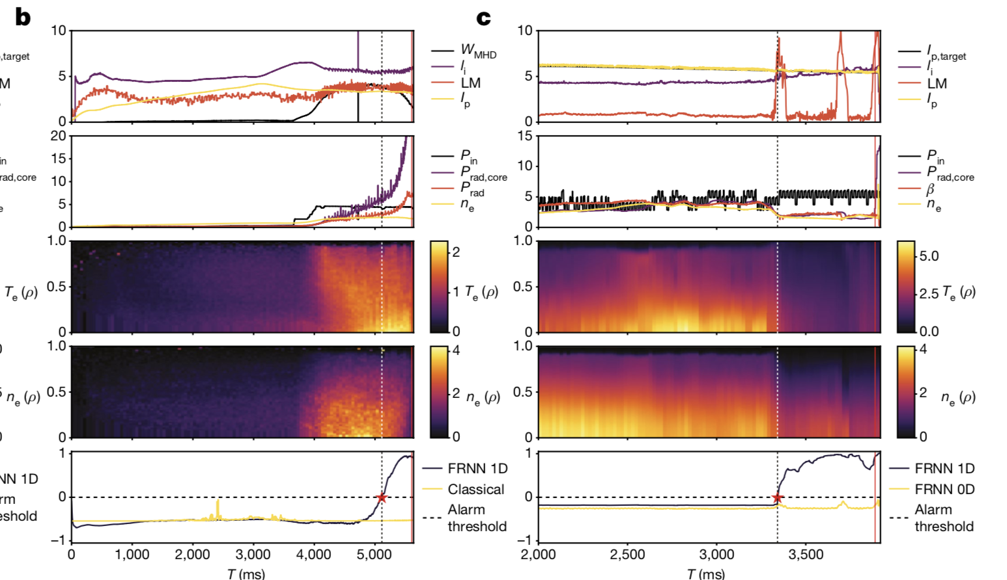
Examples of plasma breakdown predictions (fig 2b, 2c)
J. Kates-Harbeck et. al., Nature 568, 2019
DIII-D example

Slide 45
Examples of plasma breakdown predictions (fig 2b, 2c)
J. Kates-Harbeck et. al., Nature 568, 2019
DIII-D example

Slide 46
Examples of plasma breakdown predictions (fig 2b, 2c)
J. Kates-Harbeck et. al., Nature 568, 2019
DIII-D example
Note superior performance over best classical architecture (gradient boosted trees)

Slide 47
Examples of plasma breakdown predictions (fig 2b, 2c)
J. Kates-Harbeck et. al., Nature 568, 2019
DIII-D example
JET example
1D data is important → deep learning is key here

Slide 48
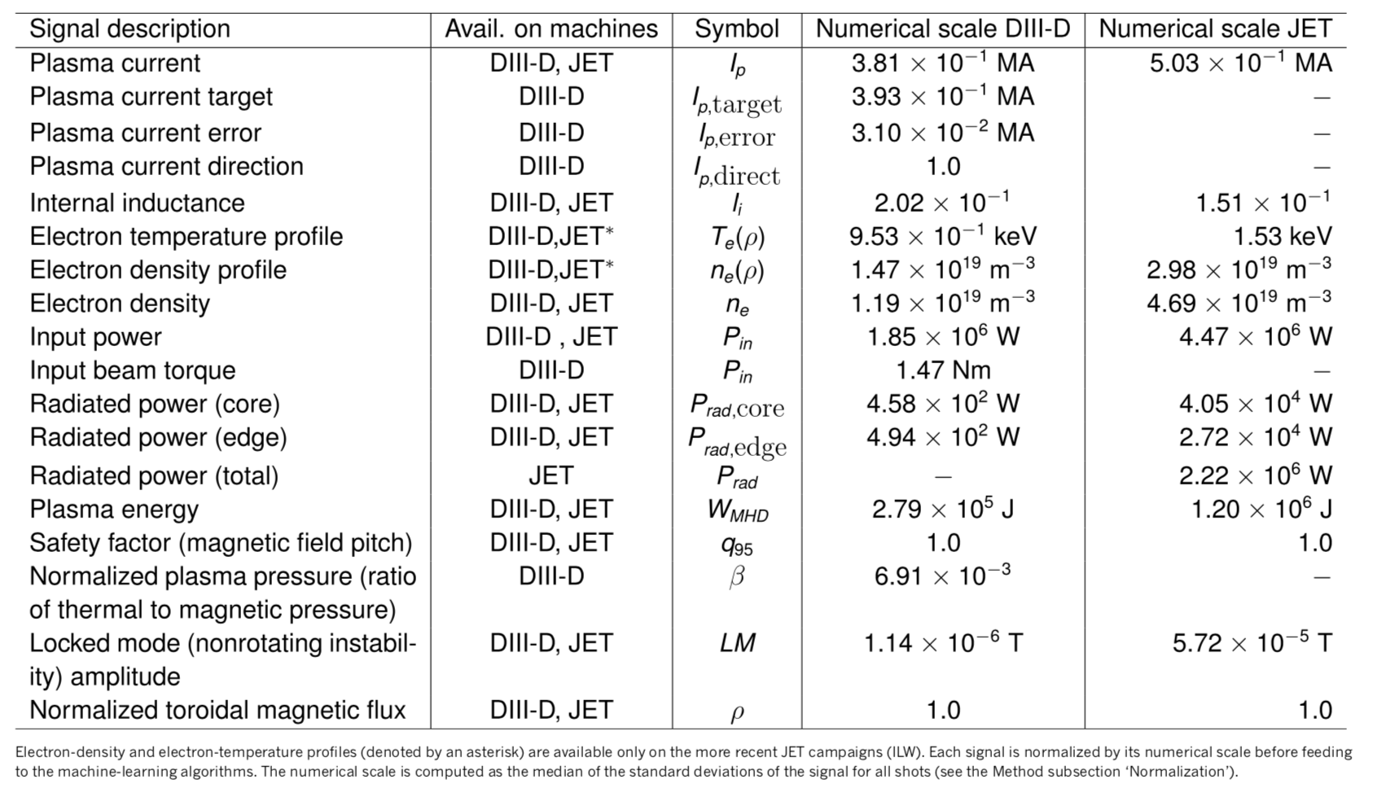
Definitions of signals used
J. Kates-Harbeck et. al., Nature 568, 2019

Slide 49
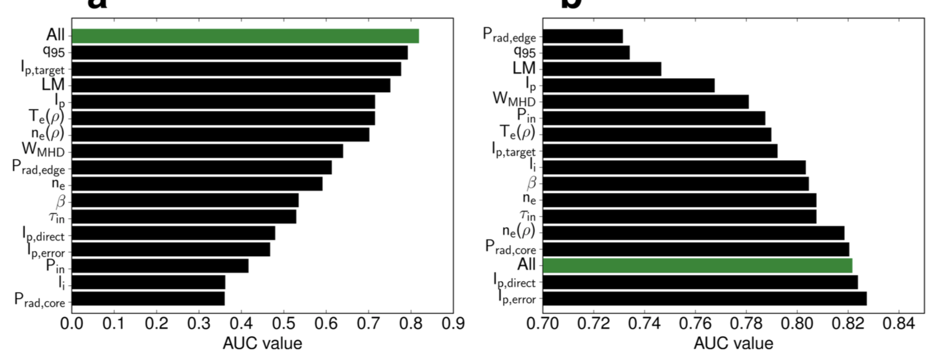
Relative importance of signals used in figure of merit
J. Kates-Harbeck et. al., Nature 568, 2019

Slide 50
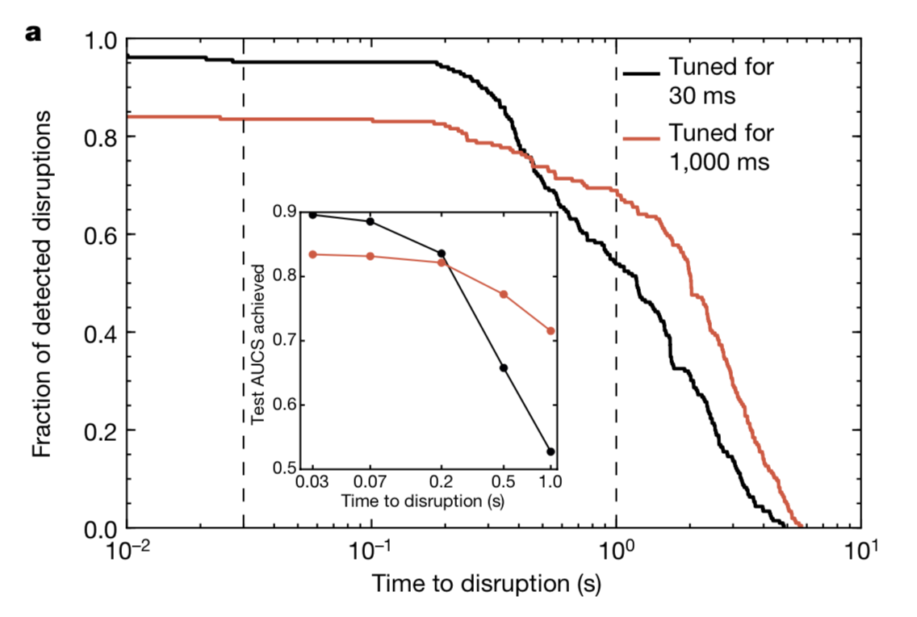
Different hyperparameters get different results
J. Kates-Harbeck et. al., Nature 568, 2019
Note figure of merit is changed here →

Slide 51
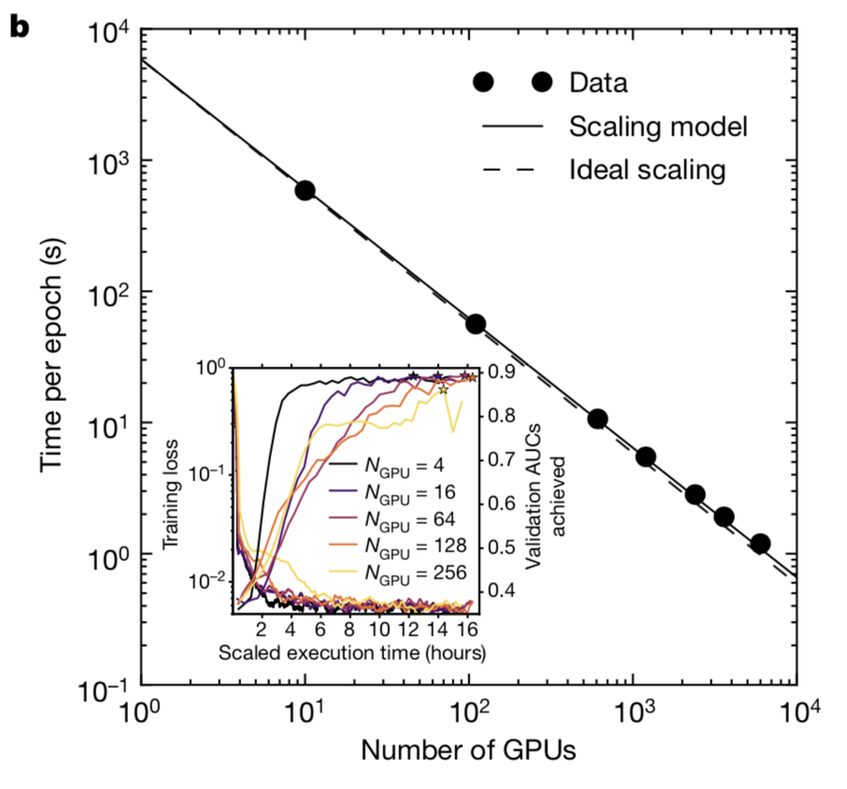
High-performance computing speeds up training
J. Kates-Harbeck et. al., Nature 568, 2019
30 mins for training on 256 GPUs

Slide 52
Summary
J. Kates-Harbeck et. al., Nature 568, 2019
Advances in deep learning, availability of supercomputing hardware, and improved data processing hardware allow for simulation of complex, nonlinear physical systems
The authors harness those techniques & to understand and predict plasma dynamics in nuclear fusion with better and more thorough results than previously accomplished
Nuclear fusion is still a long way away
  Other problems with nuclear fusion reactors still pervade the field:
    Neutron irradiation of container
    Getting confinement and temperature for long periods of time
Besides the technical challenges of getting nuclear fusion reactors to work at all, they must work well enough to justify costs → this is really hard

