Slide 1
Carbon, but at what price?
Amos Meeks
HEJC 10/18/19

Slide 2
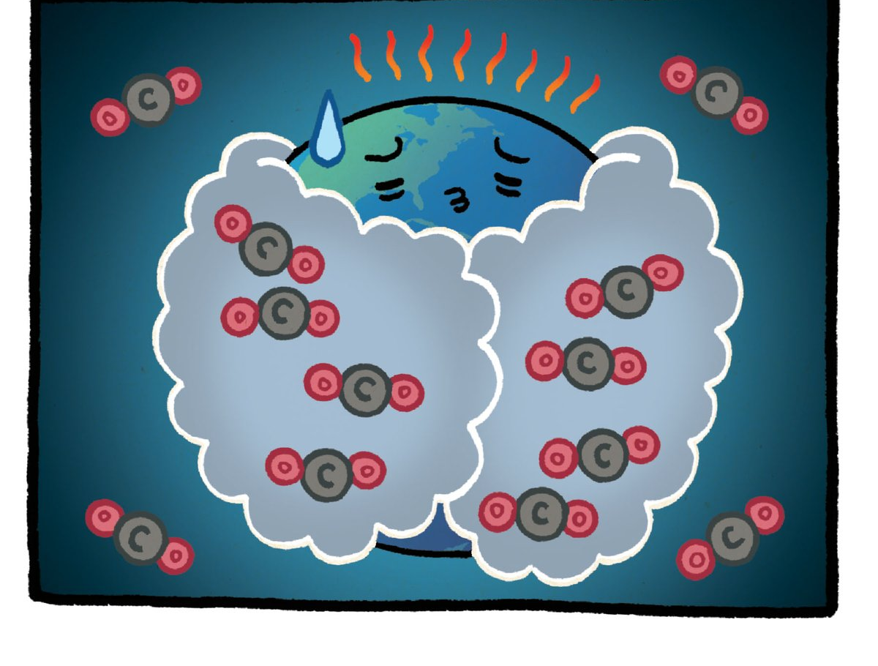
How do we determine the marginal externalized costs?
?
?
?
CO2 Emitted
GHG-induced
climate change
Societal costs
How will global agricultural production be affected?
How much CO2 will be emitted in the next 100 years?
How much CO2 will end up in the atmosphere?
Adaptation? Solar geoengineering?
How much temperature increase will higher CO2 concentrations cause?
Migration? War?
How will this effect temperature extremes? Extreme storms? Extreme precipitation? Sea level rise? Climate tipping points?
How do we discount the future?
How do we value human life?

Slide 3
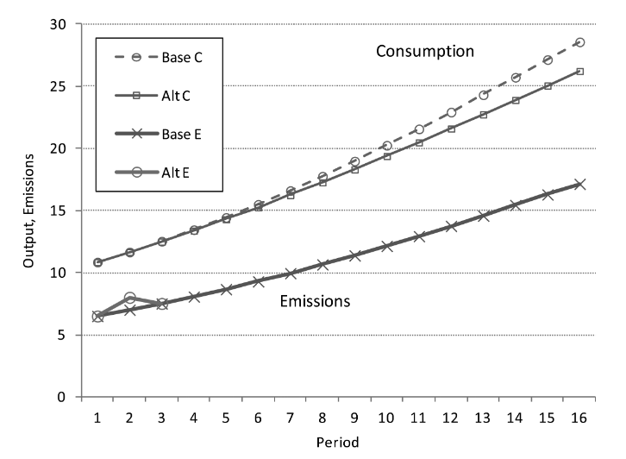
Estimating a Carbon Price through Integrated Assessment Models
DICE
Nordhaus, 2014. Journal of the Association of Environmental and Resource Economics.

Slide 4
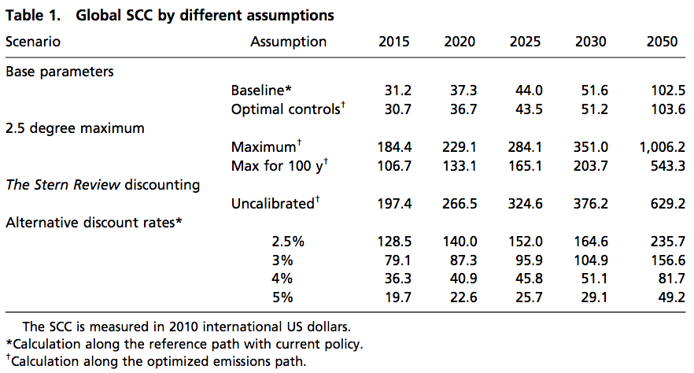
DICE Model Results
Nordhaus, 2017. PNAS.

Slide 5
Can we estimate a carbon price empirically?
Burke, M., Hsiang, S. M.&Miguel, E. Global non-linear effect of temperature on economic production.Nature527, 235–239 (2015).

Slide 6
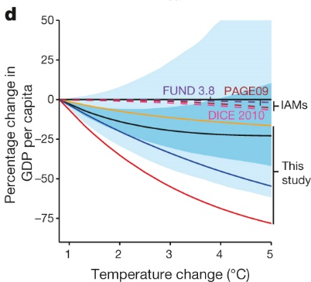
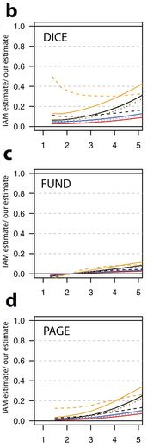
Empirical damage function compared
Notes:
comparing approaches to estimating temperature effects(pooled/differentiated: rich and poor countries assumed to respondidentically/differently, respectively; short run/long run: effectsaccount for 1 or 5 years of temperature, respectively
Line type indicates the underlying assumed socioeconomic scenario: dashindicates ‘base’ (United Nations medium variant population projections,future growth rates are country-average rates observed 1980–2010), dotsindicate SSP3, solid lines indicate SSP5

Slide 7
DICE Model Results – x10?
Nordhaus, 2017. PNAS.

Slide 8
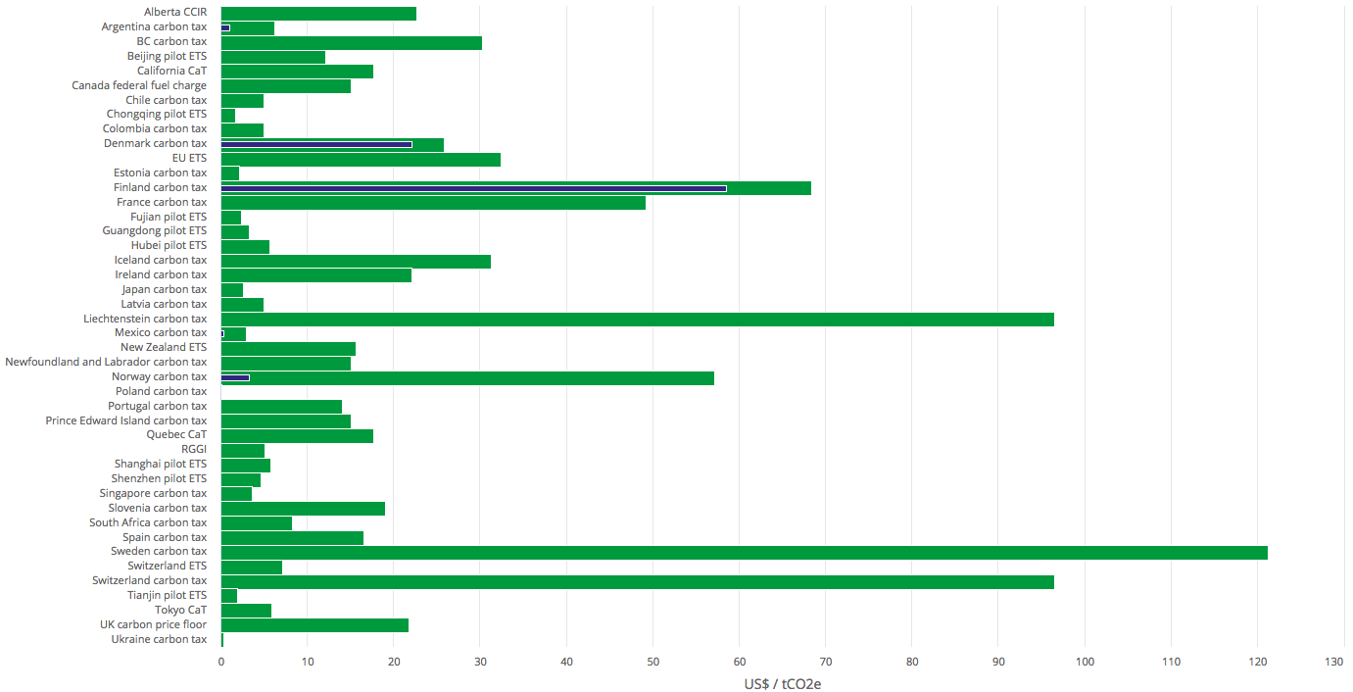
Carbon prices in the world today
https://carbonpricingdashboard.worldbank.org/map_data
Notes:
Note: $1/ metric ton of CO2 translates to a little less than 1 cent per gallon of gasoline

Slide 9
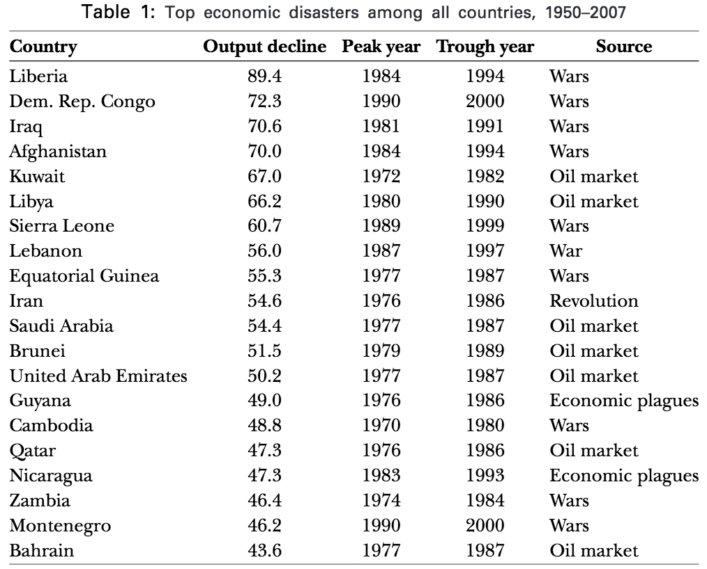
Top Economic Disasters 1950-2007

Slide 10
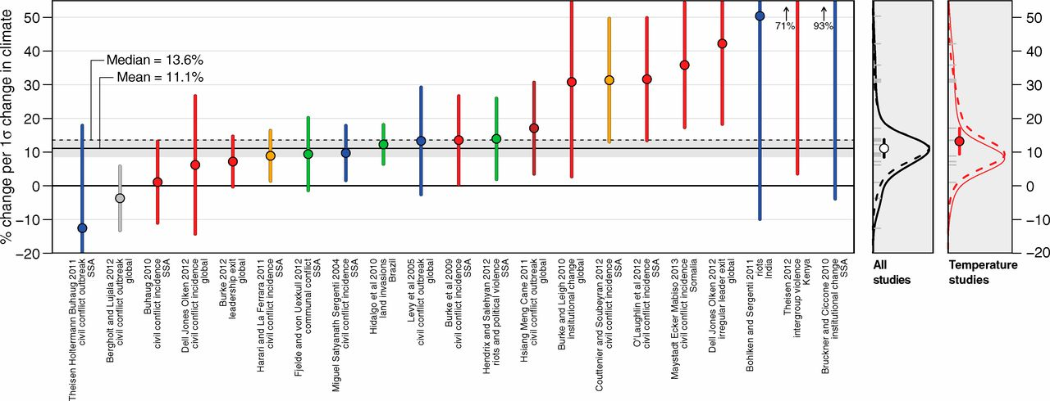
Climate Change and Conflict
Hsiang, S. M., Burke, M. & Miguel, E. Quantifying the influence of climate on human conflict. Science 341, 1235367 (2013).
Notes:
﻿higher temperature (red), greater rainfall loss (blue), greater rainfall deviation from normal (green), more floods and storms (gray),moreElNiño–like conditions (brown), or more drought (orange), as captured by different drought indices.

Slide 11
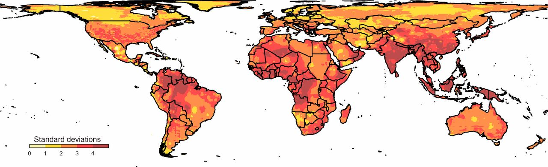
Expected Temperature Change 2050 vs. 2000
Hsiang, S. M., Burke, M. & Miguel, E. Quantifying the influence of climate on human conflict. Science 341, 1235367 (2013).
Notes:
Temperature projections are for the A1B scenario and are averaged across 21 global climate models reporting in the Coupled Model Intercomparison Project (CMIP3) (96). Changes are the difference between projected annual average temperatures in 2050 and average temperatures in 2000. The historical SD of temperature is calculated from annual average temperatures at each grid cell over the period 1950–2008, using data from the University of Delaware (131). The map is an equal-area projection.

Slide 12
Conclusions/Discussion
Current carbon pricing policies possibly price significantly below a true social cost of carbon
Current carbon pricing does not and possibly cannot properly account for catastrophe, which should further increase the social cost of carbon, and may possibly dominate a carbon price.
Previous economic catastrophes are largely linked to war and conflict, which are expected to increase in likelihood in a warmer world.
Question: in the face of so much uncertainty and high stakes, how should we approach climate change policies like carbon pricing?

