Slide 1
The Green New Deal:
Colleen Golja

Slide 2
Presentation Overview
Overview of the text of the Green New Deal
Historical Context
Political Context and Language

Slide 3
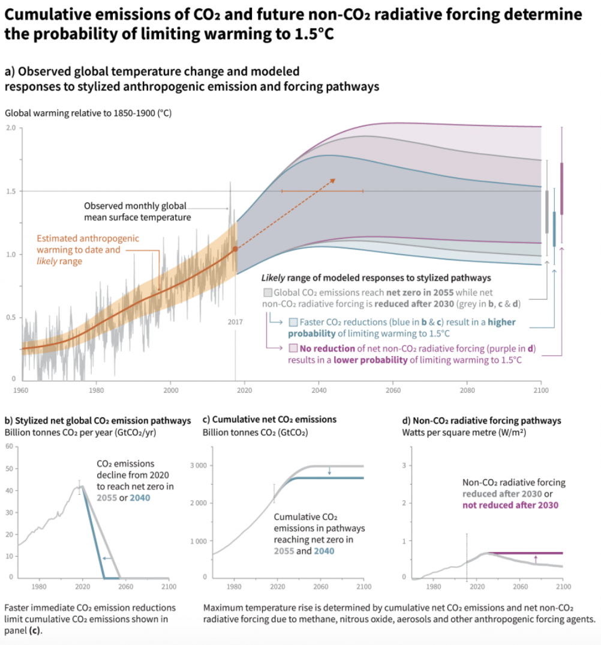
Motivation
“Climate models project robust differences in regional climate characteristics between present-day and global warming of 1.5°C, and between 1.5°C and 2°C. These differences include increases in: mean temperature in most land and ocean regions (high confidence), hot extremes in most inhabited regions (high confidence), heavy precipitation in several regions (medium confidence), and the probability of drought and precipitation deficits in some regions (medium confidence).”
https://www.ipcc.ch/sr15/graphics/#cid_603
https://www.ipcc.ch/site/assets/uploads/sites/2/2018/07/sr15_headline_statements.pdf

Slide 4
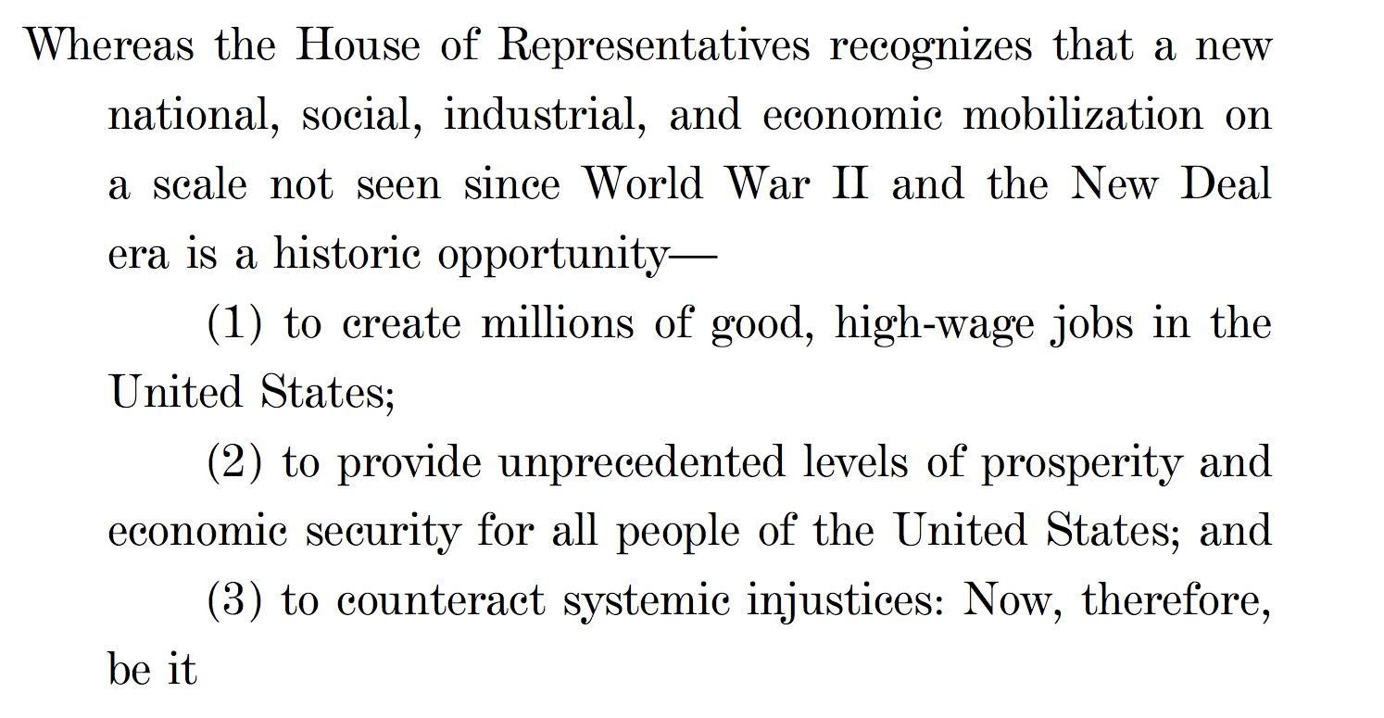

Slide 5
Goals of Green New Deal
  1). To achieve net-zero greenhouse gas emissions through a fair and just transition for all communities and workers;
  2). To create millions of good, high-wage jobs and ensure prosperity and economic security for all people of the United States;
  3). To invest in the infrastructure and industry of the United States to sustainably meet the challenges of the 21st century;
  4). To secure for all people access to :
      Clear air and water;
      Climate and community resilience
      Healthy food
      Access to nature ; and
      A sustainable environment; and
5). To promote justice and equity …”

Slide 6
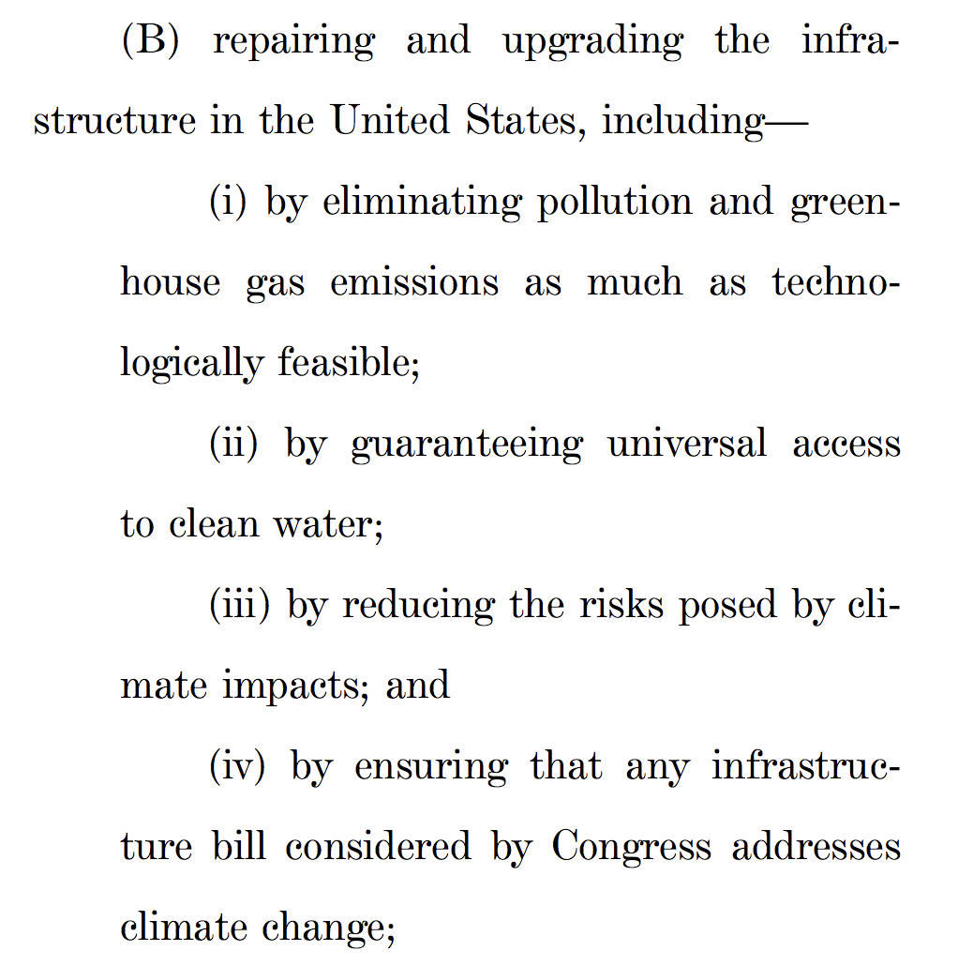
How to Meet these Goals?
Notes:
Items to be achieved through a 10 year national mobilization :

Slide 7
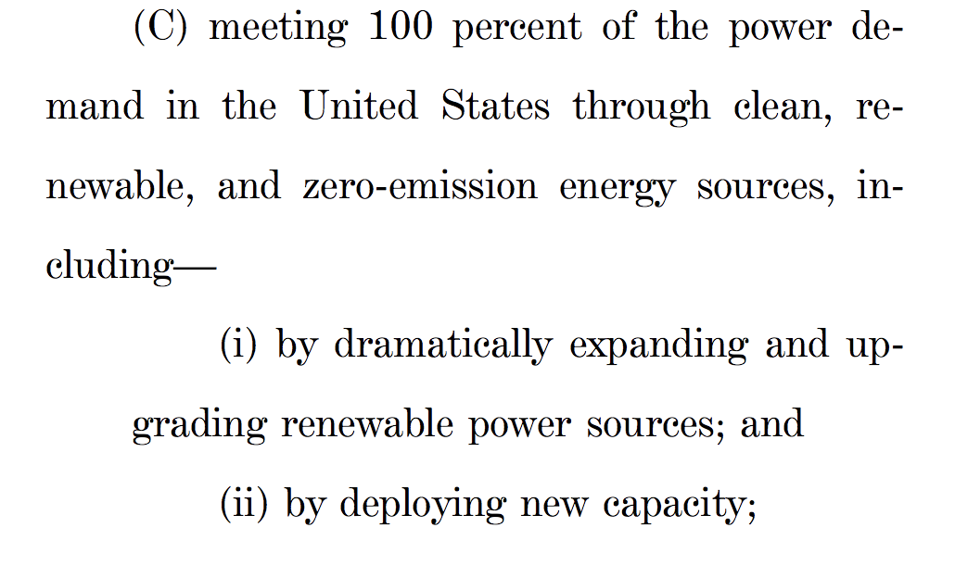
How to Meet these Goals?
Notes:
Items to be achieved through a 10 year national mobilization :

Slide 8
How to To Mobilize:
Inclusive of all sectors/ people
Provide resources training and high quality education, including higher education to all people of the US, with a focus on frontline and vulnerable communities …
Invest in research
Strengthen power of unions/ ability to unionize

Slide 9
Historical Context

Slide 10
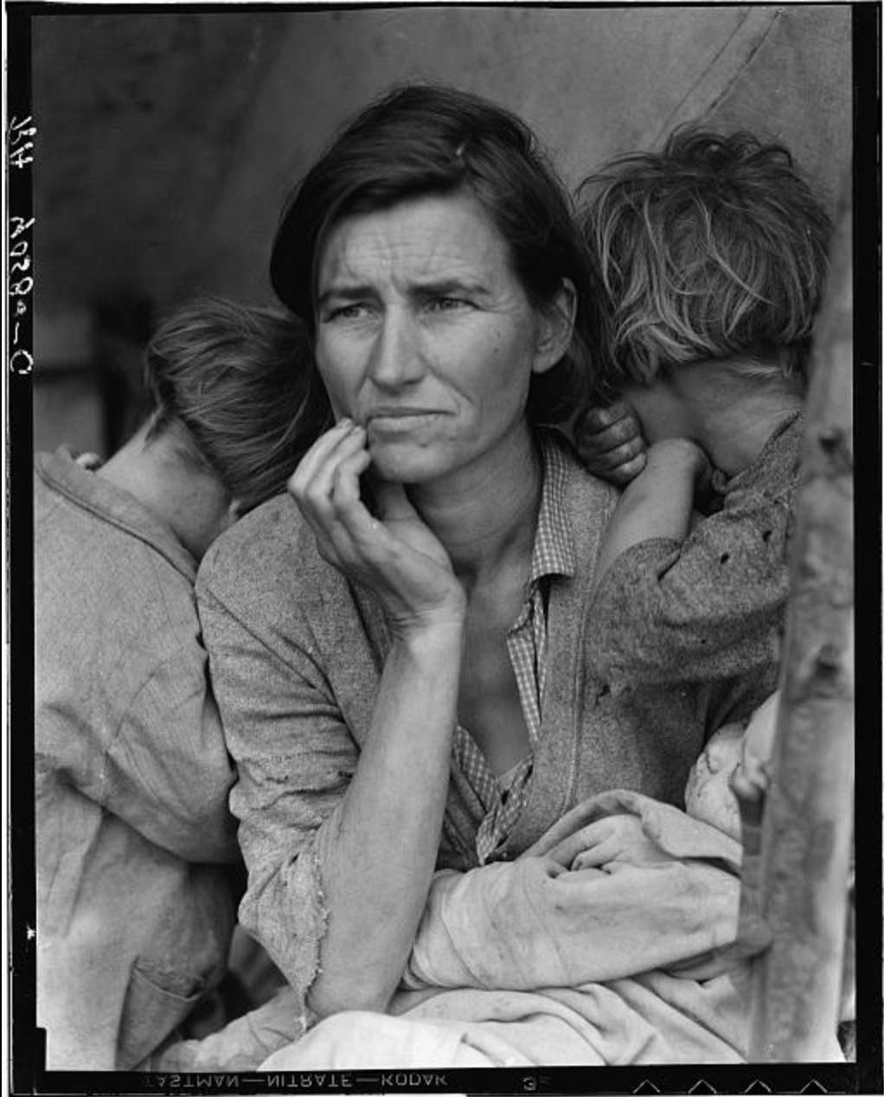
1929: Stock Market Crash ( The Great Depression)
http://www.loc.gov/pictures/resource/fsa.8b29516/
Notes:
-Dow Jones dropped 25% over 4 days
-total loss of ~3 Billion dollars
-unemployment peaks around 30%
compare to the 2009 recession https://data.bls.gov/timeseries/lns14000000 around 10%

Slide 11
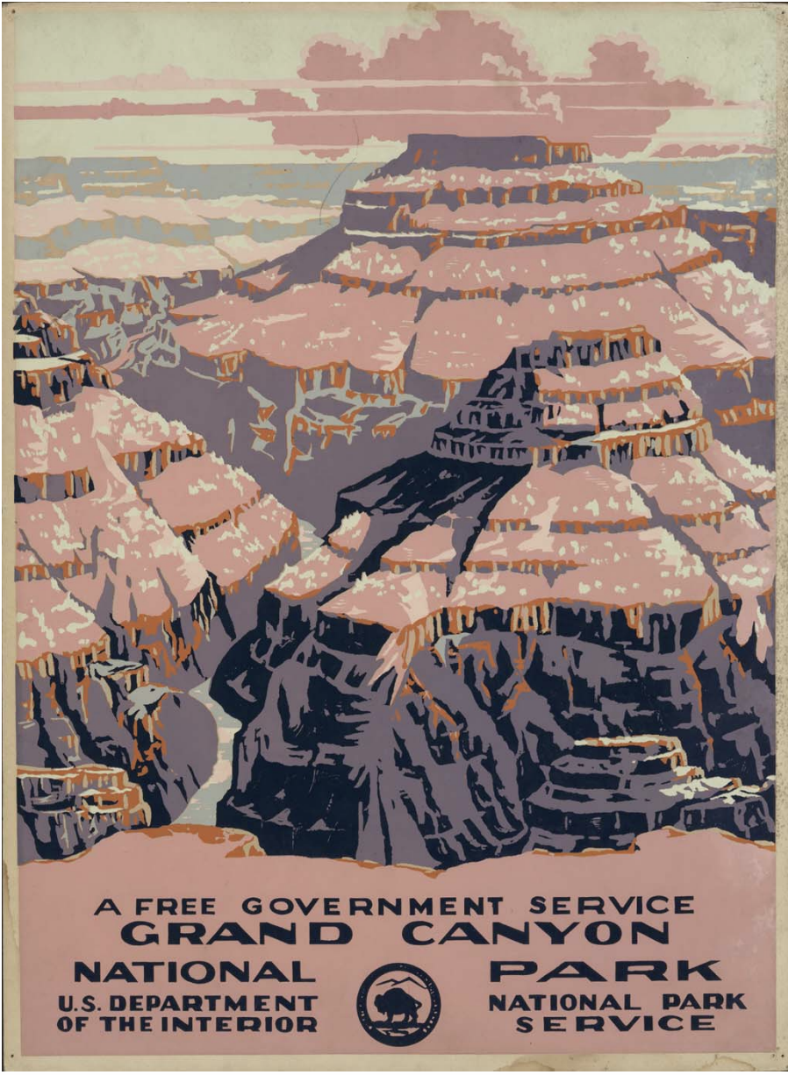
1933-1941: New Deal Era
Tennessee Valley Authority Act: allow federal gov’t to build dams along Ten. River
Agricultural Adjustment Act: Paid farmers to stop producing surplus goods
Public Works Administration
Works Progress Administration: focused on public infrastructure
Civilian Conservation Corps
http://www.loc.gov/teachers/classroommaterials/primarysourcesets/new-deal/pdf/grandcanyon.pdf
Notes:
combination of public works projects, financial reforms and regulations enacted by FDR
focused on:
relief for the poor
recovery of the economy
reform of financial system

Slide 12
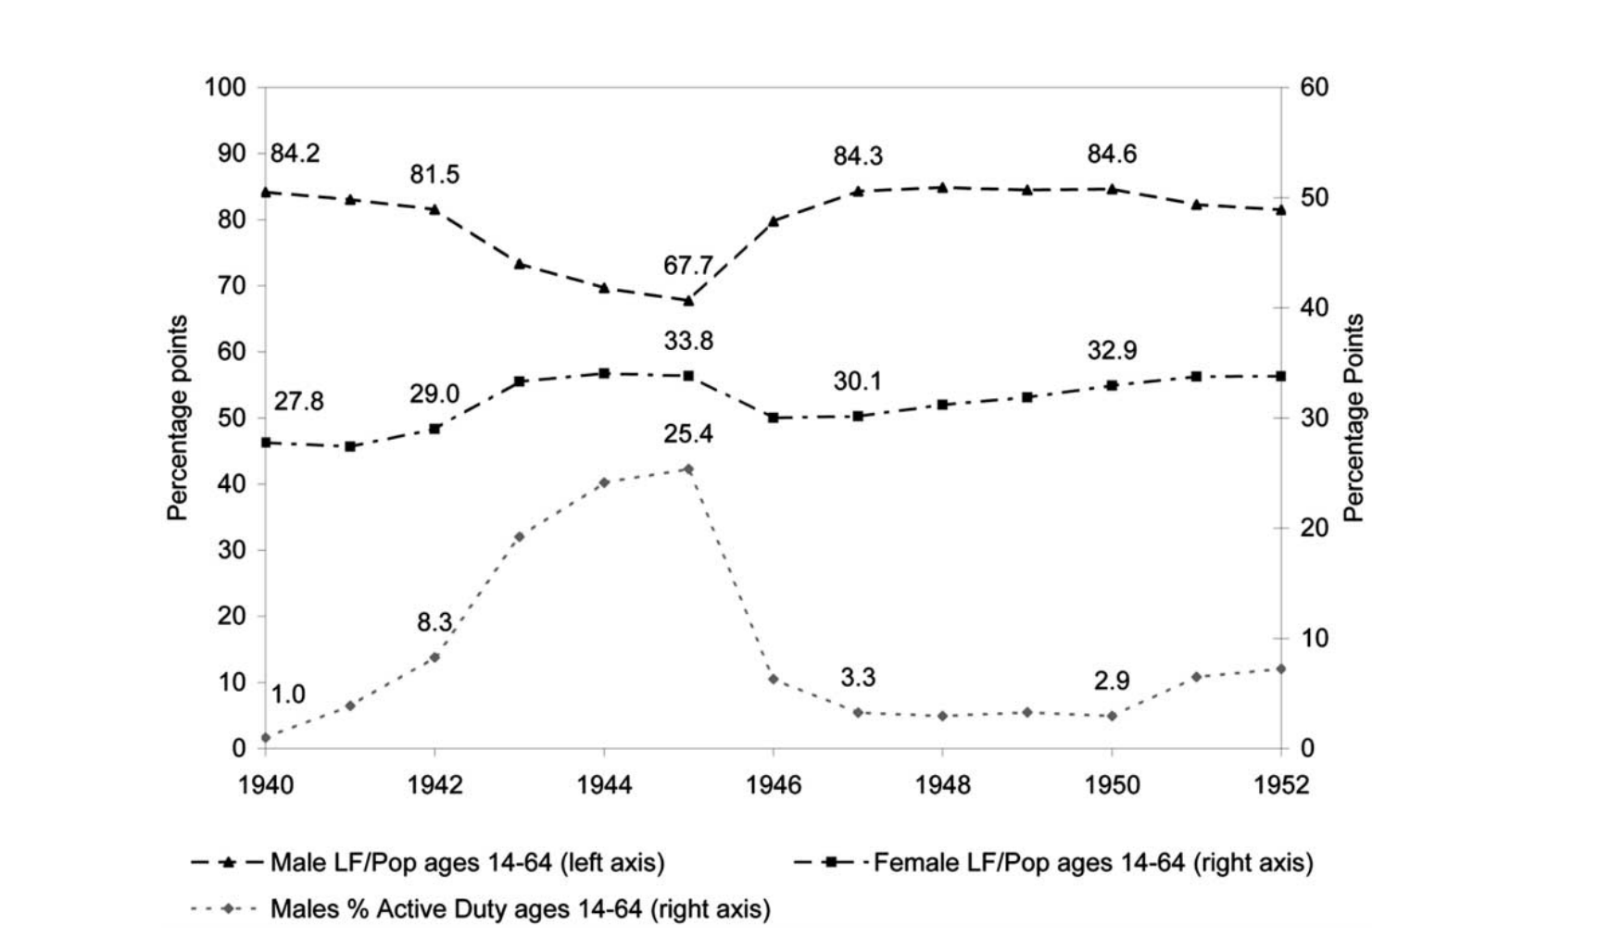
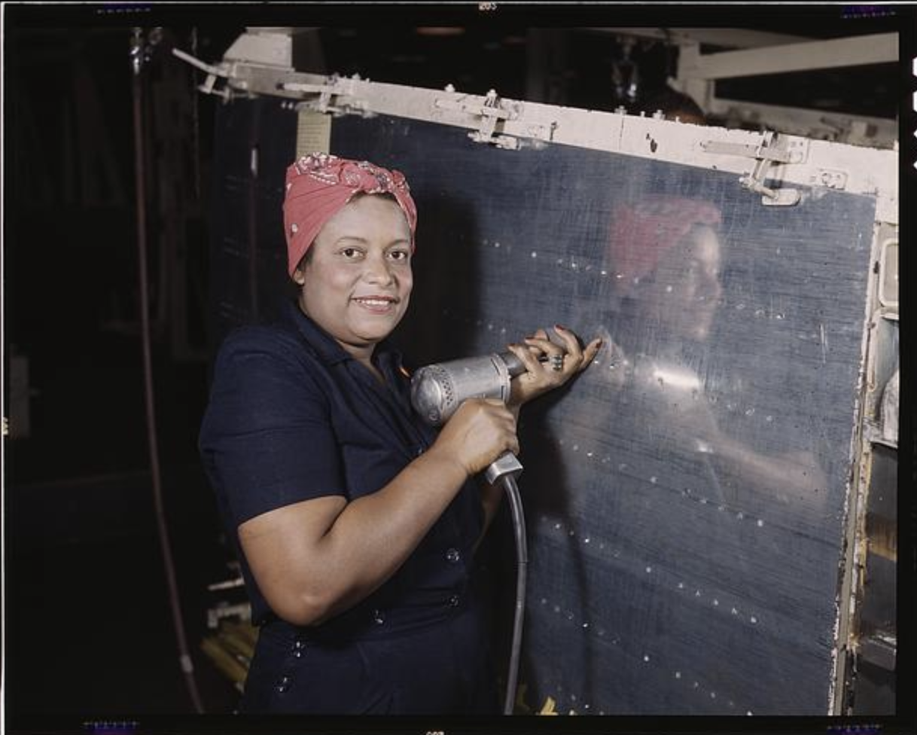
World War II Mobilization
Cost-Plus Contract Agreements
Domestic Auto Production stops
U.S. becomes top industrial producer
Changes in Labor Force
https://lccn.loc.gov/2017878542
Robert Braucher and Covington Hardee
Stanford Law Review
Vol. 5, No. 1 (Dec., 1952), pp. 4-29
https://economics.mit.edu/files/11620

Slide 13
Early ”Green New Deals”
1972-1980: Establishment of the first political green party (United Tasmania Group)
Petra Kelly and the German Green Party propel Green Parties into mainstream
1992: Planetary Meeting of the Greens - final statement proposes institutional framework to administer a new global fund
2012-2016: Jill Stein U.S. green party candidate runs on a green new deal platform
2018: Green New Deal Resolution introduced by Alexandria Ocasio-Cortez and Ed Markey
2019: Current efforts are focused on creating a House Select Committee to draft a bill
https://www.globalgreens.org/statements/planetary-greens-rio-1992
Notes:
The representatives of GREEN PARTIES, gathered here from all corners of the world on the eve of the United Nations Conference on Environment and Development (UNCED), express a rich variety of contrasting cultures and experiences. We come from both the North and the South of the planet, whose peoples are increasingly being set against each other by deepening social and ecological crisis. The world Greens condemn all forms of racism and ethnocentrism that divide human beings, generate wars and justify the discrimination, the exploitation and sometimes the extermination of peoples. As heirs of the fight for. equality, one of the most important banners of the history of mankind, we call for all peoples to live together in peace. We thus appeal to the peoples of all the world, especially those involved in wars and ethical conflicts, to put down their weapons and let the XXIst century be born under the sign of respect for ethnic, cultural, sexual and other differences

Slide 14
Political Context and Language

Slide 15
Too Broad ? Too Big? Too Specific ?
1). Broad energy language
2). Does not mention price
3). Suggests universal access to higher education
4). Strengthens unions
5). Supports front-line and vulnerable communities
Notes:
MIT Technology Review: language excludes nuclear, hydro-electric and carbon capture
staying under 1.5 degrees C is technically impossible without these technologies
Sierra club, natural resources defense council and Environmental defense fund found language restrictive
Keeping language broad kept more parties / allies on the table

Slide 16
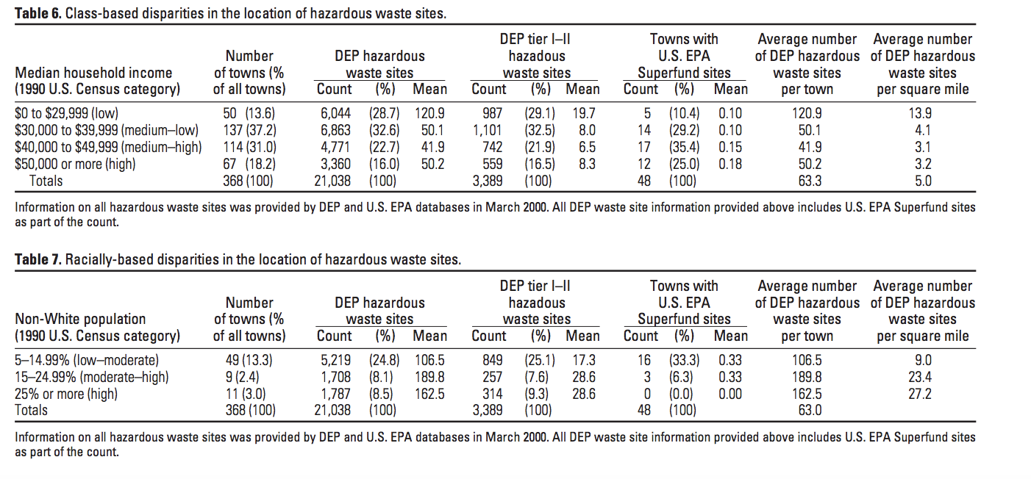
Climate Justice Perspective
Climate Justice Perspective:
https://diversityinclusion.wustl.edu/environmental-justice/
Environ Health Perspect 110(suppl 2):277–288 (2002). http://ehpnet1.niehs.nih.gov/docs/2002/suppl-2/277-288faber/abstract.html

Slide 17
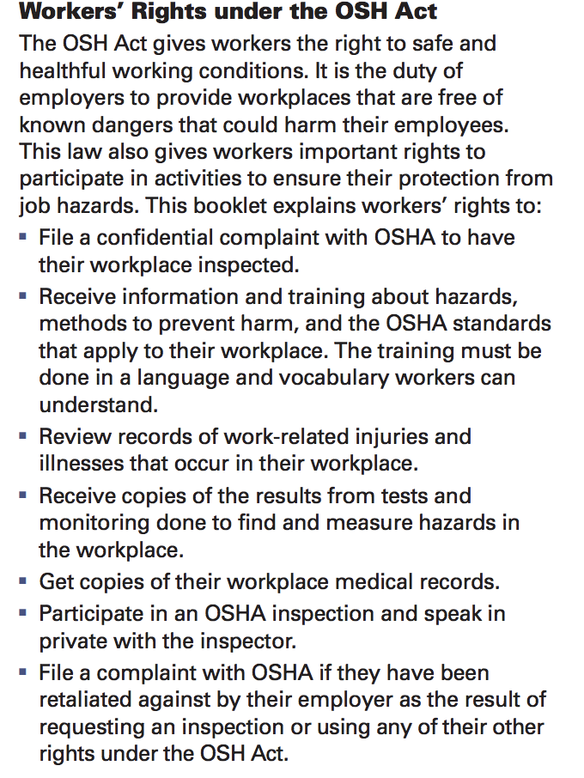
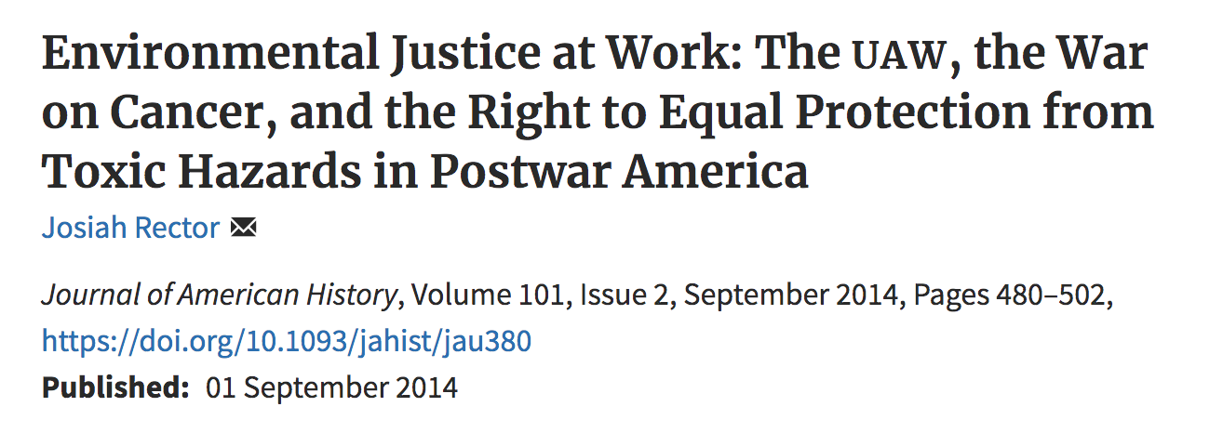
Environmentalism and Worker’s Unions
Notes:
occupational safety and health administration

Slide 18
https://www.cnbc.com/2019/03/28/green-new-deal-died-senate-2020-presidential-elections.html

Slide 19
Discussion
Discussion Questions

Slide 20
How does the American public now compare with the public of the 1930s and 1940s?
What are the implications for a works program in the current era?

Slide 21
What should be our emission goals on a national level? on a global level?

Slide 22
Is there value to overshooting political goals?
  Is it necessary?
  Does it endorse failure?

Slide 23
What types of sacrifices do you think people will make?
What changes seem unreasonable or unlikely?
Notes:
Interested specifically in agriculture…focus on family farms seems odd

