Slide 1
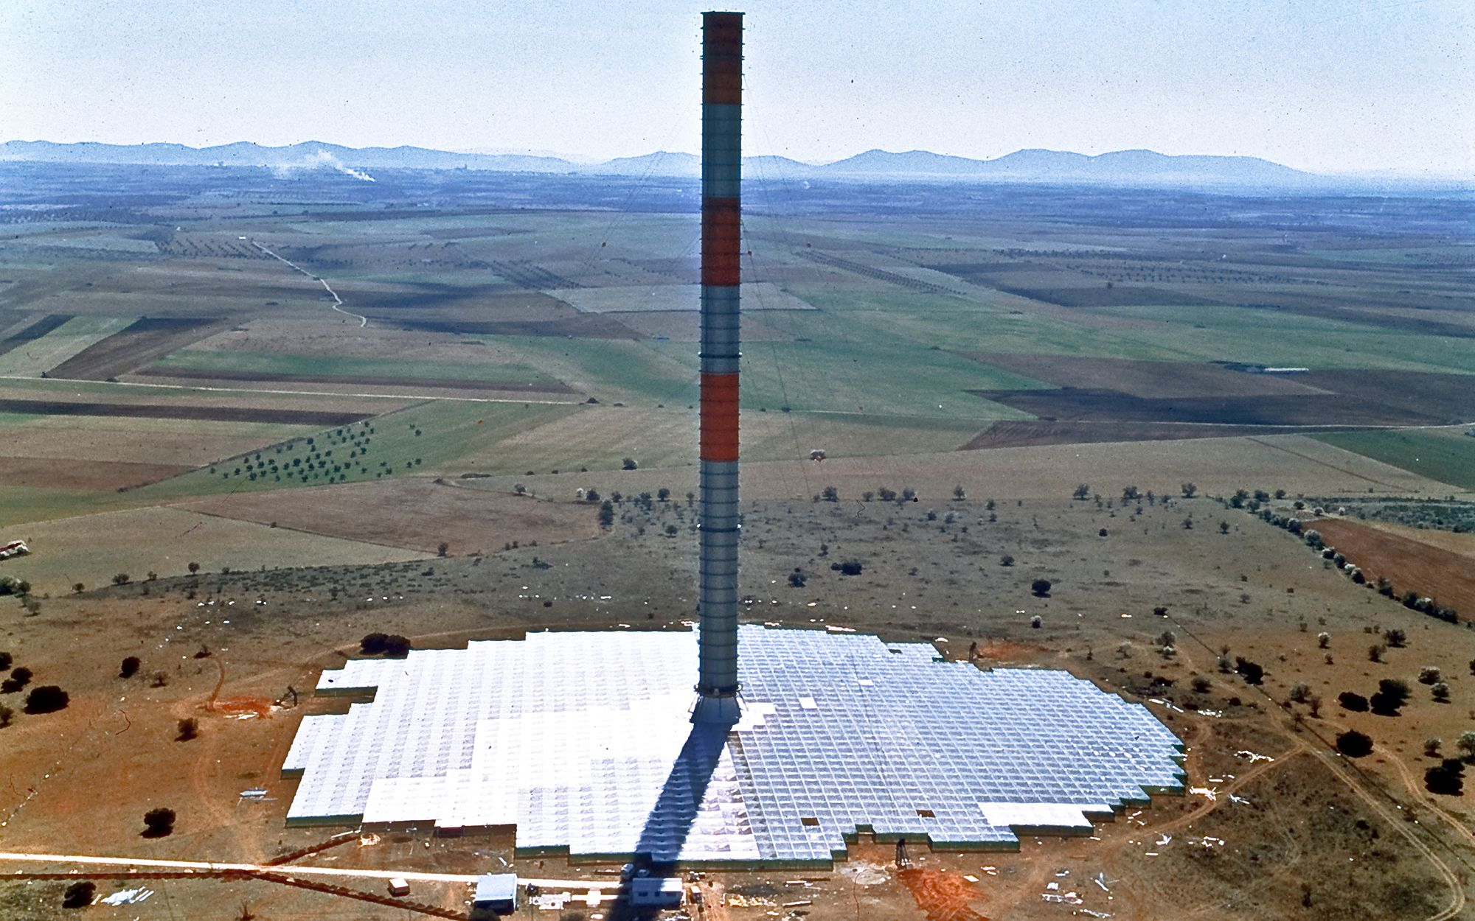
Solar Updraft Towers
Eliza Spear
Harvard Energy Journal Club
March 28, 2019

Slide 2
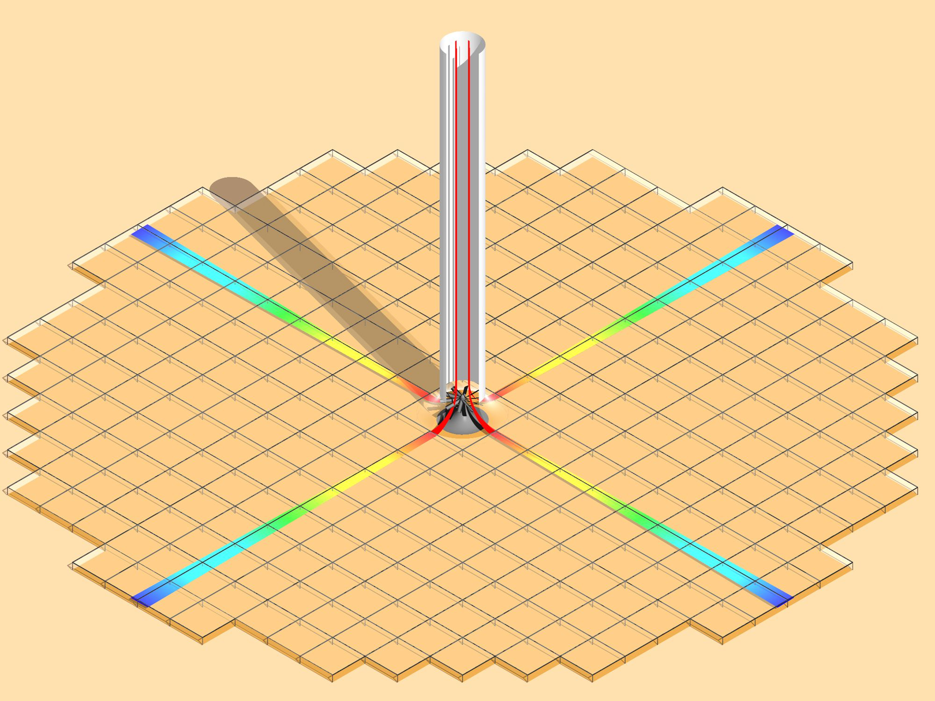
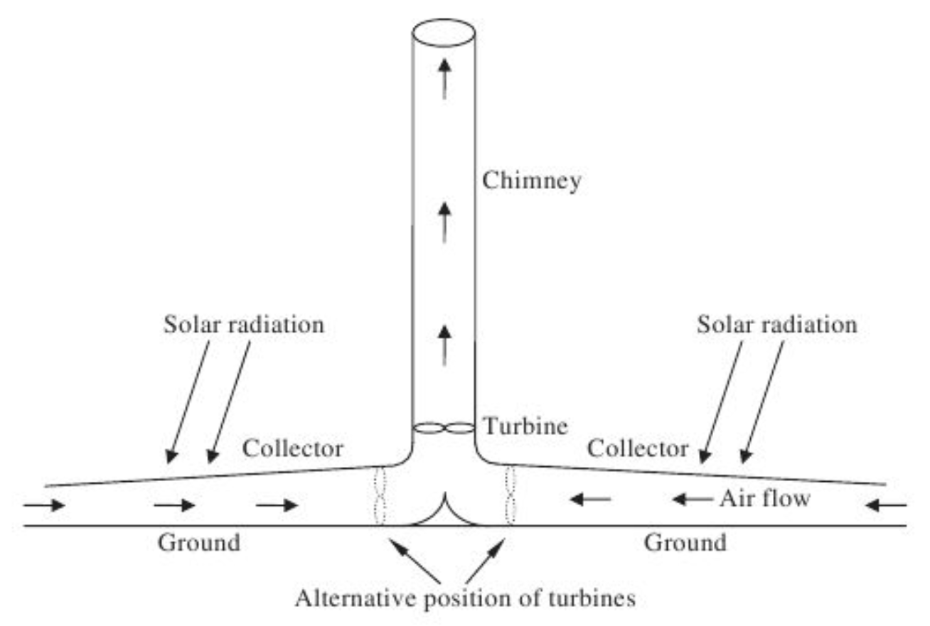
Solar Updraft Towers / Chimneys
“Solar Thermal Power Plant” -- converts solar thermal energy to electricity
Chimney surrounded by a field of transparent glass or plastic roof (the “collector”), which is a few meters above the ground, and gradually slants upward towards the central chimney
Air/ground under the collector is heated by the sun (+30-35 K in large SUTPPs)
The warmer air rises and is forced to flow through the chimney, turning turbines along the way to produce electricity
Because air from beneath the entire collector is forced to flow through the narrow chimney, the wind power delivered to the turbines is quite high (“chimney effect”)
https://www.solar-updraft-tower.com/en/
Kalogirou, Soteris A. Solar Updraft Towers. In Solar Energy Engineering, Second Edition. Academic Press, 2013; pp. 565-570.
Schlaich, J.; Bergermann, R.; Schiel, W.; Weinrebe, G. J. Sol. Energy Eng. 2005, 127, 117-124.

Slide 3
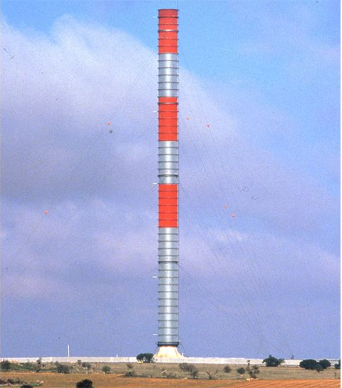
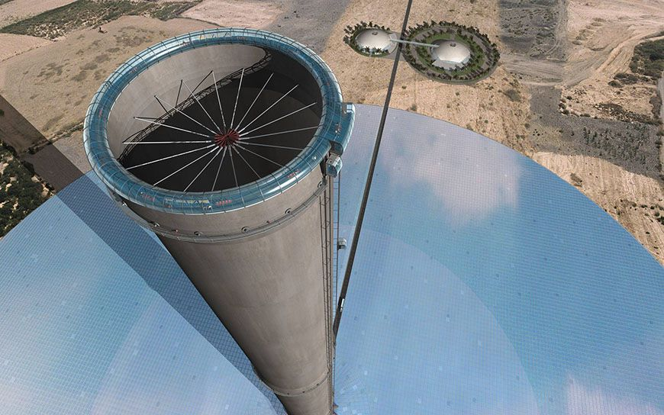
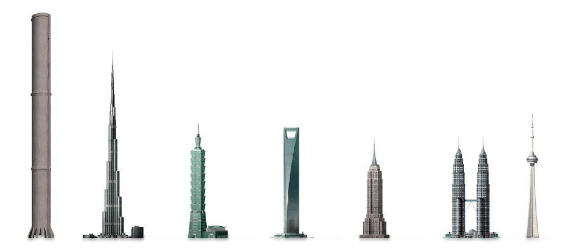
Chimneys
Schlaich Bergermann Solar website (https://www.solar-updraft-tower.com/en/); engineering/architecture firm that designed and built Manzanares SUT

Slide 4
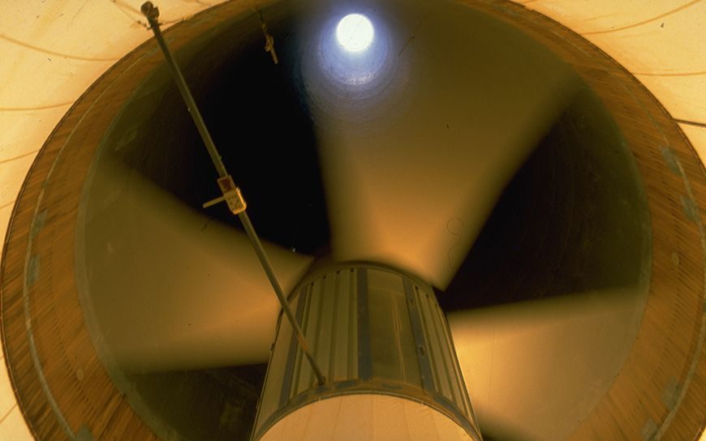
Turbines
https://www.solar-updraft-tower.com/en/

Slide 5
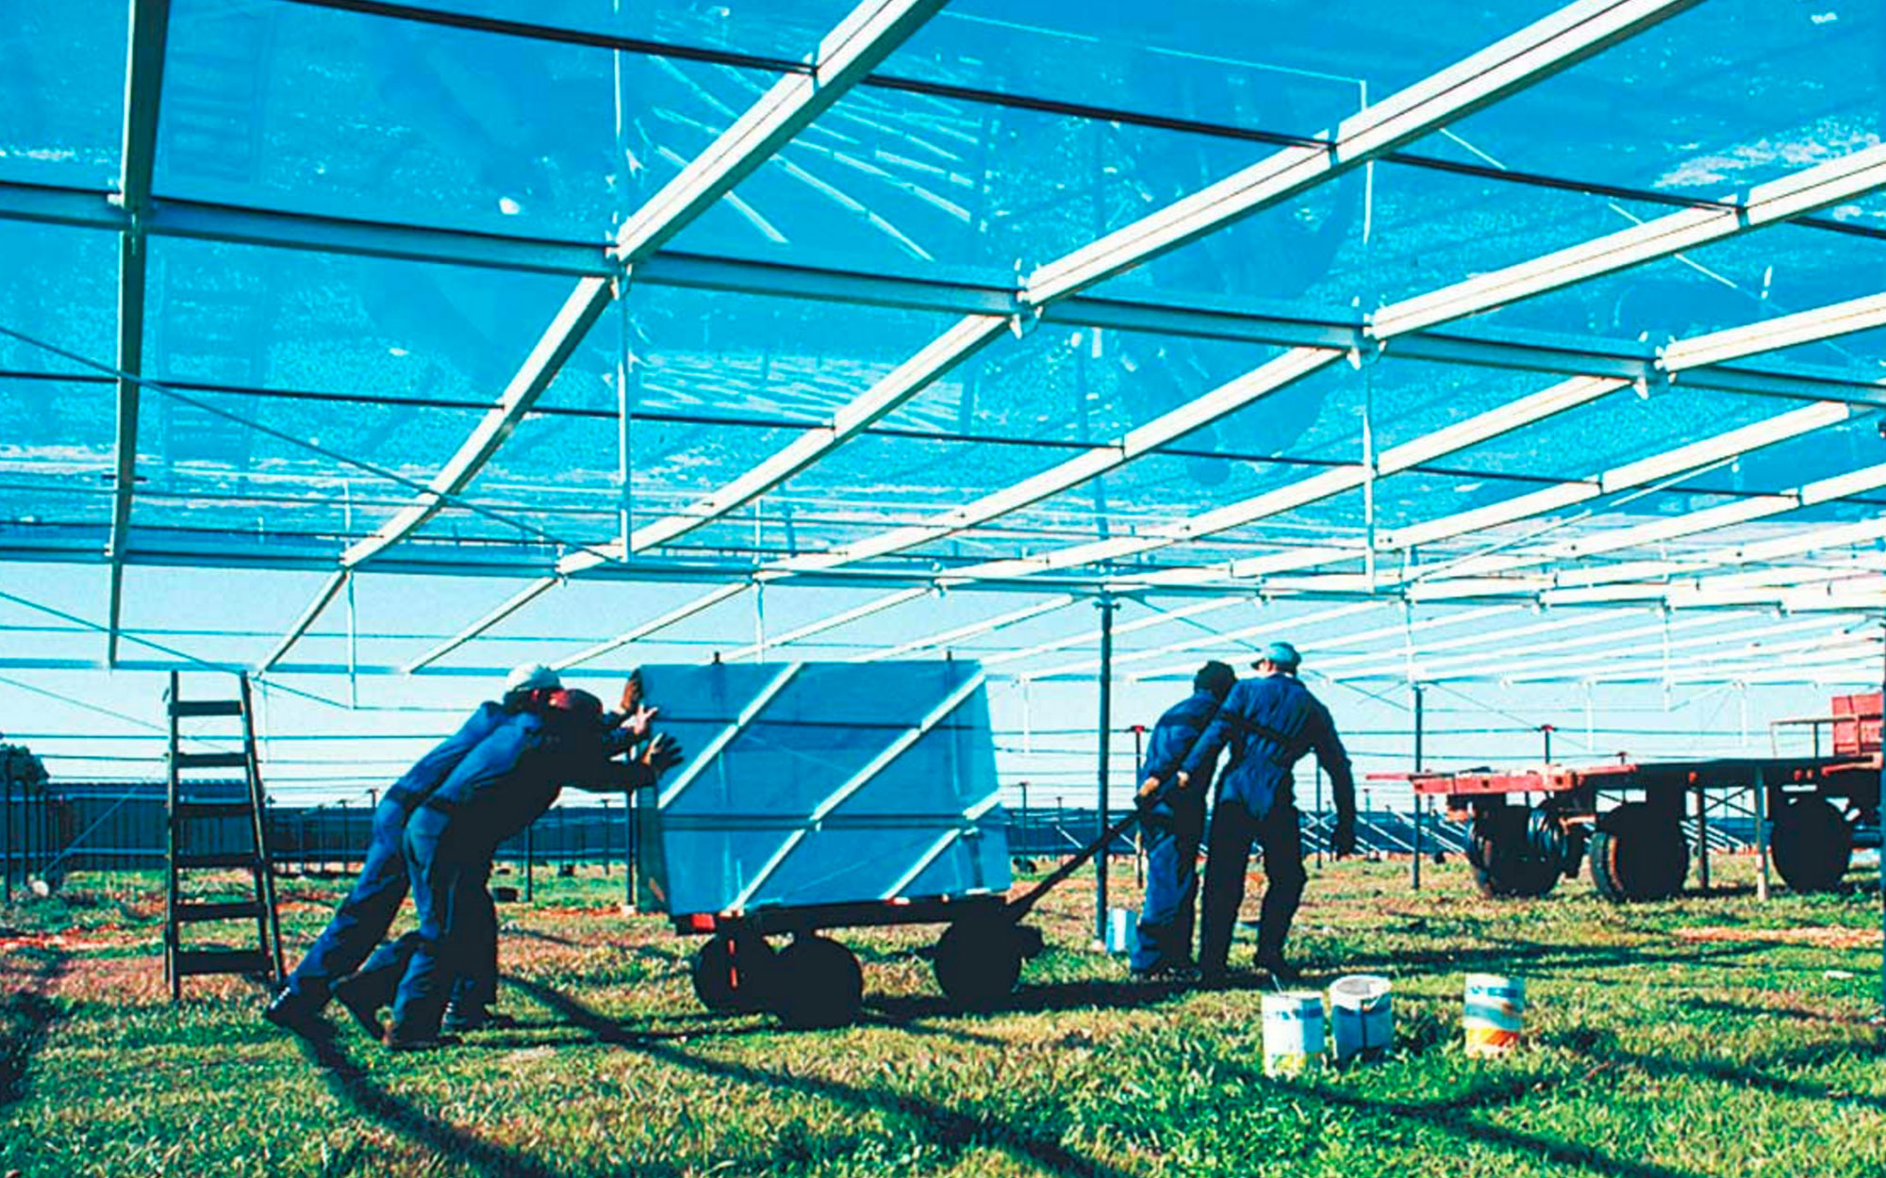
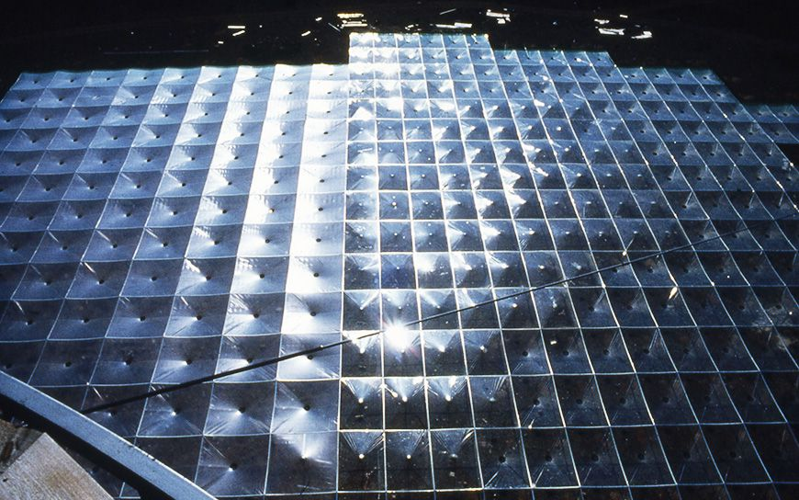
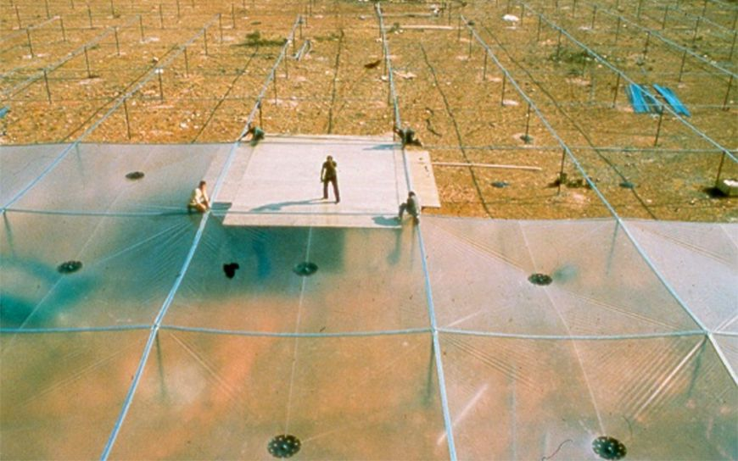
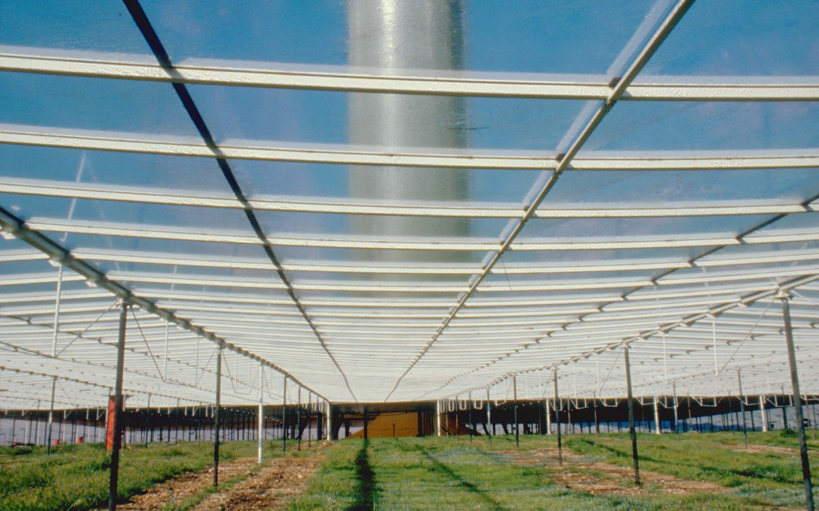
Collectors
https://www.solar-updraft-tower.com/en/

Slide 6
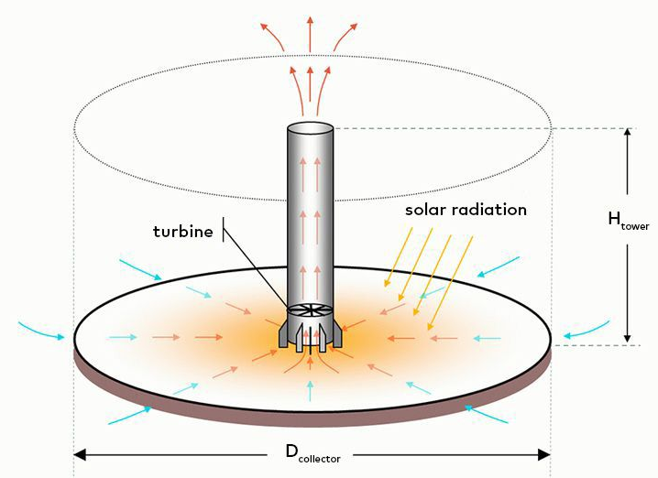
Intermittency
To address intermittency, tubes or bags of water can be placed under the collector
Water is heated by the sun during the day, and releases its heat to the air during the cooler night, so electricity is also provided at night
Tubes/bags don’t need (much) refilling, so little water is consumed after the initial fill
https://www.solar-updraft-tower.com/en/
Kalogirou, Soteris A. Solar Updraft Towers. In Solar Energy Engineering, Second Edition. Academic Press, 2013; pp. 565-570.

Slide 7
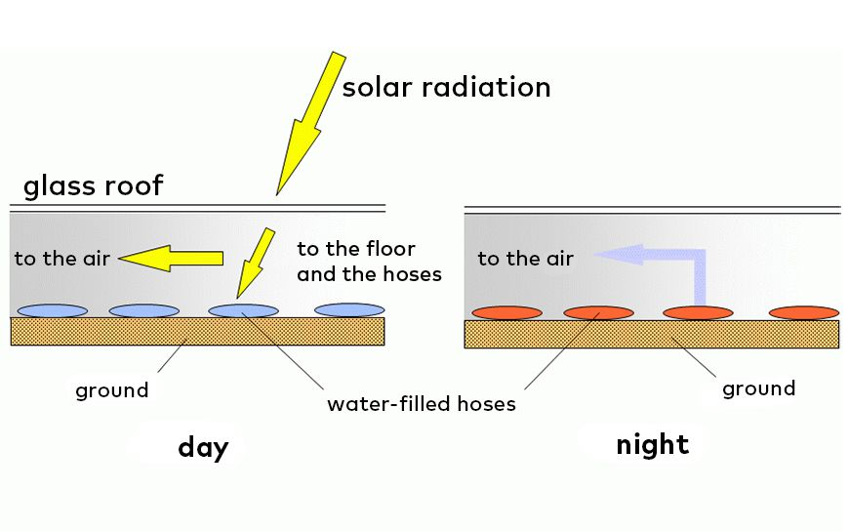
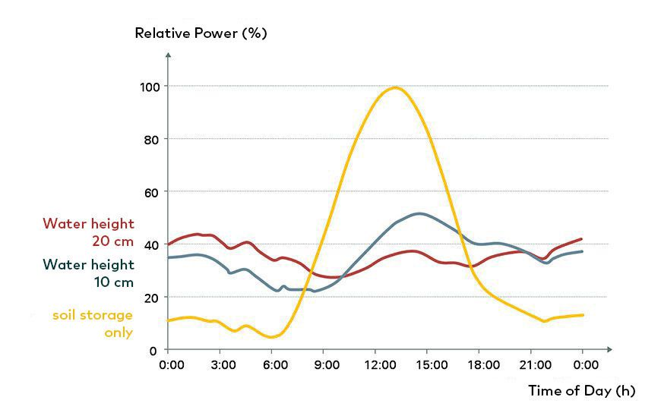
Water Bags/Hoses for Intermittency
Simulation Data
https://www.solar-updraft-tower.com/en/

Slide 8
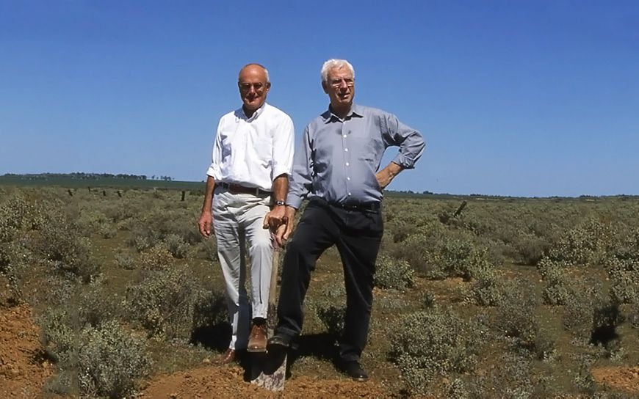
Manzanares Prototype
A 50 kW prototype SUTPP was built in Manzanares, Spain in 1981
Land was provided by Union Electrica Fenosa (Spanish utility)
Funded by German Ministry of Research and Technology
Design and construction headed by German engineers Jörg Schlaich and Rudolf Bergermann
Schlaich, J.; Bergermann, R.; Schiel, W.; Weinrebe, G. J. Sol. Energy Eng. 2005, 127, 117-124.
https://www.solar-updraft-tower.com/en/

Slide 9
Manzanares Prototype Video
video

Slide 10
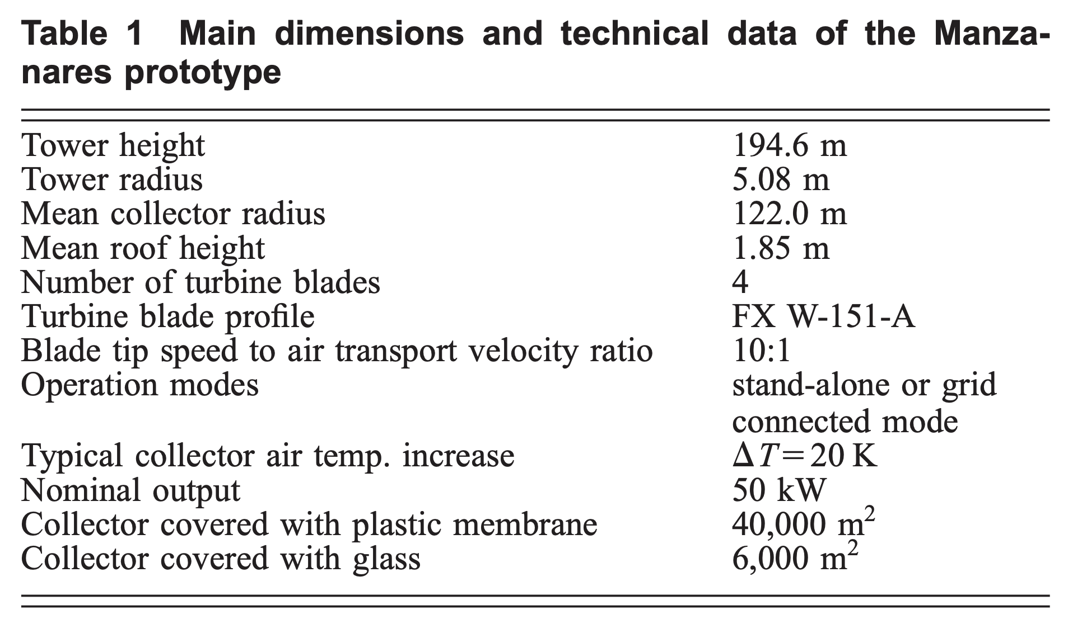
Manzanares Prototype
Tower was supported by guy lines extending from four heights in three directions; the plant was decommissioned in 1989 when these guy lines failed due to corrosion and the tower collapsed
During its operating lifetime (32 months, 1986-1989):
Plant ran when air velocity was > 2.5 m/s (automatic start-up)
Connected to the public grid
Averaged 8.9 hours/day of operation
Example year (1987):
  3067 hours of “good” insolation (>150 W/m² of global horizontal irradiation)
  Plant was operating and providing net positive power to the grid for 3157 hours (244 of these were at night)
Kalogirou, Soteris A. Solar Updraft Towers. In Solar Energy Engineering, Second Edition. Academic Press, 2013; pp. 565-570.
Schlaich, J.; Bergermann, R.; Schiel, W.; Weinrebe, G. J. Sol. Energy Eng. 2005, 127, 117-124.

Slide 11
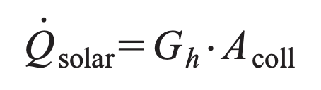
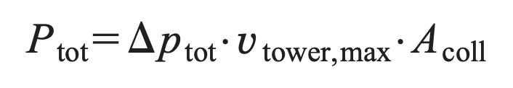
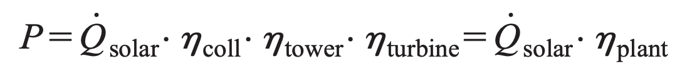
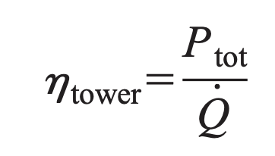
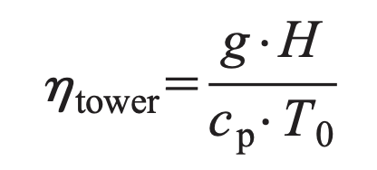
Power Capacity
Available Solar Power & Plant Efficiency
Q_{solar} = solar energy input
G_{h} = global horizontal radiation
Power in Airflow
𝚫p_{tot} = pressure difference at base of tower vs. ambient
Tower Efficiency
T₀ = ambient temperature
c_{p} = constant pressure specific heat
→ Tower efficiency depends only on tower height
Schlaich, J.; Bergermann, R.; Schiel, W.; Weinrebe, G. J. Sol. Energy Eng. 2005, 127, 117-124.
Notes:
G

Slide 12
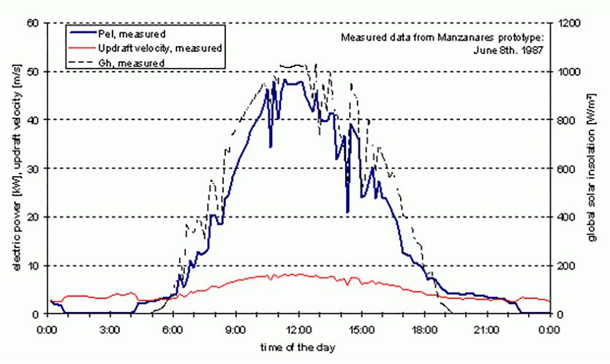
Power Capacity
Power capacity is proportional to collector area and tower height
To provide 200 MW with a 1000 m chimney height, the plant must cover an area of 38 km²
  Manzanares plant covered about 0.05 km²
Conversion efficiency of 1 kWh/m² (about 5%)
Updraft velocity and electric power output on a
typical day at the Manzanares prototype plant
https://www.solar-updraft-tower.com/en/
Kalogirou, Soteris A. Solar Updraft Towers. In Solar Energy Engineering, Second Edition. Academic Press, 2013; pp. 565-570.
Schlaich, J.; Bergermann, R.; Schiel, W.; Weinrebe, G. J. Sol. Energy Eng. 2005, 127, 117-124.

Slide 13
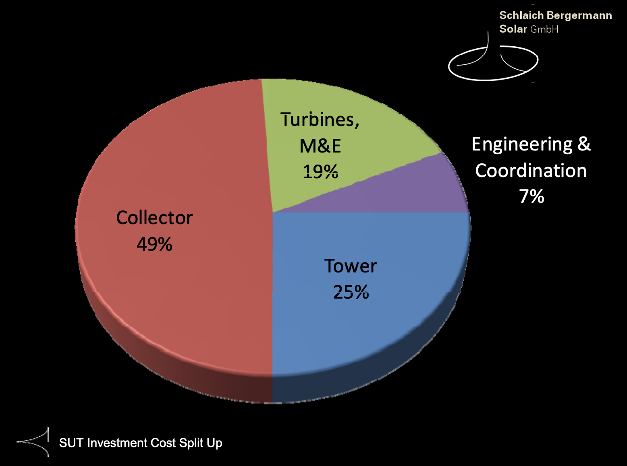
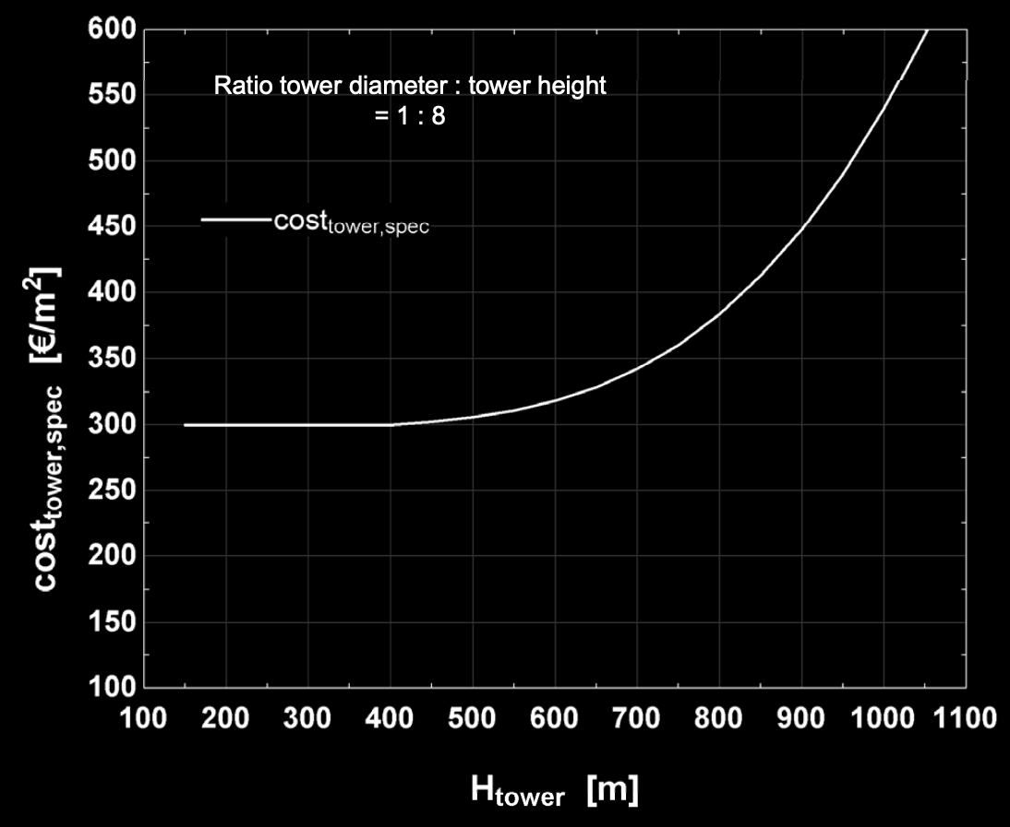
Cost
High capital cost
  Collector material costs
  Specialty construction of chimney
Low maintenance cost
  Turbine maintenance
  Plastic collectors must be replaced every few years
https://www.solar-updraft-tower.com/en/
Kalogirou, Soteris A. Solar Updraft Towers. In Solar Energy Engineering, Second Edition. Academic Press, 2013; pp. 565-570.

Slide 14
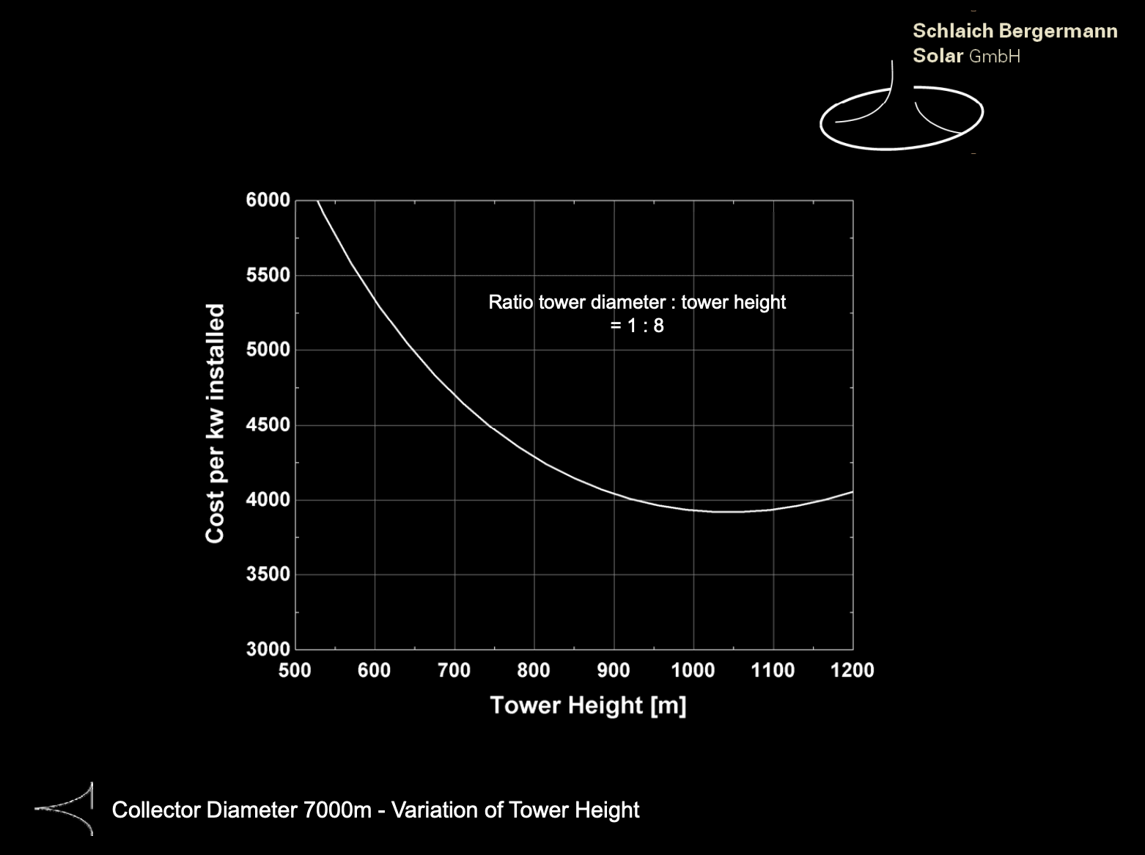
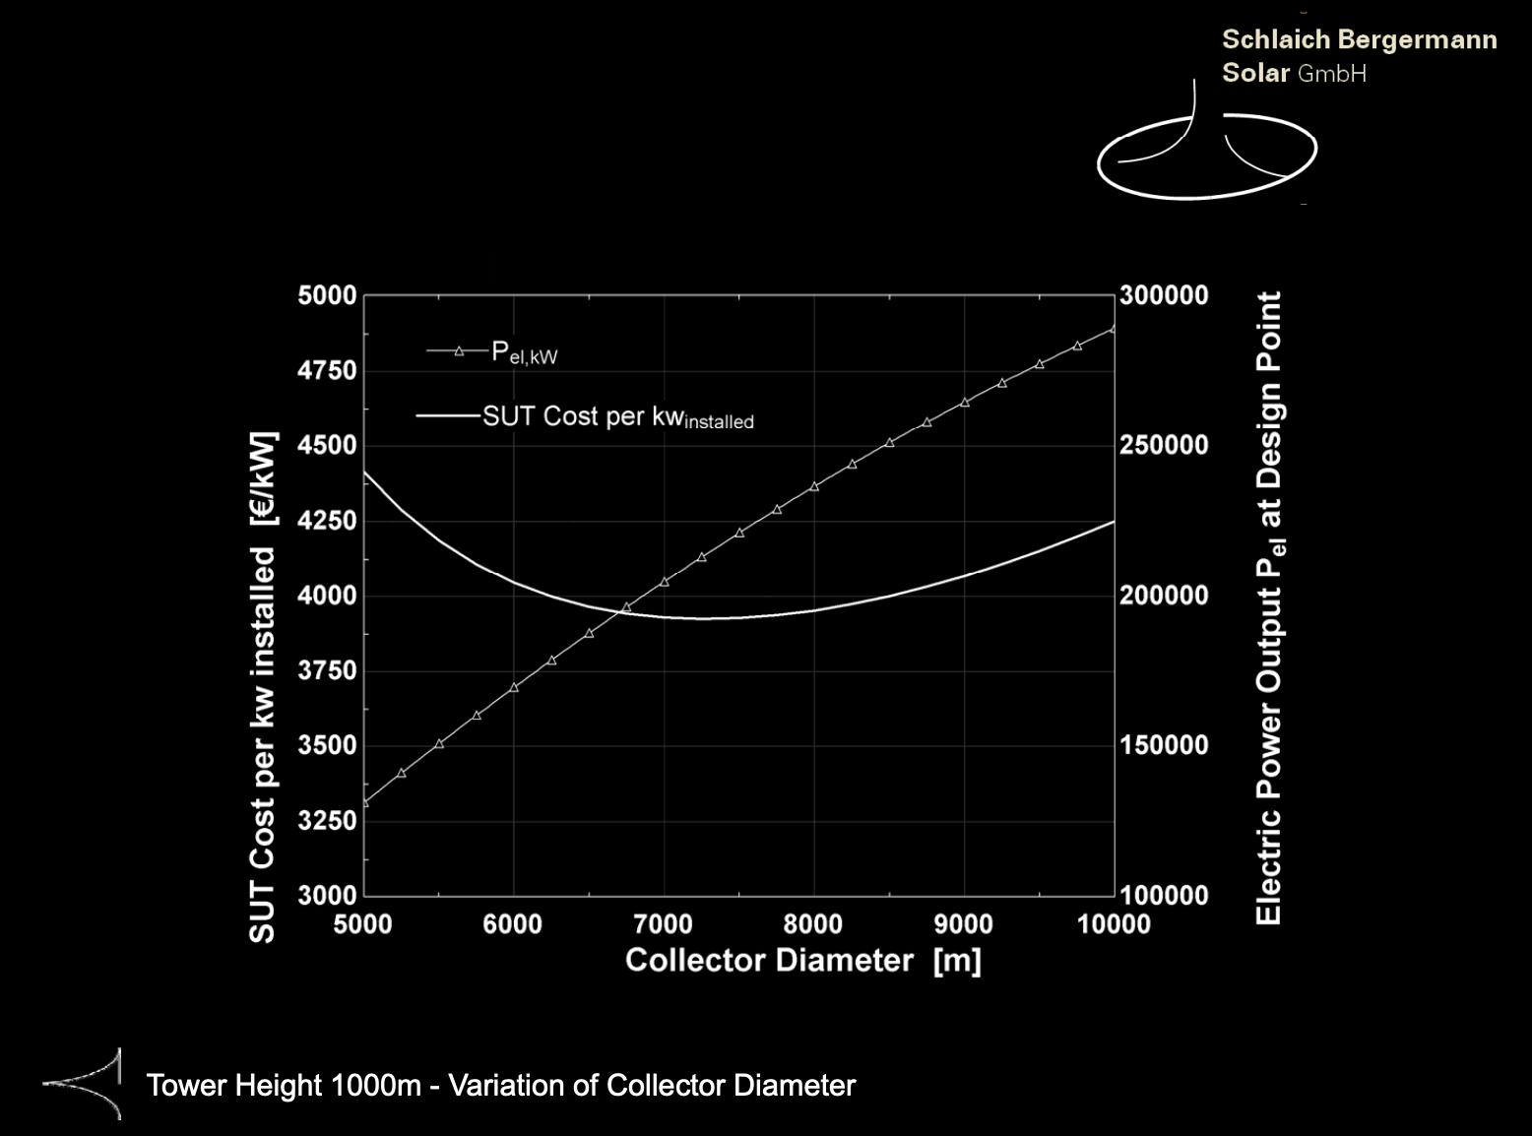
Cost
Cost per kW installed plotted against tower height
Minimum cost/kW around 1000 m tower height
Cost per kW installed and power output plotted against collector diameter
Larger collector = higher power output
Cost minimum at intermediate collector diameter
https://www.solar-updraft-tower.com/en/

Slide 15
Siting
Location requirements:
Large areas of flat, inexpensive land (no competition e.g. with agriculture)
No earthquakes to avoid costly tower modifications
Avoid areas with frequent sandstorms to reduce collector O&M costs and performance losses
Must have sufficient insolation
  Schlaich recommends average annual global solar radiation on a horizontal surface of
  > 1950 kWh/m² annually
A 1995 analysis indicated that an inexpensive local labor force and local construction materials are required to make SUTPPs affordable
For maximum performance, deserts with minimal sandstorms are ideal (low- to no-value land)
Kalogirou, Soteris A. Solar Updraft Towers. In Solar Energy Engineering, Second Edition. Academic Press, 2013; pp. 565-570.
Zhou, X.; Xu, Y. Solar Energy 2016, 128, 95-125.

Slide 16
Positive Environmental Impacts
Using collectors as a greenhouse can help with soil rehabilitation, forestry, desert cultivation
Air pollution management
Convective airflow from ground level to hundreds of meters above could be used to move harmful pollutants away from the land surface
Could alleviate harmful effects of landfill and urban pollution (however, available land is scarce in urban areas)
https://www.solar-updraft-tower.com/en/commercial-sut/components/
Zhou, X.; Xu, Y. Solar Energy 2016, 128, 95-125.

Slide 17
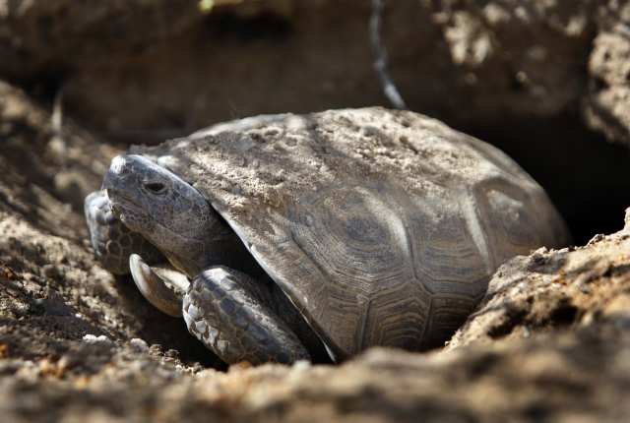
Negative Environmental Impacts
Tower height – may interfere with air travel
Collector area – may affect animal habitats
In California, an endangered desert tortoise’s habitat was threatened by a similar type of solar thermal power plant (Ivanpah solar project) and the project was halted by the Obama administration.
https://latimesblogs.latimes.com/greenspace/2011/04/desert-tortoise-ivanpah-brightsource-solar-energy-san-bernardino.html
Zhou, X.; Xu, Y. Solar Energy 2016, 128, 95-125.
Roosevelt, M. Endangered tortoises delay Mojave Desert solar plant. Los Angeles Times [Online], April 28, 2011; https://latimesblogs.latimes.com/greenspace/2011/04/desert-tortoise-ivanpah-brightsource-solar-energy-san-bernardino.html (accessed March 25, 2019).

Slide 18
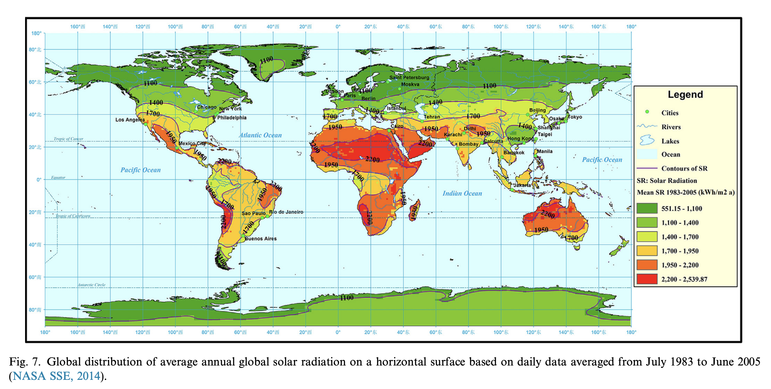
Global Insolation
  Desired: > 1950 kWh/m² annually
Zhou, X.; Xu, Y. Solar Energy 2016, 128, 95-125.

Slide 19
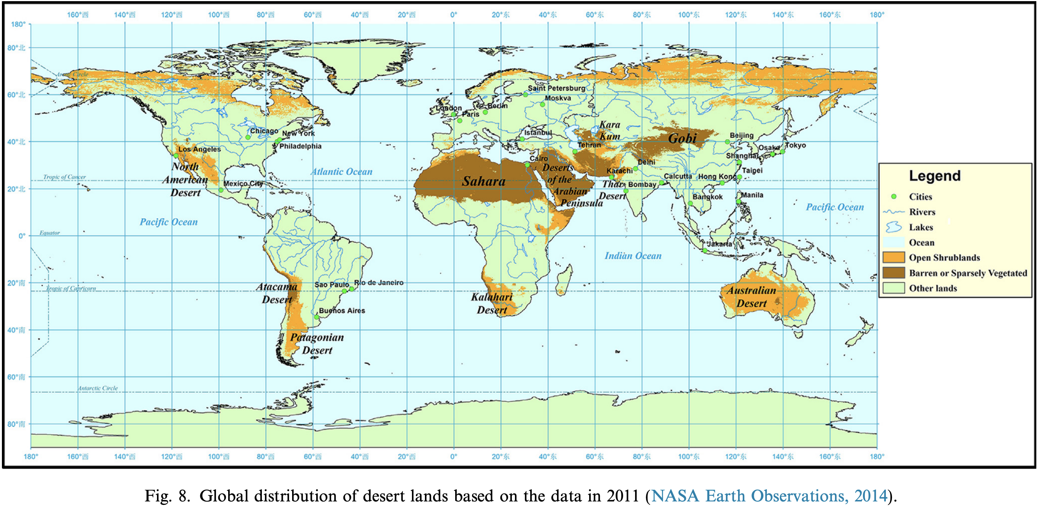
Global Desert Land
Zhou, X.; Xu, Y. Solar Energy 2016, 128, 95-125.

Slide 20
Thank you!

Slide 21
References
Kalogirou, Soteris A. Solar Updraft Towers. In Solar Energy Engineering, Second Edition. Academic Press, 2013; pp. 565-570.
Roosevelt, M. Endangered tortoises delay Mojave Desert solar plant. Los Angeles Times [Online], April 28, 2011; https://latimesblogs.latimes.com/greenspace/2011/04/desert-tortoise-ivanpah-brightsource-solar-energy-san-bernardino.html (accessed March 25, 2019).
Schlaich Bergermann Solar GmbH. https://www.solar-updraft-tower.com/en/ (accessed March 25, 2019).
Schlaich, J.; Bergermann, R.; Schiel, W.; Weinrebe, G. Design of Commercial Solar Updraft Tower Systems—Utilization of Solar Induced Convective Flows for Power Generation. J. Sol. Energy Eng. 2005, 127, 117-124.
Zhou, X.; Xu, Y. Solar updraft tower power generation (Review). Solar Energy 2016, 128, 95-125.
Title slide photograph: https://www.solar-updraft-tower.com/en/concept/prototype-manzanares/
Thank you!

