Slide 1
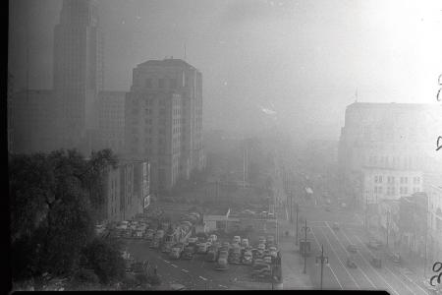
Scientific and Political Evolutions of the Clean Air Act
Bridger Ruyle & Hannah Nesser
LA Civic Center, 1948
(Source: Cal Tech)

Slide 2
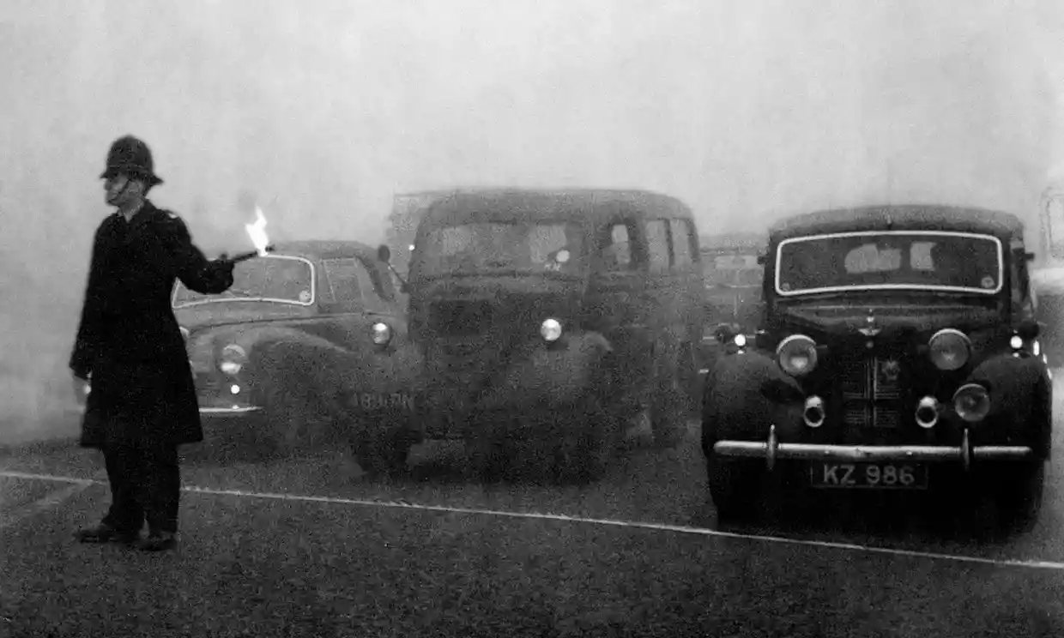
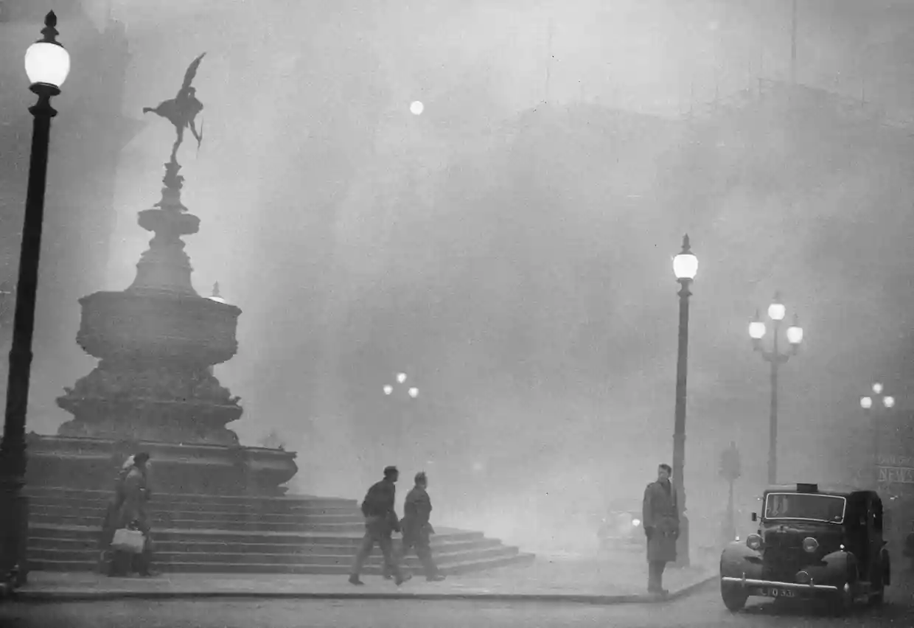
Air Pollution in the Mid-20th Century
London, December 1952
(Source: The Guardian)
London, December 1952
(Source: The Guardian)
LA Civic Center, 1948
(Source: Cal Tech)
Notes:
December 5-9, 1952: The Great London Smog
At least 4,000-12,000 people died over the course and aftermath of the week long smog event--infants and elderly were particularly vulnerable
-combination of atmospheric conditions and emissions (factory emissions/coal fires/etc)

Slide 3
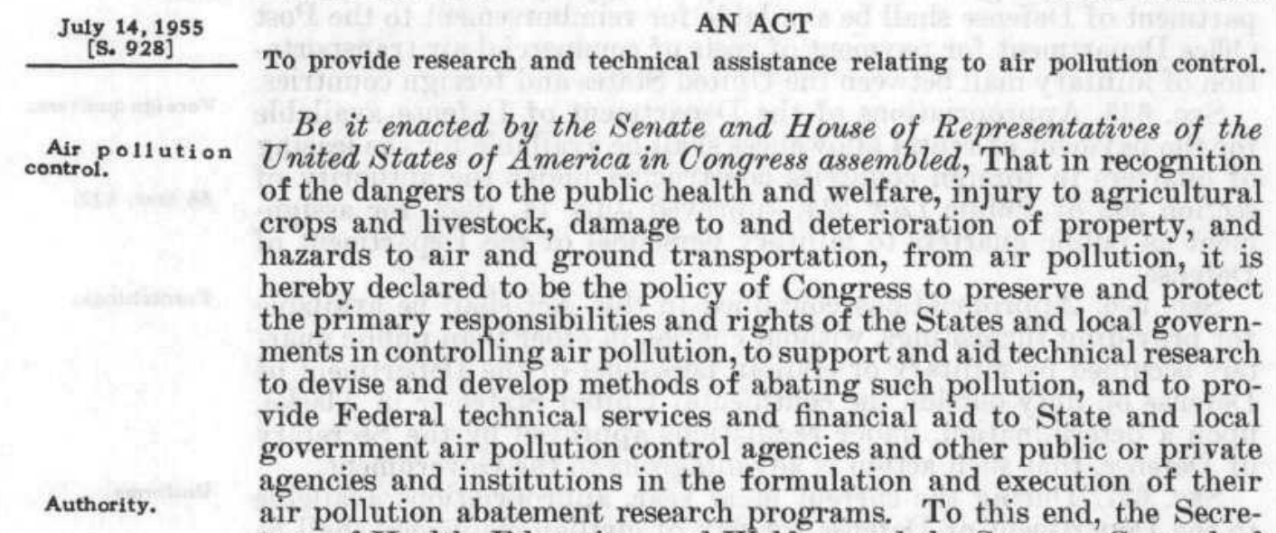
1955 Air Pollution Control Act
Supports research, not standard development or enforcement
Emphasizes state rights and authority
Notes:
Established first piece of air pollution legislation in 1955.
The act directed the surgeon general (the EPA didn’t exist at the time) to develop a research and technical assistance program. It did not allow the formation of standard development or enforcement. It also defaulted to states rights.
Authorized surgeon general to prepare or recommend research programs for reducing air pollution
Authorized surgeon general to encourage state and local governments to take air pollution reduction measures
Authorized surgeon general to, upon request of any state or local gov. air pollution control agency to conduct investigations and research concerning any specific air pollution problem
Called upon the surgeon general to prepare and publish reports of research, including recommendations for air pollution control
Authorized funding for this purpose

Slide 4
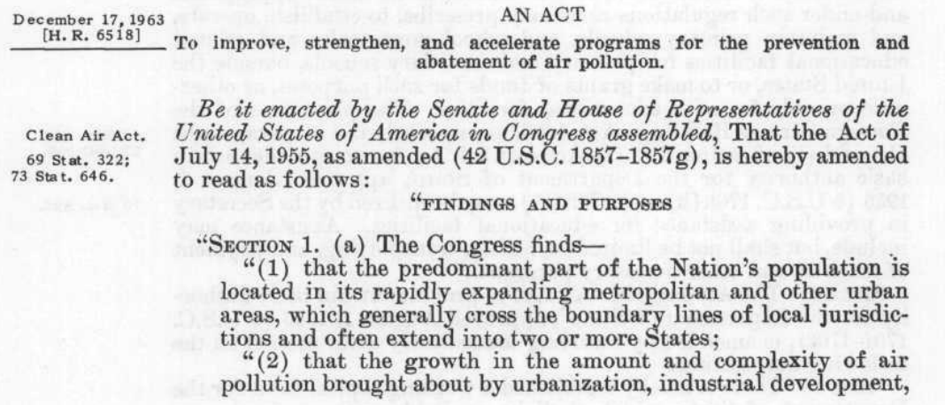
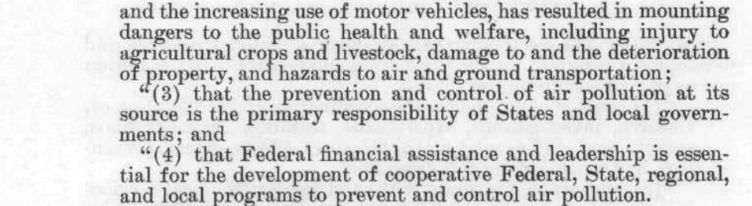
1963 Clean Air Act
1955 Air Pollution Control Act:
“To provide research and technical assistance relating to air pollution control.”
Formally recognizes interstate nature of air pollution
“The Secretary may recommend to such air pollution control agencies and to other appropriate organizations … criteria of air quality as in his judgment may be necessary to protect the public health and welfare.”
Maintains emphasis on state rights
Notes:
However, AQ continued to be a problem. On Dec. 17, 1963, congress passed the Clean Air Act. The EPA still didn’t exist, so it acted through the Dept. of Health and Human Services. The goal of this act emphasized “prevention and abatement” instead of “research and technical assistance.” It also recognized that air pollution is an issue that crosses state boundaries, requiring federal intervention--however, the bill still maintained its emphasis on state rights, something that is clear throughout the bill, but for example, is clear in the statement of the secretary’s power to establish air quality criteria. However, it still gave the secretary some power to take legal action against polluters in some limited circumstances.
Nonetheless: the bill authorized $95 million in appropriations over four years--equivalent to $770 million today.
Passed on Dec. 17, 1963
Authorized a total of $95 million in appropriations over four years (1964 – 1967) to combat air pollution (this is equivalent to $770 million today) (and equivalent to approximately 2% of the EPA’s operating budget at the time)
Replaced the Air Pollution control Act
Gave primary responsibility to state and local governments but gave the federal gov an active role (take legal action to curb AP, provide financial aid for state and local AP control programs)--FEDERALISM
Pollution control through expanded research, establishment of more PC agencies/programs, federal financial grants for control and prevention, legal action against polluters

Slide 5
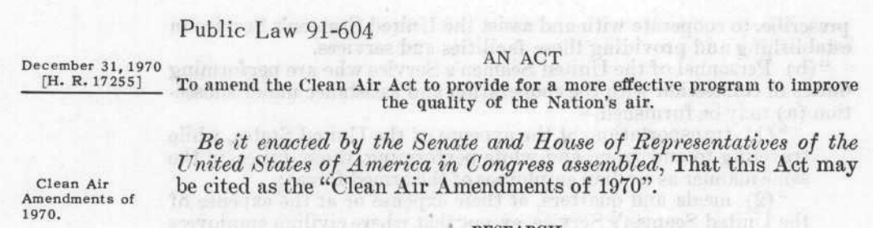
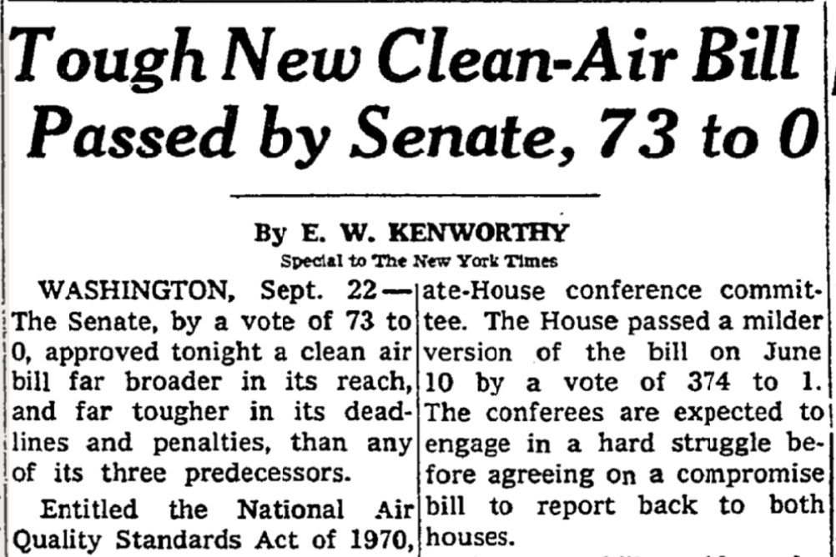
1970 Clean Air Act Amendments
1963 Clean Air Act Amendments:
“To improve, strengthen, and accelerate programs for the prevention of and abatement of air pollution.”
Notes:
Continued smog
first earth day
Nixon is president
establishes CEQ and EPA
also passes 1970 Clean Air Act Amendments
Passed the 1970 amendments: very popular.
The goal of the act emphasized increasing the efficacy of federal regulation of air pollution

Slide 6
1970 Clean Air Act Amendments
National Ambient Air Quality Standards (NAAQS)
National Emission Standards for Hazardous Air Pollutants (HAPs)
New & Existing Source Performance Standards
State Implementation Plans (SIPs)
Motor Vehicle & Fuel Emission Standards
Notes:
It did so through five major developments

Slide 7
National Ambient Air Quality Standards (NAAQS)
Pollutant | Standard | Indicator | Average Time | Level | Form
Carbon Monoxide (CO) | Both | CO | 1-hr | 35 ppm | Not to be exceeded more than once per year
 |  |  | 8-hr | 9 ppm | Not to be exceeded more than once per year
Nitrogen Oxides (NOx) | Both | NO2 | Annual | 53 ppb | Annual arithmetic mean
Total photochemical oxidants (Ozone (O3)) | Both | Total photochemical oxidants | 1-hr | 0.08 ppm | Not to be exceeded more than once per year
Particulate Matter (PM) | Primary | Total solid particulate | 24-hr | 260 μg/m3 | Not to be exceeded more than once per year
 |  |  | Annual | 75 μg/m3 | Annual geometric mean
 | Secondary |  | 24-hr | 150 μg/m3 | Not to be exceeded more than once per year
 |  |  | Annual | 60 μg/m3 | Annual geometric mean
Sulfur Oxides (SOx) | Primary | SO2 | 24-hr | 0.14 ppm | Not to be exceeded more than once per year
 |  |  | Annual | 0.03 ppm | Annual arithmetic mean
 | Secondary |  | 3-hr | 0.5 ppm | Not to be exceeded more than once per year
 |  |  | Annual | 0.02 ppm | Annual arithmetic mean
Hydrocarbons | Both | Total non-methane hydrocarbons | 3-hr | 0.24 ppm | Not to be exceeded more than once per year
Notes:
Section 108: Air Quality Criteria and Control Techniques
“... the Administrator shall … publish, and shall from time to time thereafter revise, a list which includes each air pollutant … which in his judgment has an adverse effect on public health or welfare….
Section 109: National Ambient Air Quality Standards
“... [the Administrator] shall publish proposed regulations prescribing a national primary ambient air quality standard and a national secondary ambient air quality standard for each air pollutant for which air quality criteria have been issued….”
primary: requisite to protect public health
secondary: protect the public welfare from any known or anticipated adverse effects
criteria should include
(A) those variable factors (including atmospheric conditions) which of themselves or in combination with other factors may alter the effects on public health or welfare of such air pollutant;
(B) the types of air pollutants which, when present in the atmosphere, may interact with such pollutant to produce an adverse effect on public health or welfare; and
(C) any known or anticipated adverse effects on welfare.”
EPA Sets National Air Quality Standards
[EPA press release - April 30, 1971]
William D. Ruckelshaus, Administrator of the Environmental Protection Agency, today announced final publication of National air quality standards for six common classes of pollutants--sulfur oxides, particulate matter, carbon monoxide, photochemical oxidants, nitrogen oxides and hydrocarbons.

Slide 8
National Ambient Air Quality Standards (NAAQS): Present
Pollutant |  | Standard | Indicator | Average Time | Level | Form
Carbon Monoxide (CO) |  | Both Primary | CO | 1-hr | 35 ppm | Not to be exceeded more than once per year
 |  |  |  | 8-hr | 9 ppm | Not to be exceeded more than once per year
Nitrogen Oxides (NOx) |  | Primary | NO2 | 1-hr | 100 ppb | 98th percentile of 1-hr daily maximum concentrations, averaged over 3 years
 |  | Both |  | Annual | 53 ppb | Annual arithmetic mean
Total photochemical oxidants (Ozone (O3)) |  | Both | Total photochemical oxidants O₃ | 1-hr 8-hr | 0.08 ppm 0.070 ppm | Not to be exceeded more than once per year Annual fourth-highest daily maximum 8-hour concentration, averaged over 3 years
Particulate Matter (PM) | PM_{2.5} | Primary | Total Solid Particulate PM_{2.5} | Annual | 75 μg/m3 12.0 μg/m3 | Annual geometric mean, averaged over 3 years
 |  | Secondary |  | Annual | 60 μg/m3 15.0 μg/m3 | Annual geometric mean, averaged over 3 years
 |  | Both |  | 24-hr | 260 and 150 μg/m3 35 μg/m3 | Not to be exceeded more than once per year 98th percentile, averaged over 3 years
 | PM₁₀ | Both | Total Solid Particulate PM₁₀ | 24-hr | 260 and 150 μg/m3 | Not to be exceeded more than once per year on average over 3 years
Sulfur Oxides (SOx) |  | Primary | SO2 | 24-hr 1-hr | 0.14 ppm 75 ppb | Not to be exceeded more than once per year 99th percentile of 1-hour daily maximum concentrations, averaged over 3 years
 |  | Secondary |  | 3-hr | 0.5 ppm | Not to be exceeded more than once per year
Hydrocarbons Lead (Pb) |  | Both | Pb | Rolling 3-mo. | 0.15 μg/m3 | Not to be exceeded
Notes:
Two main takeaways:
Changes in the regulated pollutants
TPO → O3
PM → PM2.5 and PM10
Elimination of hydrocarbons
Addition of lead
Decrease in standards
many standards maintained (CO, O3)
Many standards decreased sharply--esp PM
Eliminated annual SO2 standard as well
CHECK THE OZONE STANDARD--MIGHT BE 2015 BUT 2012 IS STILL IN PLACE?

Slide 9
National Emission Standards for Hazardous Air Pollutants (HAPs)
“The term 'hazardous air pollutant' means an air pollutant to which no ambient air quality standard is applicable and which in the judgment of the administrator may cause, or contribute to, an increase in mortality or an increase in serious irreversible, or incapacitating reversible, illness.”
Asbestos
Benzene
Beryllium
Coke oven emissions
Inorganic arsenic
Mercury
Radionuclides
Vinyl chloride
Notes:
“After the effective date of any emission standard under this section—
“(A) no person may construct any new source or modify any existing source which … will emit an air pollutant to which such standard applies unless the … source if properly operated will not cause emissions in violation of such standard, and
“(B) no air pollutant to which such standard applies may be emitted from any stationary source in violation of such standard….”
Preamendment § 112 was ambiguous on the breadth of the Administrator's discretion to regulate a substance as a HAP.⁹ The weighing of risks was left to the discretion of the EPA Administrator.
Implicit in this statutory timetable was the assumption that EPA would have ready access to reliable scientific data that would allow it to easily determine the extent of human exposure, the distribution of emissions, and the health risks posed.
EPA's effort to implement the former § 112 program was further complicated by the lack of clarity in the standard-setting process.
The statutory phrase "ample margin of safety" created a particularly thorny problem for the Agency whenever a substance was carcinogenic.
Additionally, § 112 did not expressly authorize EPA to consider technological constraints or economic considerations in setting a NESHAP standard.

Slide 10
New & Existing Source Performance Standards
Regulation of emissions starting with the source instead of the pollutant
Identify stationary sources by category that contribute significantly to air pollution
  Electricity Generating Utilities (EGUs), waste sector, etc.
Establish performance standards for sources within the category
  Best System of Emission Reduction (BSER): “adequately demonstrated”

Slide 11
CO₂ New Source Performance Standard
Source | BSER | NSPS
Newly Constructed Fossil Fuel-Fired Steam Generating Units | Efficient new supercritical pulverized coal utility boiler implementing partial carbon capture and storage (CCS) | 1,400 lb CO₂/MWh-g
Modified Fossil Fuel-Fired Steam Generating Units and Reconstructed Fossil Fuel-Fired Steam Generating Units | Best operating practices and equipment upgrades | 1,800 lb CO₂/MWh-g for sources with heat input > 2,000 MMBtu/h 2,000 lb CO₂/MWh-g for sources with head input ≤ 2,000 MMBtu/h
Newly Constructed and Reconstructed Fossil Fuel-Fired Stationary Combustion Turbines | Natural gas combined cycle | 1,000 lb CO₂/MWh-g or 1,030 lb CO₂/MWh-n for base load natural gas 120 lb CO₂/MMBtu for non-base load natural gas 120-160 lb CO₂/MMBtu for multi-fuel
Notes:
MWh-g = megawatt-hour gross – total amount of electricity generated
MWh-n = megawatt-hour net – total amount of electricity delivered by power plant

Slide 12
State Implementation Plans (SIPs)
“Each State shall … adopt and submit to the Administrator, within nine months after the promulgation of a national primary [and secondary] ambient air quality standard (or any revision thereof) … for any air pollutant, a plan which provides for implementation, maintenance, and enforcement of such primary [and secondary] standard in each air quality control region (or portion thereof) within such State.”
SIPs must:
Achieve primary NAAQS as quickly as possible (but within three years) and secondary NAAQS within a “reasonable time” specified by the SIP;
Include a plan for new source review;
Provide for periodic inspection of motor vehicle emissions;
Include a plan to monitor air quality;
Include “adequate provisions” for intergovernmental cooperation to address interstate air pollution;
And more! ← SIPs are designed to ensure compliance with the CAA
Notes:
Enforcement mechanism--essentially

Slide 13
Motor Vehicle & Fuel Emission Standards
“The Administrator shall by regulation prescribe (and from time to time revise) … standards applicable to the emission of any air pollutant … new motor vehicles or new motor vehicle engines, which in his judgment causes or contributes to, or is likely to cause or to contribute to, air pollution which endangers the public health or welfare. Such standards shall be applicable to such vehicles and engines for their useful life….”
Required a 90% reduction in CO and hydrocarbon emissions from light duty vehicles and engines manufactured relative to model year 1970 by 1975.
Required a 90% reduction in NO_{x} emissions from light duty vehicles and engines manufactured relative to model year 1971 by 1976.
[Ruckelshaus] said the carbon monoxide problem would be difficult to solve. "Of seven major cities ... only one … will come close with the presently contemplated automobile controls in the time allowed. And [it] will not actually reach the standard until 1977…." In the other six cities … the Federal motor vehicle control program would not bring air pollution down to the standard until sometime in the 1980s.
Notes:
Emphasized hydrocarbon and NOx emissions--aggressive standards
The EPA recognized the challenge of these standards at the time
So it’s not surprising that new amendments were needed shortly--leading us to the 1977 amendments

Slide 14
1977: Introduction of New Source Review
Non-degradation: How to protect air quality NAAQS attainment areas from deteriorating
Title 1
Part C: Prevention of Significant Deterioration
Part D: Plan Requirements for Nonattainment Areas
Extensive permitting process for all major sources in NAAQS attainment areas
  100 ton/yr of any individual NAAQS
  250 ton/yr of total emissions
Requires the implementation of “Best Available Control Technology” for all emissions
Permitting process conducted by the states with EPA guidance on control technologies
Cousin of Prevention of Significant Deterioration for major sources in NAAQS non-attainment areas
Requires the implementation of “Lowest Achievable Emission Rate”
Notes:
Best Available Control Technology – emissions limitation based on the maximum degree of control that can be achieved. Case-by-case decision that considers energy, environmental, and economic impact. BAC can be control equipment or process/methods modifications.
LAER – most stringent emission limitation contained in the implementation plan of any State for such source or the most stringent emission limitation achieved in practice by such source
Passed on Dec. 17, 1963
Authorized a total of $95 million in appropriations over four years (1964 – 1967) to combat air pollution (this is equivalent to $770 million today) (and equivalent to approximately 2% of the EPA’s operating budget at the time)
Replaced the Air Pollution control Act
Gave primary responsibility to state and local governments but gave the federal gov an active role (take legal action to curb AP, provide financial aid for state and local AP control programs)--FEDERALISM
Pollution control through expanded research, establishment of more PC agencies/programs, federal financial grants for control and prevention, legal action against polluters

Slide 15
New Source Review:
File petition with state to perform facility changes, upgrades, maintenance
State review based on EPA guidelines to determine whether petition results in (1) significant emissions increase and (2) significant new emissions increase
No permitting required
Least time and money
Routine Maintenance, Repair, and Replacement (RMRR)
Prevention of Significant Deterioration Permit
“Best Available Control Technology”
$$ + years
Nonattainment NSR Permit
Lowest Achievable Emission Rate
$$$ + years
NSR ≠ NSPS
Final permit issued by state
Notes:
Permits are mostly issued by the state

Slide 16
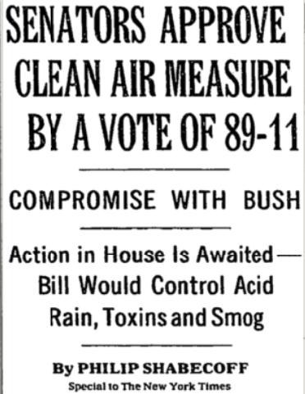
1990 Clean Air Act Amendments
President Bush proposed sweeping revisions to the Clean Air Act in June 1989.
The amendments passed the House 401-21 and the Senate 89-11.
According to the New York Times, “The bill is likely to add more than $20 billion a year to the estimated $33 billion cost of meeting current pollution laws.”

Slide 17
1990 Clean Air Act Amendments
Acid Rain
Urban Air Pollution
Toxic Air Pollutants
Ozone-Depleting Substances
National Permits Program
Improved Enforcement Program
Notes:
An estimated 20 million tons of SO₂ emitted annually
------
Persistent ozone, carbon monoxide, and particulate matter pollution
Vehicles responsible for almost half of VOC and NO_{x} emissions and for up to 90% of carbon monoxide emissions in urban areas
requires the Federal government to reduce emissions from cars, trucks, and buses; from consumer products such as hair spray and window washing compounds; and from ships and barges during loading and unloading of petroleum products.
Required reductions in emissions from evaporation of gas during refueling
Required reductions in gasoline volatility and diesel sulfur conten
-------
Estimated that more than 2.7 billion pounds of toxic air pollutants emitted each year, resulting in 1,000 to 3,000 cancer deaths
-----
Required air pollution sources to obtain a permit
Increased EPA authority to issue fines
Enhanced civil judicial penalties
Upgraded criminal penalties for knowing violations from misdemeanors to felonies
Required sources to certify compliance
Pres. Bush proposed sweeping revisions in June 1989
t

Slide 18
1990 Clean Air Act Amendments
Acid Rain
Established a cap-and-trade program to reduce SO2 emissions by 10 million tons from 1980 levels
Urban Air Pollution
Focused on hydrocarbons to decrease ozone
Tightened emission standards for cars, trucks, and gasoline
Toxic Air Pollutants
Expanded listed HAPS from 7 to 189 compounds
Ozone-Depleting Substances
Required complete phase-out of CFCs by the Montreal Protocol deadline and established more stringent interim reductions
National Permits Program
Improved Enforcement Program
Notes:
An estimated 20 million tons of SO₂ emitted annually
------
Persistent ozone, carbon monoxide, and particulate matter pollution
Vehicles responsible for almost half of VOC and NO_{x} emissions and for up to 90% of carbon monoxide emissions in urban areas
requires the Federal government to reduce emissions from cars, trucks, and buses; from consumer products such as hair spray and window washing compounds; and from ships and barges during loading and unloading of petroleum products.
Required reductions in emissions from evaporation of gas during refueling
Required reductions in gasoline volatility and diesel sulfur conten
-------
Estimated that more than 2.7 billion pounds of toxic air pollutants emitted each year, resulting in 1,000 to 3,000 cancer deaths
-----
Required air pollution sources to obtain a permit
Increased EPA authority to issue fines
Enhanced civil judicial penalties
Upgraded criminal penalties for knowing violations from misdemeanors to felonies
Required sources to certify compliance
Pres. Bush proposed sweeping revisions in June 1989
t

Slide 19
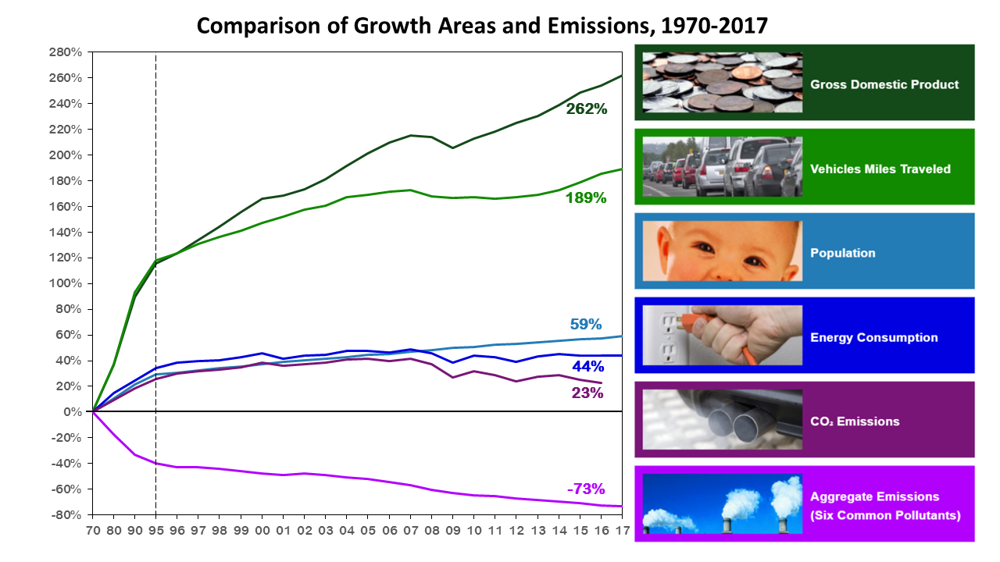
The Legacy of the Clean Air Act

Slide 20
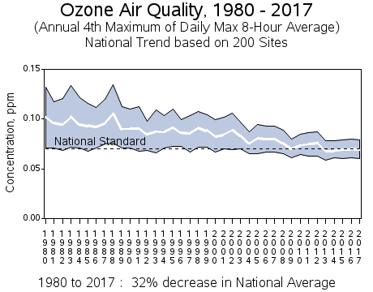
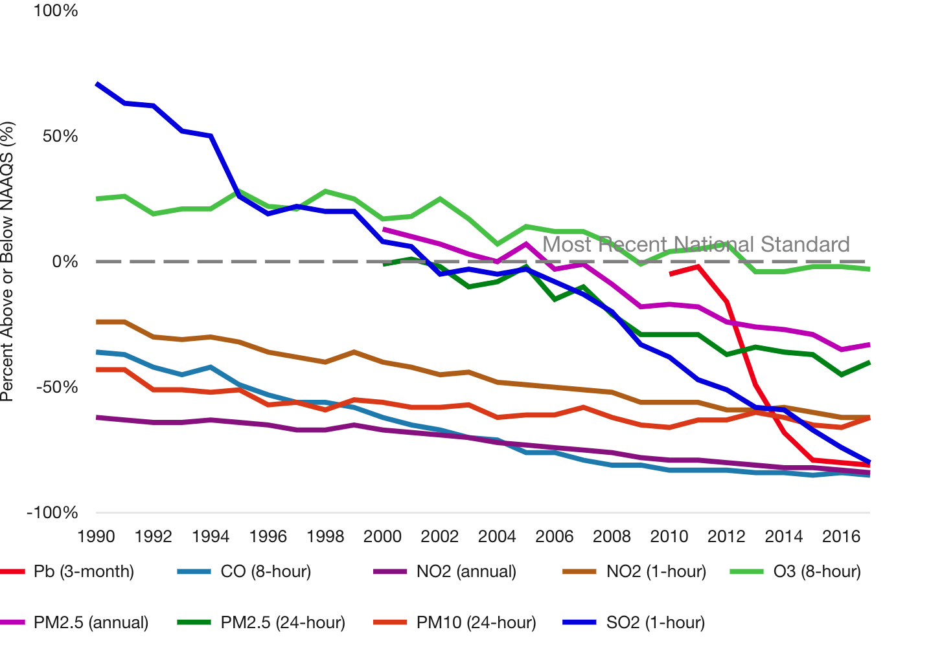
Ground-Level Ozone Remains a Challenge
Notes:
Nationally, average ozone levels declined in the 1980's, leveled off in the 1990's, and showed a notable decline after 2002.

Slide 21
Understanding Ground-Level Ozone Formation
EPA Sets National Air Quality Standards
[EPA Press Release - April 30, 1971]
“... the relationship between levels of hydrocarbons and nitrogen oxides in the air and the production of photochemical oxidants is so complex and at this juncture so little understood, that it is difficult to predict whether or not the Nation will meet the standards for these pollutants in the time allowed by the law.”
LA Civic Center, 1948
(Source: Cal Tech)
Notes:
Talk about ozone as an air pollutant--health and environment--ozone as an oxidant
The presence of high concentrations of O3 in smog was first discovered in Los Angeles in the 1950s. Previously, it was thought that tropospheric ozone originated in the stratosphere. However, laboratory chamber experiments conducted at the time showed that O3 was generated by photochemical reactions in the atmosphere involving hydrocarbons and NOx emitted from automobiles.
The details of the chemical mechanism were poorly understood until the 1970s, however, because the essential role of OH as a hydrocarbon oxidant was not recognized ( section 11.1 ).

Slide 22
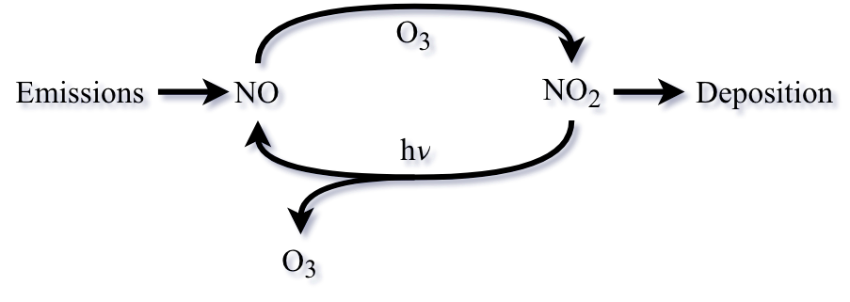



Understanding Ground-Level Ozone Formation

Slide 23
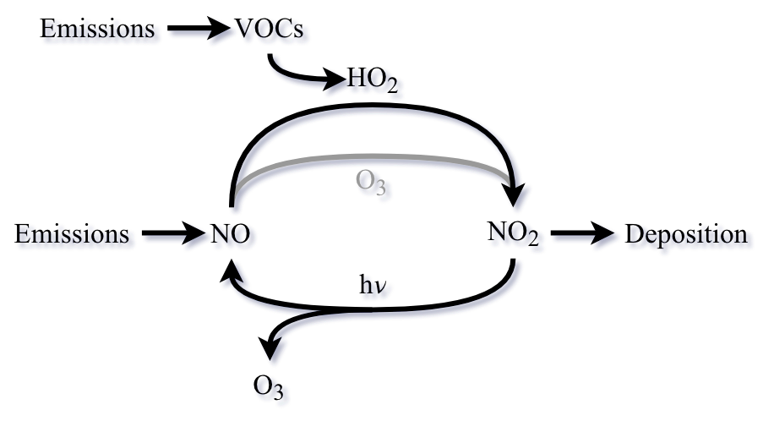

Understanding Ground-Level Ozone Formation

Slide 24
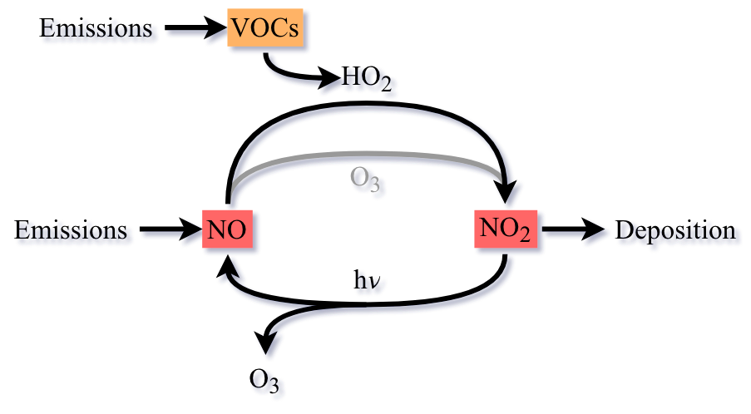
Understanding Ground-Level Ozone Formation

Slide 25
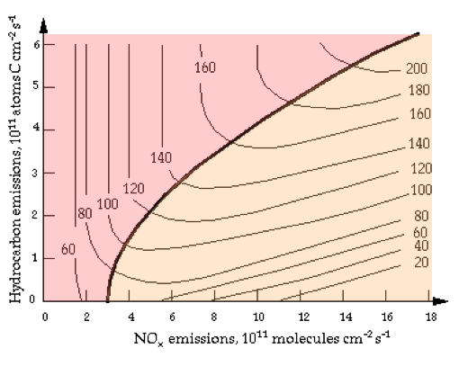
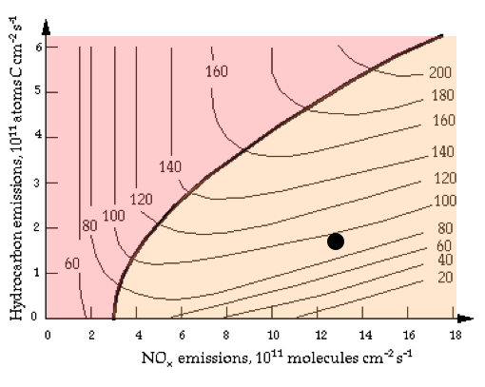
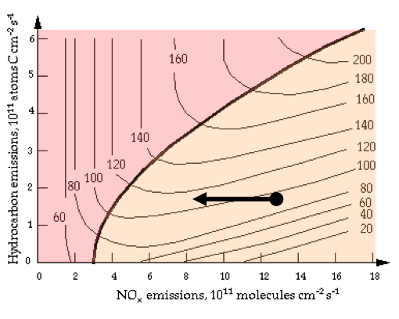
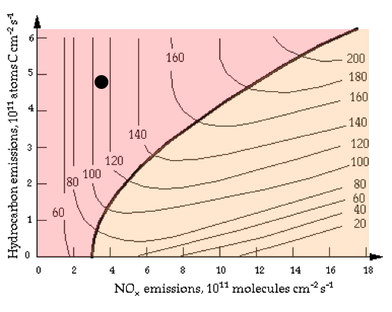
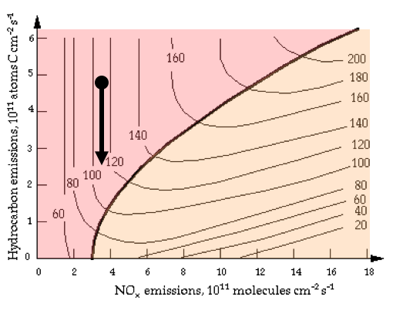
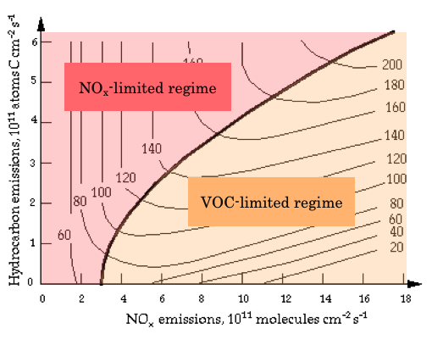
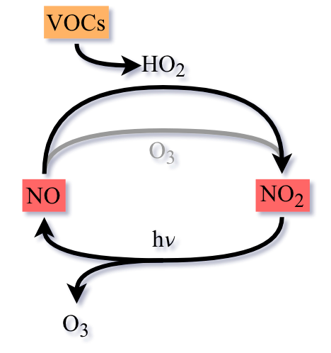
Understanding Ozone: VOC- and NOx-Limited Regimes
Notes:
The first models developed after the 1970 Clean Air Act concluded that O3 production was in general hydrocarbon-limited. This finding led to a strong regulatory effort to control hydrocarbon emissions from automobiles and industry. Emissions of NOx were also controlled, due at least initially to concern over the health effects of NO2 (a hazardous pollutant in its own right), but the effort was less than for hydrocarbon emissions. Controlling emissions has been an uphill battle because of the continuously rising population and fuel combustion per capita. Between 1980 and 1995, anthropogenic emissions of hydrocarbons in the United States decreased by 12% and NOx emissions remained constant, a significant achievement considering that population grew by 20% and automobile usage rose by 60%. Some areas such as Los Angeles enacted even more stringent emission reduction policies than the rest of the nation.
An important discovery in the past decade is that the focus on hydrocarbon emission controls to combat O3 pollution may have been partly misdirected. Measurements and model calculations now show that O3 production over most of the United States is primarily NOx-limited, not hydrocarbon-limited. The early models were in error in part because they underestimated emissions of hydrocarbons from automobiles, and in part because they did not account for natural emission of biogenic hydrocarbons from trees and crops. As can be seen from Figure 12-4 , an upward revision of hydrocarbon emissions (upward translation along the hydrocarbon coordinate) can shift the chemical regime from hydrocarbon- to NOx-limited.

Slide 26
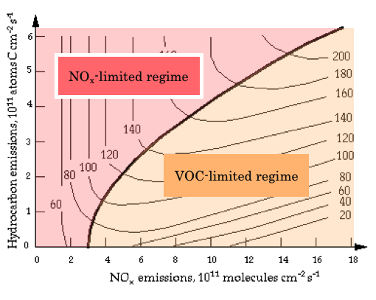
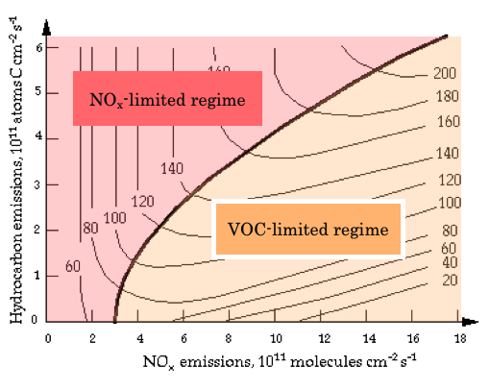
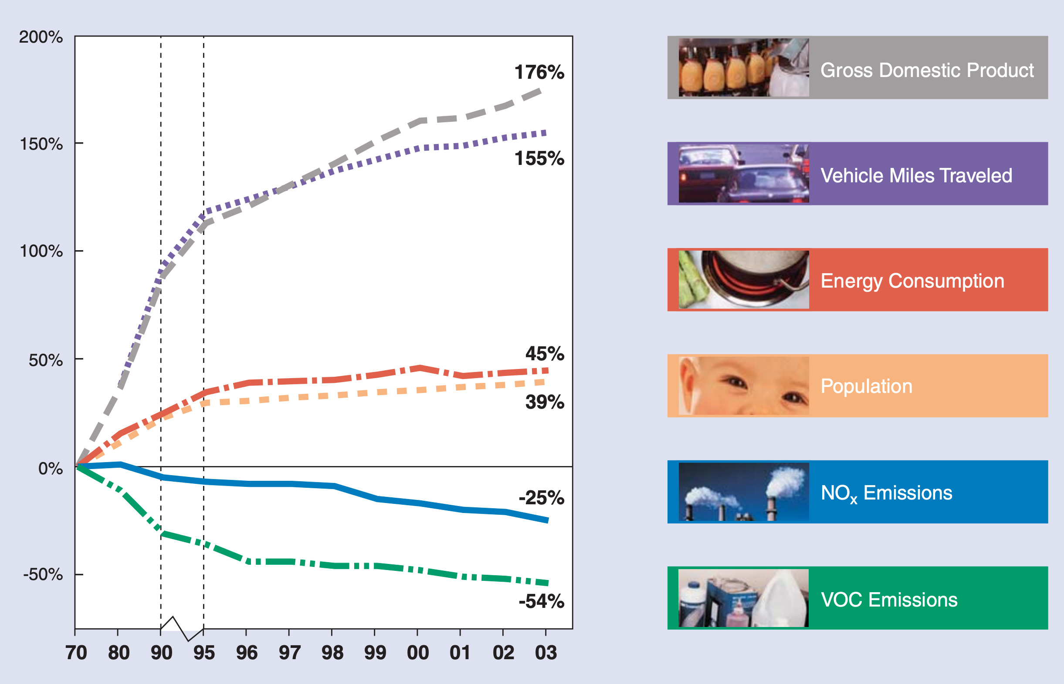
Regulating Ozone
1990 Clean Air Act Amendment Summary
“While there are other reasons for continued high levels of ozone pollution, such as growth in the number of stationary sources of hydrocarbons and continued growth in automobile travel, perhaps the most telling reason is that the remaining sources of hydrocarbons are also the most difficult to control.”
Source: EPA
Original Criteria Air Pollutants
Pollutant
Carbon Monoxide (CO)
Nitrogen Oxides (NOx)
Total photochemical oxidants (Ozone (O3))
Particulate Matter (PM)
Sulfur Oxides (SOx)
Hydrocarbons
Source: Environmental Protection agency
Notes:
The first models developed after the 1970 Clean Air Act concluded that O3 production was in general hydrocarbon-limited. This finding led to a strong regulatory effort to control hydrocarbon emissions from automobiles and industry. Emissions of NOx were also controlled, due at least initially to concern over the health effects of NO2 (a hazardous pollutant in its own right), but the effort was less than for hydrocarbon emissions. Controlling emissions has been an uphill battle because of the continuously rising population and fuel combustion per capita. Between 1980 and 1995, anthropogenic emissions of hydrocarbons in the United States decreased by 12% and NOx emissions remained constant, a significant achievement considering that population grew by 20% and automobile usage rose by 60%. Some areas such as Los Angeles enacted even more stringent emission reduction policies than the rest of the nation.
An important discovery in the past decade is that the focus on hydrocarbon emission controls to combat O3 pollution may have been partly misdirected. Measurements and model calculations now show that O3 production over most of the United States is primarily NOx-limited, not hydrocarbon-limited. The early models were in error in part because they underestimated emissions of hydrocarbons from automobiles, and in part because they did not account for natural emission of biogenic hydrocarbons from trees and crops. As can be seen from Figure 12-4 , an upward revision of hydrocarbon emissions (upward translation along the hydrocarbon coordinate) can shift the chemical regime from hydrocarbon- to NOx-limited.

Slide 27
Regulating Greenhouse Gas Emissions under the Clean Air Act

Slide 28

Title 1: A three-pronged approach, little opportunity
Section 107-110
Section 111
Section 112
Criteria air pollutants
Ground-level ozone
Particulate matter (2.5, 10)
Carbon monoxide
Lead
Sulfur dioxide (SO_{x})
Nitrogen dioxide (NO_{x})
Stationary source-specific regulation
(b) New Source Performance Standards (NSPS)
(d) Existing sources, State Implementation Plans (SIP)
Best System of Emissions Reduction (BSER)
Ex: Electric Utility Steam Generating Units (EGU)
Hazardous Air Pollutants (HAP)
187 chemicals
Exposure results in severe adverse human health impacts
Pesticides, metal compounds, solvents, chemicals used in the manufacturing
Maximum achievable control technology (MACT)

Slide 29
Title II: Moving sources, weaker standards
I.
The EPA shall regulate stationary sources which causes or contributes significantly to air pollution
4-5% of global CO₂eq emission from US transportation and electricity sector each
II.
The EPA shall regulate emissions of any air pollutant which may reasonably be anticipated to endanger public health or welfare.
Massachusetts v. EPA (2007): 5-4
  (1) Does the CAA given the EPA authority to regulate greenhouse gases from vehicles?
    Yes, definition of air pollutant in Title II is sweeping and capacious with no limitation on significance of emission
  (2) May the EPA decline to issue emission standards for motor vehicles based on policy considerations not enumerated in the CAA?
    No, EPA must issue CO₂ regulations

Slide 30
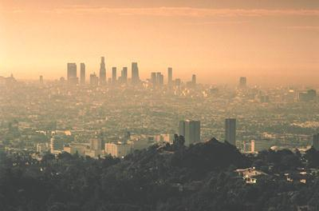


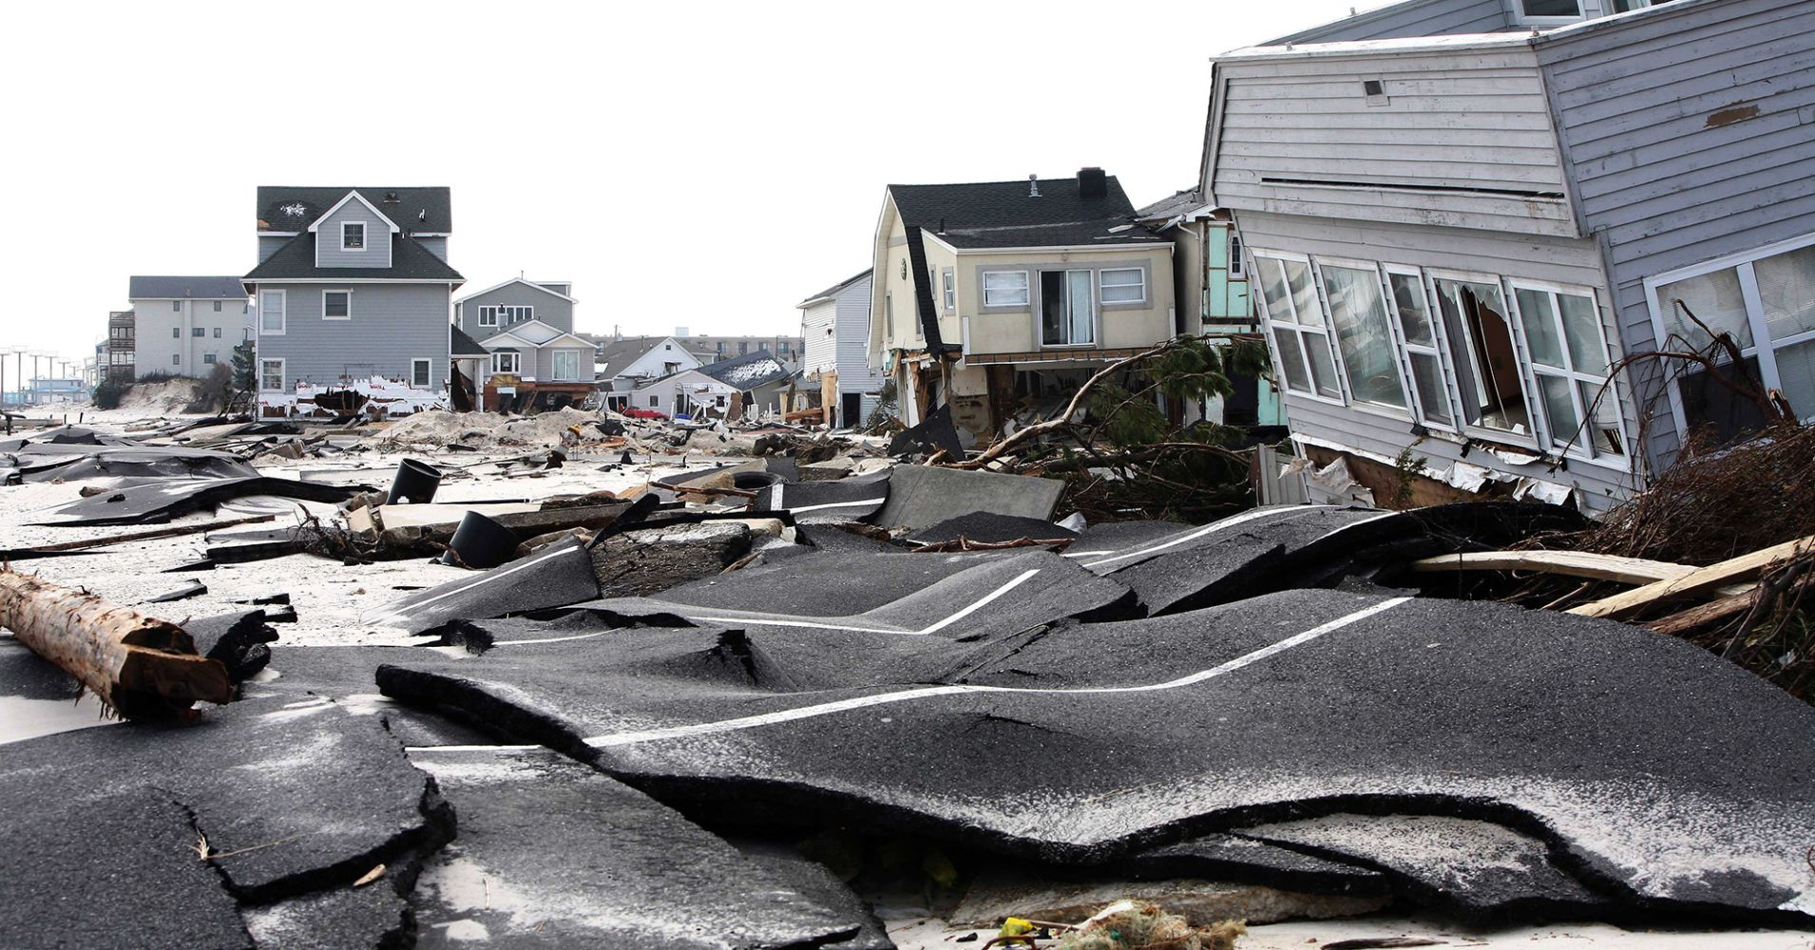
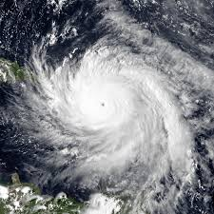
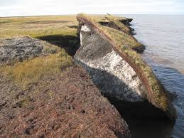
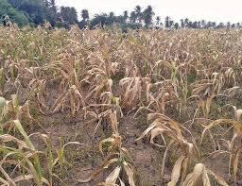
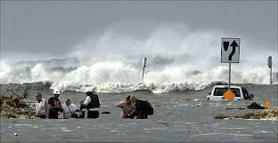

Endangerment finding
CO₂, CH₄, N₂O, HFCs, PFCs, SF₆
Health effects
Welfare effects
Ambient ozone health effects
Water resources
Heat related morbidity
Storm surges
Food production and agriculture
Extreme weather
Land loss
Peak electricity demand increase
Coastal storms
Notes:
Directly emitted, long-lived, well mixed

Slide 31
Timeline
April 2010 – GHG Emission Standards for Light-Duty Vehicles
May 2010 – Prevention of Significant Deterioration and Title V Greenhouse Gas Tailoring Rule
January 2011 – New Source Review permitting for stationary sources automatically triggered
August 2015 – Clean Power Plan
October 2015 – New Source Performance Standard for power plants
February 2016 – Supreme Court issues stay on Clean Power Plan
August 2018 – Plans to scale back Clean Power Plan announced
Notes:
PSD triggering without Tailoring Rule would have set the bar much lower (250 or 100 tons per year depending on the type of source)
GHG have been affirmed as pollutants undering the clean air act in Mass v. EPA, American Electric Power Co. v. Connecticut, and Utility Air Regulatory Group v. EPA
MAYBE ADD IN STAY?

Slide 32
Section 107-110
Section 111
Section 112
Criteria air pollutants
Ground-level ozone
Particulate matter (2.5, 10)
Carbon monoxide
Lead
Sulfur dioxide (SO_{x})
Nitrogen dioxide (NO_{x})
Stationary source-specific regulation
(b) New Source Performance Standards (NSPS)
(d) Existing sources, State Implementation Plans (SIP)
Best System of Emissions Reduction (BSER)
Ex: Electric Utility Steam Generating Units (EGU)
Hazardous Air Pollutants (HAP)
187 chemicals
Exposure results in severe adverse human health impacts
Pesticides, metal compounds, solvents, chemicals used in the manufacturing
Maximum achievable control technology (MACT)

Slide 33
CO₂ New Source Performance Standard
Source | BSER | NSPS
Newly Constructed Fossil Fuel-Fired Steam Generating Units | Efficient new supercritical pulverized coal utility boiler implementing partial carbon capture and storage (CCS) | 1,400 lb CO₂/MWh-g
Modified Fossil Fuel-Fired Steam Generating Units and Reconstructed Fossil Fuel-Fired Steam Generating Units | Best operating practices and equipment upgrades | 1,800 lb CO₂/MWh-g for sources with heat input > 2,000 MMBtu/h 2,000 lb CO₂/MWh-g for sources with head input ≤ 2,000 MMBtu/h
Newly Constructed and Reconstructed Fossil Fuel-Fired Stationary Combustion Turbines | Natural gas combined cycle | 1,000 lb CO₂/MWh-g or 1,030 lb CO₂/MWh-n for base load natural gas 120 lb CO₂/MMBtu for non-base load natural gas 120-160 lb CO₂/MMBtu for multi-fuel
Notes:
MWh-g = megawatt-hour gross – total amount of electricity generated
MWh-n = megawatt-hour net – total amount of electricity delivered by power plant

Slide 34
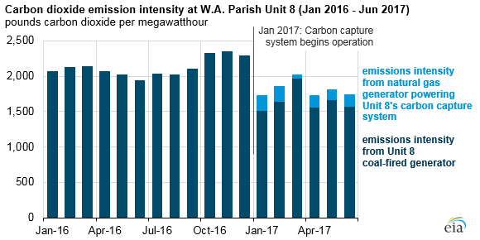
111(b): CO₂ New Source Performance Standard
Source | BSER | NSPS
Newly Constructed Fossil Fuel-Fired Steam Generating Units | Efficient new supercritical pulverized coal utility boiler implementing partial carbon capture and storage (CCS) | 1,400 lb CO₂/MWh-g
Modified Fossil Fuel-Fired Steam Generating Units and Reconstructed Fossil Fuel-Fired Steam Generating Units | Best operating practices and equipment upgrades | 1,800 lb CO₂/MWh-g for sources with heat input > 2,000 MMBtu/h 2,000 lb CO₂/MWh-g for sources with head input ≤ 2,000 MMBtu/h
Newly Constructed and Reconstructed Fossil Fuel-Fired Stationary Combustion Turbines | Natural gas combined cycle | 1,000 lb CO₂/MWh-g or 1,030 lb CO₂/MWh-n for base load natural gas 120 lb CO₂/MMBtu for non-base load natural gas 120-160 lb CO₂/MMBtu for multi-fuel
Natural gas can meet NSPS with efficiency upgrades
Coal cannot achieve NSPS without partial carbon capture and sequestration
North Dakota vs. EPA
  BSER must be “adequately demonstrated”
  One plant in the USA currently has implemented CCS which does not achieve NSPS
Literally today = proposed NSPS of 1,900 lb CO₂/MWh-g for coal plants
  Experts believe this will not have an effect on coal outlook
Notes:
MWh-g = megawatt-hour gross – total amount of electricity generated
MWh-n = megawatt-hour net – total amount of electricity delivered by power plant

Slide 35
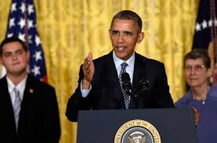
111(d): Clean Power Plan
President Obama’s signature climate policy regulating steam electric and natural gas fired power plants
Aims to reduce greenhouse gas emissions from these sources by 32% by 2030 relative to 2005 levels
  Paris: emissions decrease of 26%-28% by 2025
Implemented under Section 111(d)
Notes:
Received 4.3 million public comments, the most ever for an EPA rule

Slide 36
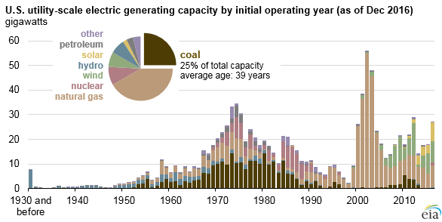
Clean Power Plan
NSPS
OLD
NEW
Notes:
40 CFR 60, 70, 71, and 98

Slide 37
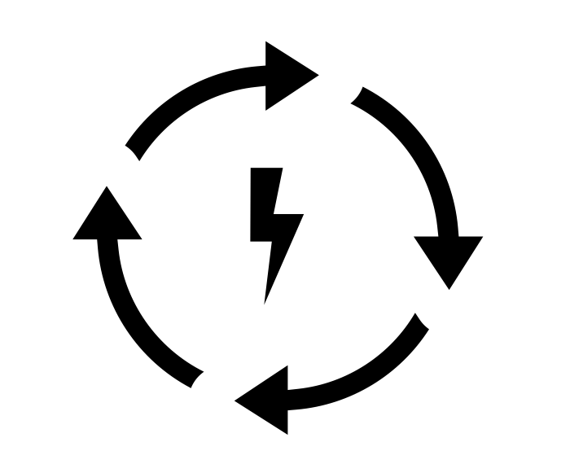



Best System of Emission Reduction
Improve heat rate at coal-steam plants (rate based)
  Capital and maintenance projects
  Operation
Shifting generation from coal-steam to natural gas combined cycle power plants
Shifting generation of all fossil fuel-based plants to zero-emitting renewables

Slide 38

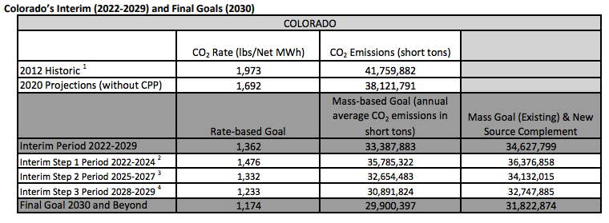
State Implementation Plans
States can decide whether to meet rate-based or mass-based target determined by the EPA
Each state has uniquely tailored goals based on how many of each of the two types of plants are in the state
Significant investment is needed to meet regulatory goals

Slide 39

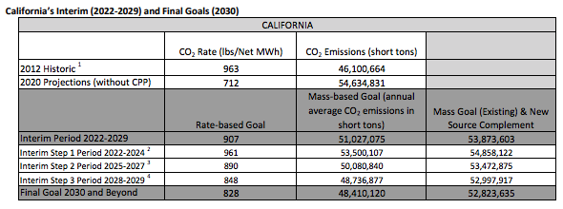
State Implementation Plans
Without CPP or regulatory intervention, California is projected to achieve its rate-based calculation for 2030 by 2020
Modest investment is needed to meet the mass-based goal
Multi-state partnerships possible

Slide 40
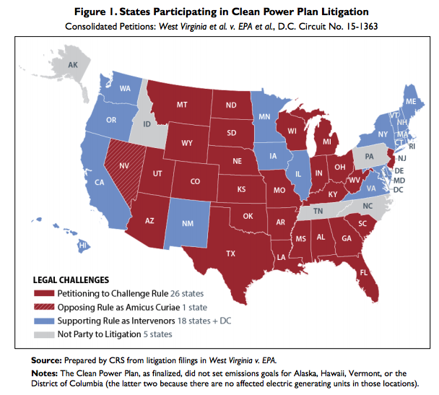
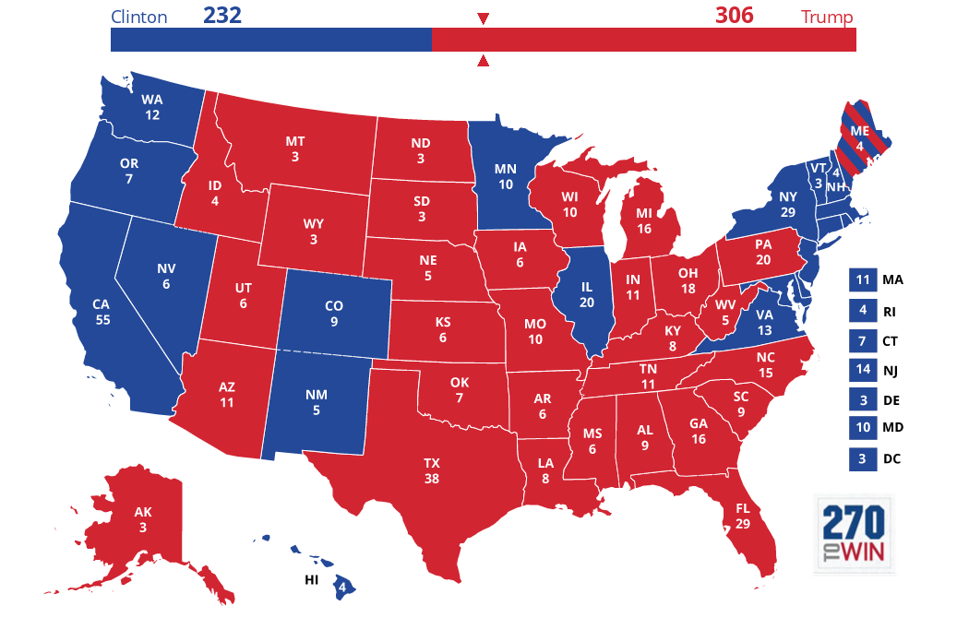
Legal Challenge: More than just partisan politics?
West Virginia v. EPA
Are BSER 2 and 3 outside the authority of the Clean Air Act?
  “inside the fenceline” vs. “outside the fenceline”
Clerical error in 1990 Amendments that state 111(d) can and cannot be applied to sources that are already regulated under 112 for HAPs
Supreme Court stays implementation of the CPP (5-4) on February 9, 2016
Justice Scalia dies on February 13, 2016
Notes:
William Ruckelshaus – EPA administrator when CAA was enacted in support of CPP
William Reilley – EPA administrator for the 1990 CAA Amendments in support of CPP

Slide 41
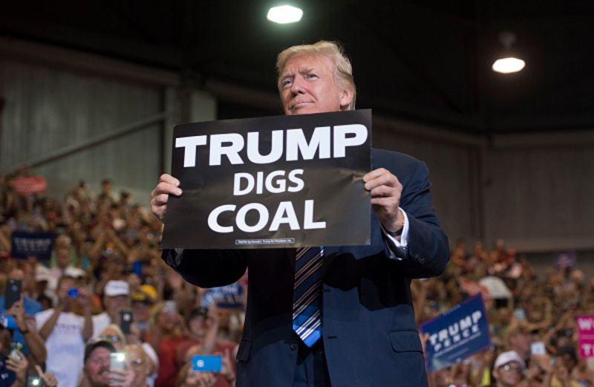

Slide 42
Rollback of CO₂ regulation under the CAA
E.O. 13783: Promoting Energy Independence and Economic Growth (March 28, 2017)
  Review + suspend, revise, or rescind:
    Clean Power Plan
    CO₂ New Source Performance Standard
  Litigation has been held in abeyance since
Affordable Clean Energy Rule (Proposed: August 21, 2018)
  Replacement for the Clean Power Plan

Slide 43

Round 2: Best System of Emission Reduction
Improve heat rate of coal-steam plants (rate based)
  Capital and maintenance projects
  Operation
Shifting generation from coal-steam to natural gas combined cycle power plants
Shifting generation of all fossil fuel-based plants to zero-emitting renewables

Slide 44
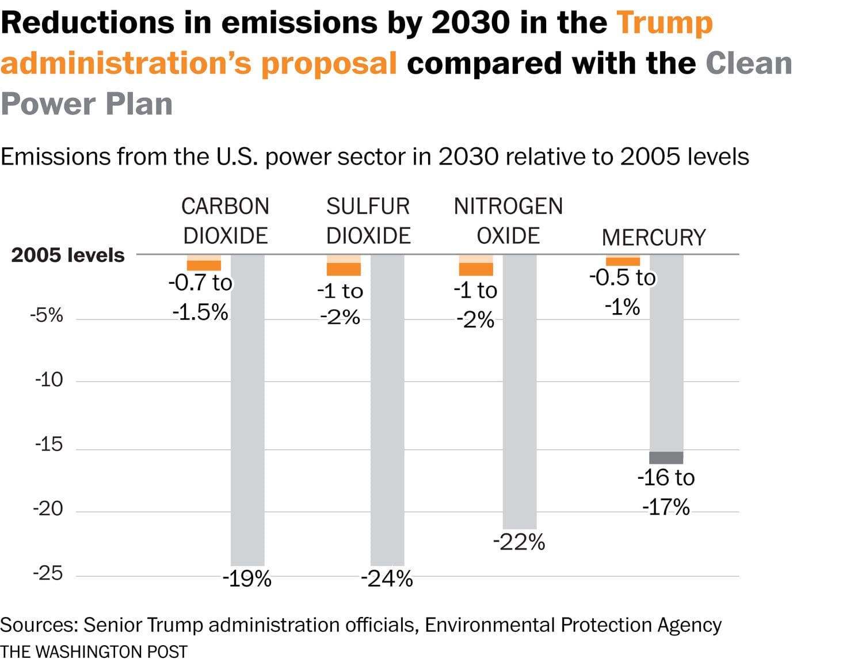

Slide 45
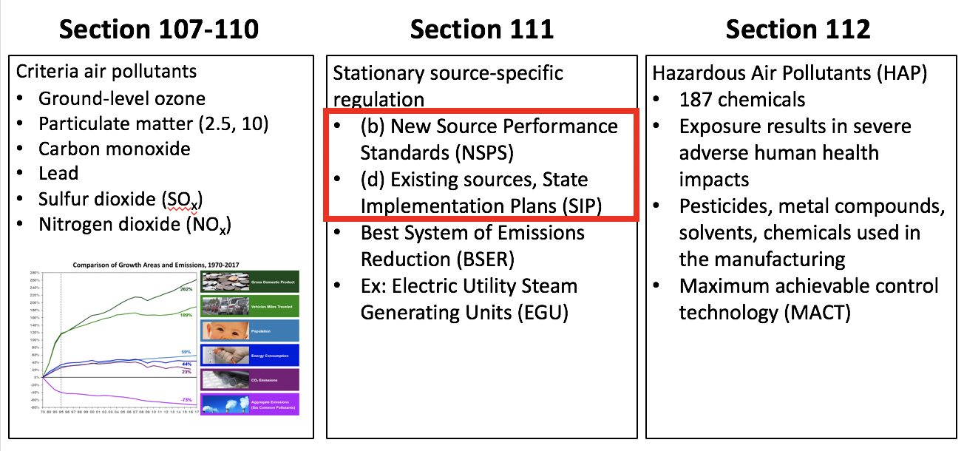
But wait there’s more…
Affordable Clean Energy Rule also proposes changes to New Source Review
Part A
New Source Review
Part C
Part D
Prevention of Significant Deterioration of Air Quality
Plan Requirements for Nonattainment Areas

Slide 46
“Modification” – a contentious word
111(a)4: The term “modification” means any physical change in, or change in method of operation of, a stationary source which increases the amount of any air pollutant emitted by such source or which results in the emission of any air pollutant not previously emitted
How to establish an emissions baseline?
How to predict future emissions of a plant?
How to measure an “increase” in emissions?

Slide 47
Emissions increase?
Conflicting definitions of the word modification exist between the NSPS (hourly) and the NSR (yearly)
In 1990s, Duke performed significant upgrades to its power plants that increased the capacity factor of the facilities
  No change in hourly emissions
  Increase in yearly emissions due to additional operational hours
EDF v. Duke (unanimous, 2007) affirming EPA’s ability to apply different definitions to two different regulatory authorities
Affordable Clean Energy Rule wants to change definition to modification to hourly and yearly
remember:
NSR ≠ NSPS

Slide 48
Change in NSR could extend the life of many old, predominantly coal plants and effect many other polluting industries

Slide 49
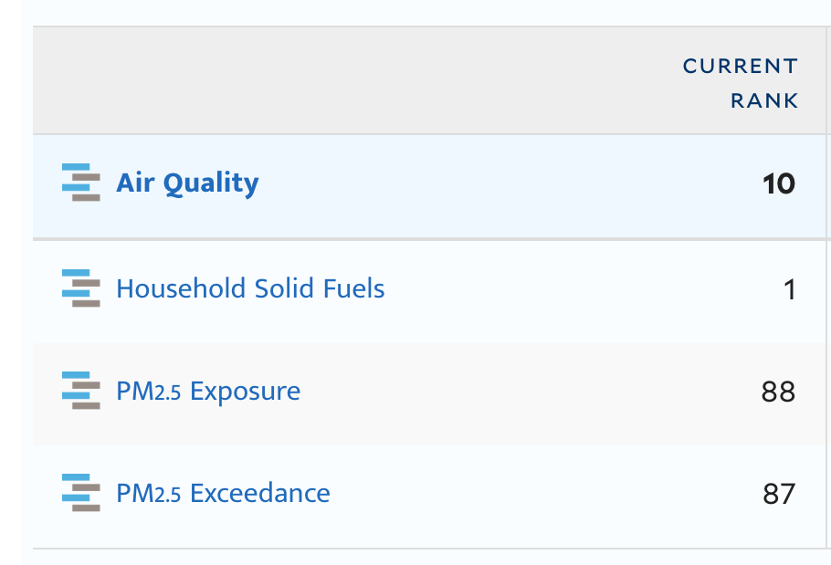
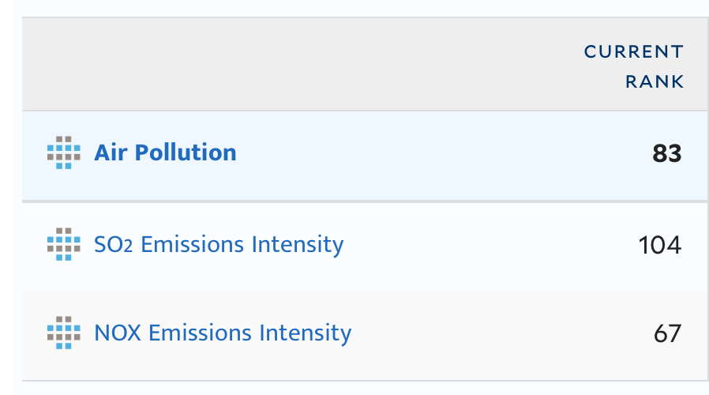
Air Quality Today
President Trump’s comments on air quality in the United States:
August 21: “I want clean air. I want crystal clean water. And we’ve got it. We’ve got the cleanest country in the planet right now. There’s nobody cleaner than us, and it’s getting better and better.”
November 27: “You look at our air and our water and it’s right now at a record clean.”
Source: Environmental Performance Index
Notes:
The 71,000 air pollution-related deaths in 2010 translates to one out of every 35 deaths in the U.S. that year — as many as from traffic accidents and gun shootings combined.

Slide 50
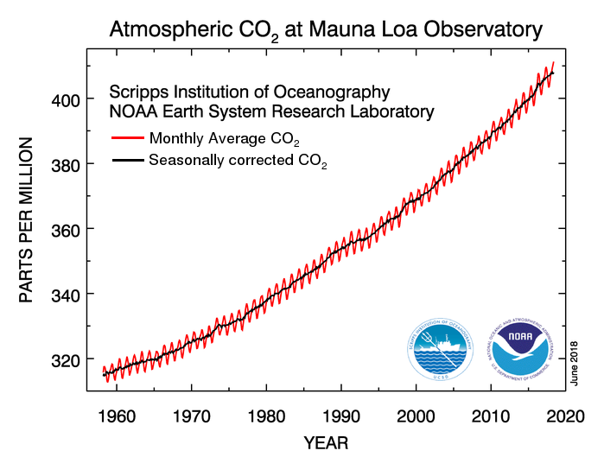
The Legacy of the Clean Air Act
CHALLENGE
Carbon emissions projected to rise by 3% in 2018
  Increase from transportation sector: cheap oil, bigger cars, more miles driven
Already experienced 1°C warming since mid-century
Emissions must be slashed to zero to avoid the worst effects of climate change

Slide 51
Extra Slides

Slide 52
National Emission Standards for Hazardous Air Pollutants (HAPs): 1990
1. Acetaldehyde | 33. Chlordane | 65. Dimethyl formamide | 97. Hydrochloric acid | 129. Pentachloronitrobenzene (Quintobenzene) | 161. 2,4,5-Trichlorophenol
2. Acetamide | 34. Chlorine | 66. 1,1-Dimethyl hydrazine | 98. Hydrogen fluoride (Hydrofluoric acid) | 130. Pentachlorophenol | 162. 2,4,6-Trichlorophenol
3. Acetonitrile | 35. Chloroacetic acid | 67. Dimethyl phthalate | 99. Hydrogen sulfide (See Modification) | 131. Phenol | 163. Triethylamine
4. Acetophenone | 36. 2-Chloroacetophenone | 68. Dimethyl sulfate | 100. Hydroquinone | 132. p-Phenylenediamine | 164. Trifluralin
5. 2-Acetylaminofluorene | 37. Chlorobenzene | 69. 4,6-Dinitro-o-cresol, and salts | 101. Isophorone | 133. Phosgene | 165. 2,2,4-Trimethylpentane
6. Acrolein | 38. Chlorobenzilate | 70. 2,4-Dinitrophenol | 102. Lindane (all isomers) | 134. Phosphine | 166. Vinyl acetate
7. Acrylamide | 39. Chloroform | 71. 2,4-Dinitrotoluene | 103. Maleic anhydride | 135. Phosphorus | 167. Vinyl bromide
8. Acrylic acid | 40. Chloromethyl methyl ether | 72. 1,4-Dioxane (1,4-Diethyleneoxide) | 104. Methanol | 136. Phthalic anhydride | 168. Vinyl chloride
9. Acrylonitrile | 41. Chloroprene | 73. 1,2-Diphenylhydrazine | 105. Methoxychlor | 137. Polychlorinated biphenyls (Aroclors) | 169. Vinylidene chloride (1,1-Dichloroethylene)
10. Allyl chloride | 42. Cresols/Cresylic acid (isomers and mixture) | 74. Epichlorohydrin (l-Chloro-2,3-epoxypropane) | 106. Methyl bromide (Bromomethane) | 138. 1,3-Propane sultone | 170. Xylenes (isomers and mixture)
11. 4-Aminobiphenyl | 43. o-Cresol | 75. 1,2-Epoxybutane | 107. Methyl chloride (Chloromethane) | 139. beta-Propiolactone | 171. o-Xylenes
12. Aniline | 44. m-Cresol | 76. Ethyl acrylate | 108. Methyl chloroform (1,1,1-Trichloroethane) | 140. Propionaldehyde | 172. m-Xylenes
13. o-Anisidine | 45. p-Cresol | 77. Ethyl benzene | 109. Methyl ethyl ketone (2-Butanone) (See Modification) | 141. Propoxur (Baygon) | 173. p-Xylenes
14. Asbestos | 46. Cumene | 78. Ethyl carbamate (Urethane) | 110. Methyl hydrazine | 142. Propylene dichloride (1,2-Dichloropropane) | 174. Antimony Compounds
15. Benzene (including benzene from gasoline) | 47. 2,4-D, salts and esters | 79. Ethyl chloride (Chloroethane) | 111. Methyl iodide (Iodomethane) | 143. Propylene oxide | 175. Arsenic Compounds (inorganic including arsine)
16. Benzidine | 48. DDE | 80. Ethylene dibromide (Dibromoethane) | 112. Methyl isobutyl ketone (Hexone) | 144. 1,2-Propylenimine (2-Methyl aziridine) | 176. Beryllium Compounds
17. Benzotrichloride | 49. Diazomethane | 81. Ethylene dichloride (1,2-Dichloroethane) | 113. Methyl isocyanate | 145. Quinoline | 177. Cadmium Compounds
18. Benzyl chloride | 50. Dibenzofurans | 82. Ethylene glycol | 114. Methyl methacrylate | 146. Quinone | 178. Chromium Compounds
19. Biphenyl | 51. 1,2-Dibromo-3-chloropropane | 83. Ethylene imine (Aziridine) | 115. Methyl tert butyl ether | 147. Styrene | 179. Cobalt Compounds
20. Bis(2-ethylhexyl)phthalate (DEHP) | 52. Dibutylphthalate | 84. Ethylene oxide | 116. 4,4-Methylene bis(2-chloroaniline) | 148. Styrene oxide | 180. Coke Oven Emissions
21. Bis(chloromethyl)ether | 53. 1,4-Dichlorobenzene(p) | 85. Ethylene thiourea | 117. Methylene chloride (Dichloromethane) | 149. 2,3,7,8-Tetrachlorodibenzo-p-dioxin | 181. Cyanide Compounds 1
22. Bromoform | 54. 3,3-Dichlorobenzidene | 86. Ethylidene dichloride (1,1-Dichloroethane) | 118. Methylene diphenyl diisocyanate (MDI) | 150. 1,1,2,2-Tetrachloroethane | 182. Glycol ethers 2 (See Modification)
23. 1,3-Butadiene | 55. Dichloroethyl ether (Bis(2-chloroethyl)ether) | 87. Formaldehyde | 119. 4,4'-Methylenedianiline | 151. Tetrachloroethylene (Perchloroethylene) | 183. Lead Compounds
24. Calcium cyanamide | 56. 1,3-Dichloropropene | 88. Heptachlor | 120. Naphthalene | 152. Titanium tetrachloride | 184. Manganese Compounds
25. Caprolactam (See Modification) | 57. Dichlorvos | 89. Hexachlorobenzene | 121. Nitrobenzene | 153. Toluene | 185. Mercury Compounds
26. Captan | 58. Diethanolamine | 90. Hexachlorobutadiene | 122. 4-Nitrobiphenyl | 154. 2,4-Toluene diamine | 186. Fine mineral fibers 3
27. Carbaryl | 59. N,N-Dimethylaniline | 91. Hexachlorocyclopentadiene | 123. 4-Nitrophenol | 155. 2,4-Toluene diisocyanate | 187. Nickel Compounds
28. Carbon disulfide | 60. Diethyl sulfate | 92. Hexachloroethane | 124. 2-Nitropropane | 156. o-Toluidine | 188. Polycyclic Organic Matter 4
29. Carbon tetrachloride | 61. 3,3-Dimethoxybenzidine | 93. Hexamethylene-1,6-diisocyanate | 125. N-Nitroso-N-methylurea | 157. Toxaphene (chlorinated camphene) | 189. Radionuclides (including radon) 5
30. Carbonyl sulfide | 62. Dimethyl aminoazobenzene | 94. Hexamethylphosphoramide | 126. N-Nitrosodimethylamine | 158. 1,2,4-Trichlorobenzene | 190. Selenium Compounds
31. Catechol | 63. 3,3'-Dimethyl benzidine | 95. Hexane | 127. N-Nitrosomorpholine | 159. 1,1,2-Trichloroethane
32. Chloramben | 64. Dimethyl carbamoyl chloride | 96. Hydrazine | 128. Parathion | 160. Trichloroethylene

