Slide 1
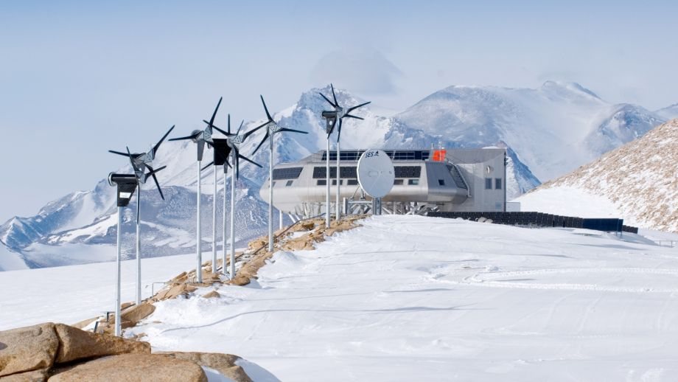
Renewable Energy at Permanent Stations
Fuel requirements vary widely depending on number of people, research equipment, operating times, etc
Wasa station (SWE) holds 12-16 people and operates summer only. Runs nearly 100% on solar.
Princess Elisabeth station (BEL) built in 2007-2008 with the goal of being a “zero emission station”
  Buildings minimize snow drift
  and maximize heat efficiency
  Nine specialized wind turbines
  PV panels and solar thermal panels
  Smart grid
  Efficient water treatment
  and recycling
  Summer only (for now)
www.antarcticstation.org

Slide 2
Wind Farms at Permanent Stations
Persistent katabatic winds make wind the most promising (and currently most used) form of renewable energy for the continent.
Case study, Mawson station (AUS) : three 300 kW wind turbines successfully operated for six years
  50 people in summer, 3 in winter
  Avg annual wind speed 25 mph, gusts can peak 150 mph
Challenges encountered over this study
  Extremely high winds coupled with the cold (- 12º C annual)
  Size of turbine limited by size of crane that could deploy to station
  Turbine manufacturers mostly unwilling to make technical modifications
  Gearboxes / hydraulics / oil seals specifically high maintenance in these conditions

Slide 3
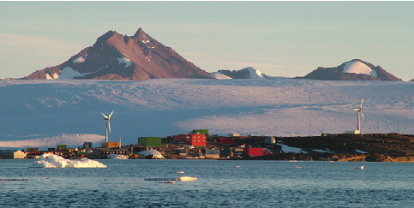
Wind Farms at Permanent Stations
Solutions
  Low-temperature steel in all tower castings and components
  Shorter tower due to wind and crane restrictions
  Variable speed, variable pitch turbines with gearboxless design (Enercon + Powercorp)
  Special attachment to tower entrance to avoid snow buildup
  No de-icing needed! Dry atmosphere.
6-year Results
  Annual avg 35% penetration
  Avg 32% fuel saving vs before study
  93% turbine total uptime
Tin et al 2009

Slide 4
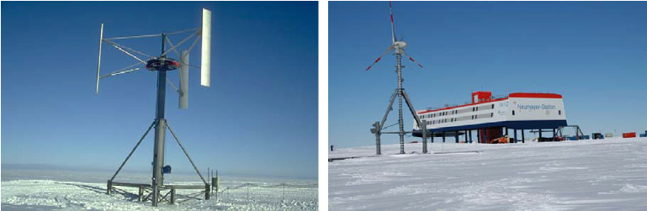
Wind Farms at Permanent Stations
Case study, Georg von Neumayer (GER)
  50 people in summer, 10 in winter
  Exists atop Ekstrom ice shelf, not on land
20 kW vertical axis wind turbine (VAWT) operated for 18 years
New 30kW horizontal axis designed, developed to be lifted off ice and moved one meter every year
Tin et al 2009

Slide 5
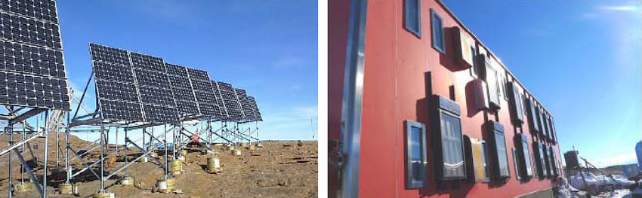
Solar Farms at Permanent Stations
Much less used than wind, but still very useful for summer stations
  Wasa station and Princess Elisabeth station examples (earlier slides)
Syowa station (JPN) has 110 people in summer / 20 in winter
  55kW of PV panels displace ~5% fuel costs despite long winter
  Solar thermal panels also used for heating
Tin et al 2009

Slide 6
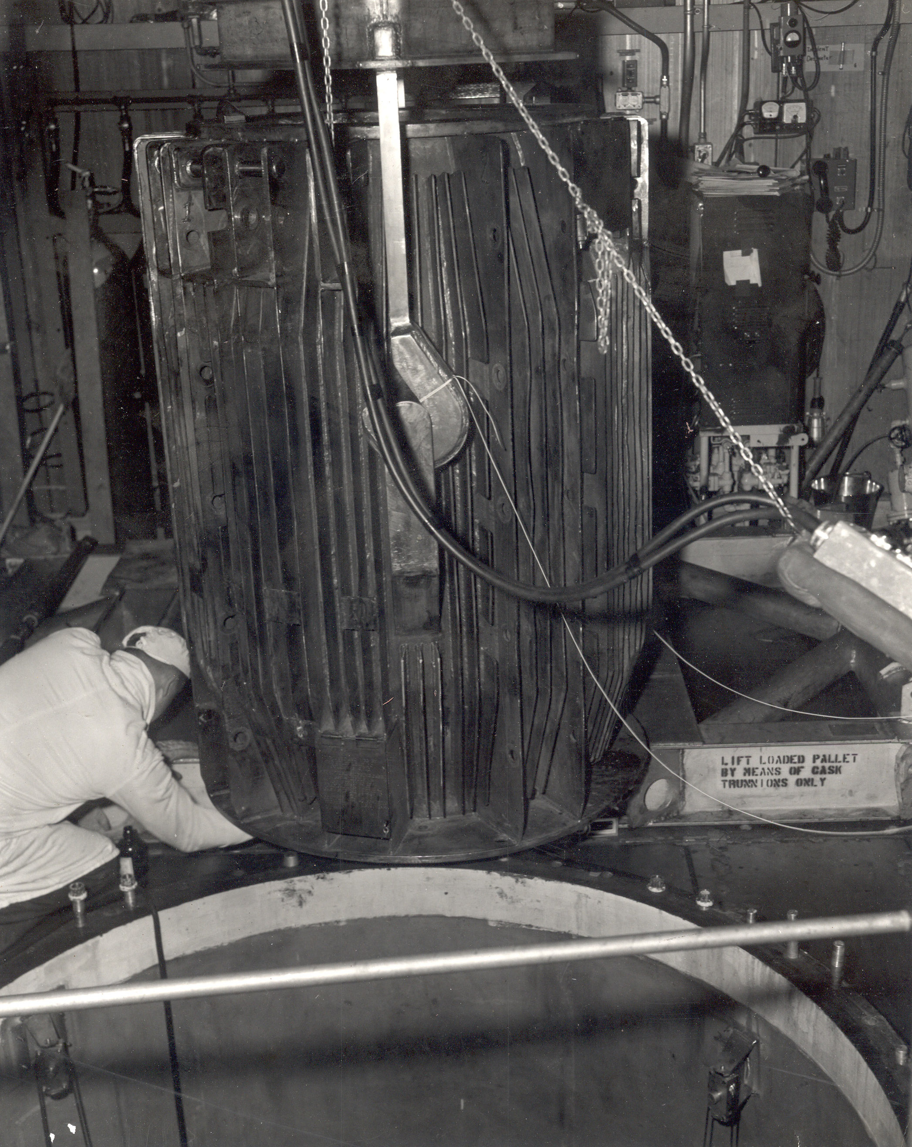
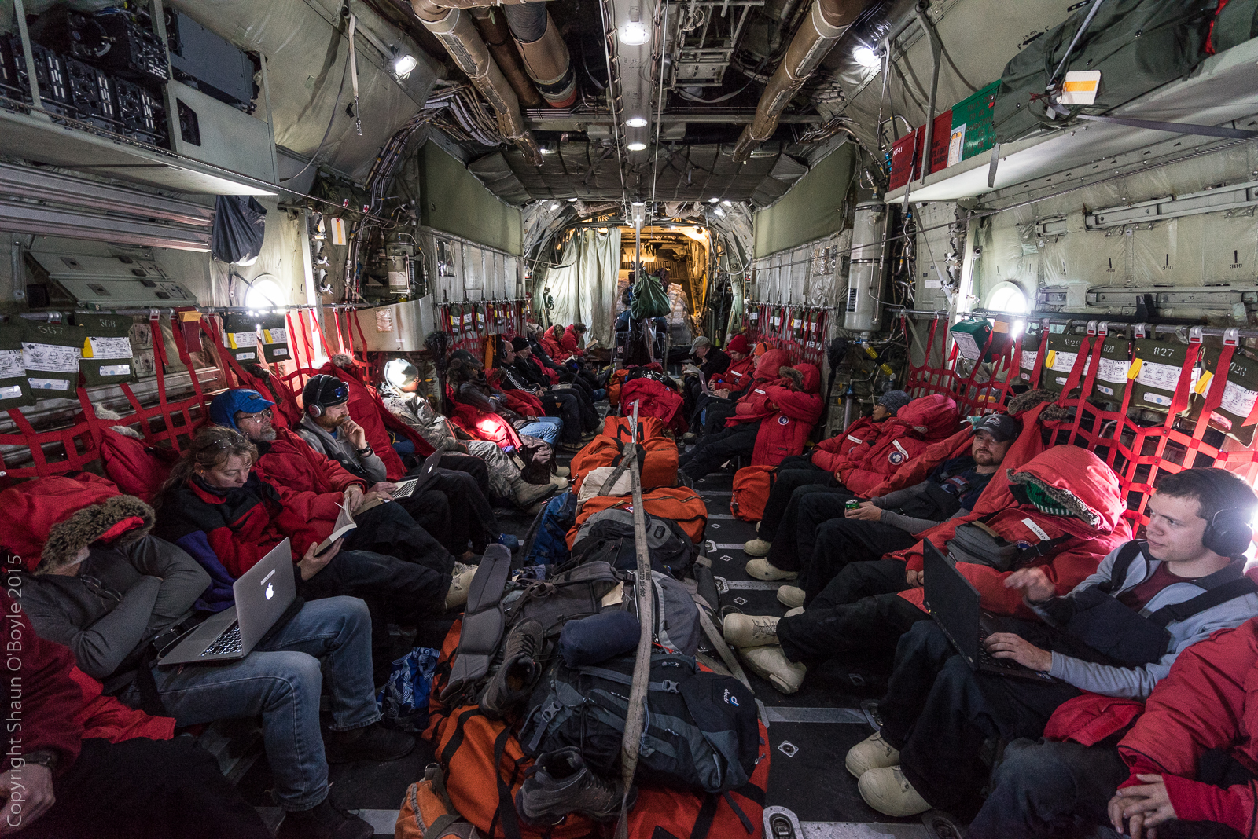
Aside – Nuclear Reactor at McMurdo Station (PM-3A)
Approved by Congress 1960, established and first criticality 1962
Potential benefits:
  More economical power than fuel
  Waste heat used for water desalination
Limitations
  Made portable (fit inside LC-130)
  Waste would be returned to US
  Delivery/installation must be done in summer
Decomissioned in 10 years
  Poor uptime
  Corrosion cracking
Inside LC-130
popantarctica.wordpress.com

Slide 7
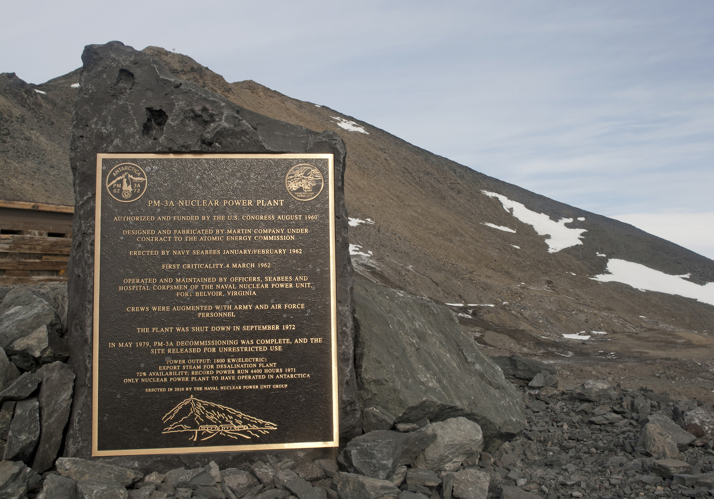
Aside – Nuclear Reactor at McMurdo Station (PM-3A)
Health & environmental after-effects
  Cracks in containment vessel, coolant leak into surrounding soil
  9000 cubic meters of soil shipped to US
  Cleanup lasted another 7 years
  223 reports of abnormal radiation exposure to crew, 14 leading to injury
  Abnormally high levels of tritium and beta activity in drinking water in late 1960s
Kiwis fear cancer after working near leaky US nuclear reactor in Antarctica
(May 2018 article)

Slide 8
Field Camps
Temporary stations used to house few people over weeks, not months
  Only done in summer
Benefits of renewables
  Saves on transporting fuel
  Makes low (or zero) atmospheric emission possible for environmental studies
  Battery-backed solar panels can allow instruments to run continuously
  Small solar panels take advantage of 24-hour sun
Primary challenge is power consumption of scientific instruments
  Example: Low Power Magnetometer, only 0.5W to measure Earth’s 3D magnetic field

Slide 9
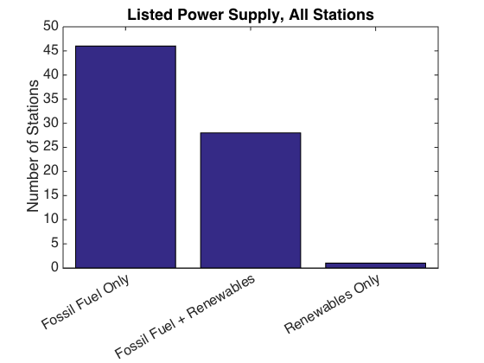
Current Status -- Overview
From COMNAP Antarctic Station catalogue:
  76 (permanent) stations listed across all countries
  Detailed statistics hard to find. Up to each individual nation to
  maximize efficiency and use renewables.
  Many countries have stations making this effort!
    Environmentally conscious building designs
    Use of solar (in summer) and wind

Slide 10
Future Prospects
Data needed to conduct proper cost-benefit analysis:
  Fuel consumption and cost
  Wind speed and variability
  Temperature and variability
  Construction available on-site, ease of transport
  Estimated fuel displaced by turbines given model and uptime
  Man-hours and flight hours required for installation
Detailed analyses done for McMurdo and South Pole Stations (2005)
  McMurdo
    Three sites considered
    Two turbine models considered
    Up to $4M in 20-year savings (turbines considered have 30-year lifetimes)
  Amundsen-Scott South Pole
    Difficult due to planned station upgrade
    Only one turbine model even close to proper operating conditions, needs modification
    Done before switching to getting fuel via traverse

Slide 11
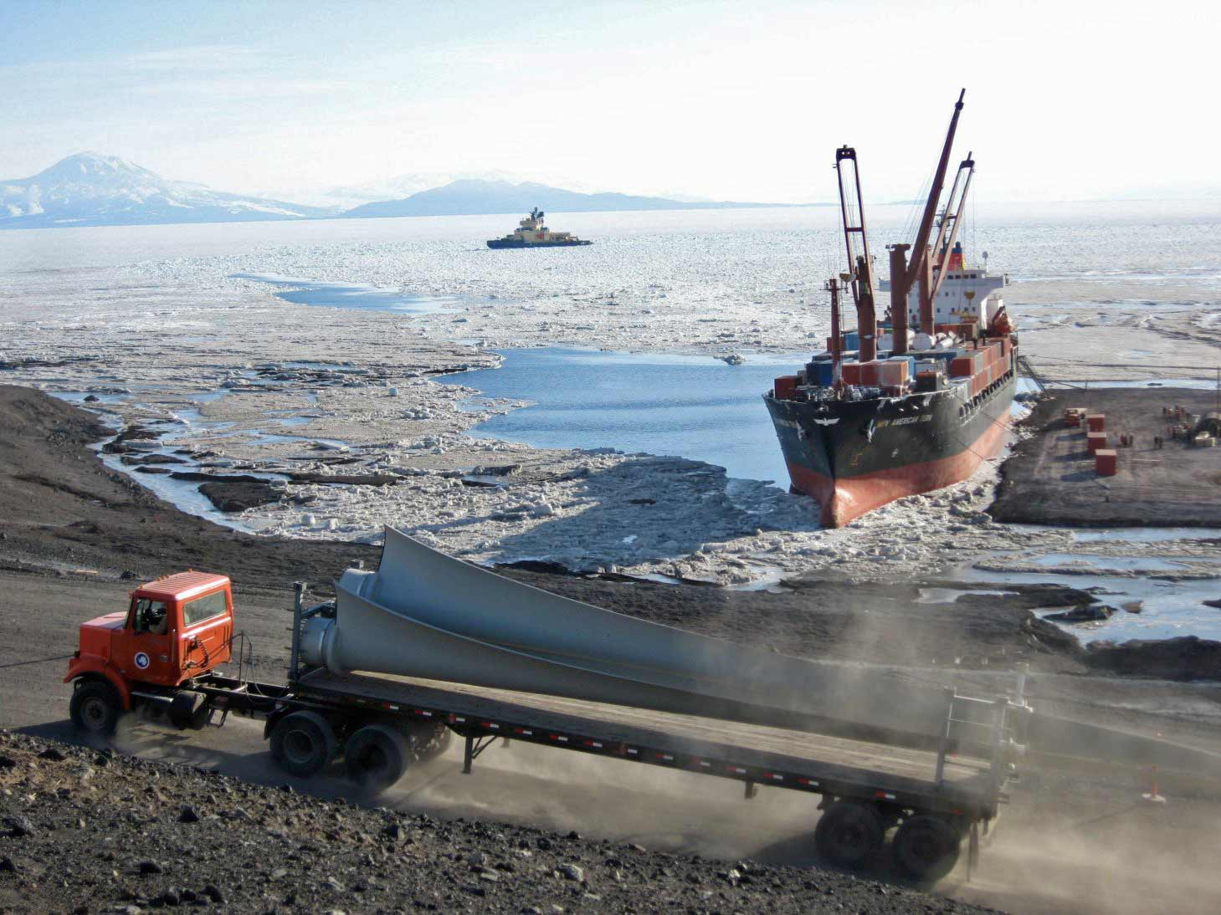
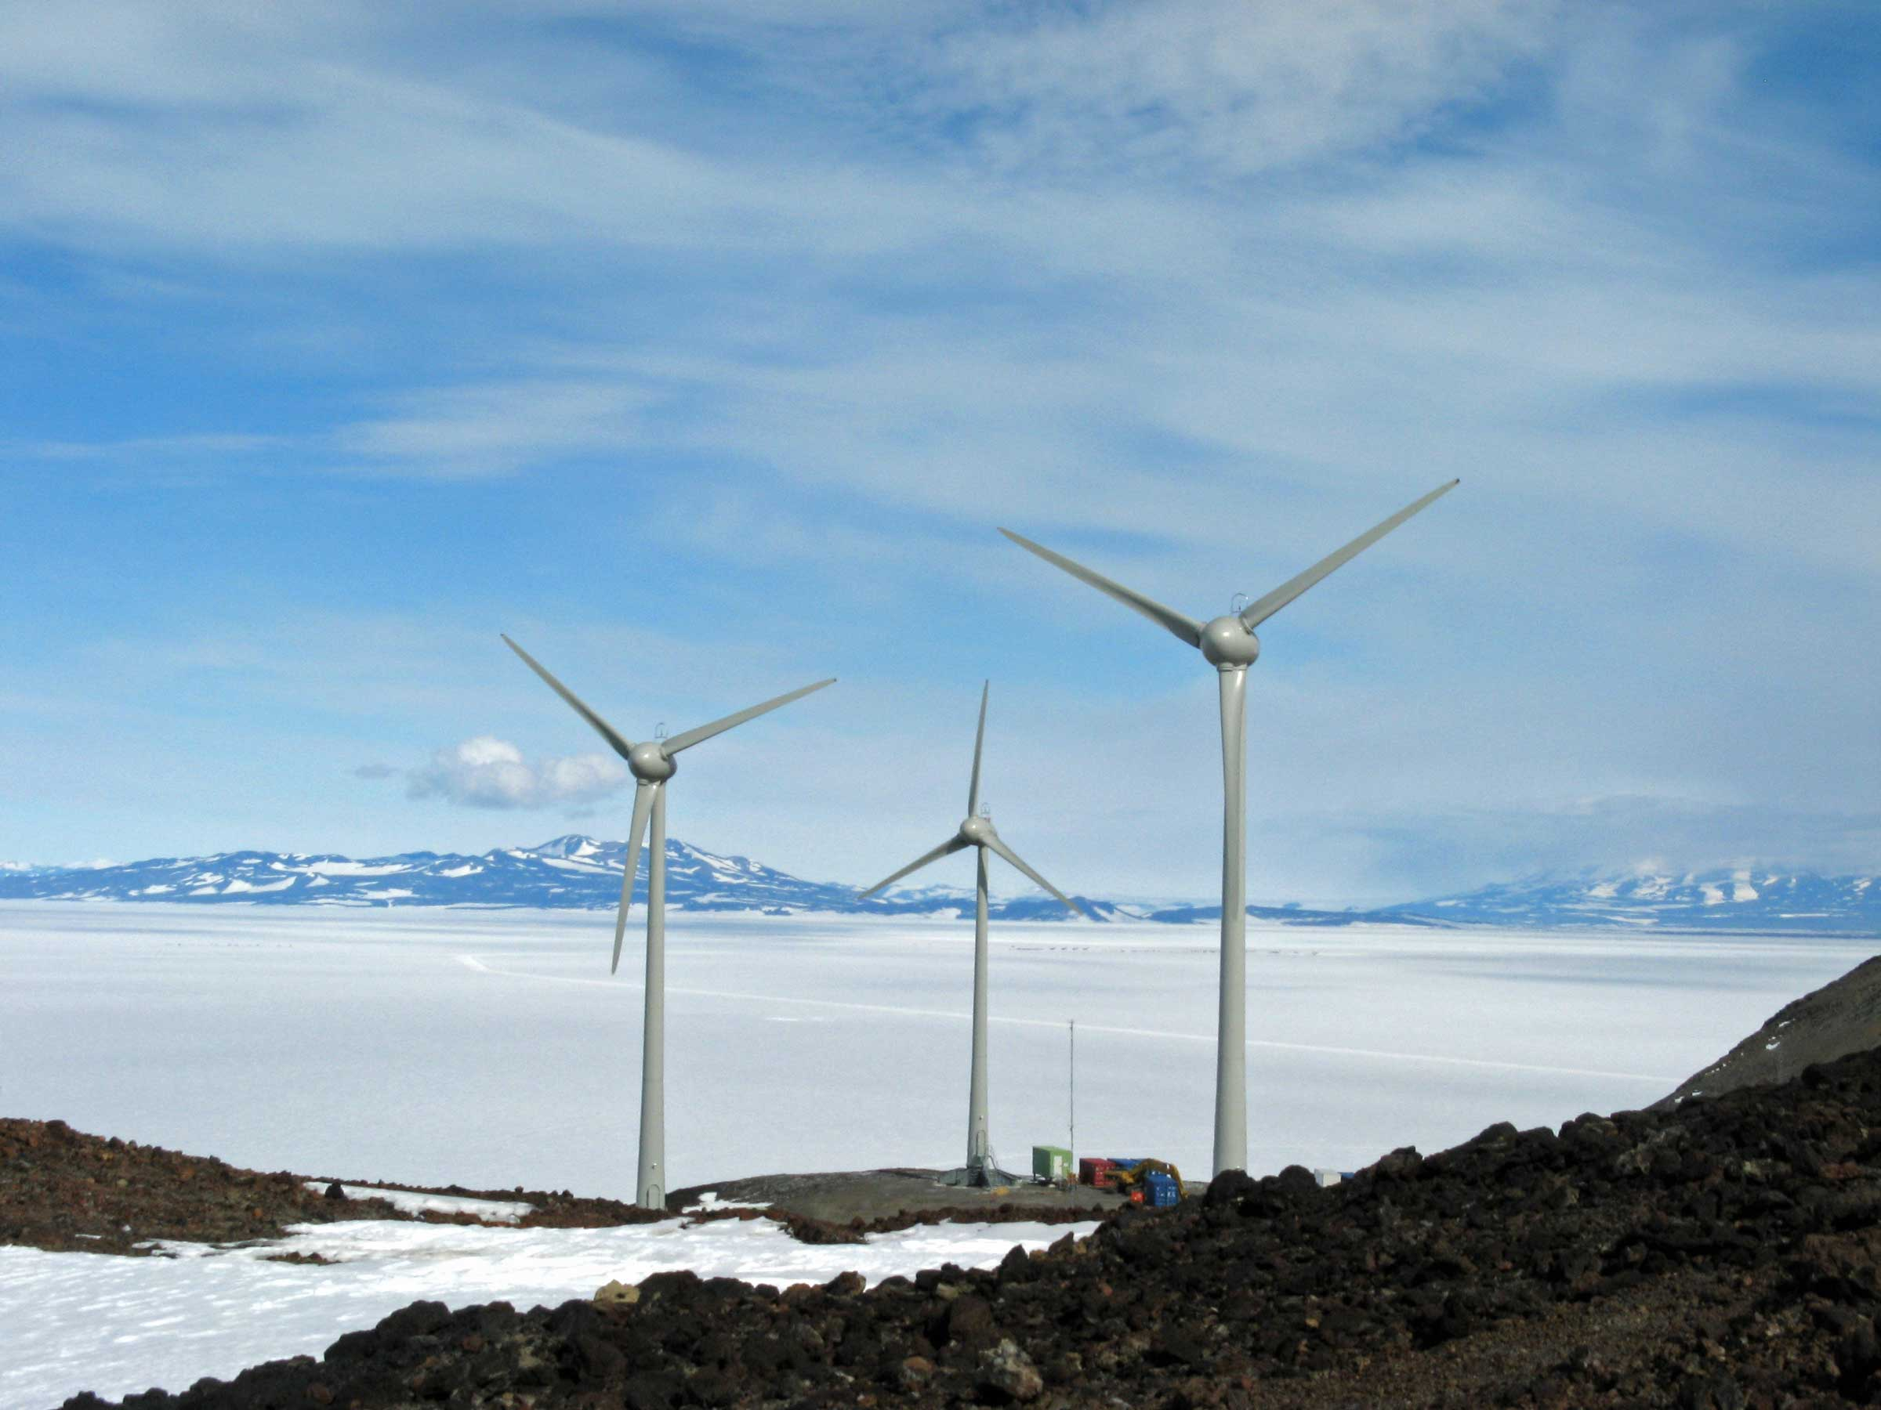
Wind Turbine Installation at McMurdo, 2008-09

Slide 12
Conclusions
Antarctica poses many unique challenges for both energy efficiency and deployment of renewables
  Weather (cold and wind)
  Accessibility
  Extra effort needed by national programs and product manufacturers
Despite this, more than 1/3 of all permanent stations currently use renewables
  Wind turbines by far the most efficient
  Solar very efficient for summer-only stations and field camps
Energy efficiency is a top priority for many stations
  Insulation, recycling wasted heat
  Building design
  Conscious use of water and power
Future outlook
  Very specific data needed for accurate cost-benefit estimates
  Up to each individual nation to supply this data, analyze, and progress toward energy upgrades

Slide 13
Sources
Tin T, et al., Energy efficiency and renewable energy under extreme conditions: Case studies from Antarctica, Renewable Energy (2009), doi:10.1016/j.renene.2009.10.020
  https://www.asoc.org/storage/documents/Meetings/ATCM/XXXIII/tin_et_al.pdf
Council of Managers of National Antarctic Programs (COMNAP)
  www.comnap.aq
Baring-Gould, I & Robichaud, Robi & McLain, Kevin. (2018). Power Needs at McMurdo Station and Amundsen-Scott South Pole Station, Antarctica.
Nuclear Power at McMurdo Station, Antarctica. Stanford course website.
  http://large.stanford.edu/courses/2014/ph241/reid2/
United States Antarctic Program Science Planning Summary
  www.usap.gov/sps
Info on McMurdo Wind Farm
  http://www.southpolestation.com/trivia/00s/windfarm2.html

