Slide 1

California vs. the EPA: How current forces are shaping the future of U.S. car efficiency standards
Harvard Energy Journal Club
10/4/18
Felix Barber

Slide 2
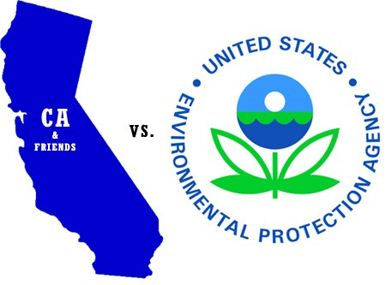
Contents
Setting the scene
What are the current CAFE standards?
The EPA’s new proposed rule
The California waivers
Where are we going?

Slide 3
Setting the scene
In the early 2000s California leads the U.S. in setting higher emissions standards, but these are not yet implemented.
  2005 requests waiver from EPA to regulate GHG emissions from vehicles, in addition to regular air pollutants
Fear from auto-makers that this will result in two standards: a national one, and one adopted by California + friends.
  Bush administration EPA denies California’s bid to set higher standards.
2007 Massachusetts vs. EPA Supreme Court decision forces EPA to regulate Carbon Dioxide and other GHG as air pollutants.
Energy Independence and Security Act of 2007 signed by president Bush.
  Motivated by spiking gas prices.
  Raised the standards of cars, light trucks, and SUVs to a combined average of at least 35 miles per gallon by 2020—a 10 mpg increase over 2007 levels.
Auto manufacturers hit hard by global financial crisis in 2008.
  Government bailouts give Obama administration leverage over auto manufacturers.
https://www.nytimes.com/2007/12/19/washington/20epa-web.html
https://www.theatlantic.com/science/archive/2018/06/how-the-carmakers-trumped-themselves/562400/

Slide 4
Setting the scene
In the early 2000s California leads the U.S. in setting higher emissions standards, but these are not yet implemented.
  2005 requests waiver from EPA to regulate GHG emissions from vehicles, in addition to regular air pollutants
Fear from auto-makers that this will result in two standards: a national one, and one adopted by California + friends.
  Bush administration EPA denies California’s bid to set higher standards.
2007 Massachusetts vs. EPA Supreme Court decision forces EPA to regulate Carbon Dioxide and other GHG as air pollutants.
Energy Independence and Security Act of 2007 signed by president Bush.
  Motivated by spiking gas prices.
  Raised the standards of cars, light trucks, and SUVs to a combined average of at least 35 miles per gallon by 2020—a 10 mpg increase over 2007 levels.
Auto manufacturers hit hard by global financial crisis in 2008.
  Government bailouts give Obama administration leverage over auto manufacturers.
https://www.nytimes.com/2007/12/19/washington/20epa-web.html
https://www.theatlantic.com/science/archive/2018/06/how-the-carmakers-trumped-themselves/562400/

Slide 5
Setting the scene
In the early 2000s California leads the U.S. in setting higher emissions standards, but these are not yet implemented.
  2005 requests waiver from EPA to regulate GHG emissions from vehicles, in addition to regular air pollutants
Fear from auto-makers that this will result in two standards: a national one, and one adopted by California + friends.
  Bush administration EPA denies California’s bid to set higher standards.
2007 Massachusetts vs. EPA Supreme Court decision forces EPA to regulate Carbon Dioxide and other GHG as air pollutants.
Energy Independence and Security Act of 2007 signed by president Bush.
  Motivated by spiking gas prices.
  Raised the standards of cars, light trucks, and SUVs to a combined average of at least 35 miles per gallon by 2020—a 10 mpg increase over 2007 levels.
Auto manufacturers hit hard by global financial crisis in 2008.
  Government bailouts give Obama administration leverage over auto manufacturers.
https://www.nytimes.com/2007/12/19/washington/20epa-web.html
https://www.theatlantic.com/science/archive/2018/06/how-the-carmakers-trumped-themselves/562400/

Slide 6
Setting the scene
In the early 2000s California leads the U.S. in setting higher emissions standards, but these are not yet implemented.
  2005 requests waiver from EPA to regulate GHG emissions from vehicles, in addition to regular air pollutants
Fear from auto-makers that this will result in two standards: a national one, and one adopted by California + friends.
  Bush administration EPA denies California’s bid to set higher standards.
2007 Massachusetts vs. EPA Supreme Court decision forces EPA to regulate Carbon Dioxide and other GHG as air pollutants.
Energy Independence and Security Act of 2007 signed by president Bush.
  Motivated by spiking gas prices.
  Raised the standards of cars, light trucks, and SUVs to a combined average of at least 35 miles per gallon by 2020—a 10 mpg increase over 2007 levels.
Auto manufacturers hit hard by global financial crisis in 2008.
  Government bailouts give Obama administration leverage over auto manufacturers.
https://www.nytimes.com/2007/12/19/washington/20epa-web.html
https://www.theatlantic.com/science/archive/2018/06/how-the-carmakers-trumped-themselves/562400/

Slide 7
Setting the scene
In the early 2000s California leads the U.S. in setting higher emissions standards, but these are not yet implemented.
  2005 requests waiver from EPA to regulate GHG emissions from vehicles, in addition to regular air pollutants
Fear from auto-makers that this will result in two standards: a national one, and one adopted by California + friends.
  Bush administration EPA denies California’s bid to set higher standards.
2007 Massachusetts vs. EPA Supreme Court decision forces EPA to regulate Carbon Dioxide and other GHG as air pollutants.
Energy Independence and Security Act of 2007 signed by president Bush.
  Motivated by spiking gas prices.
  Raised the standards of cars, light trucks, and SUVs to a combined average of at least 35 miles per gallon by 2020—a 10 mpg increase over 2007 levels.
Auto manufacturers hit hard by global financial crisis in 2008.
  Government bailouts give Obama administration leverage over auto manufacturers.
https://www.nytimes.com/2007/12/19/washington/20epa-web.html
https://www.theatlantic.com/science/archive/2018/06/how-the-carmakers-trumped-themselves/562400/

Slide 8
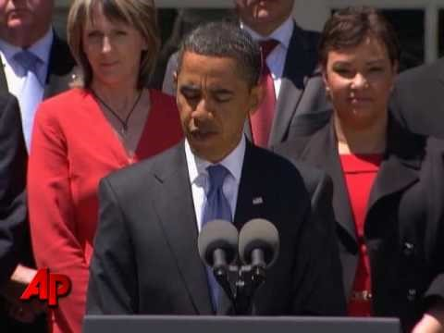
California driving up vehicle emissions standards
2009 led to establishment of national program for fuel efficiency standards.
  First meaningful fuel efficiency improvements in over 30 years
  First-ever global warming pollution standards for light trucks
  California accepts compliance with national standard.
https://www.ucsusa.org/clean-vehicles/fuel-efficiency/fuel-economy-basics.html#.W7OJOBRRepd

Slide 9
Contents
Setting the scene
What are the current CAFE standards?
The EPA’s new proposed rule
The California waivers
Where are we going?

Slide 10
How do the CAFE standards work?
Corporate Average Fuel Economy (CAFE) standards first established in 1975.
Phase I of current standards: 2012–2016
  Global warming pollution standards of 250 grams per mile, on average, for model year (MY) 2016 vehicles
  Fuel efficiency standards with a new vehicle average of 34.1 miles per gallon (mpg) in MY2016
Phase II of current standards: 2017–2025
  Global warming pollution standards of 163 grams per mile, on average, for model year (MY) 2025 vehicles. Equivalent of 54.5 mpg.
https://www.ucsusa.org/clean-vehicles/fuel-efficiency/fuel-economy-basics.html#.W7OJOBRRepd

Slide 11
How do the CAFE standards work?
Corporate Average Fuel Economy (CAFE) standards first established in 1975.
Phase I of current standards: 2012–2016
  Global warming pollution standards of 250 grams per mile, on average, for model year (MY) 2016 vehicles
  Fuel efficiency standards with a new vehicle average of 34.1 miles per gallon (mpg) in MY2016
Phase II of current standards: 2017–2025
  Global warming pollution standards of 163 grams per mile, on average, for model year (MY) 2025 vehicles. Equivalent of 54.5 mpg.
https://www.ucsusa.org/clean-vehicles/fuel-efficiency/fuel-economy-basics.html#.W7OJOBRRepd

Slide 12
How do the CAFE standards work?
Corporate Average Fuel Economy (CAFE) standards first established in 1975.
Phase I of current standards: 2012–2016
  Global warming pollution standards of 250 grams per mile, on average, for model year (MY) 2016 vehicles
  Fuel efficiency standards with a new vehicle average of 34.1 miles per gallon (mpg) in MY2016
Phase II of current standards: 2017–2025
  Global warming pollution standards of 163 grams per mile, on average, for model year (MY) 2025 vehicles. Equivalent of 54.5 mpg.
https://www.ucsusa.org/clean-vehicles/fuel-efficiency/fuel-economy-basics.html#.W7OJOBRRepd

Slide 13
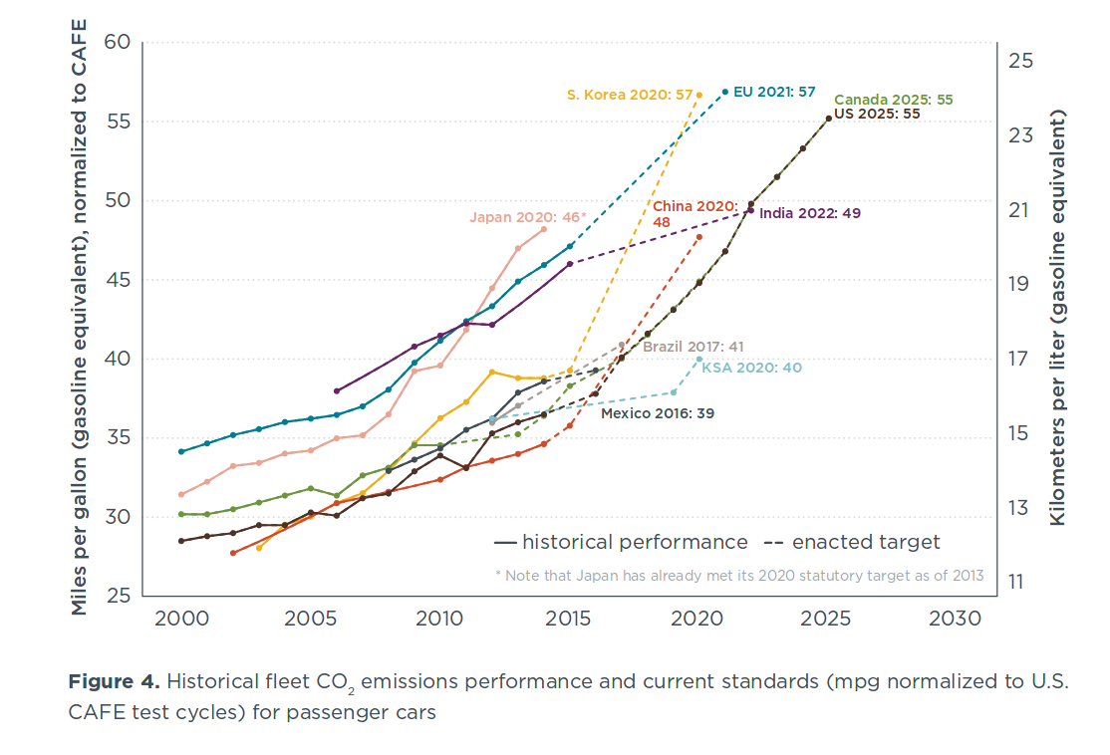
In a global context
Source: ICCT 2017 global update. LIGHT-DUTY VEHICLE GREENHOUSE GAS AND FUEL ECONOMY STANDARDS. https://www.theicct.org/sites/default/files/publications/2017-Global-LDV-Standards-Update_ICCT-Report_23062017_vF.pdf
Notes:
Slow ramp.

Slide 14
Contents
Setting the scene
What are the current CAFE standards?
The EPA’s new proposed rule
The California waivers
Where are we going?

Slide 15
What’s the catch?
Auto manufacturers went along with Obama administration provided that in 2017 this could be revisited by the current administration.

Slide 16
What’s the catch?
Auto manufacturers went along with Obama administration provided that in 2017 this could be revisited by the current administration.
Enter Trump.

Slide 17
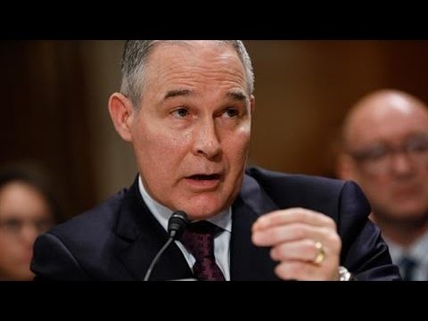
How the (former) head of the E.P.A. views climate change

Slide 18
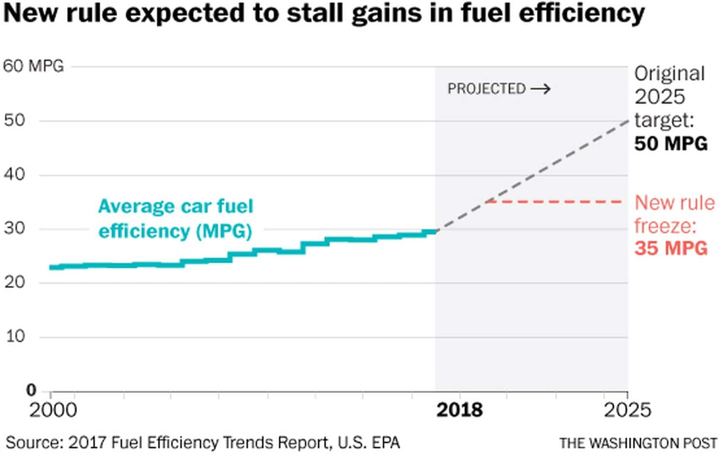
What’s the new plan?
Lobbying by auto industry in 2017 to review standards got more than they bargained for [1, 2].
The E.P.A.’s new proposed rule freezes fuel efficiency standards at 2020 levels.
Proposal to revoke California’s waiver to set higher vehicle emissions standards and encourage Zero Emissions Vehicles.
[1] https://www.nytimes.com/2018/03/30/climate/epa-auto-pollution-pruitt.html
[2] https://www.theatlantic.com/science/archive/2018/06/how-the-carmakers-trumped-themselves/562400/

Slide 19
What’s the new plan?
Lobbying by auto industry in 2017 to review standards got more than they bargained for [1, 2].
The E.P.A.’s new proposed rule freezes fuel efficiency standards at 2020 levels.
Proposal to revoke California’s waiver to set higher vehicle emissions standards and encourage Zero Emissions Vehicles.
[1] https://www.nytimes.com/2018/03/30/climate/epa-auto-pollution-pruitt.html
[2] https://www.theatlantic.com/science/archive/2018/06/how-the-carmakers-trumped-themselves/562400/

Slide 20
What’s the new plan?
Lobbying by auto industry in 2017 to review standards got more than they bargained for [1, 2].
The E.P.A.’s new proposed rule freezes fuel efficiency standards at 2020 levels.
Proposal to revoke California’s waiver to set higher vehicle emissions standards and encourage Zero Emissions Vehicles.
[1] https://www.nytimes.com/2018/03/30/climate/epa-auto-pollution-pruitt.html
[2] https://www.theatlantic.com/science/archive/2018/06/how-the-carmakers-trumped-themselves/562400/

Slide 21
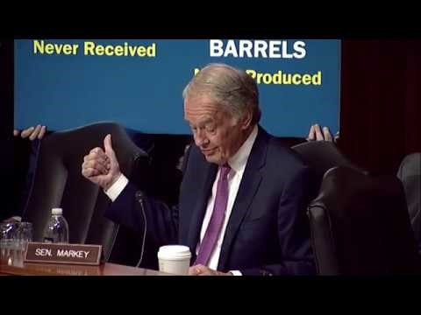
Sen. Markey Questions Acting E.P.A. administrator Andrew Wheeler
Notes:
Skip after 5 mins.

Slide 22
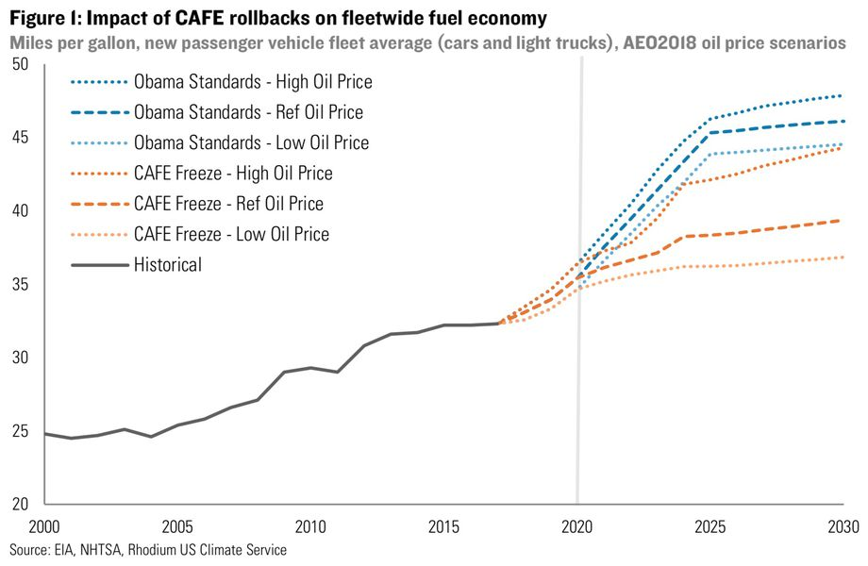
https://rhg.com/research/sizing-up-a-potential-fuel-economy-standards-freeze/

Slide 23
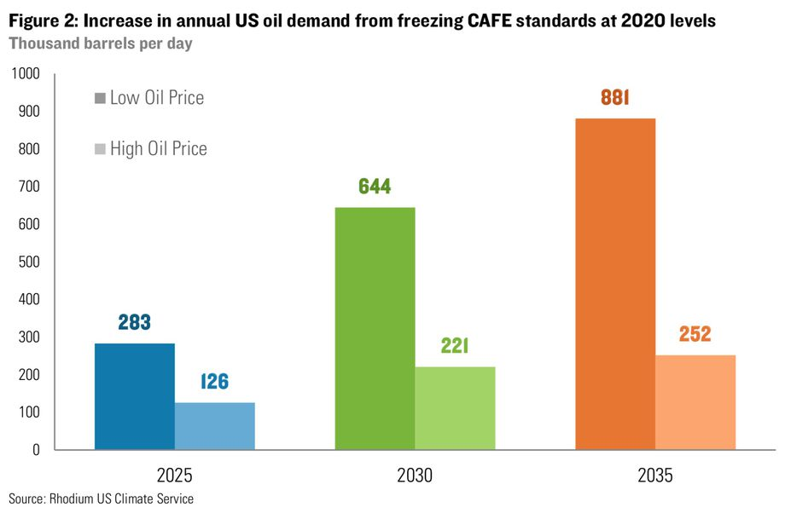
https://rhg.com/research/sizing-up-a-potential-fuel-economy-standards-freeze/
Notes:
Purchasing this oil would cost drivers an additional $193 to $236 billion cumulatively between now and 2035, again depending on oil prices.

Slide 24
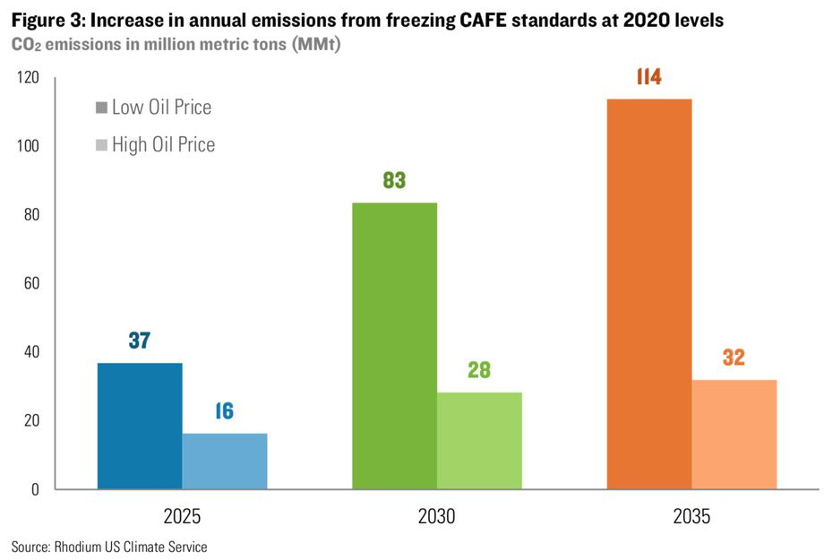
https://rhg.com/research/sizing-up-a-potential-fuel-economy-standards-freeze/
Notes:
the equivalent of opening 28 new coal plants.

Slide 25
Contents
Setting the scene
What are the current CAFE standards?
The EPA’s new proposed rule
The California waivers
Where are we going?

Slide 26
Legal challenge to California’s waiver
EPA is proposing to withdraw the 2013 waiver for California’s Advanced Clean Car (ACC) program, Zero Emissions Vehicle (ZEV) mandate, and Greenhouse Gas (GHG) standards
Waiver is allowed based on 1970 clean air act, and is followed by 13 states as well as the District of Columbia.
Under CAA section 209(b)(1)(B), E.P.A. proposes to find that California does not need its GHG and ZEV standards to meet compelling and extraordinary conditions because:
  those standards address environmental problems that are not particular or unique to California;
  That are not caused by emissions or other factors particular or unique to California; and
  for which the standards will not provide any remedy particular or unique to California.
https://nepis.epa.gov/Exe/ZyPDF.cgi?Dockey=P100V26M.pdf
Notes:
EPA is proposing to withdraw the January 9, 2013 waiver of CAA preemption for California’s Advanced Clean Car (ACC) program, Zero Emissions Vehicle (ZEV) mandate, and Greenhouse Gas (GHG) standards that are applicable to model years 2021 through 2025.

Slide 27
Legal challenge to California’s waiver
EPA is proposing to withdraw the 2013 waiver for California’s Advanced Clean Car (ACC) program, Zero Emissions Vehicle (ZEV) mandate, and Greenhouse Gas (GHG) standards
Waiver is allowed based on 1970 clean air act, and is followed by 13 states as well as the District of Columbia.
Under CAA section 209(b)(1)(B), E.P.A. proposes to find that California does not need its GHG and ZEV standards to meet compelling and extraordinary conditions because:
  those standards address environmental problems that are not particular or unique to California;
  That are not caused by emissions or other factors particular or unique to California; and
  for which the standards will not provide any remedy particular or unique to California.
https://nepis.epa.gov/Exe/ZyPDF.cgi?Dockey=P100V26M.pdf
Notes:
EPA is proposing to withdraw the January 9, 2013 waiver of CAA preemption for California’s Advanced Clean Car (ACC) program, Zero Emissions Vehicle (ZEV) mandate, and Greenhouse Gas (GHG) standards that are applicable to model years 2021 through 2025.

Slide 28
Legal challenge to California’s waiver
EPA is proposing to withdraw the 2013 waiver for California’s Advanced Clean Car (ACC) program, Zero Emissions Vehicle (ZEV) mandate, and Greenhouse Gas (GHG) standards
Waiver is allowed based on 1970 clean air act, and is followed by 13 states as well as the District of Columbia.
Under CAA section 209(b)(1)(B), E.P.A. proposes to find that California does not need its GHG and ZEV standards to meet compelling and extraordinary conditions because:
  those standards address environmental problems that are not particular or unique to California;
  That are not caused by emissions or other factors particular or unique to California; and
  for which the standards will not provide any remedy particular or unique to California.
https://nepis.epa.gov/Exe/ZyPDF.cgi?Dockey=P100V26M.pdf
Notes:
EPA is proposing to withdraw the January 9, 2013 waiver of CAA preemption for California’s Advanced Clean Car (ACC) program, Zero Emissions Vehicle (ZEV) mandate, and Greenhouse Gas (GHG) standards that are applicable to model years 2021 through 2025.

Slide 29
Auto makers lobbying for CAFE rollback: the dog that caught the truck
February 2018: Letter from Auto Alliance to EPA.
  Claims that climate scientists were “tuning” their models to get certain results, and it cast doubt on whether global warming would cause droughts, floods, and more intense hurricanes.
April 3, Pruitt announced that he would direct the EPA to change the cafe standards.
May 2018: Letter from automakers to White House
  “Climate change is real and we have a continuing role in reducing greenhouse gases and improving fuel efficiency.”
Alliance of Automobile Manufacturers letter to White House, May 3rd 2018

Slide 30
Auto makers lobbying for CAFE rollback: the dog that caught the truck
February 2018: Letter from Auto Alliance to EPA.
  Claims that climate scientists were “tuning” their models to get certain results, and it cast doubt on whether global warming would cause droughts, floods, and more intense hurricanes.
April 3, Pruitt announced that he would direct the EPA to change the cafe standards.
May 2018: Letter from automakers to White House
  “Climate change is real and we have a continuing role in reducing greenhouse gases and improving fuel efficiency.”
Alliance of Automobile Manufacturers letter to White House, May 3rd 2018

Slide 31
Auto makers lobbying for CAFE rollback: the dog that caught the truck
February 2018: Letter from Auto Alliance to EPA.
  Claims that climate scientists were “tuning” their models to get certain results, and it cast doubt on whether global warming would cause droughts, floods, and more intense hurricanes.
April 3, Pruitt announced that he would direct the EPA to change the cafe standards.
May 2018: Letter from automakers to White House
  “Climate change is real and we have a continuing role in reducing greenhouse gases and improving fuel efficiency.”
Alliance of Automobile Manufacturers letter to White House, May 3rd 2018

Slide 32
What spooked the auto industry?
Dual market: A nightmare scenario for auto makers
May 2018: Letter from Alliance of Automobile Manufacturers to the White House
  “Operating under two or three sets of regulations would be inefficient and disrupt a period of rapid innovation in the auto industry that is improving safety, efficiency, and mobility. In fact, such a fractured regulatory environment could negatively impact the roughly 7 million individuals who are employed directly or indirectly as part of the U.S. auto sector via jobs tied to vehicle manufacturers, suppliers, or dealers.”
Alliance of Automobile Manufacturers letter to White House, May 3rd 2018

Slide 33
Will it pass?
Proposed revoke of waiver on the grounds that “the environmental problems it addresses are not particular or unique to California.” Yet nowhere does the Clean Air Act mention “particular or unique” as a waiver requirement.
  The statute provides that “no such waiver will be granted” if the Administrator finds any of the following:
  …
    (B) [California] does not need such State standards to meet compelling and extraordinary conditions
“There is no precedent for revoking California’s waiver,” said Dan Becker, director of the Safe Climate Campaign of the Center for Auto Safety, an advocacy group in Washington. “There is no provision in the Clean Air Act for revoking a waiver. … The world is looking to California to hold its ground.”
http://prospect.org/article/can-epa-roll-back-californias-clean-air-standards

Slide 34
Will it pass?
Proposed revoke of waiver on the grounds that “the environmental problems it addresses are not particular or unique to California.” Yet nowhere does the Clean Air Act mention “particular or unique” as a waiver requirement.
  The statute provides that “no such waiver will be granted” if the Administrator finds any of the following:
  …
    (B) [California] does not need such State standards to meet compelling and extraordinary conditions
“There is no precedent for revoking California’s waiver,” said Dan Becker, director of the Safe Climate Campaign of the Center for Auto Safety, an advocacy group in Washington. “There is no provision in the Clean Air Act for revoking a waiver. … The world is looking to California to hold its ground.”
http://prospect.org/article/can-epa-roll-back-californias-clean-air-standards

Slide 35
Where are going?
The Safer Affordable Fuel Efficient (SAFE) Vehicles Proposed Rule for Model Years 2021-2026 was released in early August.
Currently undergoing public comment until October 26th, 2018!
https://www.epa.gov/regulations-emissions-vehicles-and-engines/safer-affordable-fuel-efficient-safe-vehicles-proposed
California not backing down.

Slide 36
Where are going?
The Safer Affordable Fuel Efficient (SAFE) Vehicles Proposed Rule for Model Years 2021-2026 was released in early August.
Currently undergoing public comment until October 26th, 2018!
https://www.epa.gov/regulations-emissions-vehicles-and-engines/safer-affordable-fuel-efficient-safe-vehicles-proposed
California not backing down.

Slide 37
Where are going?
The Safer Affordable Fuel Efficient (SAFE) Vehicles Proposed Rule for Model Years 2021-2026 was released in early August.
Currently undergoing public comment until October 26th, 2018!
https://www.epa.gov/regulations-emissions-vehicles-and-engines/safer-affordable-fuel-efficient-safe-vehicles-proposed
California not backing down.

