Slide 1
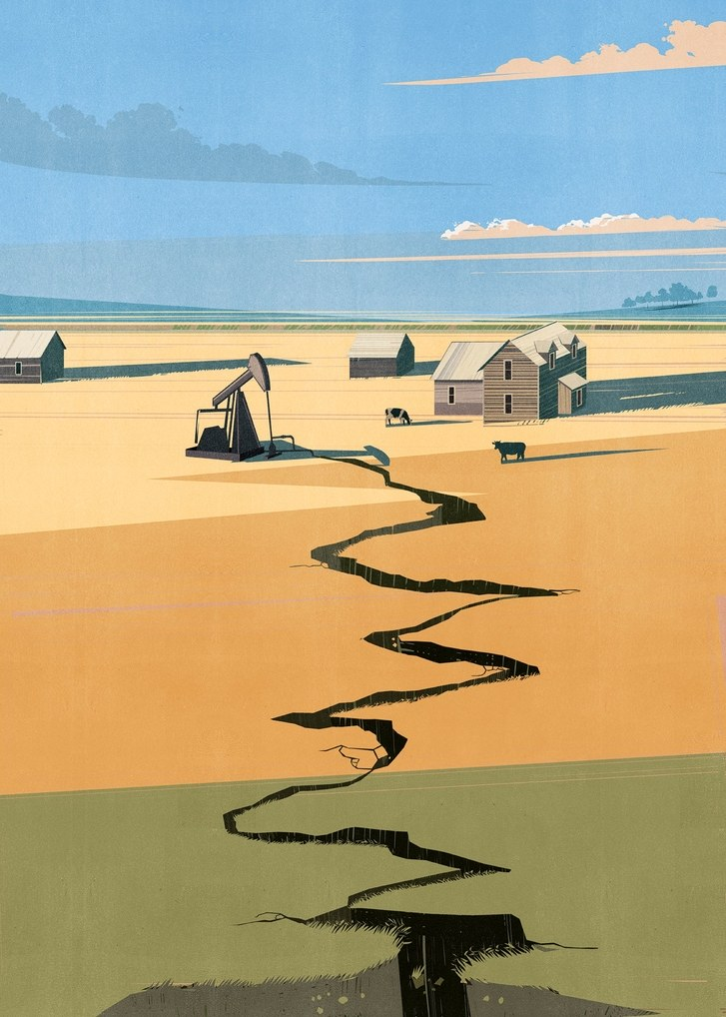

Induced Seismicity
The arrival of man-made Earthquakes
Franklin Wolfe
HEJC – Fall 2017
Notes:
Franklin Wolfe
2nd year
Earth and Planetary Sciences
Structural Modeling & Earth Resources Group
Earthquake Hazard and Energy Systems
more frequently the intersection of these systems to solve problems of induced seismicity

Slide 2


Outline For Today’s Talk
Earthquake Overview & Induced Seismicity
Mechanics
Historic Case Studies/Proof
  Federal & State Responses/Legislation
  Visualization Lab (Castor, Spain)

Slide 3
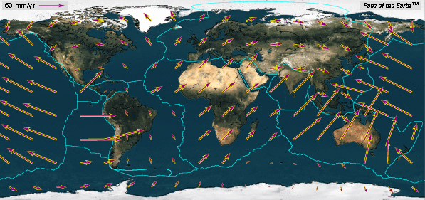
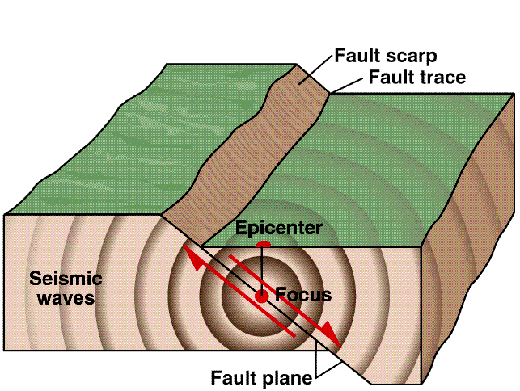
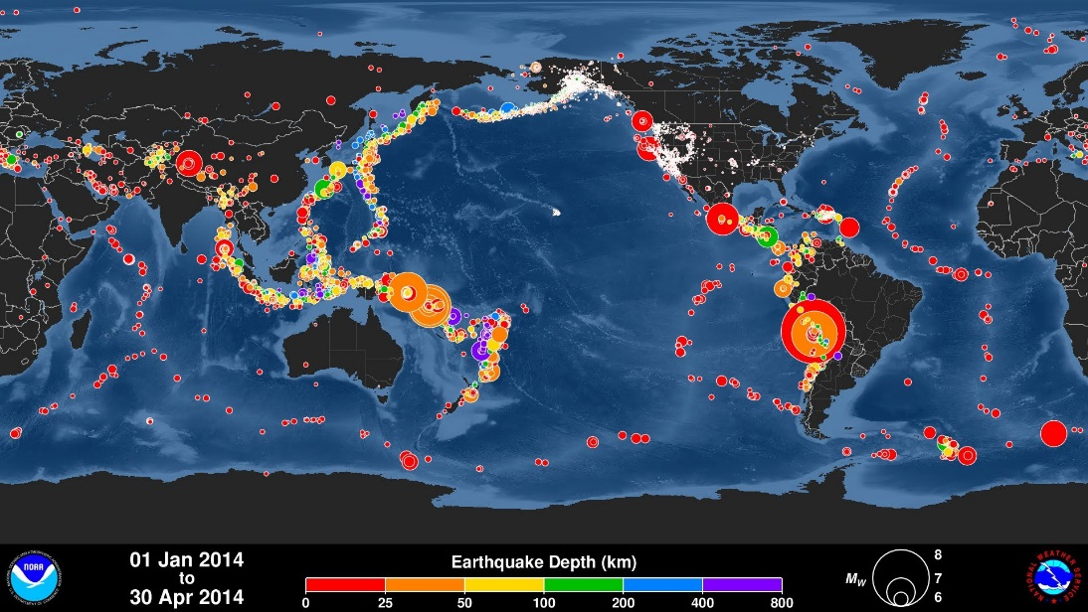
What is an Earthquake?
Global Tectonic Plate Motion Vectors
Sudden release of stored energy in the Earth’s crust that generates seismic waves generally caused by rupture on geologic faults
Energy released in the form of seismic waves causes ground shaking and surface rupture can directly damage structures
Landslides, avalanches, fires, soil liquefaction, tsunami, flood
http://maxworldgeography.weebly.com/geosphere.html
Fault Rupture and Seismic Waves
Global Earthquake Locations
Wikifuller.wikispaces.com
Pacific Tsunami Warning Center

Slide 4
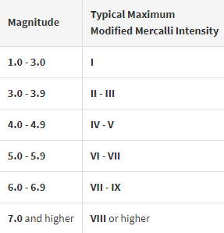
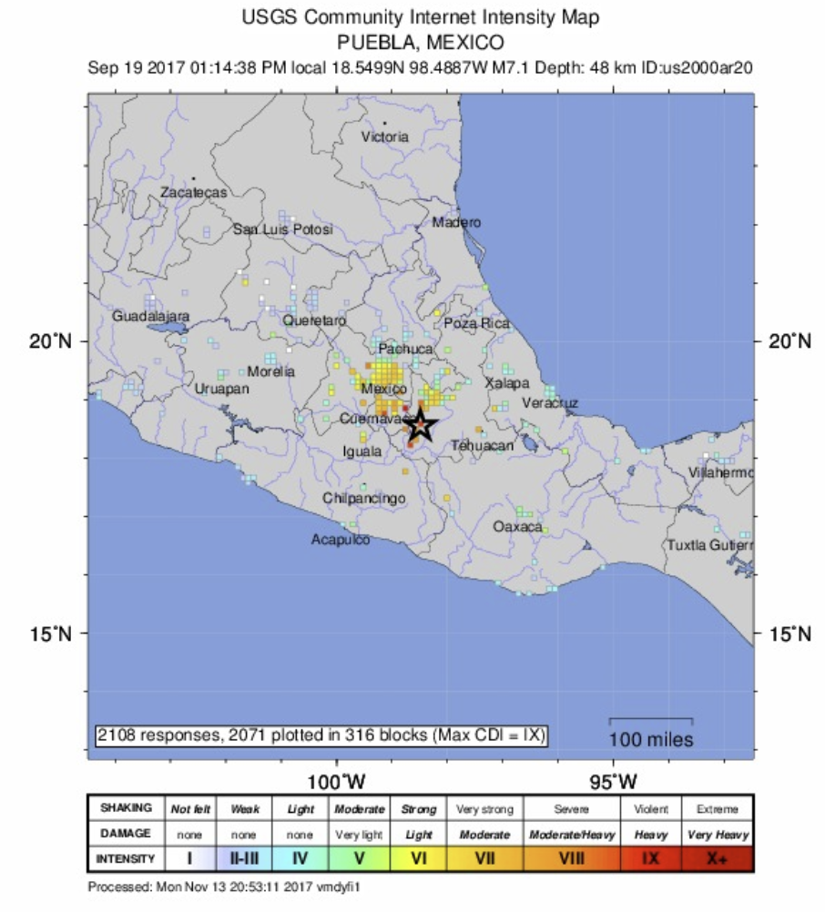
What Earthquakes Feel Like?
II: Felt by a few at rest
IV: Felt indoors by many, dishes, windows, and doors disturbed
VI: Felt by all, many frightened, heavy furniture moved
IX: Considerable damage to structures
Source: United States Geological Survey
Notes:
Earthquake magnitude is a number that characterizes the relative size of an earthquake.
In general with equal distance and ground beneath you
For each whole number increase in the Richter scale, the ground motion increases by 10 times

Slide 5

What is Induced Seismicity?
Earthquakes caused by human activities
Human activities can alter the state of stress on pre-existing faults and/or create new fractures within the crust
Date of Search: 11/15/17

Slide 6
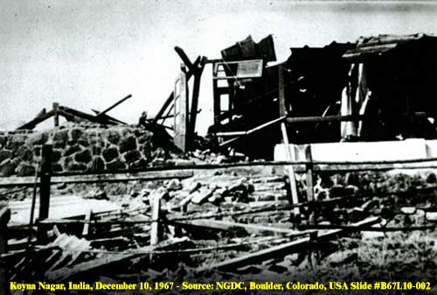
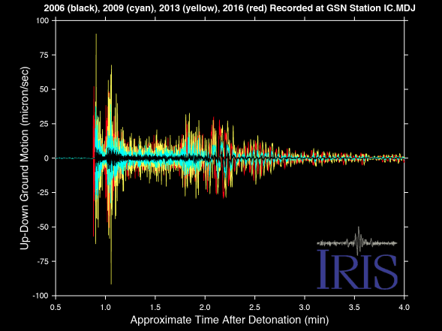
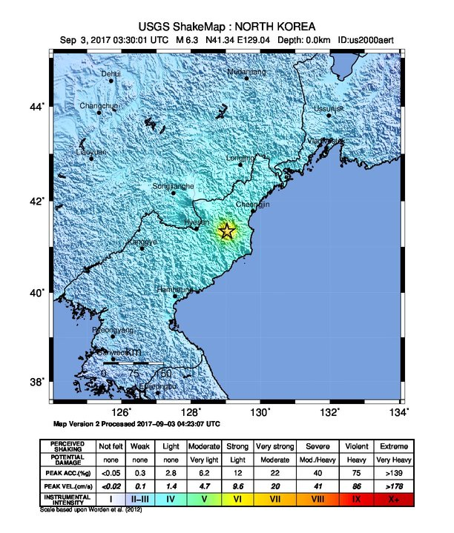

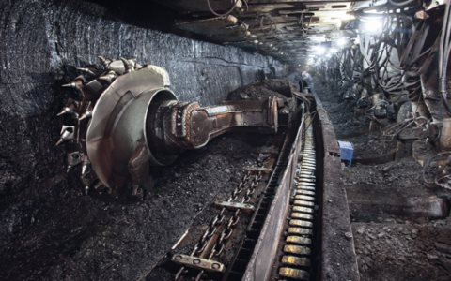
Induced Events
Reservoirs
1967 - M 6.5, 5.2 Koynanager, India
>177 deaths & 2,000 injuries
Nuclear Bombs
2017 – M 6.3 not far from North Korea’s Punggye-ri nuclear test site
Mining Activites
1983 – CSA coal mine
50 deaths
Source: United States Geological Survey; inducedearthquake.com; charlesmccain.com; worldcoal.com
Notes:
Not a new phenomena
The 1967 in India near the site of Koyna dam, raising questions about induced seismicity, and claimed at least 177 lives and injured over 2,200.
How we often know that there has been an underground nuclear test. Specific signal – isotropic energy release
During cold war, a lot progress in seismicity was made due to nations trying to learn about what they were up to
Mining leaves voids that generally alter the balance of forces in the rock, many times causing rock bursts. These voids may collapse producing seismic waves and in some cases reactivate existing faultscausing minor earthquakes

Slide 7
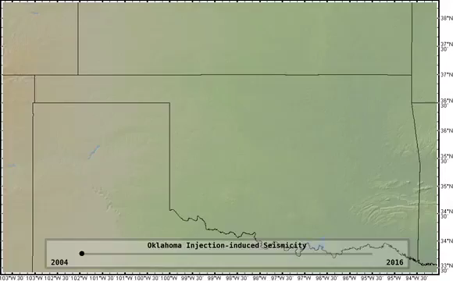
Source: seismicsoundlab vimeo
Notes:
More prevalent in recent years

Slide 8
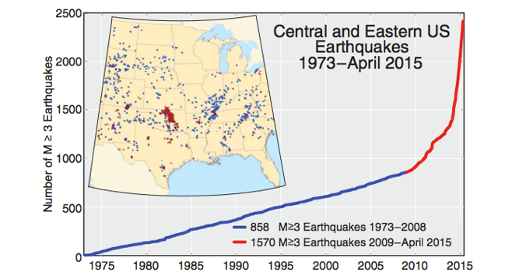
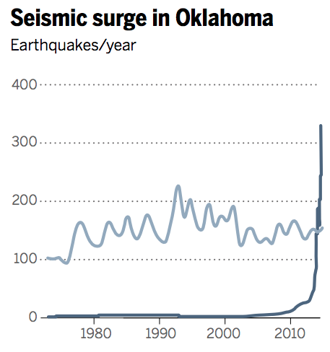
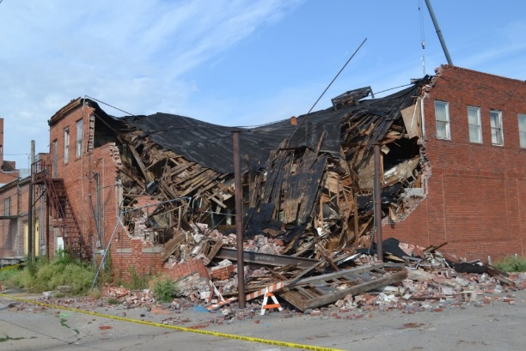
Oil and Gas Activities
1973-2008
21 >M3
2009-2013
99
Big Events
M5.6 Prague, Oklahoma
M5.3 Trinidad, Colorado
M5.0 Cushing, Oklahoma
M5.8 Pawnee, Oklahoma
Number of M3+
Earthquakes per year
California Earthquakes
Oklahoma Earthquakes
Source: forbes.com; rbnenergy.com; insideenergy.org
McGarr et al. 2015
Notes:
sharp increase in seismicity since 2009, increasing from an average of 24 earthquakes per year of magnitude 3.0 (M 3.0) or greater prior to 2009,1 to an average of 193 earthquakes of M 3.0 or greater through 2014

Slide 9
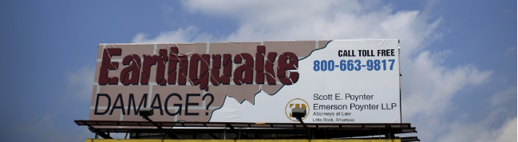
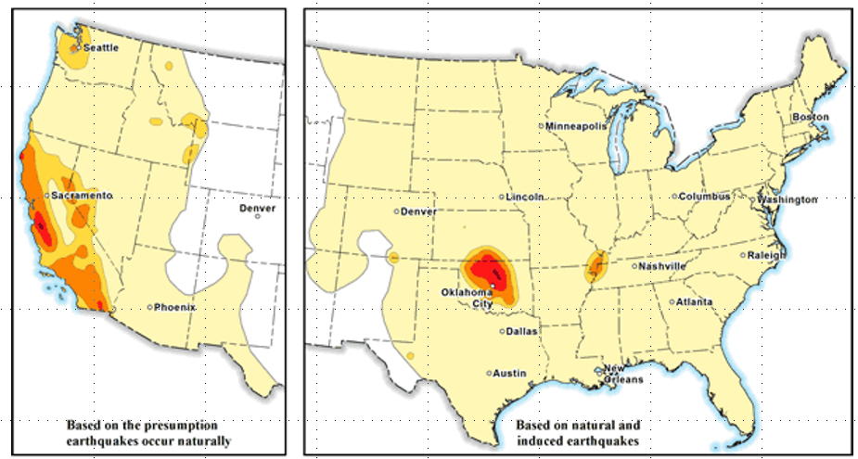
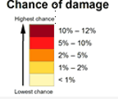
USGS 2017 One-year model
Source: United States Geological Survey; PBS
Notes:
model for assessing the overall seismic hazard in the United States
used to set design provisions in building codes
excluded the seismic hazard posed by human-induced earthquakes because of its time dependency.

Slide 10
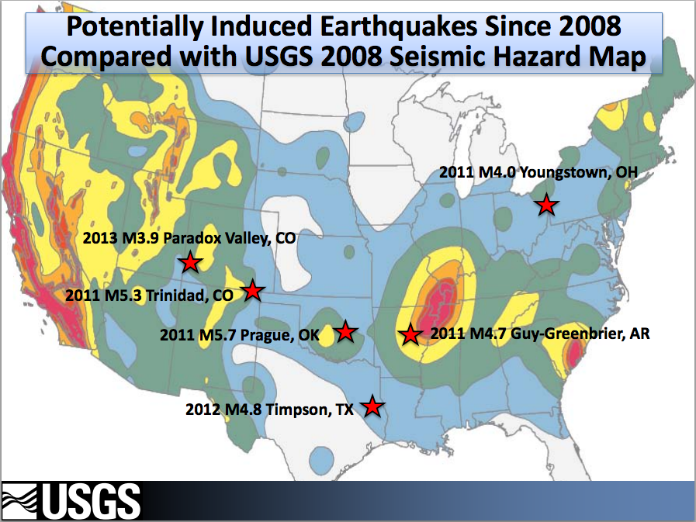
Ohio
2011-2012 - over 100 small earthquakes in Youngstown, Ohio where there were no known past earthquakes, largest earthquake was a M 3.9
Arkansas
2010-2011 – Increase in number of M 2.5 or greater events from 1 in 2007, to 2 in 2008, to 10 in 2009, 54 in 2010, and 157 in 2011, including a M 4.7 earthquake in 2011.
Texas
2009 – Dallas-Fort Worth Airport, 180 M < 3.3 earthquakes
Kansas
2013-2014 – M 4.3, and a few over M 3.0
Colorado
2011 – M 5.3 in the Raton Basin

Slide 11


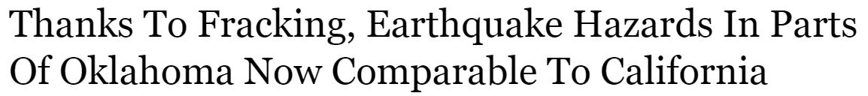


Notes:
Fact 1: Fracking is NOT causing most of the induced earthquakes. Wastewater disposal is the primary cause of the recent increase in earthquakes in the central United States.
Wastewater disposal wells typically operate for longer durations and inject much more fluid than hydraulic fracturing, making them more likely to induce earthquakes. Enhanced oil recovery injects fluid into rock layers where oil and gas have already been extracted, while wastewater injection often occurs in never-before-touched rocks. Therefore, wastewater injection can raise pressure levels more than enhanced oil recovery, and thus increases the likelihood of induced earthquakes.
Fact 2: Not all wastewater injection wells induce earthquakes.
Most injection wells are not associated with felt earthquakes. A combination of many factors is necessary for injection to induce felt earthquakes. These include: the injection rate and total volume injected; the presence of faults that are large enough to produce felt earthquakes; stresses that are large enough to produce earthquakes; and the presence of pathways for the fluid pressure to travel from the injection point to faults.
Fact 3: Wastewater is produced at all oil wells, not just hydraulic fracturing sites.
Most wastewater currently disposed of across the nation is generated and produced in the process of oil and gas extraction. As discussed above, saltwater is produced as a byproduct during the extraction process. This wastewater is found at nearly every oil and gas extraction well.
The other main constituent of wastewater is leftover hydraulic fracturing fluid. Once hydraulic fracturing is completed, drilling engineers extract the fluids that are remaining in the well. Some of this recovered hydraulic fracturing fluid is used in subsequent fracking operations, while some of it is disposed of in deep wells.
Fact 6: Wells not requiring surface pressure to inject wastewater can still induce earthquakes.
Wells where you can pour fluid down the well without added pressure at the wellhead still increase the fluid pressure within the formation and thus can induce earthquakes.

Slide 12
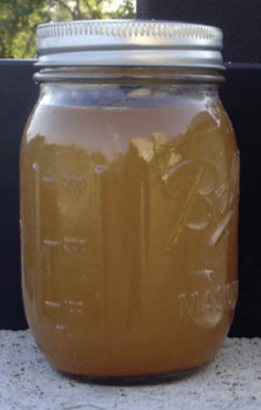
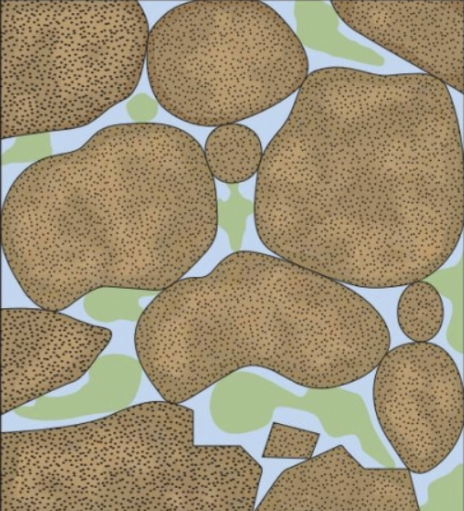
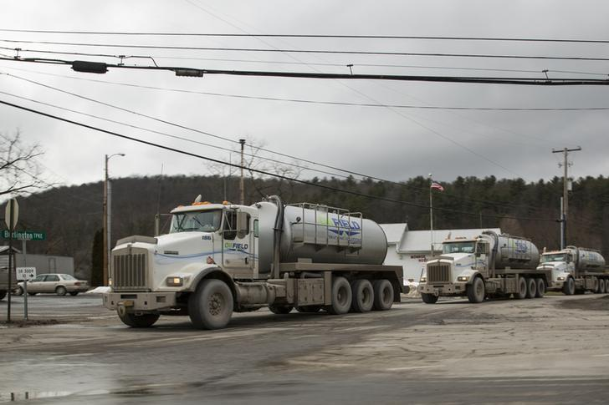

Salt/Formation Water Disposal
2012- 21.2 billion barrels of produced water in U.S. generated (2x the amount of Niagara Falls)
Extremely high salinity (~>300,000 mg/L vs. 3,500 mg/L in ocean), oil and grease, toxic compounds, radioactive material, unknown composition due to proprietary info
~91% injected underground ($1-8/bbl vs. up to $100/bbl)
Became preferred method environmentally and economically after state implementation of rules preventing disposal to surface water or soils
Fossil water found in the same formations as oil/gas
5-95% of produced fluid from well (9x1 to oil)
Source: Abdallah (Oil Field Review); petrowiki.org; reuters.com
Notes:
Wastewater disposal, much larger scale process in terms of its disturbance to the earth
Before I talk about mechanism,
~180,000 Class 2 wells in operation (mainly Tx, Ca, Ok, Ka)

Slide 13





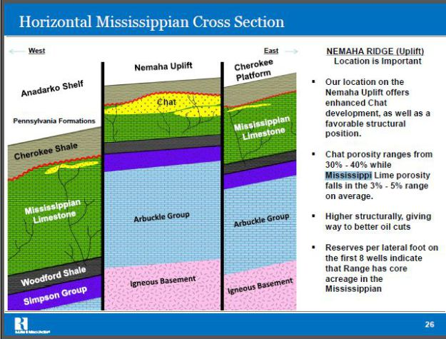

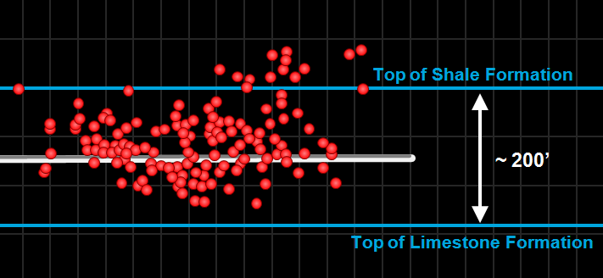
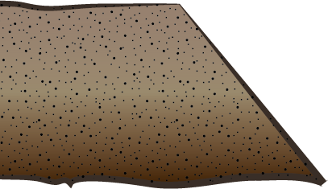
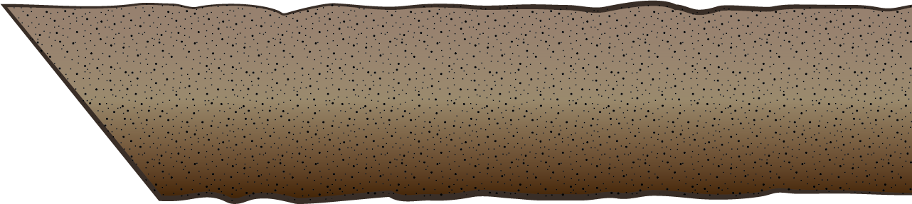
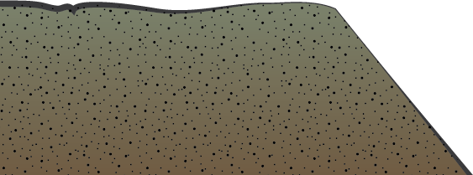
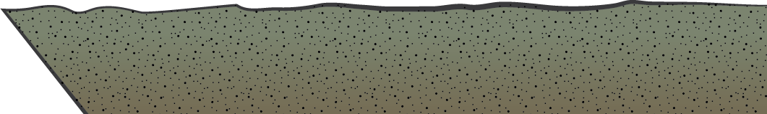
Injection in Oklahoma
CONVENTIONAL
OIL PRODUCING
WELL
ENHANCED OIL
RECOVERY
INJECTION
WELL
HORIZONTAL
HYDRAULIC
FRACTURING
WELL
SALTWATER
DISPOSAL
WELL
SALTWATER
DISPOSAL WELL
Drinking Water
Mississippi Limestone
Woodford Shale
Hunton
Sedimentary
Rocks
10,000 ft
Conventional Oil Field
Arbuckle
Tectonic
Stress
20,000’
SHEAR
STRESS
NORMAL
STRESS
Igneous
Basement
Rocks
Credit to Rall Walsh (Stanford University)
Modified from:
Notes:
HYDRAULIC FRACTURING VS WASTEWATER DISPOSAL
2-8 MILLION GALLONS PER WELL – ONE MONTH
0.8% OF WATER USED IN REGIONS WITHIN THE MARCELLUS SHALE (NY, PENN, WV)
1% OF TOTAL U.S. WATER USAGE
500,000 BARRELS/DAY – 150,000,000 BARRELS OVER 25 YEAR LIFETIME

Slide 14
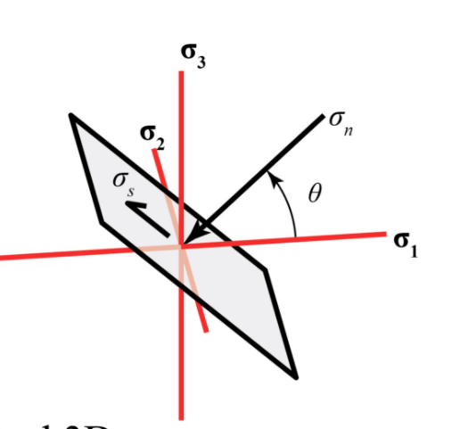
Mechanism
Changing the state of stress in the rocks by creating new fractures or inducing slip on pre-existing geologic faults
Pore Pressure Increase
Source: Waldron 2016

Slide 15
1. An Experiment in Earthquake Control at Rangely, Colorado
Confirming the Mechanism
C.B. Raleigh, J.H. Healy, J.D. Bredehoeft
2. The Denver area earthquakes and the Rocky Mountain Arsenal Disposal Well
David Evans

Slide 16
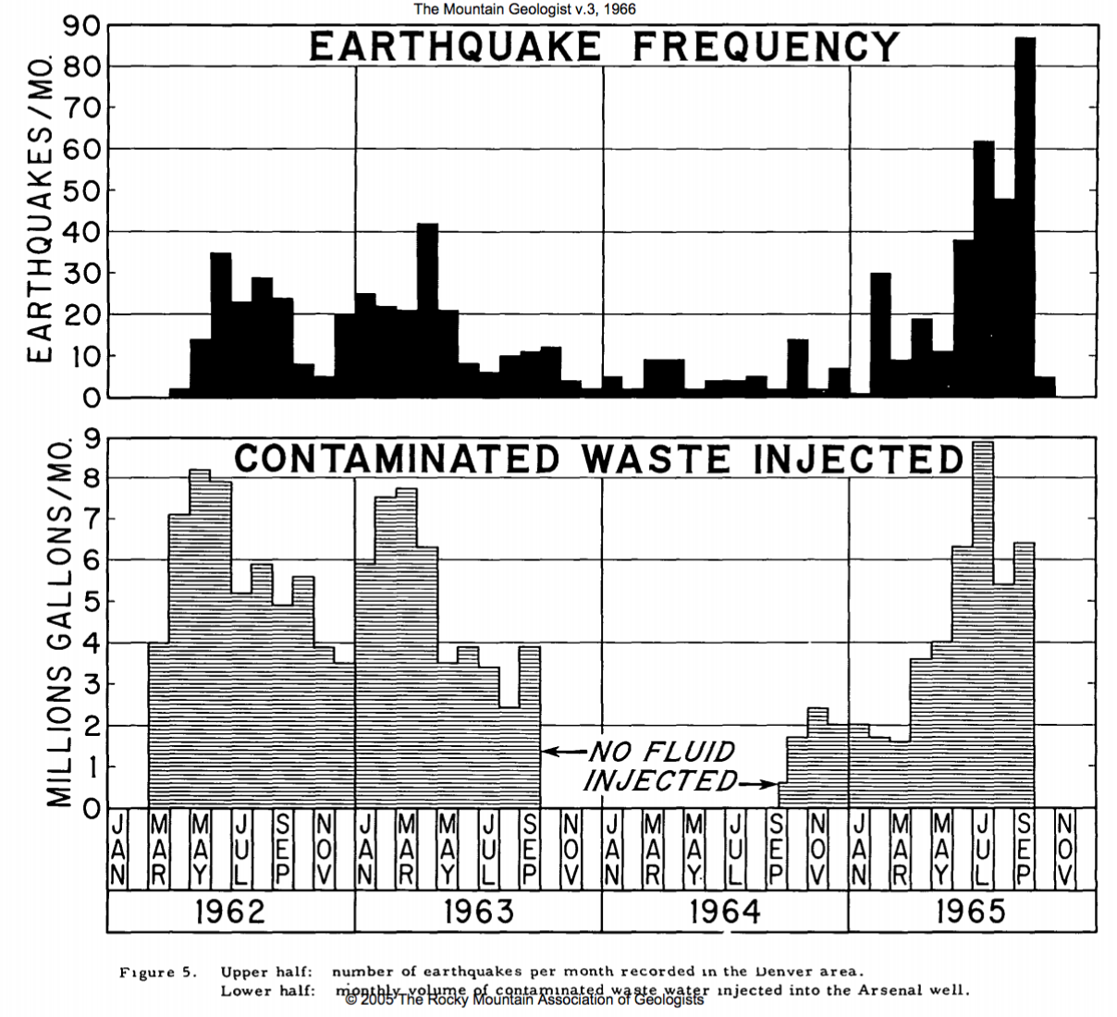
l. Rock Mountain Arsenal
1882-1961 – No earthquakes felt
1962-1965 – 710 earthquakes within 5 mile radius of the well
Injection ceased in 1966 – No earthquakes after
Evans, 1966
Discovery that the injection of fluid at high pressure could trigger earthquakes through this correlation
Led to the hypothesis that earthquakes could be controlled by fluid injection

Slide 17
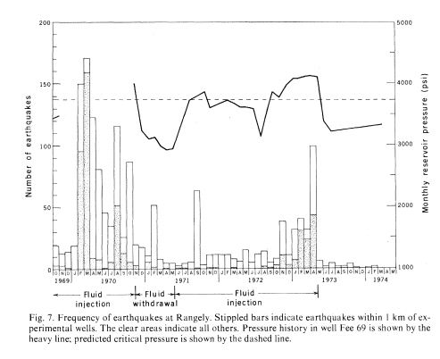

ll. Rangely Experiment
Collaboration between Chevron and Department of Defense
Oil field tertiary recovery
Testing the ‘earthquake control’ hypothesis
Alternated fluid pressure above and below a experimentally determined critical value
Temporal correlation with earthquakes
Source: Raleigh et al. 1976)
“But, given the encouraging results… we feel that control of the San Andreas fault could ultimately prove to be feasible… The recent rapid advances in research on the mech- anisms of earthquakes, combined with the Rangely results, lead us to the conclusion that initial experiments preliminary to control of earthquakes on the San Andreas fault should now be carried out”
2
Notes:
feasibility of earthquake control.
Variations in seismicity were produced by controlled variations in the fluid pressure in a seismi- cally active zone.
earthquakes clustered about a fault trending through a zone of high pore pressure
Laboratory measurements of the frictional properties an in situ stress measurement used to predict the fluid pressure required to trigger earthquakes on pre- existing fractures.

Slide 18
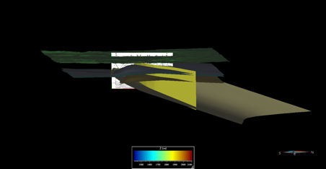
Harvard-MIT Collaboration
Developing a coupled flow-geomechanical analysis for the Rangely Oil Field experiments

Slide 19

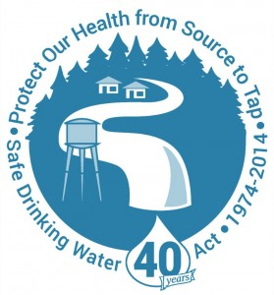
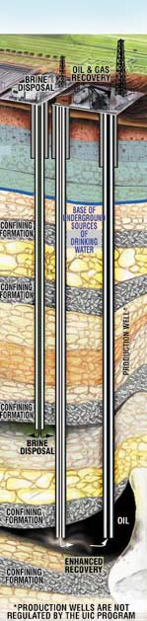

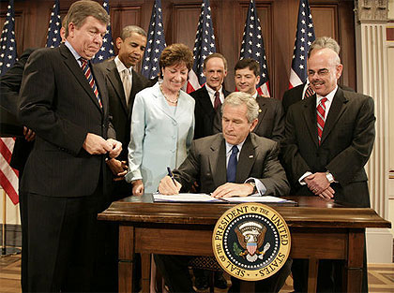

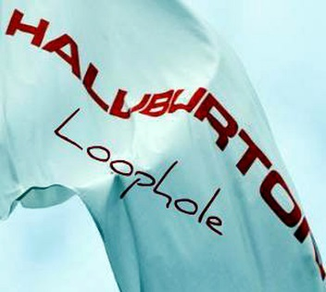
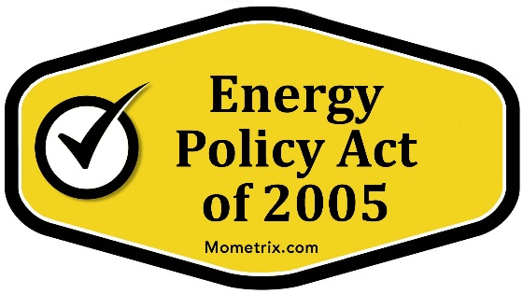
Federal Regulations
Source: Google Images
Notes:
No federal law whose primary purpose is to reduce risk that fluid withdrawals or injections will trigger seismic activity
Safe Drinking Water Act regulates injection for purposes of drinking water (water can be affected by seismicity rather than cause it)
2005- EPA amended to exempted the underground injection of fluids or propping agents (other than diesel fuels) pursuant to oil and gas activities
2010 – EPA announced that it interpreted wells that are hydraulically fractured using diesel as falling under Class 2
injection pressures for Class II (and other) wells may not exceed a pressure that would initiate or propagate fractures in the confining zone adjacent to a USDW.
BLM – “research on the phenomena of induced seismicity from hydraulic fracturing operations is still ongoing and inconclusive”
The SDWA does not mention seismicity; rather, the law’s UIC provisions authorize EPA to regulate underground injection to prevent endangerment of underground sources of drinking water. However, seismicity has the potential to affect drinking water quality through various means (e.g., by damaging the integrity of a well, or creating new fractures and pathways for fluids
injection pressures for Class II (and other) wells may not exceed a pressure that would initiate or propagate fractures in the confining zone adjacent to a USDW.
As a secondary benefit, limiting injection pressure can prevent fractures that could act as conduits through which injected fluids could reach an existing fault.
The Practical Approaches document notes that, while EPA is unaware of any USDW contamination resulting from seismic events related to induced seismicity
In the 114th Congress, no legislation has been introduced to address induced seismicity associated with oil and gas wastewater disposal or other injection activities. The Fracturing Responsibility and Awareness of Chemicals (FRAC) Act of 2015 was introduced in the House (H.R. 1482) and the Senate (S. 785). Among other things, the bills would amend the SDWA term “underground injection” to include the injection of fluids and proppants used in hydraulic fracturing operations, thus authorizing EPA to regulate this process under the SDWA. It is unclear whether the legislation would affect EPA regulatory authority regarding the potential for induced seismicity from hydraulic fracturing, unless it could be shown that induced seismicity caused by the hydraulic fracturing process posed a threat to underground sources of drinking water.
The Environmental Protection Agency’s (EPA) - Underground Injection Control (UIC) program under the Safe Drinking Water Act (SDWA)
regulates the subsurface injection of fluids to protect underground drinking water sources.
six classes of injection wells, including Class II wells used for oil and gas wastewater disposal and enhanced recovery.
Most oil and gas producing states administer the Class II program.
SDWA does not address seismicity, EPA rules for certain well classes require evaluation of seismic risk.
Such requirements do not apply to Class II wells; however, EPA has developed a framework for evaluating seismic risk when reviewing Class II permit applications
Class I Wells inject hazardous wastes, industrial non-hazardous liquids, or municipal wastewater beneath the lowermost underground source of drinking water (USDW). (680 wells, including 117 hazardous waste wells)
Class II Wells inject brines and other fluids associated with oil and gas production and liquid hydrocarbons for storage.
Types of Class II wells :
Enhanced recovery wells: used to inject produced water (brine), fresh water, steam, polymers, or carbon dioxide (CO2) into oil-bearing formations to recover additional oil (and sometimes gas) from production wells. Approximately 80% of Class II wells are ER wells.
Disposal wells: Produced water and other fluids associated with oil and gas production
Hydrocarbon storage wells: More than 100 Class II wells are used to inject liquid hydrocarbons (e.g., petroleum) into underground formations for storage.
Class III inject fluids associated with solution mining of minerals (e.g., salt and uranium) beneath the lowermost USDW. (22,131 wells)
Class IV inject hazardous or radioactive wastes into or above USDWs.
Class V includes all injection wells not included in Classes I-IV, including experimental wells. (e.g., cesspools and stormwater drainage wells, geothermal energy and aquifer storage wells)
Class VI established in 2010, includes wells used for the geologic sequestration of CO2. (Two permits were approved in 2014.)

Slide 20
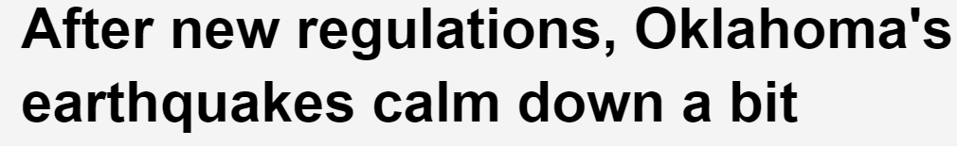









States Initiatives
Source: Google Images
Notes:
For oil-and-gas-related injection operations, the law allows states to administer the UIC program using state rules rather than meeting EPA regulations,
Most oil and gas states and some tribes have assumed primacy for Class II wells under this provision.
Under the UIC program, EPA, states, and tribes regulate more than 800,000 injection wells.
Oklahoma – Record more information, traffic light system, determine proximity to known faults, well shutdowns
Ohio – Install monitoring equipment and automatic shutoff device, prohibited injection into certain formations, baseline tests
Texas – Research of seismicity within 100 sq. mi. of site,
Kansas – Numerical monitoring score and additional state funded-monitors, response plan, purchased a portable seismic array, numerous orders of injection limits
Illinois – Traffic light system
Colorado – Review of historic seismicity in area, limits on injection volume and pressure, established an induced seismicity advisory group, issued a traffic light system
California – must monitor state seismic network and submit reports
Arkansas – In 2011, instituted a moratorium for 6 mo., bi-weekly reports of daily injection volumes and pressures. Permanent moratorium near a major fault system, purchased additional seismic monitoring equipment

Slide 21
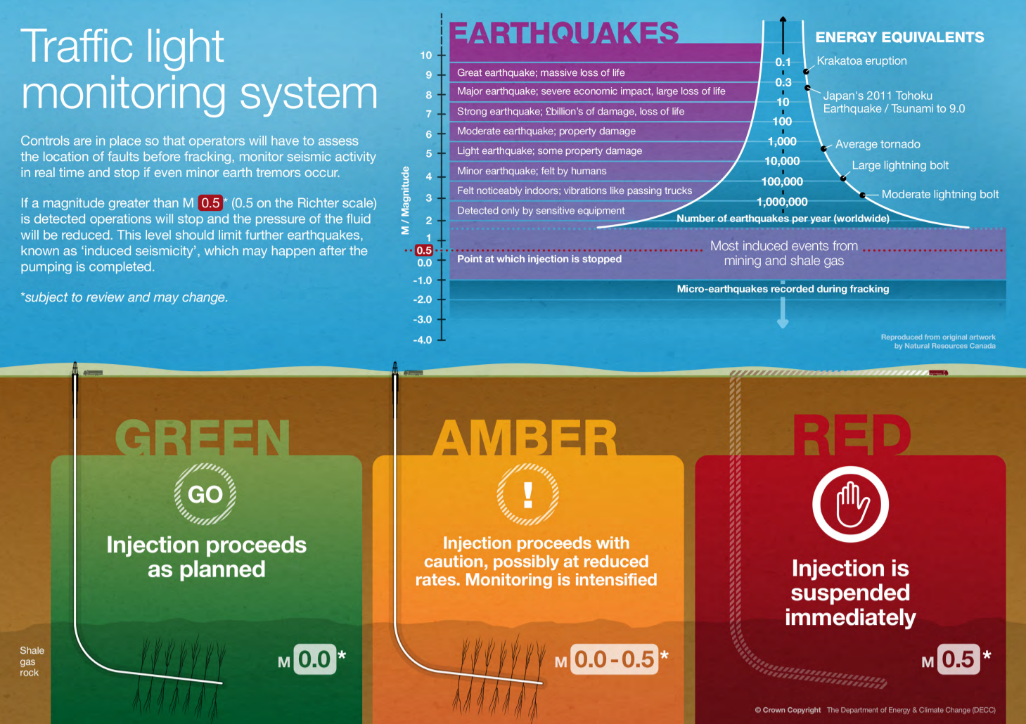
Source: University of Nottingham

Slide 22
Mitigation
Baseline studies
Borehole measurements
Numerical modeling
Pre-fracture injection tests
Seismic reflection surveys
Traffic-light systems
Notes:
Matt Skinner, a spokesman for the OCC, said so far those targeted areas have reduced wastewater injections by roughly 40 percent.
Baseline studies
Temporary local seismometer networks deployed before a project can improve earthquake-detection thresholds and provide more complete assessments of natural seismicity to inform safety strategies.
Borehole measurements
Borehole measurements can be taken to analyse in situ stress. This can help scientists understand local and regional stress states, and identify which faults are more likely to be critically stressed.
Numerical modelling
Computer models can make estimates of the likely effects of a project on, for example, the stress field, subsurface faults and fractures, and fluid flow. Such models are simplified scenarios of reality and require input parameter values that are usually poorly known, however their results may still be useful.
Pre-fracture injection tests
For fluid-injection projects it is common to inject a small volume of fluid prior to the commencement of full-scale injection. This provides information on how the subsurface may respond to larger-volume injection.
Seismic reflection surveys
Using artificial acoustic signals (e.g. explosions or vibration trucks) transmitted into the ground and recorded at the surface, geophysicists can calculate the travel times of reflected signals in order to construct an image of the subsurface. These images may be two-, three- or even four-dimensional (the fourth dimension being time), and may reveal potentially unstable geological features such as faults.
Traffic-light systems
As well as baseline seismic monitoring prior to the start of a project, seismic monitoring can also be undertaken throughout a project’s lifetime. A user-friendly format is the traffic-light system, where predefined seismic magnitudes correspond to the traffic-light colours. If these magnitudes are exceeded this may result in the modification or termination of a project. Green usually means the project continues as planned, orange may mean the project continues at reduced rates (modification), and red may mean an immediate halt in the project. An example is the UK traffic-light system for shale gas hydrofracturing.

