Slide 1
Advanced Research Projects Agency – Energy: Accelerating U.S. Energy Innovation
Dr. Lakshana Huddar, Fellow
Harvard Energy Journal Club
December 1st , 2017

Slide 2

Introductions
Ph.D. Nuclear Engineering
University of California, Berkeley
Interests at ARPA-E
Energy Storage
Nuclear Fission/Fusion
Ocean Carbon Sequestration

Slide 3
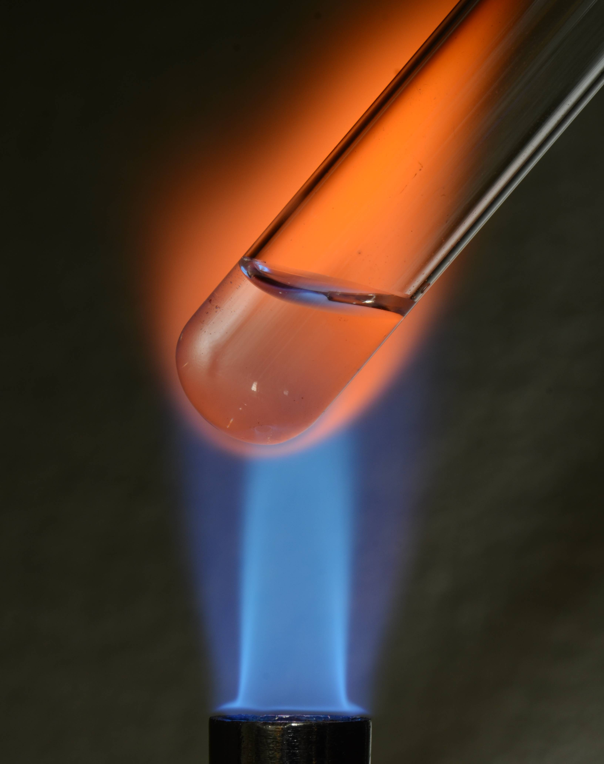
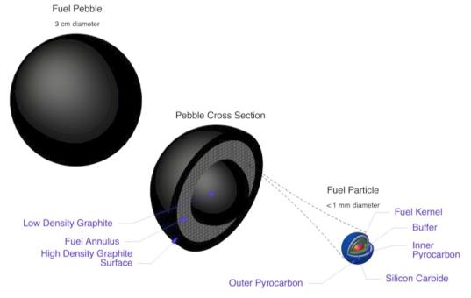
The Fluoride salt cooled High temperature Reactors (FHR) is an Advanced Reactor
Design features:
Fluoride salt coolant
Pebble fuel
Passive safety systems for cooling during accident scenarios
Advantages over current reactors:
Ability to cool the core even when there is a loss of power
Online refueling
Operates at atmospheric pressure
Photo credit: Brian Kelleher

Slide 4
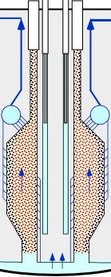
Coolant enters the pebble-bed reactor from the bottom
The coolant is flibe, composed of LiF and BeF2
Heat generation from nuclear reactions in the pebble fuel
Need to accurately model the temperature distribution in the core
Fuel (solid phase)
Coolant (liquid phase)
Notes:
Advanced nuclear reactor design with several proven technologies such as flibe.
Describe flibe a bit
Flow path – two primary modes of operation: normal and natural circulation
Thus, it’s important to understand heat transfer within the core itself and because it’s a pebble bed it can be modeled using porous media equations

Slide 5
Porous media governing energy equations for PB-FHRs
Coolant (fluid) phase
Time-dependent + advection = diffusion + viscous dissipation +
Fuel (solid) phase
Time-dependent = diffusion + heat generation +
The literature does not cover the FHR operational regime.
So how can we determine the interfacial heat transfer coefficient?
Notes:
Conservation equations for PB-FHRs
Viscous dissipation
Thermal dispersion
Darcy is not applicable to this core (only for low Re number flows), check ReK
Viscous dissipation, permeability: Carman-Kozeny and Darcy’s Law
a is the specific surface area (surface area per unit volume)

Slide 6
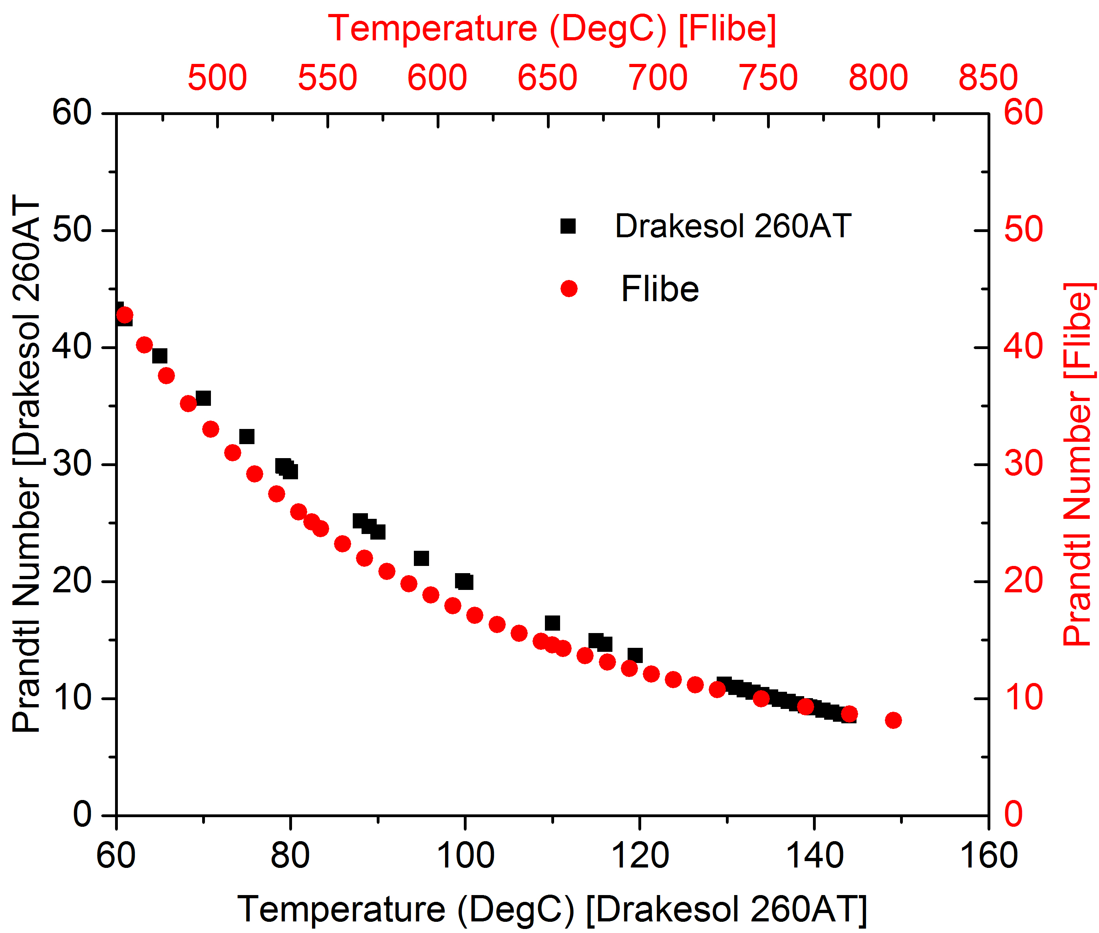
Notes:
Max distortion, 16%

Slide 7
Using Wakao correlation for predictions (for water and air)
Experimental values: 49-412
Experimental values: 26-75
PB-FHR
 | Natural circulation | Forced circulation
Prandtl | 15 | 15
Reynolds | 19 | 955

Slide 8
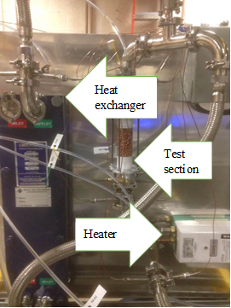
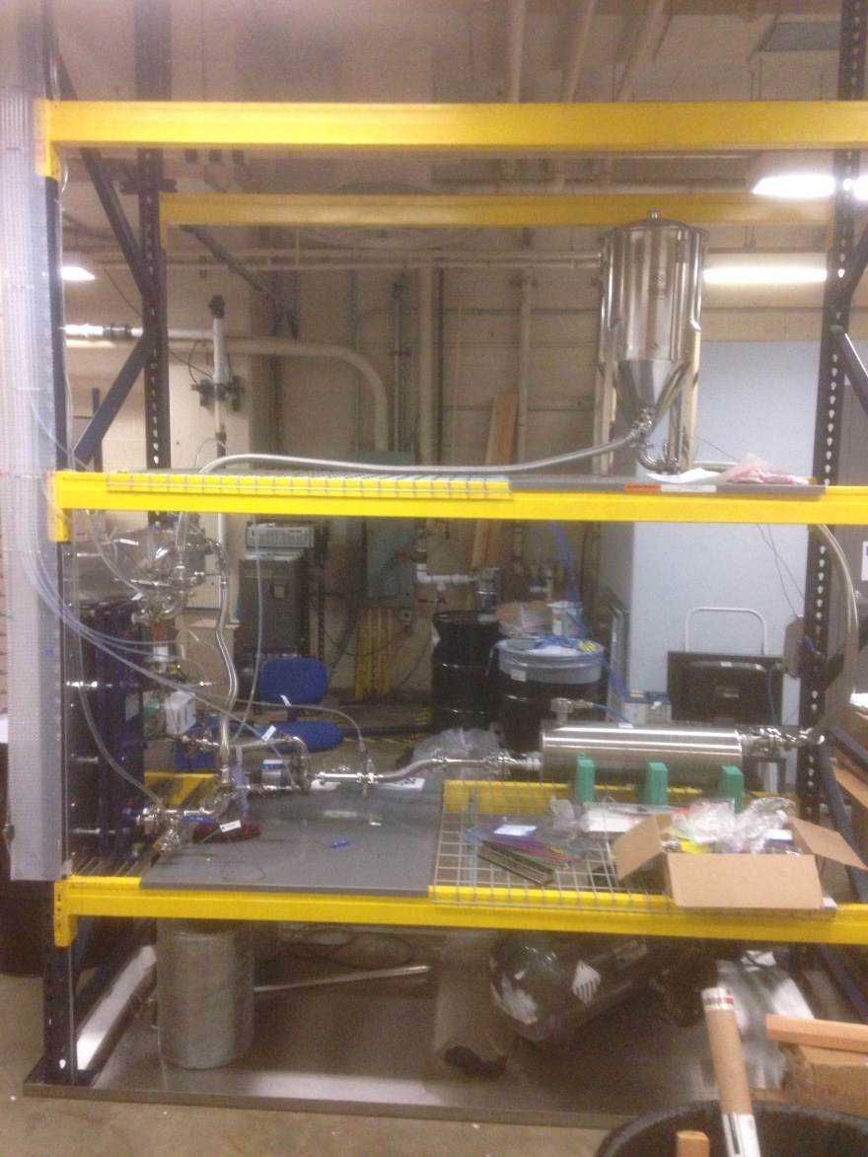
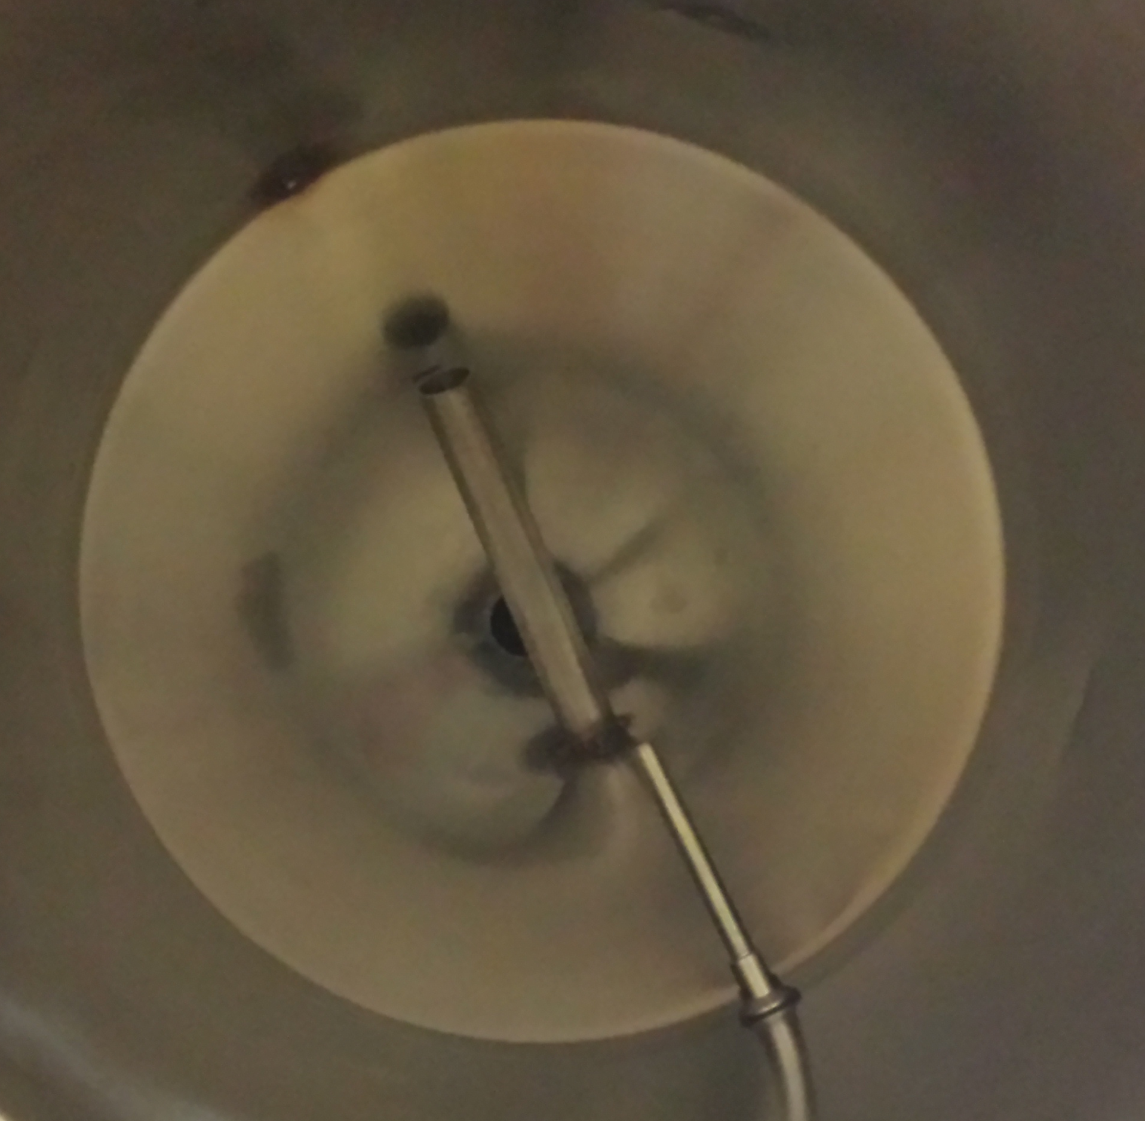
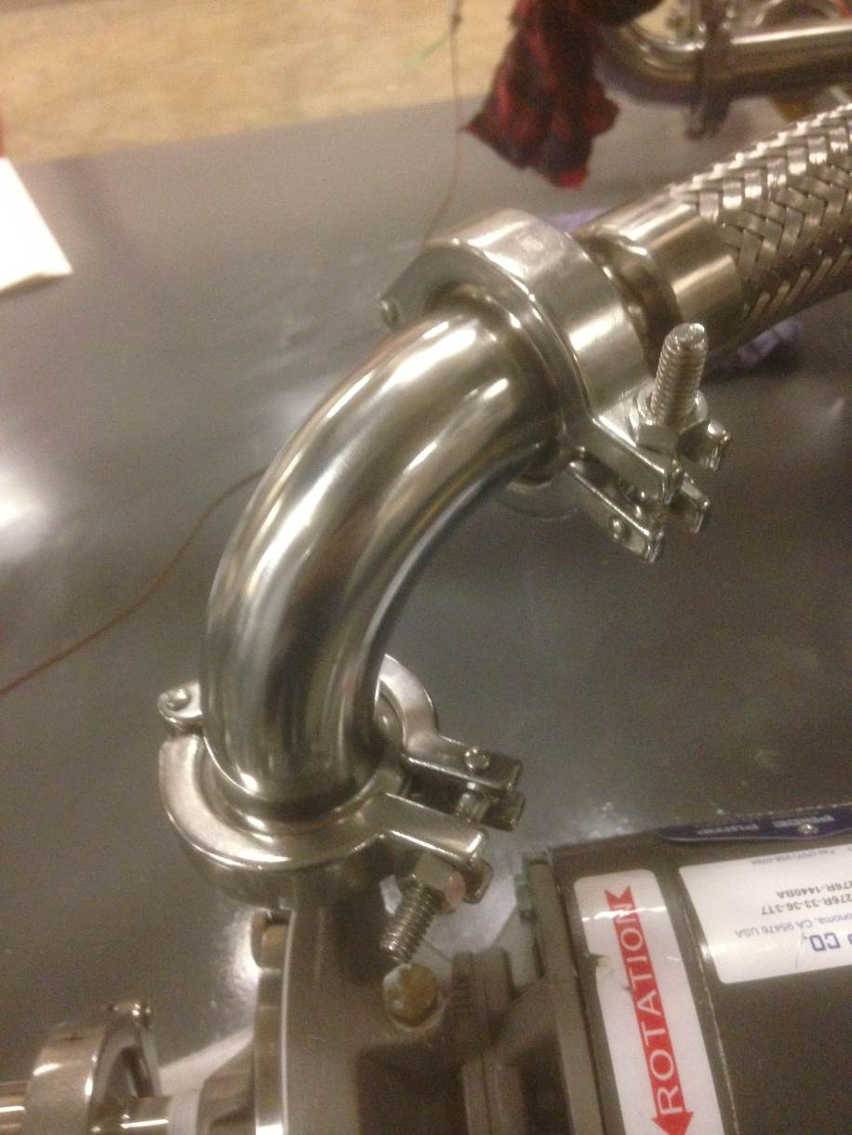


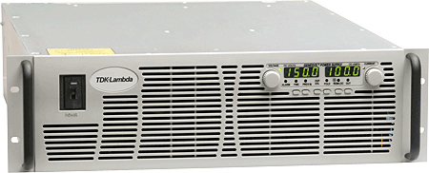

Experimental Set-Up

Slide 9
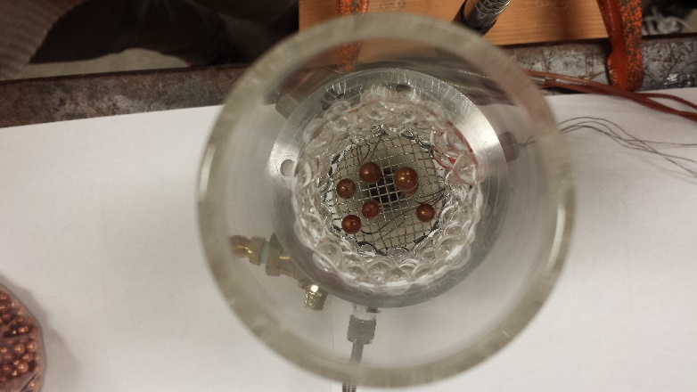
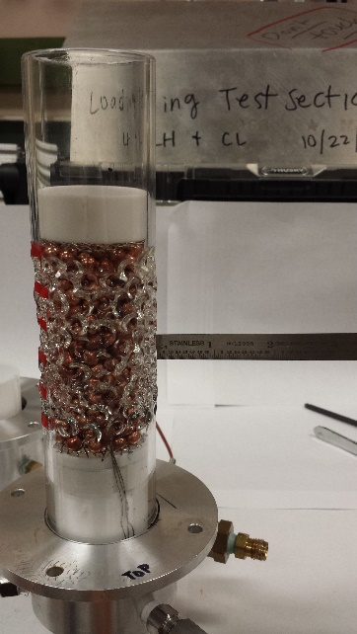
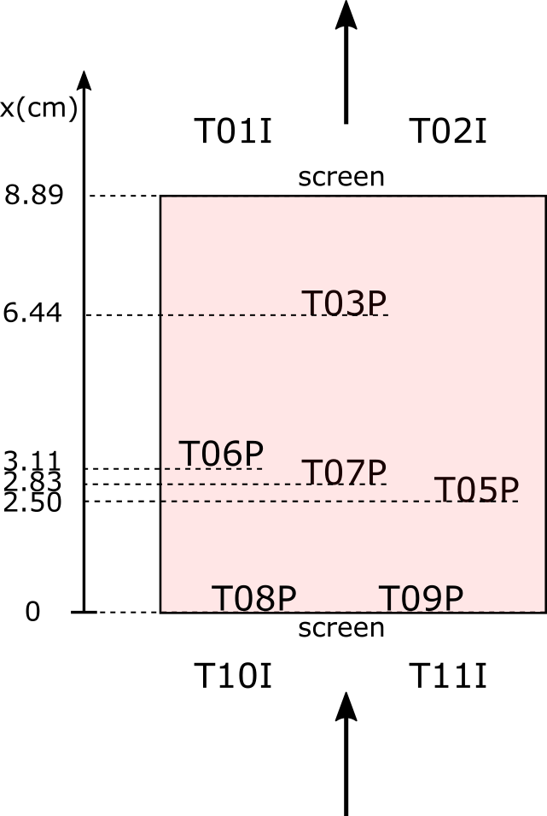
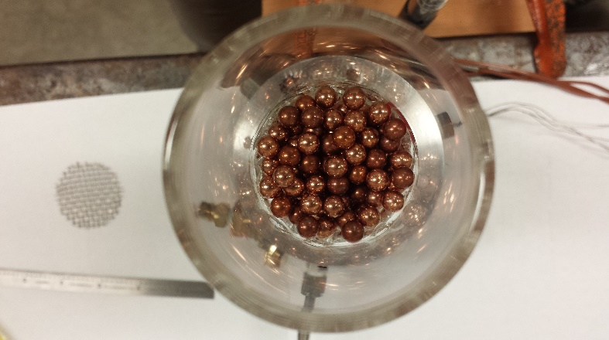
Test Section Instrumentation

Slide 10
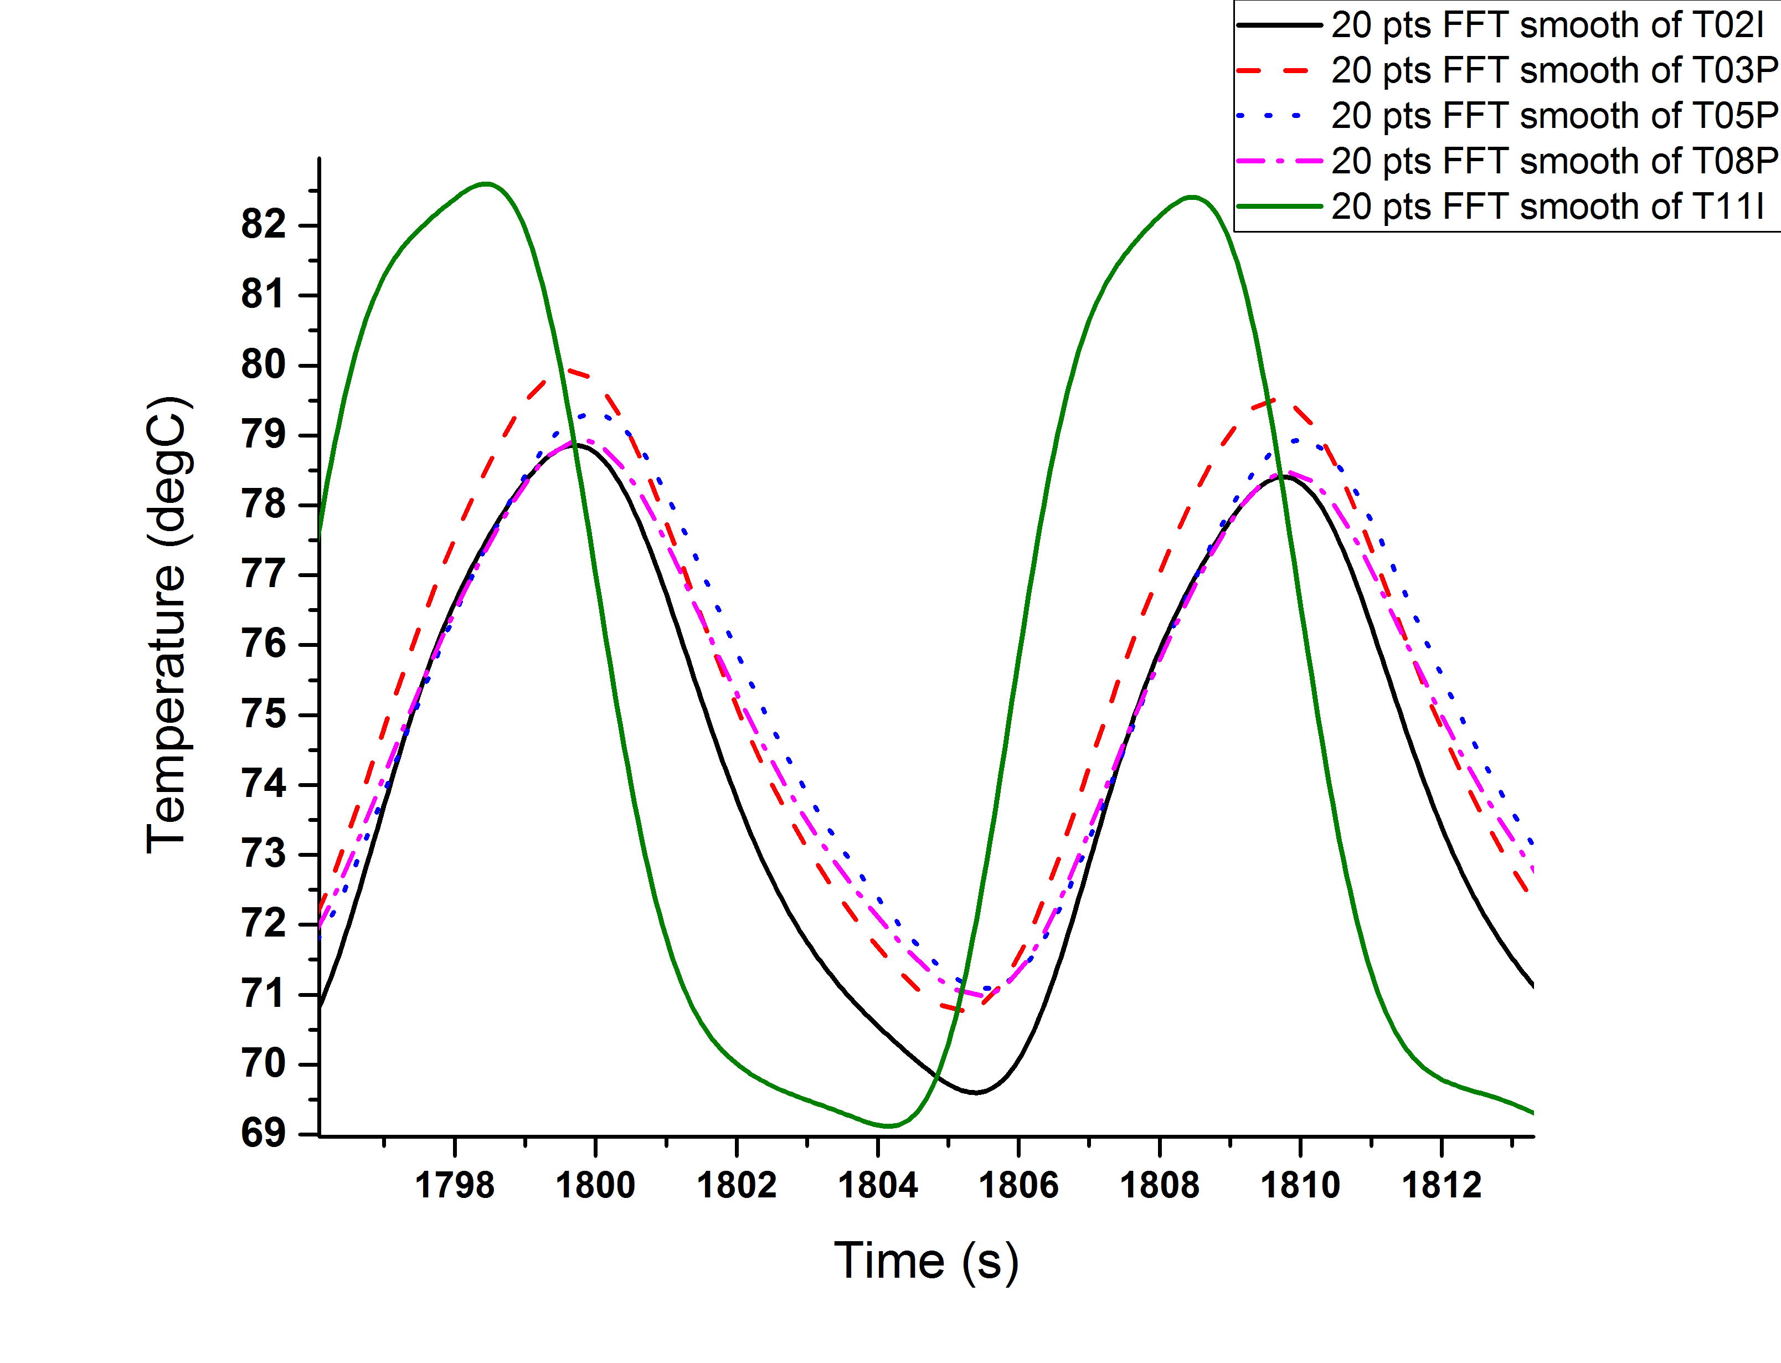
0.1Hz (10s period)
Exit fluid
Bottom pebble
Middle pebble
Top pebble
Entrance fluid

Slide 11
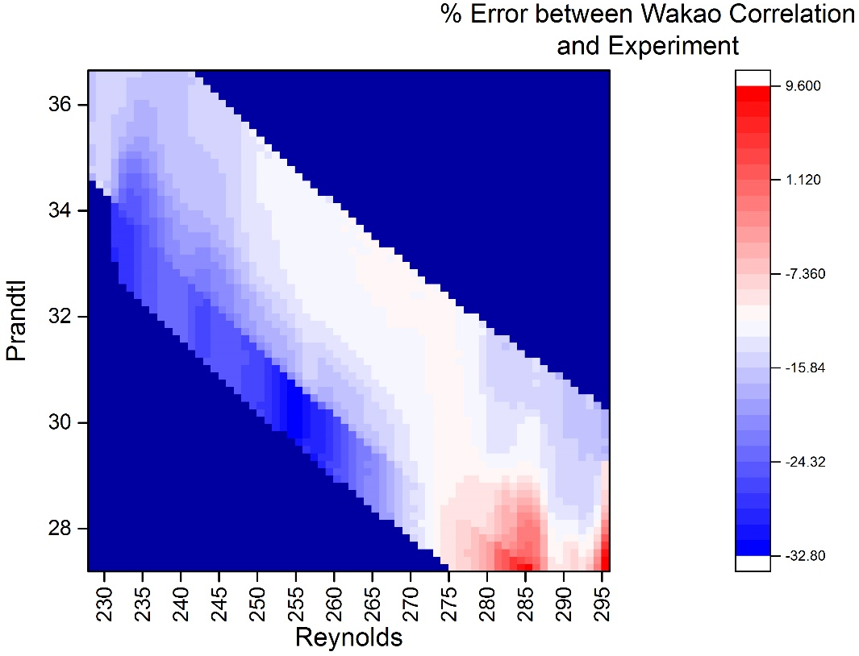
~90% of the collected data was within 20% of literature

Slide 12
Background and Introduction
ARPA-E: Accelerating U.S. Energy Innovation

Slide 13




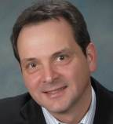



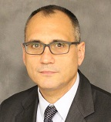





ARPA-E Program Development Staff
Acting
Director
Assoc. Director
for Technology
15 Program Directors
6 Fellows

Slide 14







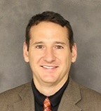

ARPA-E Commercialization Staff
Acting Dept. Director
10 Tech-to-Market Advisors

Slide 15
History of ARPA-E
In 2007, The National Academies recommended Congress establish an Advanced Research Projects Agency within the U.S. Department of Energy
Coming
soon
500+
39
32
23
Awards Announced
37
20
16
12
Programs
To Date
7
1
2007
Rising Above
the Gathering Storm
Published
2009
American Recovery & Reinvestment Act Signed
2010
2011
2012
2013
2014
2015
2016
2017
America COMPETES
Reauthorization Signed
$275 Million
(FY2012)
$280 Million
(FY2015)
America COMPETES
Act Signed
$280M
(FY14)
$306M
(FY17)
$400M
(Recovery Act)
$180M
(FY11)
$275M
(FY12)
$251M
(FY13)
$280M
(FY15)
$291M
(FY16)
$280M
(FY14)
Notes:
Congress was asked to "identify the most urgent challenges the U.S. faces in maintaining leadership in key areas of science and technology,"
2007 – US advantages in Science and technology were beginning to erode. Warning.
Updated to reflect 2015 numbers
Budget (Million) Data Source:
FY2009: $15,000 http://energy.gov/sites/prod/files/FY11Orgsum.pdf ARRA $388,856 http://energy.gov/sites/prod/files/FY11Orgsum.pdf (Note: rounded to $400 million in all public documents, did so here to maintain consistency.)
FY2010 $0 http://energy.gov/sites/prod/files/FY11Orgsum.pdf
FY2011 $179,640 http://energy.gov/sites/prod/files/FY13Volume4.pdf (p. 401)
FY2012 $275,000 http://energy.gov/sites/prod/files/2013/04/f0/orgsum.pdf
FY2013 $250,636 http://energy.gov/sites/prod/files/2014/04/f14/FY%202015%20DOE%20Budget%20by%20Organization.pdf
FY2014 $280,000 http://energy.gov/sites/prod/files/2015/01/f19/FY2016BudgetSummaryTableByOrg_0.pdf
F2015 $279,982 http://energy.gov/sites/prod/files/2015/01/f19/FY2016BudgetSummaryTableByOrg_0.pdf
FY2016 (Requested) 325,000 http://energy.gov/sites/prod/files/2015/01/f19/FY2016BudgetSummaryTableByOrg_0.pdf

Slide 16





ARPA-E impact indicators
Since 2009 ARPA-E has provided $1.5 billion in R&D funding
to more than 580 projects.
74 projects have attracted more than $1.8 billion in private-sector follow-on funding
208 patents issued by U.S. Patent and Trademark Office
56 projects have formed new companies
1,328 peer-reviewed journal articles from ARPA-E projects
68 projects have partnered with other government agencies to further development
As of February 2017

Slide 17
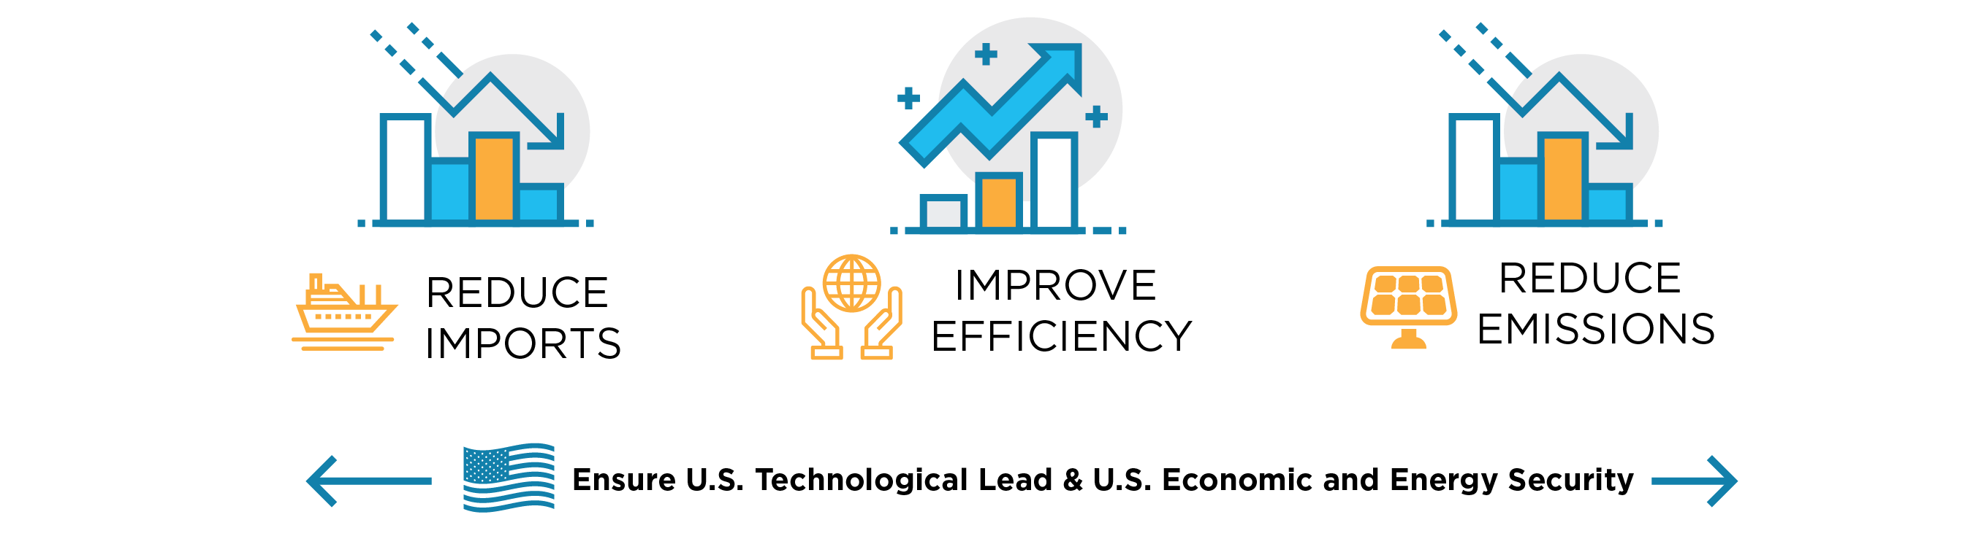
ARPA-E mission
Mission: To overcome long-term and high-risk technological barriers in the development of energy technologies
Means:
  Identify and promote revolutionary advances in fundamental and applied sciences
  Translate scientific discoveries and cutting-edge inventions into technological innovations
  Accelerate transformational technological advances in areas that industry by itself is not likely to undertake because of technical and financial uncertainty

Slide 18
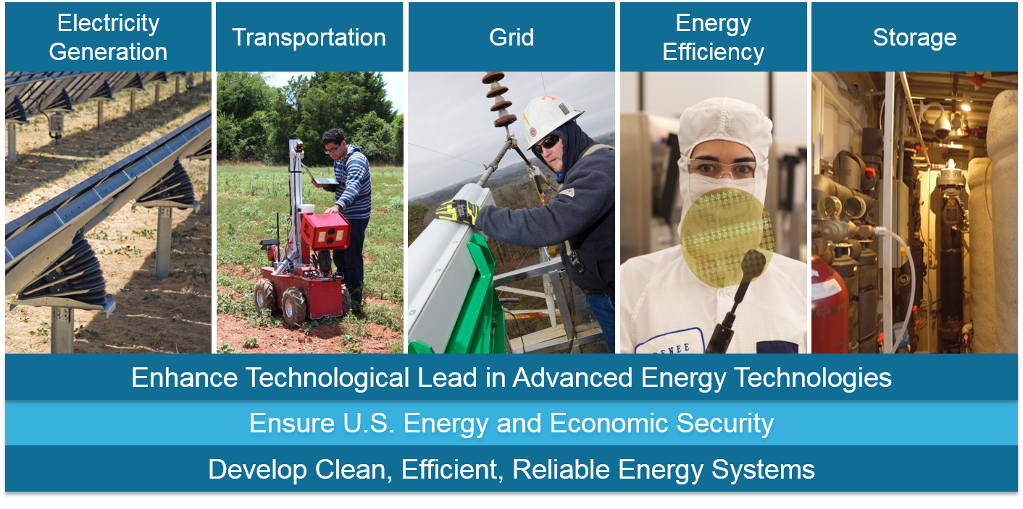
ARPA-E mission

Slide 19
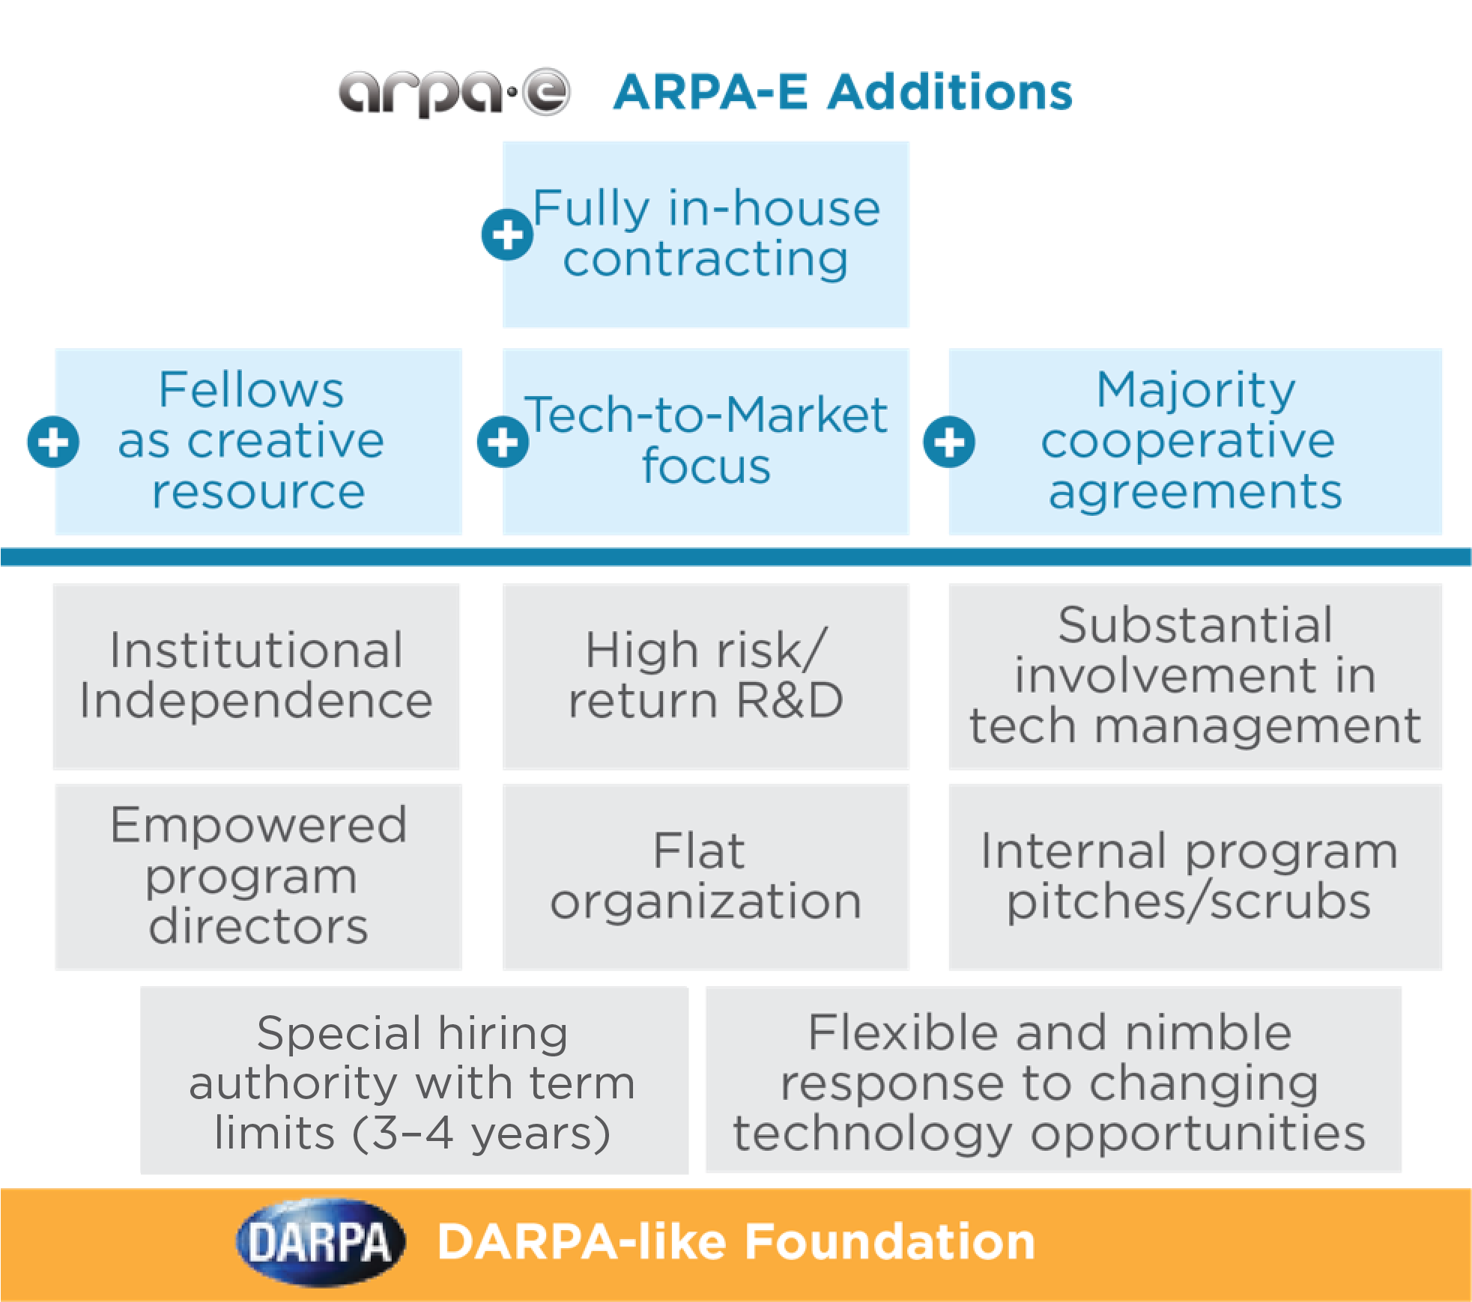
Built on DARPA foundation, but with key differences…
Notes:
Direct milestone negotiations w/ awardees

Slide 20
Programs and Projects
ARPA-E: Accelerating U.S. Energy Innovation

Slide 21



Technology development opportunities at ARPA-E
Focused Programs
Developed by PDs & Fellows
Aimed at a specific energy challenge
OPEN Program
Spans many energy technologies
Historically announced every 3 years
IDEAS Program
Spans many energy technologies
Seedling projects funded up to $500k for 1 year
As of August 2017

Slide 22

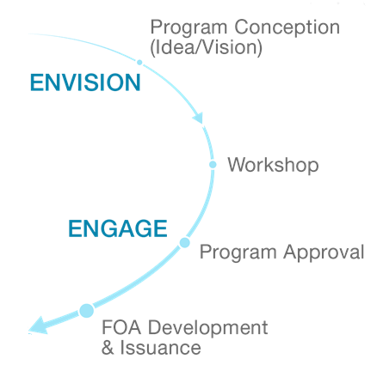
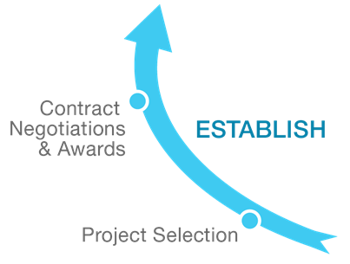
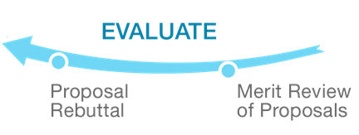
Technology acceleration model
FOCUSED PROGRAM DEVELOPMENT CYCLE
(~4 YEARS)

Slide 23
Ongoing Technology Development Efforts
ARPA-E: Accelerating U.S. Energy Innovation

Slide 24
NEW ARPA-E Opportunities… Dec 2017
2016/2017 Program Development | Current Status
FOA: Funding Opportunity Announcements:
MEITNER – Modeling-Enhanced Innovations Trailblazing Nuclear Energy Reinvigoration | Concept Papers Submission and review
MARINER – Macro Algae Research Inspiring Novel Energy Resources | Projects Announced
SENSOR – Saving Energy Nationwide in Structures with Occupancy Recognition
ROOTS – Rhizosphere Observations Optimizing Terrestrial Sequestration | Projects underway
METALS – Modern Electro/Thermochemical Advances in Light Metals Systems
IDEAS - Innovative Development Energy Related Applied Science | Seedling Solicitations
Notes:
MEITNER: technologies that enable low-lost designs for safe advanced nuclear reactors
MARINER: macroalgae for energy, transportation. Without competing with food crops for land and water
SENSOR: building sensors for increased energy efficiency - heating, lighting and HVAC. Human presence sensors, automatic sensors etc.

Slide 25
Programs to discuss
ROOTS
METALS

Slide 26
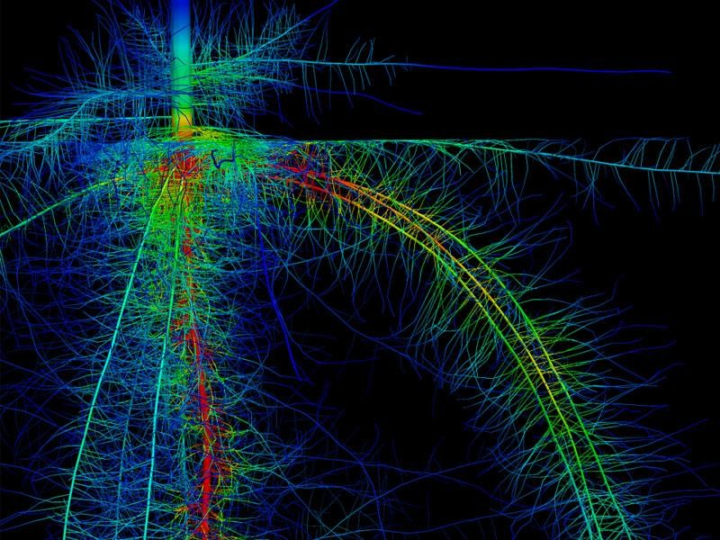
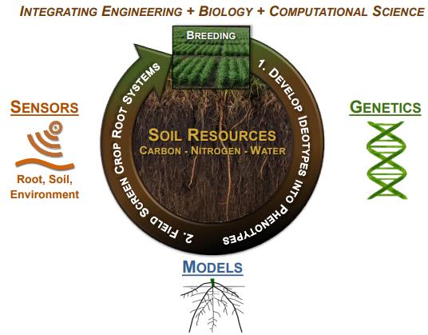
ROOTS
RHIZOSPHERE OBSERVATIONS OPTIMIZING TERRESTRIAL
SEQUESTRATION
Goal
Mitigate ~10% of total U.S. greenhouse gas emissions (GHG) annually while also improving the climate resiliency of U.S. agricultural production by achieving:
50% increase in carbon deposition depth and accumulation
50% decrease in fertilizer N₂O emissions
25% increase in water productivity
Approach
Develop novel, non-destructive, field deployable technologies to:
Measure root functional properties
Measure soil functional properties
Advance predictive and extensible models that accelerate cultivar selection and development
Notes:
A small percent of the CO2 absorbed by plants enters the soil carbon pool

Slide 27

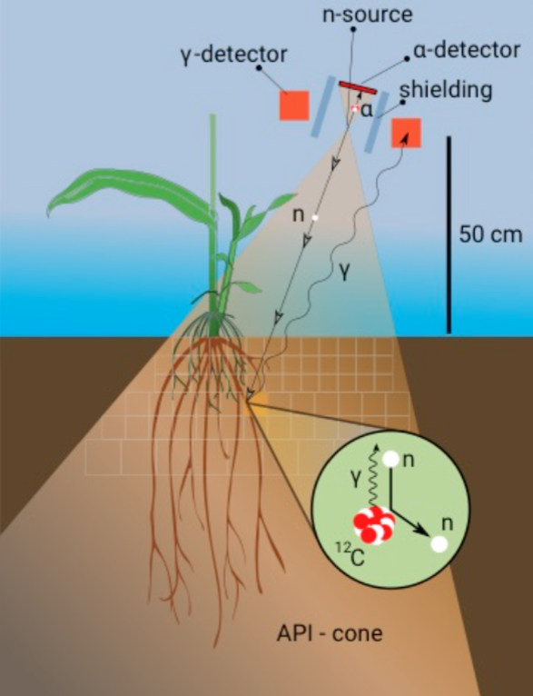

ROOTS: project examples
Integrated Imaging and Modeling Toolbox for Accelerated Development of Root-focused Crops at Field Scales
An Integrated Phenotyping Platform for Deeper Roots

Slide 28
METALS
Modern Electro/Thermochemical Advances in Light Metal Systems
Goal
Cost-effective and energy-efficient manufacturing techniques to process and recycle metals for lightweight vehicles and aircraft
Approach
Novel, low-cost processing of aluminum, magnesium, and titanium
Automation of light metal scrap sorting techniques that can be integrated with a high efficiency systems
Potential Impact
Security
Light-weighting vehicles to improve fuel efficiency could reduce U.S. dependence on foreign fossil fuel resources.
Environment
Utilizing light metals to manufacture vehicles and aircraft decreases their weight, reducing overall fuel consumption and CO₂ emissions.
Economy
Reducing light metal processing costs compared to steel enables the development of lightweight vehicles and aircraft.

Slide 29
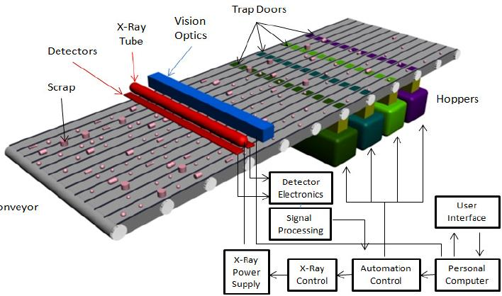
Metals: project examples
Low-Cost High Throughput In-Line X-Ray Fluorescence Scrap Metal Sorter
Carbothermal Reduction Process for Producing Magnesium Metal using a Hybrid Solar/Electric Reactor
Goal
Carbothermal magnesium production reactor with dramatically improved energy efficiency compared to conventional technologies.
Challenges
Generation of hot magnesium vapor from magnesium oxide and carbon with the collection and recovery device in tandem.
Condensation magnesium while preventing re-oxidation.
Transition from batch to continuous processes.
Goal
Develop a high throughput, fully automated sorter for light metal alloys.
Challenges
Develop high intensity, linear X-ray tube for parallel elemental composition measurement @ 1/10 s
Develop low cost X-ray optics and silicon detector arrays to continuously resolve real time XRF signals with sufficient sensitivity to distinguish different alloy compositions
Develop intelligent software to correlate the XRF data with optical images to identify the unique elemental composition signature for each piece of scrap.
Notes:
In a double-blind test, the proof-of-concept system has demonstrated a better than 99% sorting accuracy, including the ability to separate 5000 and 6000 series aluminum alloys.
UHV has built a pilot sorting line with a potential throughput of 40 million lbs/year at an industrial partner’s (OmniSource) scrap processing yard
UCB – solar-powered Mg production reactor. Solar day, electricity at night

Slide 30
Career Opportunities
ARPA-E: Accelerating U.S. Energy Innovation

Slide 31




Why work at ARPA-E?
CONTRIBUTE TO A BETTER ENERGY FUTURE
    Work towards creating a more efficient, more secure energy future
WORK IN DIVERSE TECH AREAS
    At ARPA-E you’ll have the opportunity to work with a diversity of energy issues and explore new fields
  JOIN OUR INNOVATIVE
  STARTUP-LIKE CULTURE
    ARPA-E is a fast-paced,
    action-oriented Agency
  COLLABORATE WITH
  OTHER EXPERTS
    Work with other experts from many different disciplines who are devoted to creating a better energy future
    If you are interested in applying or learning more, please email arpa-e-jobs@hq.doe.gov.

Slide 32

















ARPA-E builds experience to position you for success anywhere
Academia
Public/NGO
Large Business
Start-up/VC

Slide 33
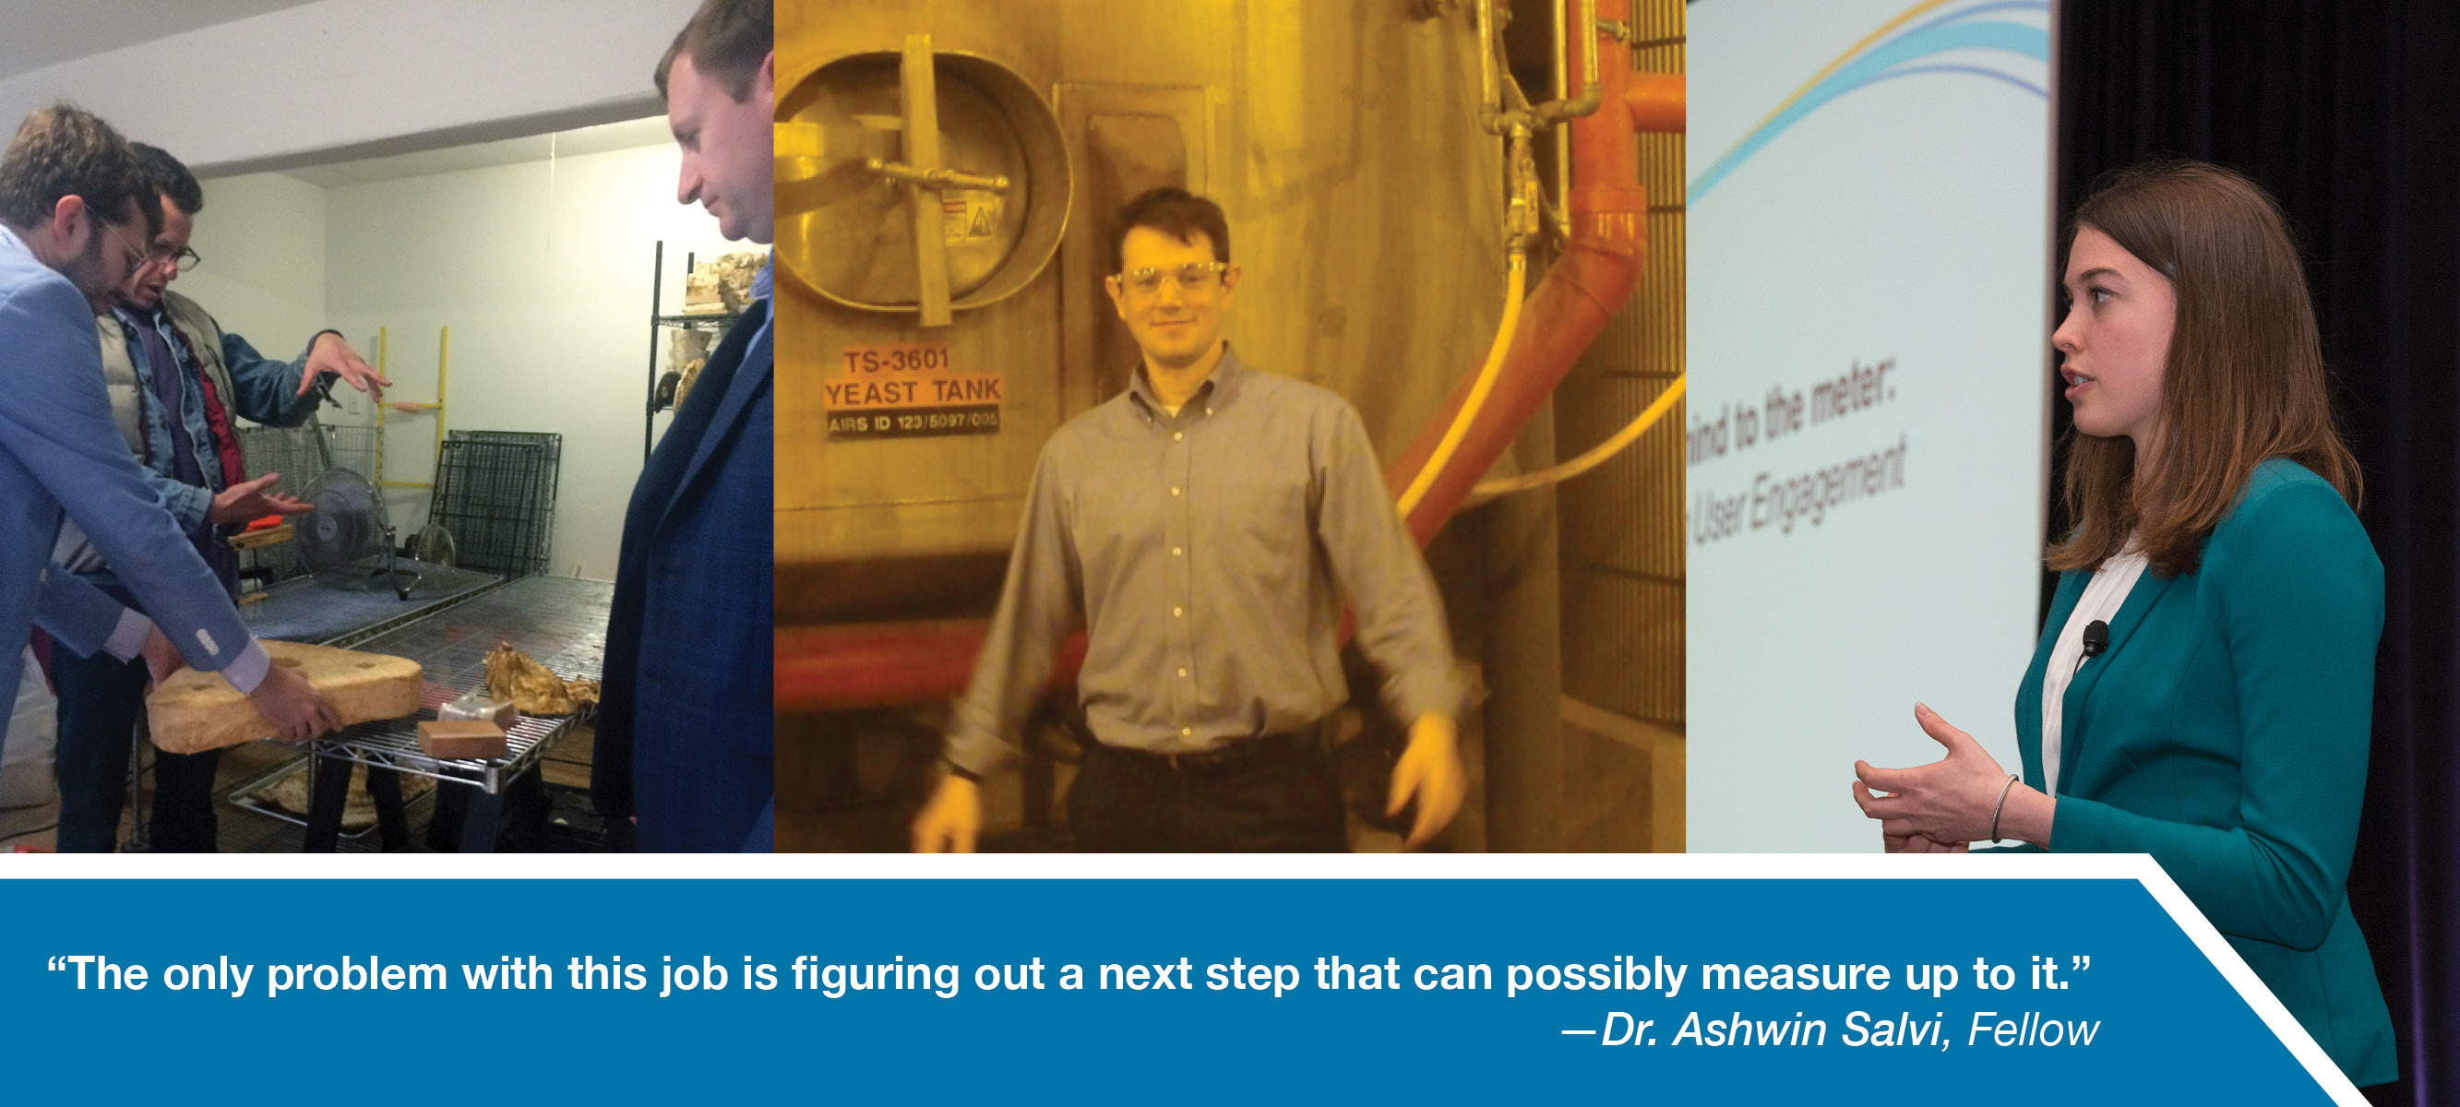
Fellows are early-career innovators
PROGRAM DEVELOPMENT
PROJECT SUPPORT
AGENCY STRATEGY
AND VISIONING
Notes:
Notes for presenter:
Two years
Ph.D & U.S. Citizen* (or actively seeking)

Slide 34




ARPA-E recruitment opportunities: Fellows
Roles, Responsibilities, and Attributes
Independent Energy Technology Development
Perform primary technical and economic analyses to identify high-impact technologies for the Agency
Learn from and brainstorm with experts in a
variety of fields
Publish original research papers and reviews
Organizational Support
Contribute to the strategic direction and vision
of the Agency
Review proposals and funding opportunities
Qualifications
Ph.D. in science or engineering; strong analytical, research, and communication skills; ability to initiate independent projects; passion to change the world through energy technology research; U.S. citizenship
Program Director Support
Help develop future programs through technical analysis, discussions, debate and workshops
Support existing programs through technical and economic analyses and on-site project visits

Slide 35
Fellows Backgrounds
Fellows Have Diverse Backgrounds
Hybrid metal halide perovskites
Novel electrocatalysts for artificial photosynthesis
Antihydrogen trapping
Genetically-encodable neural recording devices
Wireless sensing for civil infrastructure systems
Passive & heat-activated pumps and compressors
Molecular vibrations in primary electron transport

Slide 36

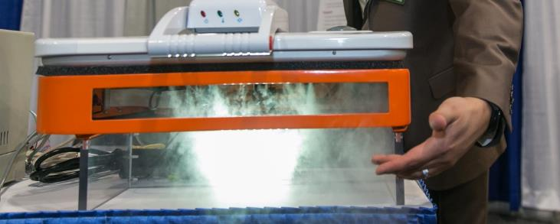

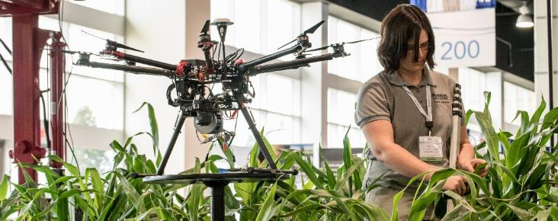
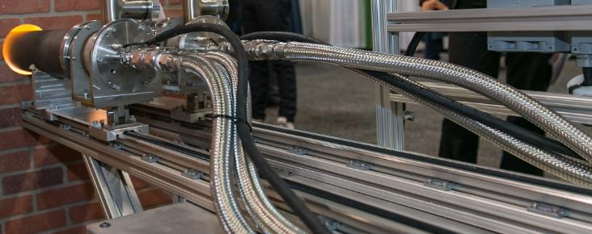
2018 ARPA-E Energy Innovation Summit:
Student Program
Attend the premier event showcasing America’s future energy technologies
Network with corporate recruiters
Enjoy complimentary registration &
student-focused energy programming
Apply by January 2, 2018 at
www.arpae-summit.com/Students
March 13 – 15, 2018
Washington, DC

Slide 37

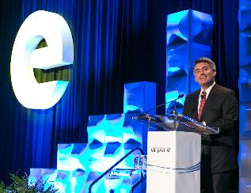
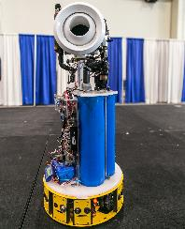
Student Program
Why Apply?
Join top graduate-level students from across the nation
Enjoy complimentary Summit registration & student-specific programming
Network with corporate recruiters
Learn about new energy initiatives
Application for 2018 is open through January 2
Who are the Students?
Students have a mix of technical, scientific, business, and policy backgrounds from a variety of institutions
Energy leaders on campus
Students planning for a professional career in energy

Slide 38


Join our team
For more information, contact me:
lakshana.huddar@hq.doe.gov
https://arpa-e.energy.gov

Slide 39
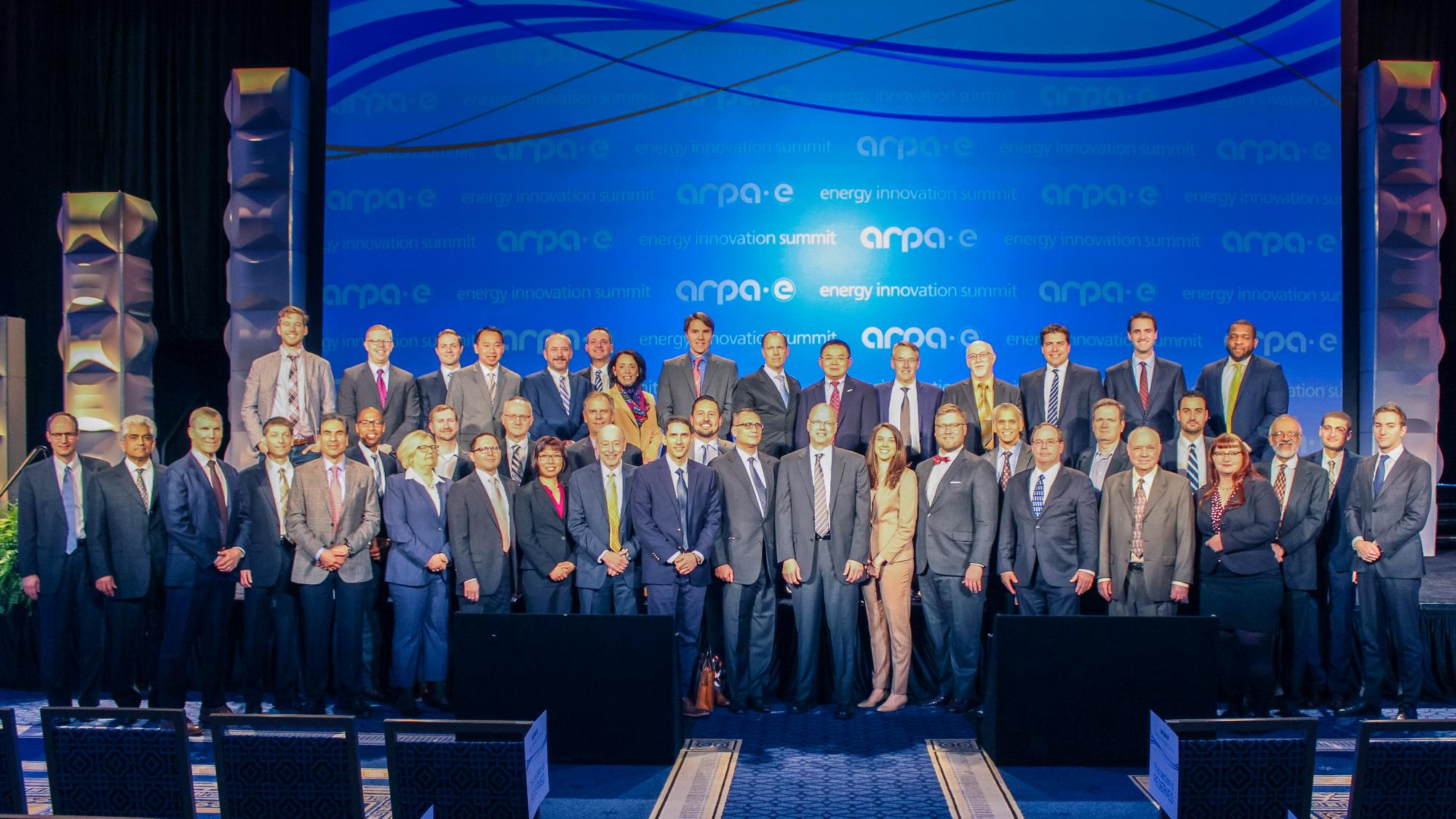
Thank you!

