Slide 1
The Carbon Clock is Ticking:
An Update on the Implementation of the Paris Agreement
Bridger Ruyle — Energy Journal Club — November 10, 2017
bruyle@g.harvard.edu
Notes:
"The Carbon Clock is Ticking: An Update on the Implementation of the Paris Agreement"
It has been two years since negotiation of the Paris Agreement, the landmark treaty on climate change. The accord aims to mitigate the most disastrous effects of climate change by limiting temperature rise beyond 2°C. At Energy Journal Club this week, we will discuss the progress made on the negotiation's major achievements and important international events, including the election of U.S. President Donald Trump, that have effected its long-term viability.
Pictures are:
On left, the Navajo Power Generating Facility, the largest coal fired power plant in the Western United States located in Page, Arizona. The 2250MW station announced this year it would close in 2019 due to the high costs of electricity generation compared to nearby natural gas plants. An estimated 430 plant workers and 325 miners are expected to lose their jobs.
On right, the bleaching of the Great Barrier Reef, the worlds largest coral reef, has been intense in 2016 and 2017, with a recent Nature paper suggesting 50% of the remaining coral was lost over the past two years. Coral bleaching occurs when water temperatures are too warm and can lead to widespread death in some of the most biodiverse ecosystems in the world.

Slide 2
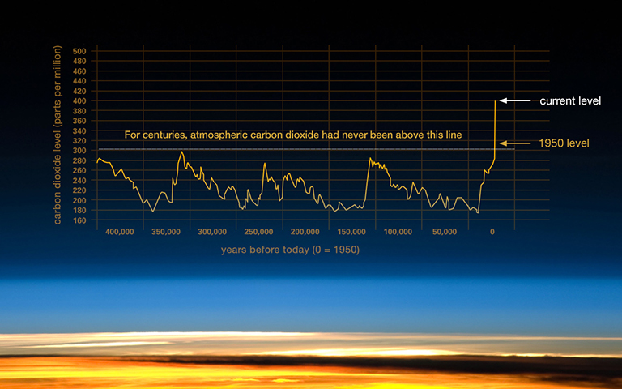
Current climate science
407.25 ppm
July 2017 – Mauna Loa
Courtesy of NASA
Notes:
Current state of CO2 in the environment:
- Carbon dioxide levels in the environment have been in between 180 and 300 ppm for the past several hundreds of thousands of years
Starting in the 1800s with the industrial revolution, concentration has risen past historical levels due to anthropogenic activities
The largest sources of carbon dioxide emissions include electricity, transportation, industry, agriculture, and land use change
In 2015, the United States emitted 6,587 million metric tons of CO2 equivalent, the world’s second largest emitter
July 2017 – CO2 levels at Mauna Loa station in Hawaii = 407.25ppm, concentrations not observed in over 800,000 years
Figure: https://climate.nasa.gov/climate_resources/24/

Slide 3
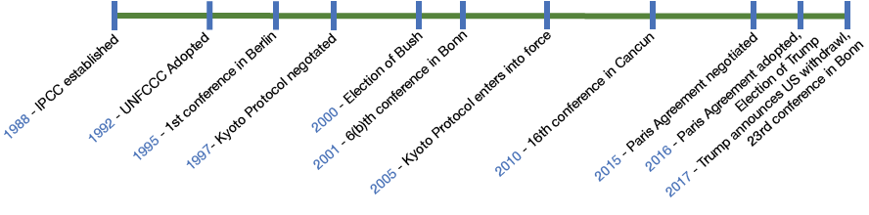
Paris: 27 years in the making
Anthropogenic greenhouse gas problem understood as early as the 1950s
Paris Agreement achieved after 20 previous conferences
Notes:
To date there have been 23 United Nations Framework Convention on Climate Change (UNFCCC) Conference of Parties, including COP23 which is presently going on in Bonn, Germany (3rd time Bonn will be host)
First established to organize for the Kyoto Protocol
The first COP was held in 1995 in Berlin, Germany
Kyoto Protocol in 1997
COP6.2 in Bonn 2001, idea of Green Climate Fund first developed
Talks about a successor to the Kyoto Protocol first start in COP14, 2008 in Ponzan, Poland
COP 16 in Cancún, Mexico → 100 billion for the Green Climate Fund but no mechanism to fund it, recognize IPCC 4th report that we should keep temperature from rising <2°C
COP21 in Paris → Paris Accord
Keeling curve = 1960
1965 report by Lindon Administration:
“The part that remains in the atmosphere may have a significant effect on climate; carbon dioxide is nearly transparent to visible light, but it is a strong absorber and back radiator of infrared radiation, particularly in the wave lengths from 12 to 18 microns; consequently, an increase of atmospheric carbon dioxide could act, much like the glass in a greenhouse, to raise the temperature of the lower air”

Slide 4
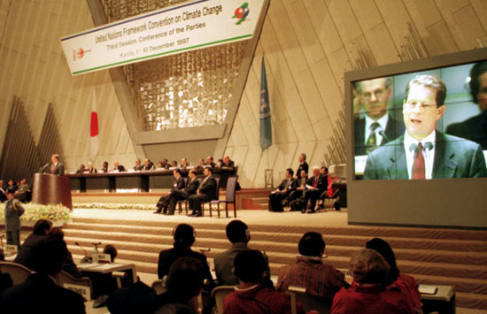
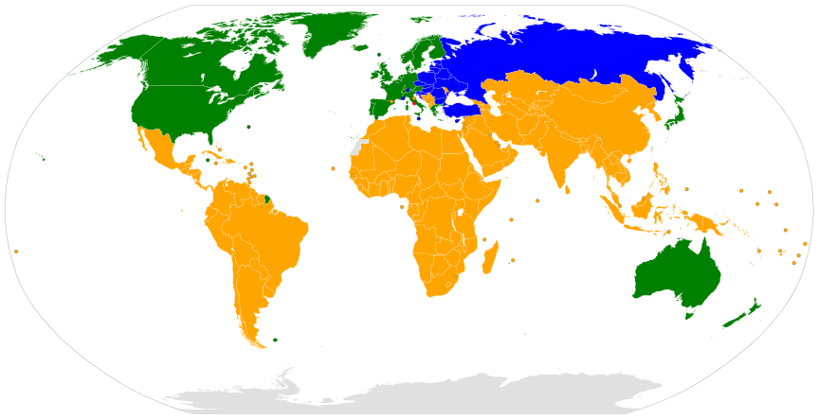
Kyoto Protocol
QELRO = Quantified Emissions Limitation and Reduction Objectives
Annex I and II parties — United States, Northern Europe
Annex I only parties — ex: Russia, Turkey
Non-Annex I parties — ex: China, Brazil, India
Observer states — ex: the Holy See
Notes:
Signatories commit to:
Global warming is occurring
Our CO2 emissions are extremely likely the cause
Reduce greenhouse gas concentration in atmosphere to “a level that would prevent dangerous anthropogenic interference with the climate system”
Annex I – developed countries or economies in transition (mostly old Soviet Union countries) that are bound to meet targets, 43 parties
Annex II – 24 of the Annex I countries that are part of the OECD, responsible for financial and technical support to other countries
Non-Annex I -- developing countries that can voluntarily propose targets
There are many sub-groups within the Conference of Parties as well such as the Alliance of Small Island States. These aren’t legally defined but often act together in negotiations
Structure:
1st round of emissions targets 2008-2012
Binding targets – quantified emission limitation and reduction objectives (QELRO)
How: thru reductions or three flexibility mechanisms – emissions trading, clean development (Annex 1 → non-Annex 1) focusing on mitigation and adaptation, and joint implementation (Annex 1 → Annex 1)
Greenhouse gases considered: CO2, methane, nitrous oxide, Sulphur hexafluoride, hydrofluorocarbons (HFCs), and perflourocarbons (PFCs)
Russia and Canada ratify in 2002 (55% emitters achieved) and protocol goes into force in 2005
Like what we will see with Paris, even if targets were achieved, they would not be enough
Ex: EU commits to 6.7% reduction from 1990 base years
Not all countries used the same base year and some countries (ex: France) did not commit to reduction but rather no increase
Targets did not include international aviation and shipping
2nd round of targets from 2012 (extended in Doha conference)
Was not widely accepted and never went into force outside of Europe (exception: Kazakhstan, Australia)
Ends in 2020, Paris (starting in 2020) is a separate instrument and not an amendment like Doha
Picture: https://www.britannica.com/event/Kyoto-Protocol
Map: https://en.wikipedia.org/wiki/United_Nations_Framework_Convention_on_Climate_Change#/media/File:UNFCCC_parties.svg

Slide 5
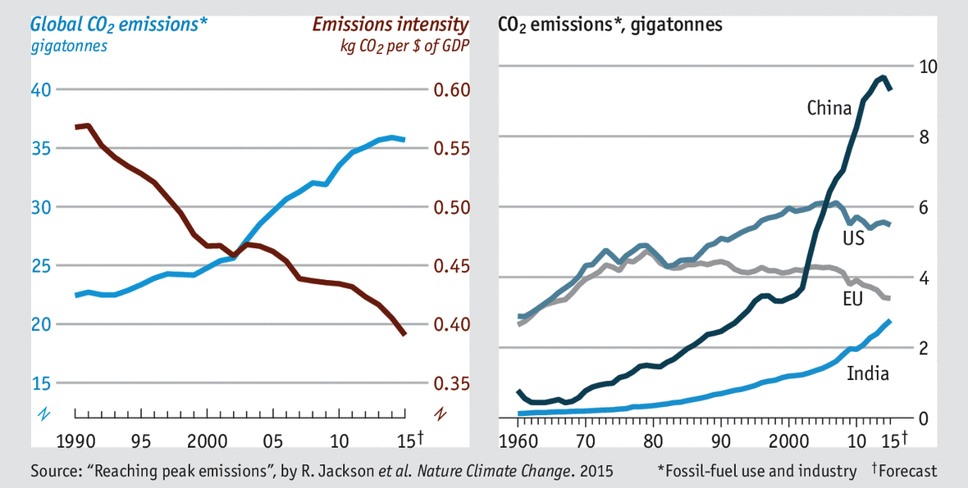
Notes:
CO2eq emissions from fossil-fuel use and industry since Kyoto… has the Kyoto protocol been effective?
Negotiations initially wanted emissions to be stabilized to 1990 levels by 2000, which most industrialized countries didn’t want → this lead to binding commitments
Final targets negotiated on last minute political compromises based mostly on Argentinian Raul Estrada’s plan (chair of negotiations)
All COPs can be described loosely as developing countries offering more than what should be expected, and developed countries offering less
Compliance: “monitoring compliance with the commitments and penalties for non-compliance”
Scholars note that consequences are actually weak despite the great stir they caused in negotiation
US:
Signed by President Clinton
Senate passes Byrd-Hagel Resolution (95-0) that expressed disapproval for agreement because it didn’t require developing countries (China especially) to make binding emissions reductions. They believed this would seriously harm the economy of the US. Echos of Trump
Because of Senate Resolution, the treaty was never submitted to the Senate for approval
Article 2, Section 2 of the Constitution: ”The President shall have power, by and with the advice and consent of the Senate, to make treaties, provided two-thirds of senators present concur”
Precursor to some choices made at Paris
For treaty to go into effect without the US (36% of 1990 emissions), almost all other Annex 1 countries would have to become signatories
Emissions:
Did not stabilize in 2000 as originally hoped for
According the Jackson paper in Nature Climate Change, 2015 is the first year that CO2 emissions didn’t grow – main reason is attributed to slowdown of the Chinese economy, which has seen an enormous rise in energy use/development
Remember that China wasn’t even classified as a EIT and was a non-Annex I country
This was the primary objection of much of Congress and Bush
Much uncertainty in Chinese emissions: studies have come out revising historical CO2 emissions both up and down
What about Annex I and II emissions? For 1990-2008 excluding/including LULUCF: http://unfccc.int/resource/docs/2011/sbi/eng/inf01.pdf
United States (remember didn’t actually commit to any targets) = +13.3/15.3%
Norway = 9.4/-32.8
EU = -11.3/-13.3
Germany = -23.4/-17.6
Spain = 42.5/ 44.0
For those countries that did make decreases, UNFCCC credits: “considerable credit is due to their implementation of effective policies that, mainly, promote energy efficiency, renewable energy sources and fuel switching”
Figure: https://cdn.static-economist.com/sites/default/files/images/2015/12/blogs/graphic-detail/20151212_woc737_0.png

Slide 6
Is Clean Development Mechanism Effective?
Changuinola Dam, Panama
Notes:
Thought that clean development would be more popular… cheaper to cut emissions in developing countries than developed countries... But there has low demand outside of China
Hard to prove additionality: whether the project truly makes additional savings to GHG emissions
Environmental = emissions from project lower than baseline (HFC-23 destruction) VS. Project = would it happen or not
Problems:
Exclusion of forest conservation and agricultural projects
Note that countries could meet targets thru LULUCF in their own lands, but couldn’t use this for CDM
Economic allocation was inefficient with significant overhead, fraud (ex: projects already completed)
destruction of HFC-23 refrigerant (38% of all emission credits went to this)
However, it was so cheap to destroy (cheaper than credit), it incentivized leakage and for some companies to produce even more to then flip a profit
Picture: Changuinola Dam in Panama: http://begira.ulma.com/en/news/ulma-construccion-uses-advanced-engineering-in-the-changuinola-i-dam-in-panama/image
- Built in 2007, a 223MW power station
Cost $563 million built by AES Corporation, a US power generator and distributor, Fortune 200 company
Built in the middle of a UNESCO biosphere: La Amistad

Slide 7
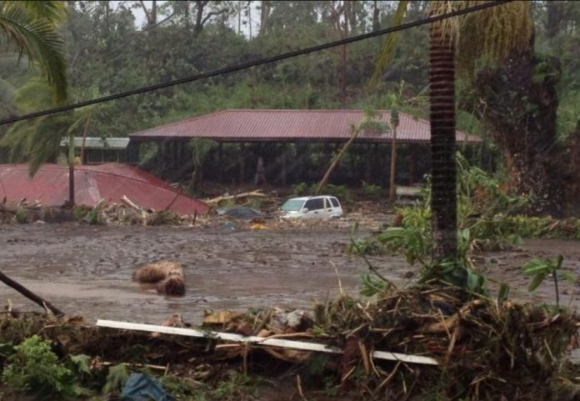

Green Climate Fund
Established at COP16 Cancún in 2010
Goal to raise $100 billion/yr by 2020
Total donations to date = $10.3 billion
Flooding on the Vaisigano River, Samoa
Notes:
Green Climate Fund
“Supports the efforts of developing countries to respond to the challenges of climate change”
Set up in COP16 in Cancun, Mexico 2010
Aims to deliver equal amount of funding to mitigation and adaptation
Mitigation = reduce the magnitude of climate change itself: reduce emissions, geoengineering
Adaptation = reduce vulnerability to climate change impacts
Internal goal was to raise $100 billion a year by 2020… as of 2017, only $10.3 billion has been pledged
EU does not contribute, individual countries can donate individually (accounting for approx. half of current donations)
US committed to $3 billion under Obama, one of his final acts as president was to deliver the second $500million installment (total given so far is $1 billion)
Trump has stated that he will not honor the rest of the pledge and has criticized the fund as wealth distribution
The Trump proposed budget, the state dept budget, and both congressional budgets allocate 0 to GCF
Only the senate budget allocates money to the IPCC
Lack of funding has lead to worry in developing countries who made nationally determined contributions counting on finance from the green climate fund
Either projects won’t be funded and they won’t achieve their NDCs
OR
Private sector will have to step up
Adaptation – integrated flood management to enhance climate resilience of the Vaisigano River Catchment in Samoa ($65 million)
Mitigation – Accelerating the transformational shift to a low-carbon economy in the Republic of Mauritius
Still a lot of focus on dams/hydroelectric
Not to be confused with the Adaptation fund
Established in the Kyoto protocol
Associated with the clean development mechanism
Has spent $462 million in 73 countries since 2010
Funded through donations (government and private) and revenue (2%) from the certified emission reductions in the CDM
Focus on adaptation
Other UNFCCC funds
Special Climate Change Fund: complementary funding mechanism
Least Developed Countries Fund: focus on special programs targeted at the LDCs
In total, UNFCC estimates that $200-210 billion per year will be needed by 2030 for the funds to be successful (http://unfccc.int/press/fact_sheets/items/4982.php)
Images: http://www.samoaplanet.com/will-65m-usd-vaisigano-flood-management-project/
Image shows a flood of the Vaisigano River in Samoa. In Samoa, the Vaisigano Catchment Area, which includes the nation’s capital, has the highest concentration of infrastructure in the country. It is estimated that recent cyclones have cause 200 million dollar of damage per event. In 2012, Cyclone Evan caused damage equivalent to 40% of the country’s GDP (http://www.greenclimate.fund/-/integrated-flood-management-to-enhance-climate-resilience-of-the-vaisigano-river-catchment-in-samoa)

Slide 8
Public v. private sector funding
The United States has repeatedly advocated for large private sector funding for GCF
Some developing countries resistant of private sector
  Developed countries get out of equitable contributions
Egypt Renewable Energy Financing Network (Private)
Enhancing Climate Change Adaption in the North
Coast and Nile Delta Regions in Egypt (Public)
Notes:
Equity →
Nationally appropriate mitigation actions: COP13 in Bali in 2007
Based on equity, recognizing that each country is at different stages of development and have contributed varying degrees to current crisis
Developed countries will subsidize and provide technology to developing countries (such as through the green climate fund, or the clean development mechanism)
NAMA was part of the COP15 fiasco in Copenhagen in 2009
Pictures
Egypt Renewable Energy Financing Network: http://www.greenclimate.fund/documents/20182/301053/header-project-039.jpg/cccb685c-14fb-4b8e-8d84-7ba7ed21b7c4?t=1492744861347
shown:
$1 billion project funded by the European Bank for Reconstruction and Development
Support Egypt’s NDC of 20% renewable energy generation by 2022 through technical assistance and scale up investments/capital funding
Enhancing Climate Change Adaptation in the North Coast and Nile Delta Regions in Egypt: http://www.greenclimate.fund/documents/20182/301053/header-project-053.jpg/09751d09-5541-4188-8792-709dc0731223?t=1509087268187
shown:
$105.2 million project funded by the United Nations Development Programme
Provide coastal defense soft structures and coastal management program to adapt Nile River from flooding due to sea level rise
Estimated 1 meter rise will submerge 20% of the Nile Delta

Slide 9
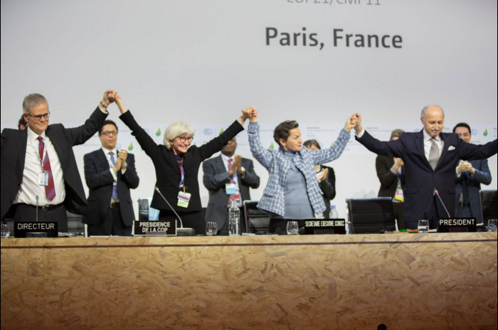
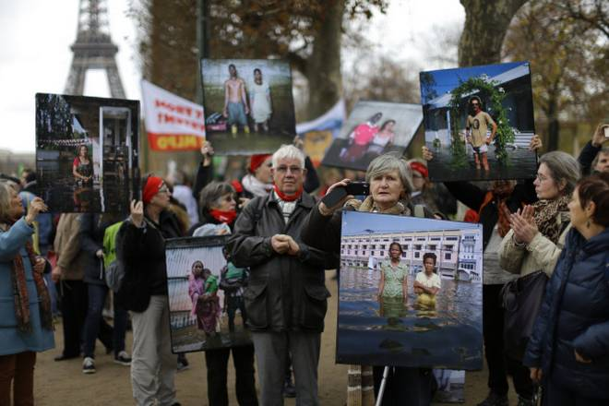
Paris Agreement
“Holding the increase in the global average temperature to well below 2°C above pre-industrial levels and pursuing efforts to limit the temperature increase to 1.5°C above pre-industrial levels”
Notes:
COP21 – Paris, November 30-December 12, 2015
Big arguments:
1.5 v 2 degree (SIDS = push for 1.5, developed countries want 2)
Shall vs. should
Agreement does not participation through ratification of treaties in each country
Avoid the mistake of Kyoto, recognize that Paris would not be ratified by US Congress (Article 2, Section 2)
Requires 55 parties accounting for at least 55% of global GHG emissions to sign to go into force
US and China jointly announce they would sign on April 1, 2016
Agreement enters force when EU joins on November 4, 2016
How is double counting taken into effect:
Ex: A single greenhouse gas emission reduction is credited to both the financing country and host country
Other examples include double issuance, double purpose, double finance, double use
Article 6 of the agreement discusses double counting/joint cooperation
Either host or financing country can benefit from project but both cannot
No specific actions are taken to prevent double counting, thus the need for transparency is critical
http://www.climatefocus.com/sites/default/files/20160105%20-v.2.0%20Double%20Counting%20and%20Paris%20Agreement%20FIN.pdf.pdf
Picture:
@ COP, announcement of agreement - https://www.desmog.ca/sites/beta.desmogblog.com/files/styles/full_width_blog_image/public/blogimages/UN%20Paris%20Agreement.png?itok=E5WovxHs
People @ COP rally - http://www.thehindu.com/migration_catalog/article13952632.ece/alternates/FREE_660/4TH_PARIS_

Slide 10
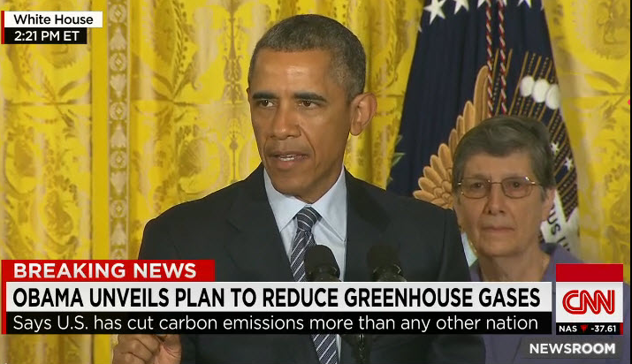
Implementation of commitments
Each country required to submit an Intended Nationally Determined Contribution (INDC)
  Applies to developed and developing countries
Outlines country-specific GHG reduction targets
Unlike Kyoto, NDCs are non-binding targets
Notes:
What do I mean by semi-independently
Paris let countries propose their own INDCs, compromise between QELRO and NAMA
Idea was developed first at COP19 in Warsaw in 2013. Countries were mandated to create plans in between COP20 Lima in 2014 and bring them to Paris for negotiation
Ex: the United States and the Clean Power Plan, Climate Action Plan
Note the negotiations at Paris were largely semantic about should v. shall, and 1.5°C v. 2°C (INDCs didn’t even add up to 2… will talk about this later in the presentation)
Figure:
Left: Obama speaking about his climate action plan
- https://i.imgur.com/HN6N6jA.jpg
Right: Obama announces his Clean Power Plan, an EPA rule that requires each state to meet CO2 reduction standards. Before Trump executive order repeal, states were required to develop plan by 2018 or have the EPA impose a plan on them
- https://images.angelpub.com/2015/32/32480/cleanpowerplan.jpg

Slide 11
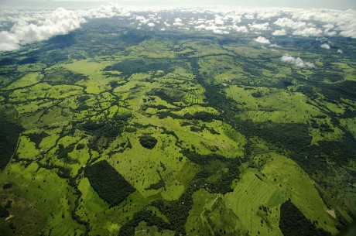
Examples of plans: Brazil
Reduction of 37% from 2005 baseline by 2025
  43% by 2030
Plan focuses on proven biofuel program and reforestation
Sugar cane is used for ethanol in Brazil
Brazil hopes to reforest approx. 2%
of Amazon by 2030
Notes:
http://www4.unfccc.int/Submissions/INDC/Published%20Documents/Brazil/1/BRAZIL%20iNDC%20english%20FINAL.pdf
Brazil accounts for 1% of CO2 emissions (12th most in the world)
Reduce GHG emissions by 37% below 2005 levels in 2025
43% reduction by 2030
Abs. target in relation to base year
Already seen delinking of economic growth and emissions
From 2004-2012, GDP increased by 32% while emissions/GDP unit dropped by 52%
23 million people lifted from poverty
One of the most successful biofuel programs: brazilian sugar cane → ethanol
40% of all energy use comes from renewables, 75% of electricity supply
Strategies
Further increase biofuels
Stop illegal deforestation by 2030
Restoring 12 million hectares of amazon (2%)
More renewables
Rated as insufficient by Climate Action Tracker
Pictures:
Left: Brazilian sugarcane used for ethanol, http://us-east.ln.thebrazilbusiness.com/www/images/media/700_394/586.jpg
Right: Reforestation of the amazon, http://panoslondon.panosnetwork.org/wp-content/files/2012/04/00086290-460x305.jpg

Slide 12
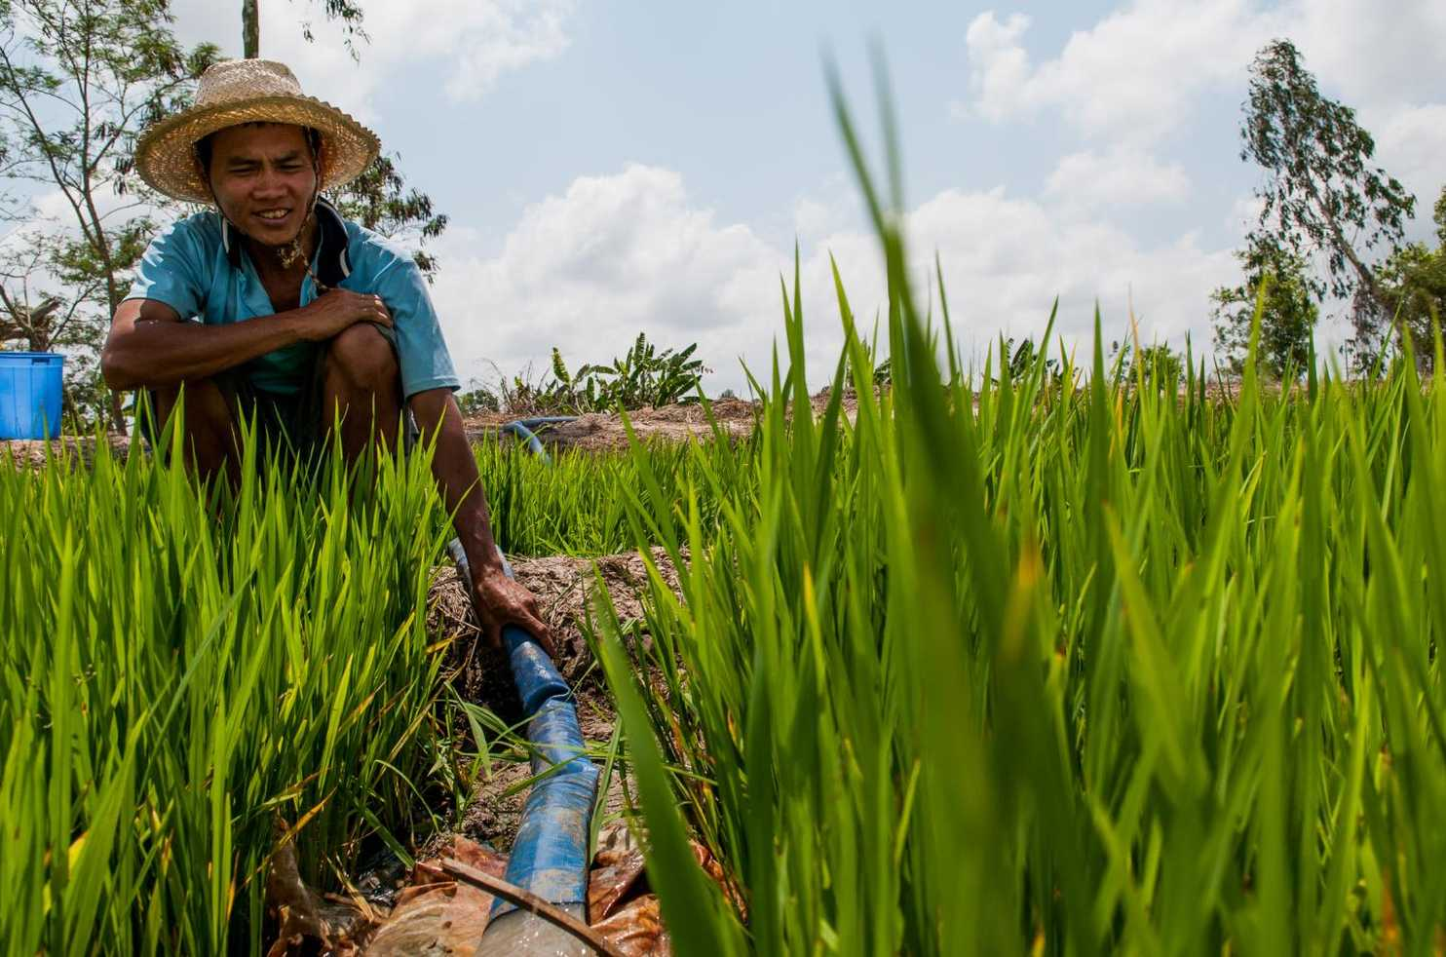
Examples of plans: Vietnam
Notes:
http://www4.unfccc.int/ndcregistry/PublishedDocuments/Viet%20Nam%20First/VIETNAM%27S%20INDC.pdf
Example of a country whose plan is highly reliant on conditional funding
GHG emissions in 2010 = 246.8 MtCO2eq, 0.5% of GHG emissions in 2010
According to BAU
2020 = 474.1 MtCO2eq
2030 = 787.4 MtCO2eq
Pledge is to reduce 8% from BAU by 2030 unconditionally = 724.408 MtCO2eq emissions, 200% growth since 2010
Suggest they can achieve 25% reduction by 2030 with conditional contributions = 590.55CO2eq
Difference of: 133.858 MtCO2eq
Vietnam = 4th largest recipient of CDM funds accounting for 137.4 MtCO2eq since creating to 2015
Most have gone to energy projects and waste treatment
Strategies
Energy efficiency
Sustainable agriculture, forestry
Plan is vague and lacks specifics
Picture: https://img.washingtonpost.com/pbox.php?url=http://img.washingtonpost.com/news/energy-environment/wp-content/uploads/sites/43/2016/05/vietnamese-rice-farmer.jpg&w=1484&op=resize&opt=1&filter=antialias&t=20170517
Vietnamese farmer irrigating rice patty
N2O emissions from agriculture are very important but often under thought of compared to the electricity and transportation sectors

Slide 13
Examples of plans: Nauru
“In Nauru’s case the threat is to its very existence”
Highest elevation: 200ft
Nauru, a small island developing state, is particularly vulnerable to climate change
Notes:
Nauru: http://www4.unfccc.int/Submissions/INDC/Published%20Documents/Nauru/1/Nauru%20INDC%20Submission_Final.pdf
Small Island Developing State (1.5°C was big push from these states)
Accounts for 0.0002% of world emissions in 2014, lowest of any country on Earth
Is a phosphate rock, mining of phosphate has slowed significantly in the 21st century and their BAU scenario predicts 2030 emissions at the same mass as 1990 emissions
Plan focuses on adaptation (small mitigation effort → international financing of $50 million for solar, $5 million from domestic)
Priorities:
Water security (has suffered from bad droughts)
Energy security
Food security
A healthy environment
A healthy people
Productive, secure land resources
Losses and damages from climate change
Idea first entered into UNFCCC at COP18 in Doha
Contentious because some developed parities associate losses and damages with liability and compensation
SIDS see it as recognizing limits to adaptation measures acknowledged in 4th and 5th IPCC Assessment Report
Image: Island nation of Nauru http://nauru-news.com/wp-content/uploads/2017/09/05Nauru-video-videoSmall.jpg

Slide 14
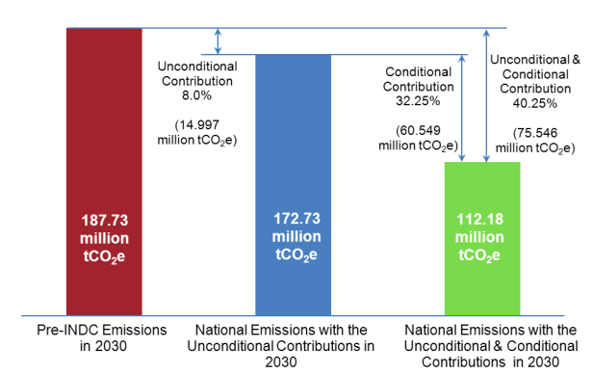
Examples of plans: North Korea
Yes, North Korea signed the Paris Agreement
  they also signed Kyoto
8% emission reduction from 2030 Business-as-Usual baseline
Courtesy of the UNFCCC
Notes:
North Korea: http://www4.unfccc.int/ndcregistry/PublishedDocuments/Democratic%20People%27s%20Republic%20of%20Korea%20First/DPRK-INDC%20by%202030.pdf
Non-Annex I Country
Promises 8% reduction of CO2 emissions from BAU 2030 unconditionally (nationally financed)
Believes they could cut emissions by 40.25% if international finance is leveraged through green climate fund
Currently accounts for 0.16% of GHG emissions and has one of the lowest GHG/per capita of any country
Strategies to meet targets:
1. Reduce power transmission losses by 6%
2. Build a 2000MW Nuclear Power Station
3. Install 1000MW of solar PV connected to the grid
9 (out of 19). To replace conventional wood stoves for cooking with efficient wood stoves at rural households
18 (out of 19). To introduce Bus Rapid Transit in large cities
Will provide update to UNFCCC every two years
Figure: North Korea’s intended emissions reductions from 2030 Business as Usual baseline http://www4.unfccc.int/ndcregistry/PublishedDocuments/Democratic%20People%27s%20Republic%20of%20Korea%20First/DPRK-INDC%20by%202030.pdf

Slide 15
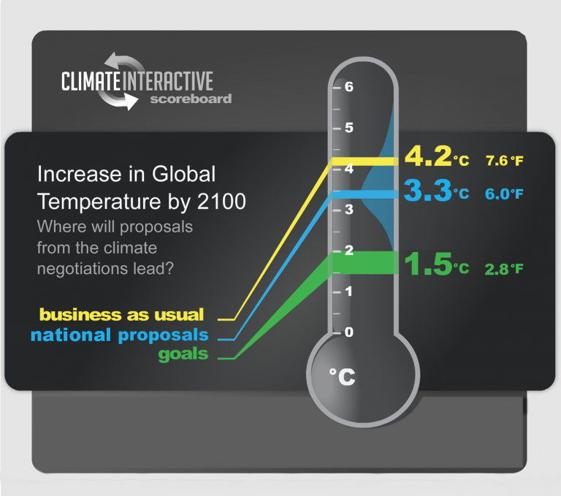
Notes:
Are pledges sufficient if fully executed
Latest IPCC reports say:
we need 40-70% reduction from 2010 baseline by 2050 and NET ZERO by end of 21st century for 2°C cap
70-95% reduction from 2010 baseline by 2050 and NET ZERO by 2060-2080 for 1.5°C cap
Recent UNFCCC report pre-Bonn says:
gaps exist between temperature goals and commitments
11-13.5 GtCO2eq by 2030 (=China’s yearly emissions) for 2°C
16-19 GtCO2eq for 1.5°C
Overall, pledges would result in a 56 gigatons reduction of CO2 over BAU in the atmosphere if completely achieved but total CO2 emissions will have increased from the time of Paris
Climate Interactive (MIT) estimates that in total these pledges if achieved would not be enough for the 2030 benchmark and notes that long-term, century plans are needed (https://www.climateinteractive.org/)
Some countries like India and China have outperformed their goals already, for example in installed solar capacity
Some countries will undoubtedly underperform their goals, USA repeals CAP and CPP
EU = 9.62% of emissions in 2015, 40% reduction by 1990 baseline by 2030 with eventual goal of 80-95% reduction by 2050
EU wants a 60% cut of global emissions by 2050
This goal is consistent with 2°C cap but not 1.5°C cap
EU’s plan has been criticized as vague, unambitious, untransparent… WWF, Oxfam, Carbon Market Watch
Would need to double its current rate of decarbonization (2%/year since 2000) to meet target
Ranked by the Climate Action Tracker as Insufficient to meet even the 2°C Paris mark
China = 29.51% of emissions in 2015, of emissions peak CO2 by 2030 (12 GtCO2/yr), 20% non–fossil fuel energy consumption by 2030, increase forested area by 4.5 billion cubic meters compared to 2005
China’s CO2 emissions have already peaked due to ongoing reduction in coal use
China’s non-CO2 gases are as uncertain as CO2 emission so CO2 equivalent could increase until at least 2030
China has already met its solar targets for 2020
Widely thought that submitted NDC is not sufficient to meet 2°C target, so overachieving its goals does not necessarily mean they are going above and beyond
Ranked by climate action tracker as highly insufficient to critically insufficient
USA = 14.34% of emissions in 2015, implementation of plan for 28% below 2005 by 2025 (already likely insufficient for 2°C) has been halted by repeal of Clean Power Plan and Climate Action Plan by Trump admin
Figure: https://www.climateinteractive.org/programs/scoreboard/

Slide 16
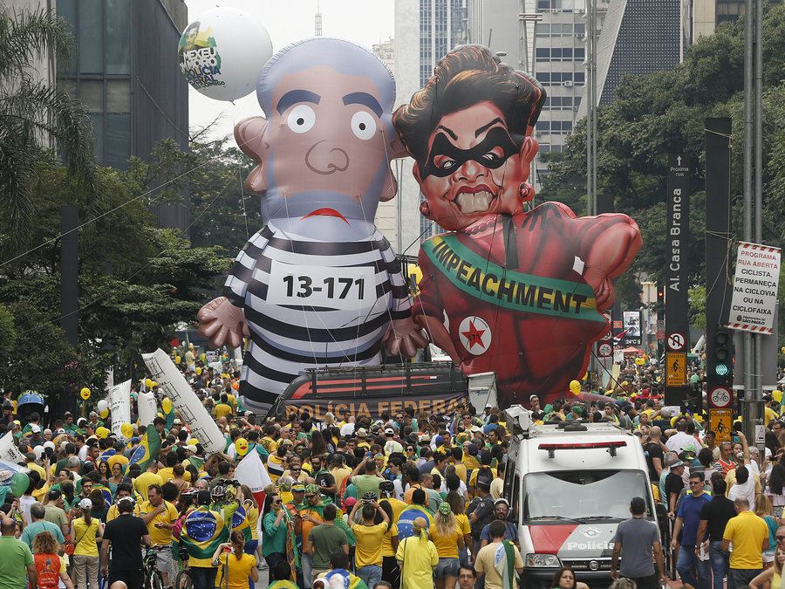
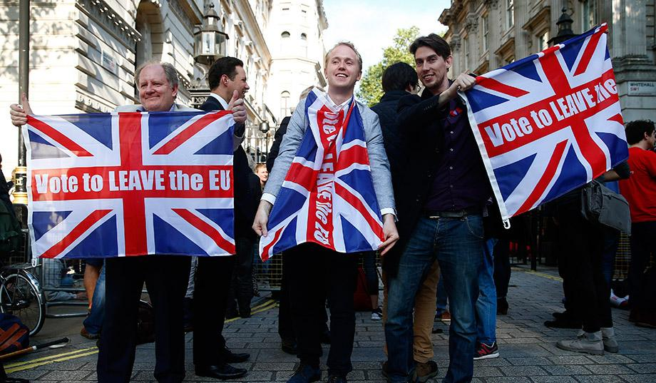

Since Paris
Notes:
2015 was hottest year on record (since data collection in the 1880) according to NOAA and NASA
2016 was then the hottest year on record according NOAA and NASA
Marks third year in a row to set a new record for global average surface temperatures
0.99°C hotter than mid-20th century
We have already spent ½ of our temperature goal
The Larsen C Ice Sheet (4th Largest in Antarctica) has begun to separate from the continent
Projections estimate that sea level could rise 10cm if all the ice Larsen C holds back enters the ocean
India: 2°C compatible http://climateactiontracker.org/countries/india.html
On track to achieve its NDC with current policies
India is on track to be the worlds most populated country by 2030 and has the worlds fastest growing electricity market (5.2% according to IEA’s World Energy Outlook)
PM Modi has made climate change an important agenda for his government
Has surpassed solar target of 10GW by 2017 (12.2GW) and is planning to have 20GW installed by 2022
New coal installation has been effectively suspended until at least 2027
Brazil: insufficient http://climateactiontracker.org/countries/brazil.html
Political turmoil and caused an economic recession
Impeachment of PM for corruption and now deeply unpopular new PM
Rise of alt-right
Reversal of forestry laws that have decreased the rate of deforestation in the Amazon
EU: insufficient
http://climateactiontracker.org/countries/eu.html
Trend away from coal plants to natural gas
Reform of the EU Emissions Trading System, the cornerstone of the EU’s plan in power and industry sectors
If you have time look up more
China: Highly insufficient http://climateactiontracker.org/countries/china.html
Estimates that China will meet its 2020 pledge but still be increasing emissions
Reminder that coal has likely reached peak usage already
High rates of curtailment of installed renewable capacity because of grid integration lags
Estimated in some provinces this could be as high as 40% for wind
Estimates suggest they have already met their installed solar and wind targets
Started tracking HFC emissions in 2015
Russia: Criticaly Insufficient http://climateactiontracker.org/countries/russianfederation.html
Emissions will be lower than 1990 because of the collapse of the soviet union
Their pledge is based on 1990 (Kyoto legacy)
Emissions projected to rise
Putin is a climate skeptic
USA: Critically insufficient http://climateactiontracker.org/countries/usa.html
Election of US president Donald Trump, climate skeptic and anti-international trade agreements he sees as weakening the US
Zeroed out the funds in state department budget for the Green Climate Fund so US will not meet its $3 billion dollar pledge
Repeal of CPP and CAP
States and market pressure
Some studies have shown that non-state actors have already taken us to 50% of our 2020 pledge
Shift to natural gas economy
Pictures:
Donald Trump: https://i.ndtvimg.com/i/2017-06/donald-trump-reuters_650x400_81496346817.jpg
Impeachment parade: http://media.npr.org/assets/img/2016/03/14/ap_252523447697-63c1d6443da35a2115bb5dab602630d990263d7d-s900-c85.jpg
http://media.npr.org/assets/img/2016/03/14/ap_252523447697-63c1d6443da35a2115bb5dab602630d990263d7d-s900-c85.jpg
Brexit: http://c3.nrostatic.com/sites/default/files/styles/original_image_with_cropping/public/uploaded/brexit-vote-liberal-cosmopolitan-anger.jpg?itok=sD4i-Hwfdemoc
Larsen C Ice sheet Crack:
https://en.wikipedia.org/wiki/Larsen_Ice_Shelf#/media/File:LarsenC_photo_2016315_lrg.jpg
Earth temperature change:
https://www.nasa.gov/sites/default/files/thumbnails/image/2016globaltempstill.jpg

Slide 17
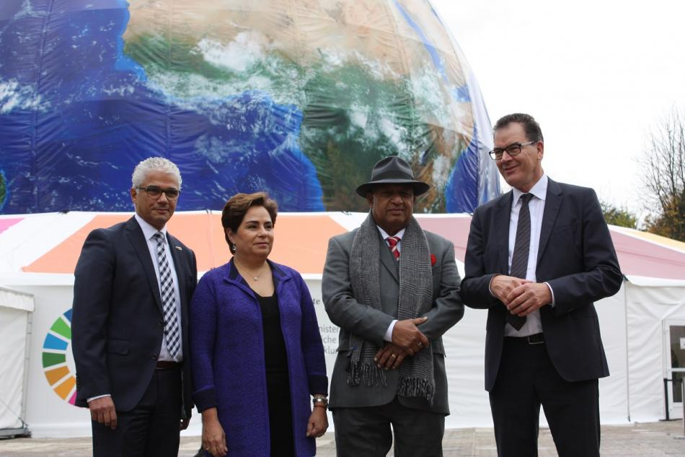
Happening this week: Bonn
Notes:
Bonn
President of meeting for first time is lead by one of the small island developing countries (Fiji)
goal is to discuss guidelines for making national pledges and policies more transparent so outsiders can see progress precisely
Most Paris pledges (2 years after commitment) are still opaque and have no policy specifics
Germany has pledged an addition $50 million to the adaptation fund
Oxfam “Good start to conference but still insufficient
Countries seem insistent on honoring commitments despite USA withdrawal… except Turkey who wants to be taken out of Annex I classification
Some believe Rex Tillerson has different opinions than Trump and he will be more willing to negotiate
African delegations want to eject USA delegation
Coalition of large German businesses call for Germany to come up with a coal exit strategy
Picture: https://www.cleanenergywire.org/news/cop23-day-1-more-german-money-adaptation-fund
Shown is Bonn mayor Ashok Sridharan, UNFCCC executive sectretary Patricia Espinosa, Fiji president Frank Bainimarama, and German development cooperation minister Gerd Muller.

Slide 18
Questions moving forward?
Will countries honor their commitments in light of US withdrawal?
How will developing countries finance plans without adequate support from Annex I countries?
Can we keep global temperature rise below 1.5°C?
  What about 2? or 3?

Slide 19
Questions?

