Slide 1
Solar Fuels
October 29th, 2015

Slide 2
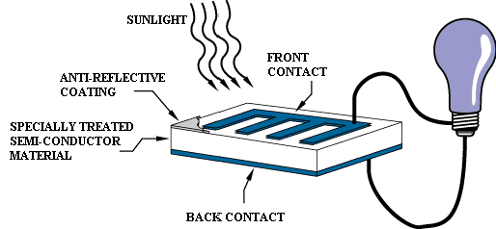
Photovoltaic cell diagram
The diagram above illustrates the operation of a basic photovoltaic cell, also called a solar cell. Solar cells are made of
the same kinds of semiconductor materials, such as silicon, used in the microelectronics industry. For solar cells, a thin
semiconductor wafer is specially treated to form an electric field, positive on one side and negative on the other. When
light energy strikes the solar cell, electrons are knocked loose from the atoms in the semiconductor material. If electrical
conductors are attached to the positive and negative sides, forming an electrical circuit, the electrons can be captured in
the form of an electric current -- that is, electricity. This electricity can then be used to power a load, such as a light or a tool.

Slide 3
What are solar fuels?

Slide 4
What are solar fuels?
Utilizing sunlight to make fuels directly like hydrogen.

Slide 5

What are solar fuels?
Utilizing sunlight to make fuels directly like hydrogen.
Like storing sun in a bottle

Slide 6
Use of transportation fuel
“Globally, just over 60% of world oil consumption is for transport (1) and, in affluent countries like the UK, transport typically accounts for about one third of the average energy consumption per person.” (2)
^{-- Alan Heeger,} Solar Fuels and Artificial Photosynthesis, 2012
1 International Energy Agency, Key World Energy Statistics 2011 www.iea.org/publications/free_new_desc.asp?pubs_ID=1199
2 Sustainable Energy – Without the Hot Air, David JC MacKay, UIT Cambridge Ltd., p104, 2009

Slide 7
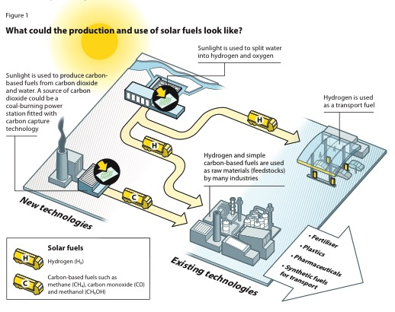
Production of soalr fuels
^{Alan Heeger,} Solar Fuels and Artificial Photosynthesis, 2012

Slide 8
Methods of generating solar fuels
Biohybrid Solar cells
Biomimetic Water-Oxidation Catalysts
Solar Water Splitting Using Semiconductor Photocatalyst

Slide 9
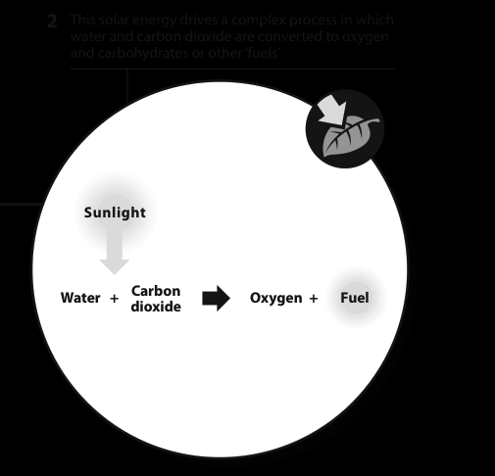
Natural Photosynthesis
^{Alan Heeger,} Solar Fuels and Artificial Photosynthesis, 2012

Slide 10
Natural Photosynthesis
Solar Energy for Fuels, 2016?

Slide 11
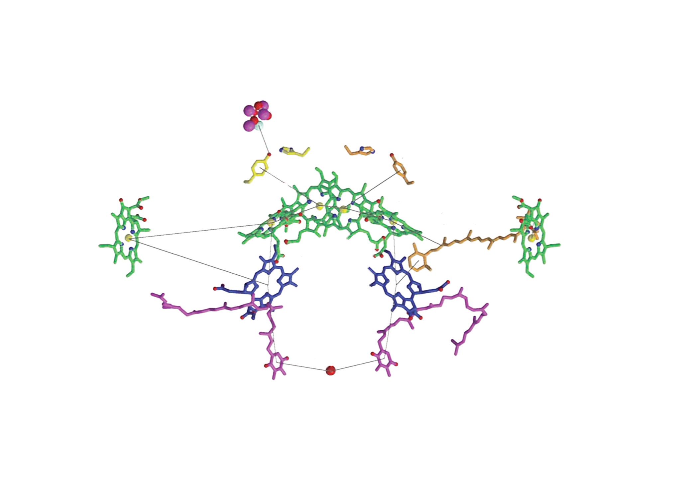
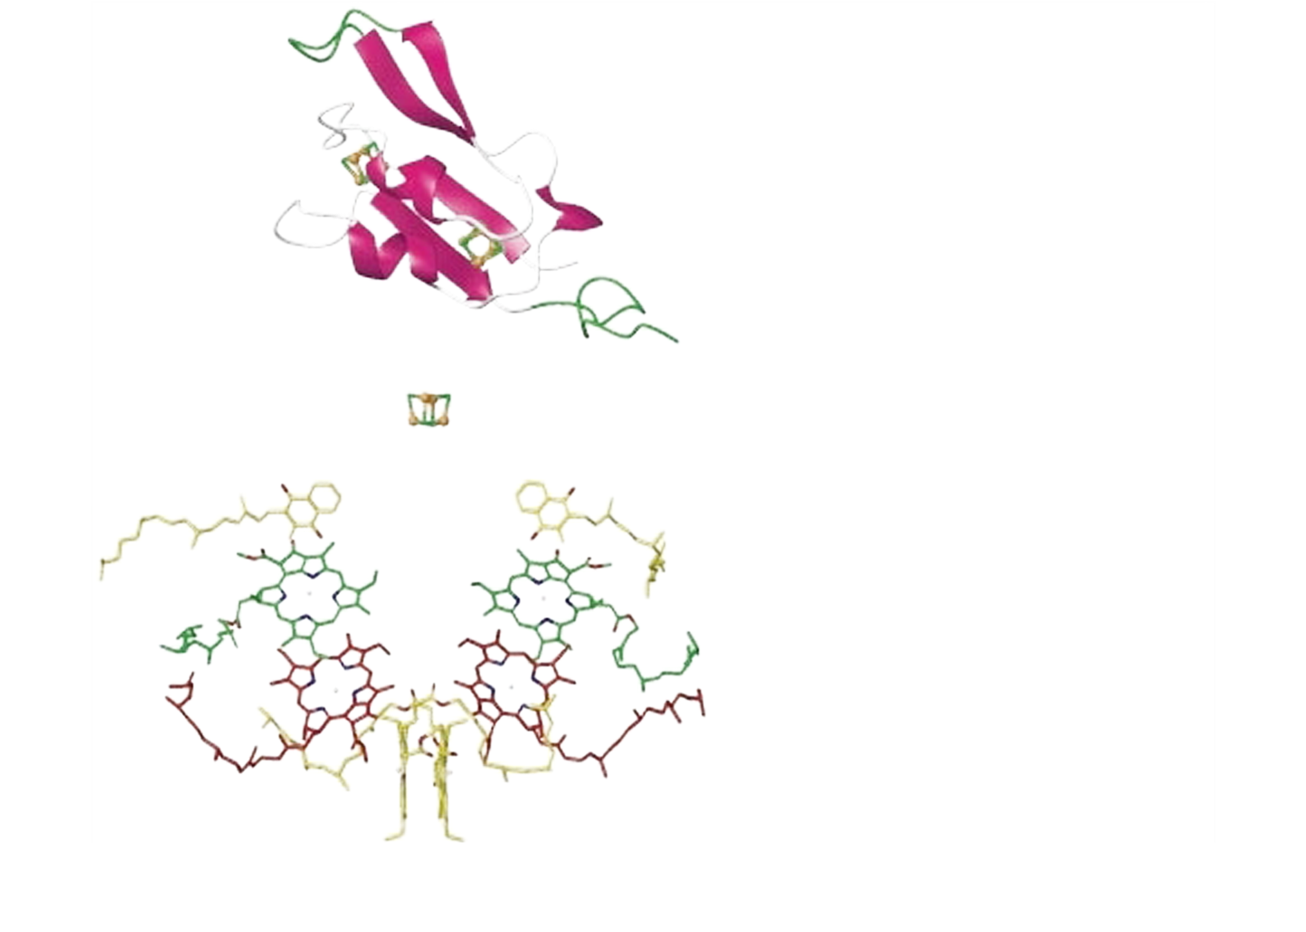
Biohybroid solar system example
Pt
2H⁺ + 2e⁻
H₂
PSI
H₂O ½ O₂ + 2H⁺ + 2e⁻
PSII
wire
Mn4
Y_{Z}
P₆₈₀*
P₆₈₀
F_{A}/F_{B}
Pheo
F_{x}
Q_{A}
A₁
A₁
A₀
A₀
hν
O
P₇₀₀*
P₇₀₀
R
Ciesielski, P. N., D. E. Cliffel, et al. (2011). "Kinetic Model of the Photocatalytic Effect of a Photosystem I Monolayer
on a Planar Electrode Surface." The Journal of Physical Chemistry A 115(15): 3326-3334.
Notes:
Reactions involved in the PSI CC.
We can measure some of these reactions
Electron transfer from the electrode either
through a mediator
or directly
Reduction of PSI CC (JTS, Photo acoustic) ***** will be difficult **** have not done measurements yet
Reductions of Platinum (electro chemistry)
H2 generation, (Gas chromatography)

Slide 12
Photosynthetic core complexes
II
I
II
I
II
II
II
I
I
I

Slide 13
Biomimetic Water-Oxidation Catalysts
Solar Energy for Fuels, 2016?

Slide 14
Biomimetic Water-Oxidation Catalysts
Solar Energy for Fuels, 2016?

Slide 15
Biomimetic Water-Oxidation Catalysts
dx.doi.org/10.1021/ja5110393 |Ullman et al. J. Am. Chem. Soc. 2014, 136, 17681−17688

Slide 16
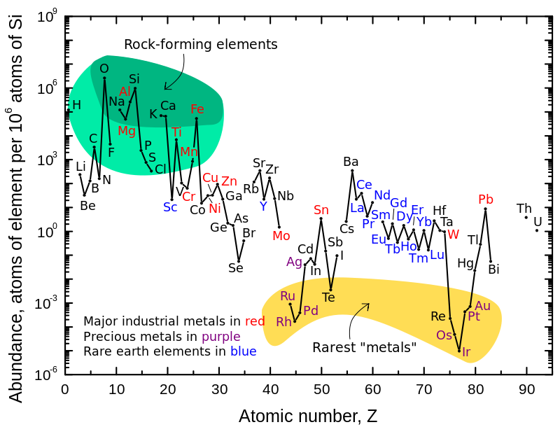
Earth Abundance of Elements

Slide 17
Semiconductor Photocatalyst
Important Parameters
Photon Absorption
Exciton separation
Carrier diffusion
Carrier transport
Catalytic efficiency
Mass transfer of reaction
N. Lewis and D. Nocera, PNAS Vol 103, n0. 40 p15729-15735, 2006

Slide 18
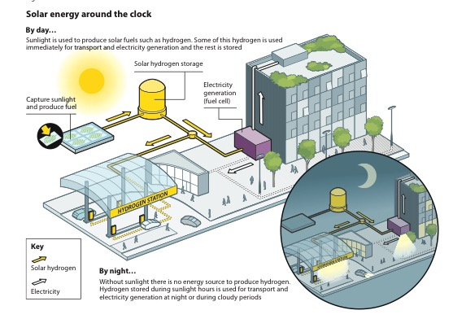

Slide 19
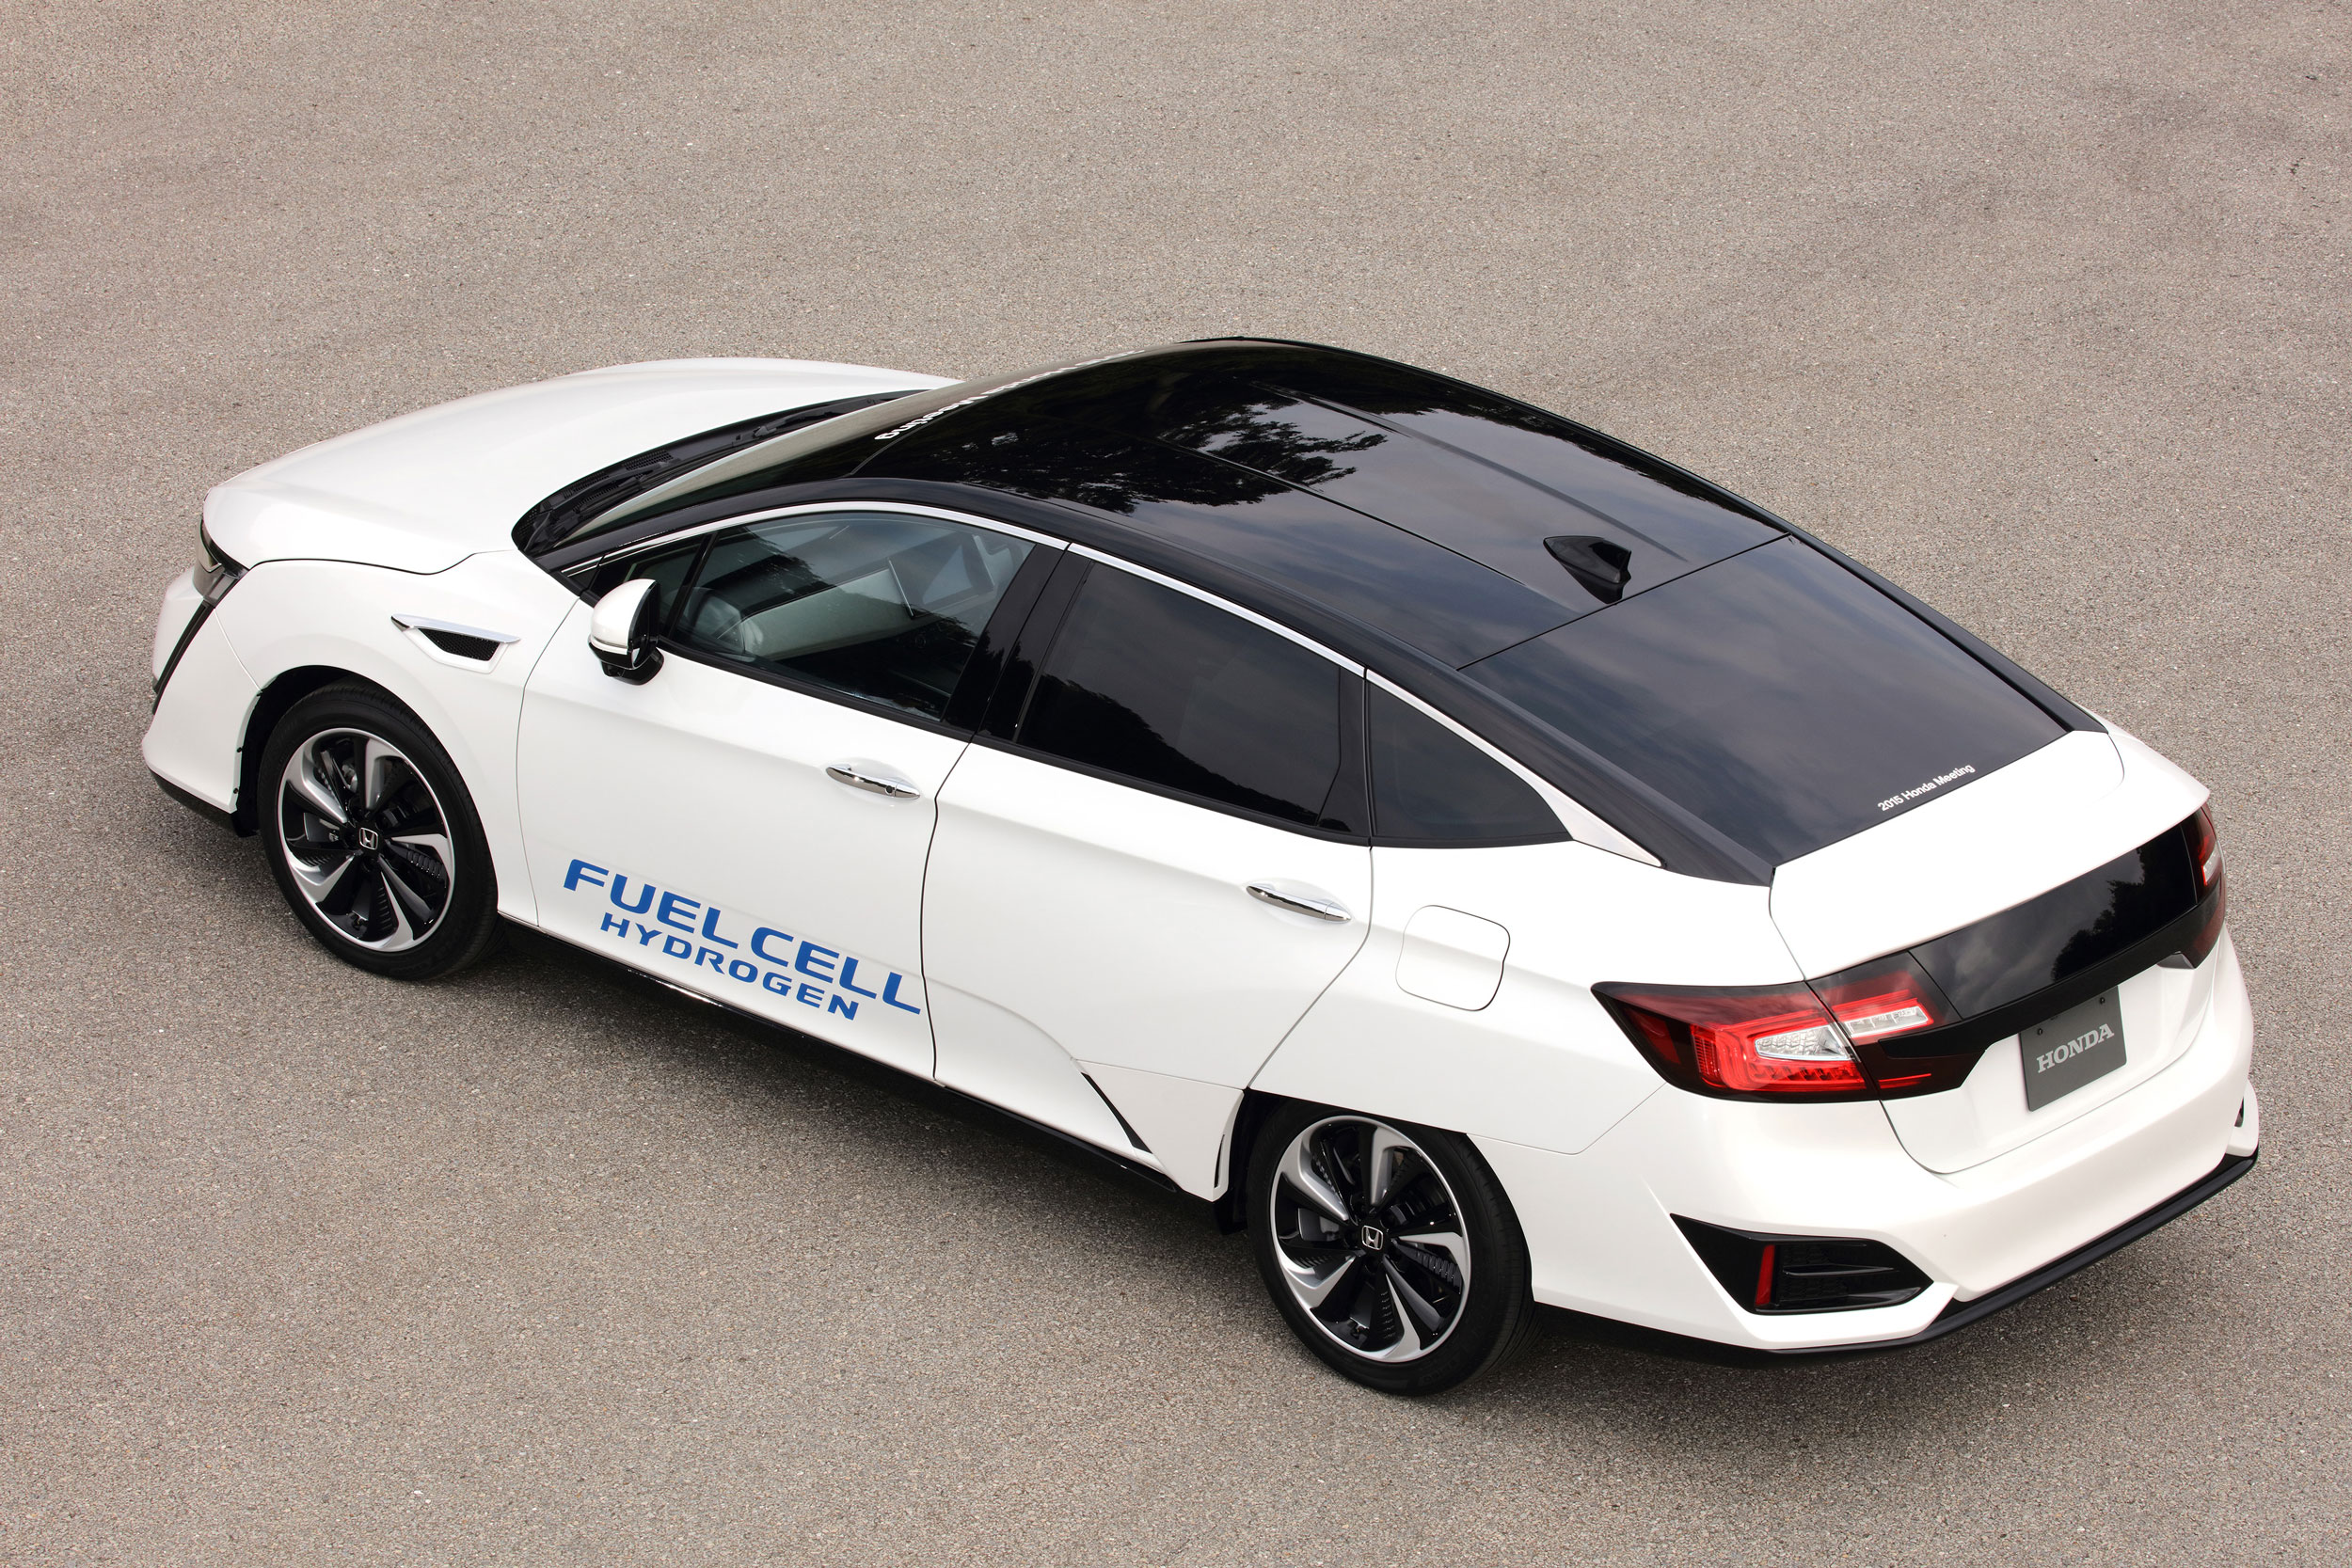
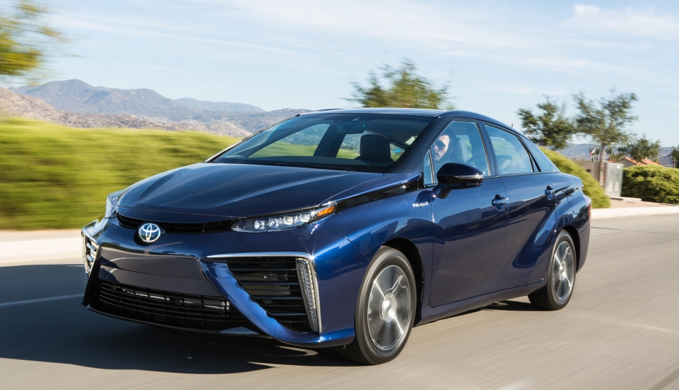
Hydrogen Cars
Honda Clarity
175 Horsepower
>300 Miles range
$63,000 MSRP
Toyota Mirai
151 Horesepower
300 Mile range
$57,500

