Slide 1
Coal Technologies

Slide 2
General Facts
Coal produces 40% of world electricity
Also used to produce iron and steel
Produces 40% of global CO₂ emissions
http://ngm.nationalgeographic.com/2014/04/coal/nijhuis-text

Slide 3
Total Usage: 4.1 billion short tons
Total Usage*: 8.2 billion short tons
* These figures do not include the recent revelation that China has been misestimating its usage for years.
EIA: International Energy Statistics
Notes:
US use up 26% from 1980
Chinese use up 473%

Slide 4
Coal Mining
Mining approaches depend on depth of coal vein:
  Shallow veins worked by surface mining
  Deeper veins worked by underground techniques

Slide 5
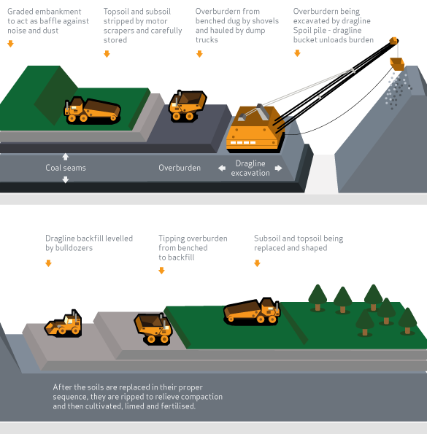
Surface Mining
http://www.worldcoal.org/coal/coal-mining
Notes:
Recovery rate as much as 90%

Slide 6
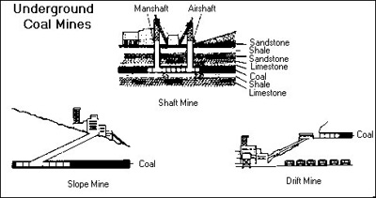
Underground Mining
Shaft mines are deepest
Slope mines are for shallow veins
Drift mines enter a hillside horizontally
http://www.umwa.org/index.php?q=content/types-underground-coal-mines

Slide 7
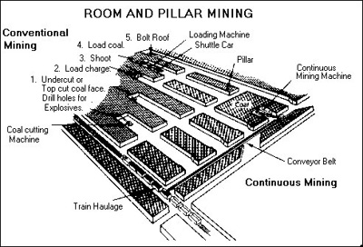
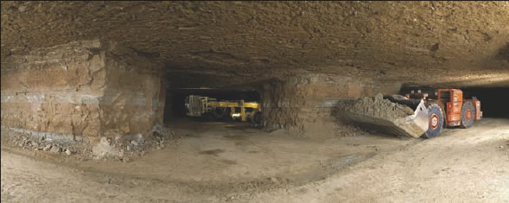
Room-and-Pillar Mining
40-60% recovery; up to 80% with retreat mining
http://www.wvcoal.com/mining-101/room-a-pillar-underground-mining.html
http://www.umwa.org/index.php?q=content/room-and-pillar-mining
https://archives.aapg.org/explorer/divisions/2006/05emd.cfm

Slide 8
Longwall Mining
Unlike room-and-pillar mining, the roof is held up only long enough to cut the coal loose and move the mining equipment forward
75% recovery
http://www.worldcoal.org/coal/coal-mining

Slide 9
Risks
191 people died in mining accidents between 2007 and 2013
Estimated 55,000 cases of mining-related diseases between 2000 and 2010
http://www.coal-is-dirty.com/the-coal-hard-facts

Slide 10
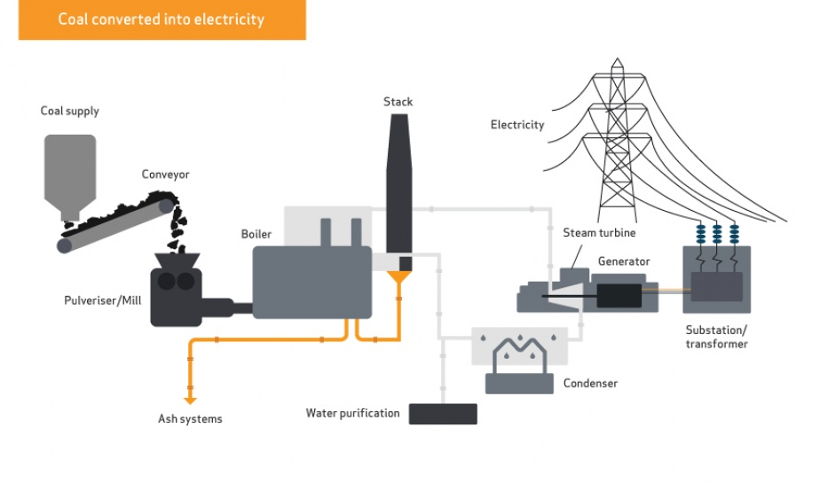
Traditional Coal Burning
http://www.worldcoal.org/coal/uses-coal/coal-electricity
Notes:
Efficiency 35-45% depending on criticality of steam

Slide 11
Direct Chemical Looping
Burning in highly concentrated oxygen reduces flue gas complexity
Concentrating oxygen directly from the air is expensive
Substitution: Redox reaction along metal catalysts
Possible to achieve 90% carbon capture for less than 35% price increase
http://oee.osu.edu/successful-200-hour-continuous-operation-of-coal-direct-chemical-looping-combustion-technology.html

Slide 12
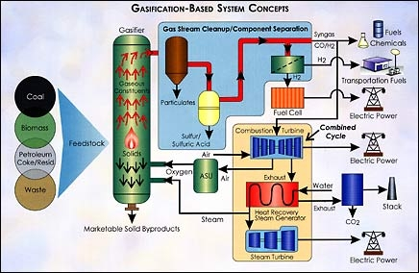
Coal Gasification
http://energy.gov/fe/how-coal-gasification-power-plants-work
Notes:
Efficiency starts at 40%, w/ better fuel cells, hope to improve to 60%

Slide 13
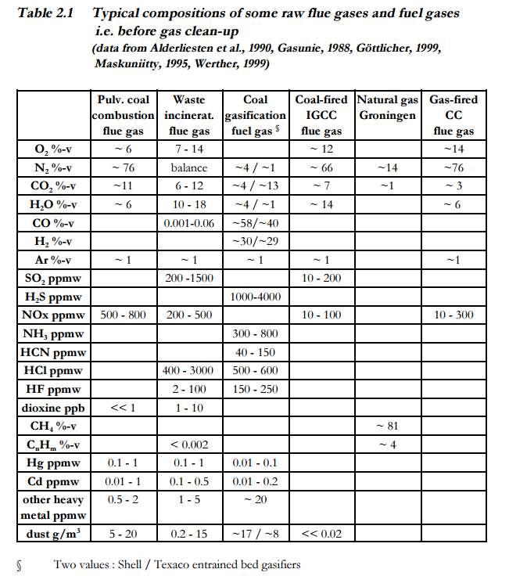
Zevenhoven & Kilpinen, 2001

Slide 14
Summary
Mining
Consuming
Surface
  Shallow veins
  90% Recovery
Underground
  Room-and-pillar
    40-80% recovery
    Roof left stable
  Longwall
    75% recovery
    Roof allowed to collapse
Traditional pulverized burn
  35-45% efficiency
  Hard to separate CO₂
Direct chemical looping
  Improves purity of flue gas
  Recapture 90% of carbon
  Applicable to all burned fuels
Gasification
  Reduce materials to CO / H₂
  40% or greater efficiency

