Slide 1
Wind Energy & Technology
Nare Janvelyan
Harvard Energy Journal Club
April 1, 2015

Slide 2
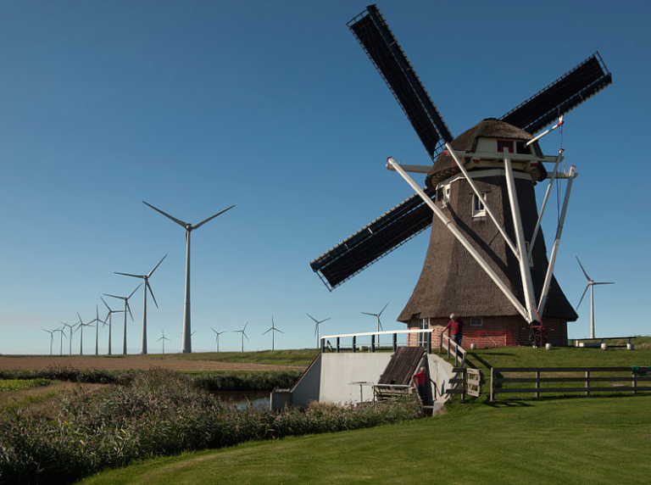
Harnessing wind energy
Notes:
Centuries ago used to mill grains and corn or pump water. Now used to generate electricity and pump water as well.

Slide 3
Wind Energy History
5000 BC
Sailboats used on the Nile indicate the power of wind
500-900 AD
First windmills developed in Persia
1300 AD
First horizontal-axis
windmills in Europe
1850s
Daniel Halladay and
John Burnham build
Halladay Windmill;
start US Wind
Engine Company
Late 1880s
Thomas O. Perry
conducted 5,000
wind experiments;
starts Aermotor Company
1888
Charles F. Brush
used windmill to generate electricity
in Cleveland, OH
Early 1900s
Windmills in CA
pumped saltwater
to evaporate ponds
1941
In VT, Grandpa’s
Knob turbine
supplies power to
town during WWII
1979
First wind turbine
rated over 1 MW
began operating
1985
CA wind capacity
exceeded 1,000 MW
1993
US WindPower developed
first commercial variable-speed wind turbine
2004
Electricity from
wind generation
costs 3 to 4.5 cents per kWh
2011
Wind power provided
over 12% of renewable
energy used in US
Exploring Wind Energy, National Energy Education Development (NEED)

Slide 4
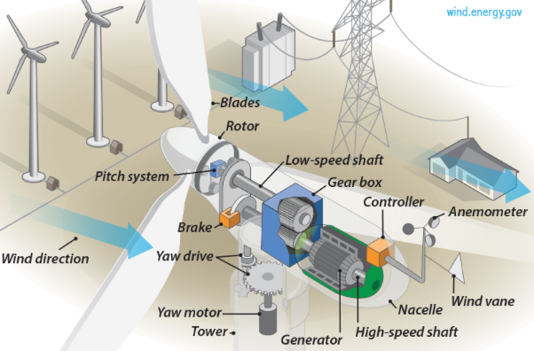
Parts of a Wind Turbine
National Resource Energy Laboratory (NREL)

Slide 5
How turbines work
1. Wind blows in direction of turbine
2. Pocket of low-pressure air forms on downwind side of blade
3. Blade pulled toward low-pressure causing rotor to turn (lift)
4. Turning causes spinning of shaft that leads to a generator
5. Generator consists of a coiled wire surrounded by magnets
6. Rotating shaft turns magnets around the conducting wire and generates and electric current
7. Sensors cause turbine rotate to face the wind and blades to change their angle to best catch the wind.

Slide 6
Wind Power
Characterize wind resources by wind-power density classes
Classes range from 1 to 7
Good wind resources are class 3 and above
  6.4 m/s (14.3 mph)
Mounted 100 feet (30 meters) or more aboveground to take advantage of the faster and less turbulent wind
  Power proportional to cube of wind speed
  Power proportional to swept area of blades

Slide 7
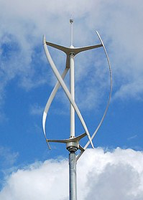
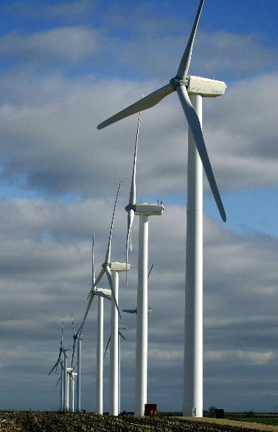
Types of Wind Turbines
Vertical Axis
Horizontal Axis
Notes:
Defined by axis of rotation

Slide 8
Vertical Axis Turbines
Advantages
Disadvantages
Accepts wind from any direction
Can be mounted at ground level
- ease of service
- lighter weight towers
Can theoretically use less materials to capture the same amount of wind
Can be located where taller structures are prohibited
Near ground → winds lower
Centrifugal force stresses blades
Poor self-starting capabilities
  May need require an external power source
Requires support at top of turbine rotor
Requires entire rotor to be removed to replace bearings
Overall poor performance and reliability

Slide 9
Horizontal Axis Turbines
Advantages
Disadvantages
The tall tower base allows access to stronger wind in sites with wind shear. In some wind shear sites, every ten meters up the wind speed can increase by 20% and the power output by 34%
Higher efficiency because movement is perpendicular to the wind
Must be pointed toward wind
  Requires an additional yaw mechanism to turn blades
Massive tower and component assembly required
Require a braking mechanism to prevent turbine from spinning and damaging itself in high winds
Can be visually displeasing

Slide 10
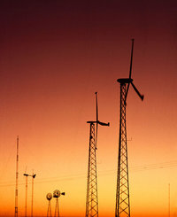
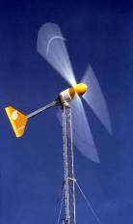
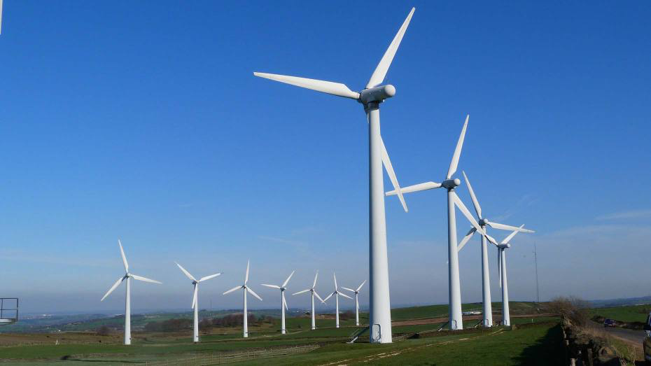
Sizes of Horizontal-Axis Turbines
Small (<10 kW)
Homes
Farms
Intermediate (10-250 kW)
Village Power
Hybrid Systems
Distributed Power
Large (250 kW - 2+ MW)
Central Station Wind Farms
Distributed Power
Notes:
Ideal locations have constant flow of non-turbulent wind throughout the year, with minimal likelihood of sudden powerful bursts. Access to local demand or transmission grid.
Turbines on farms: Can use land right up to the base of the turbine, livestock free to graze around it

Slide 11
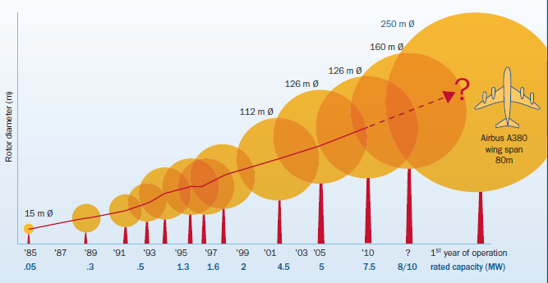
Evolution of Wind Turbines
Vesta 164: 8 MW
164 m ϕ
140 m height
90 m
Statue of Liberty 93m/Big Ben 96m

Slide 12
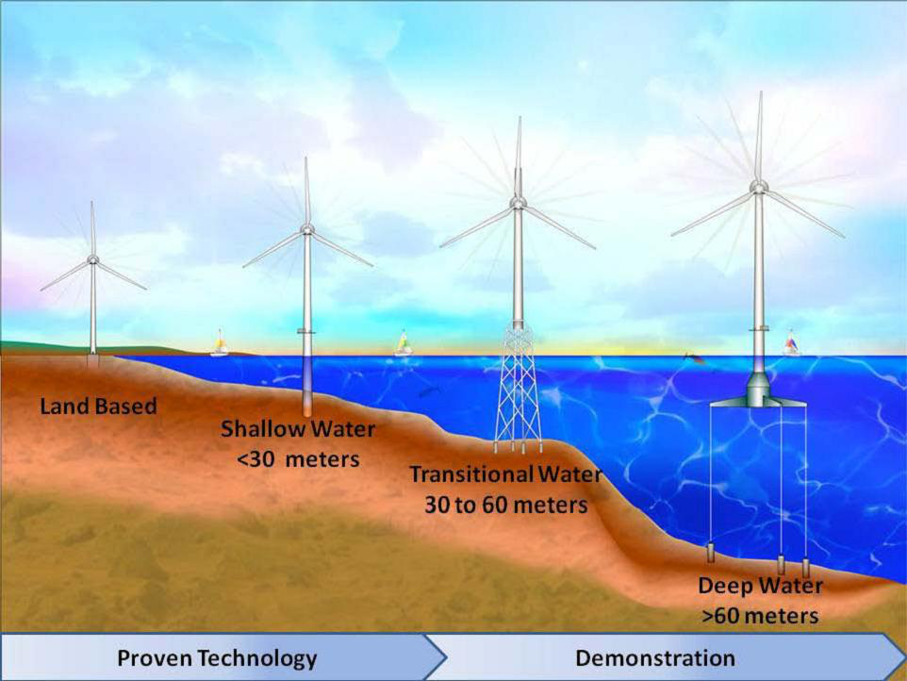
Evolution of Offshore Wind Turbines
National Resource Energy Laboratory (NREL)
Notes:
Offshore winds blow harder and more uniformly than on land
Similar to land-based. Modifications to prevent corrosion. Foundations designed to prevent harsh environments, storms, ice, hurricanes.
Shallow areas: a steel pile driven into seabed, supports tower and nacelle

Slide 13
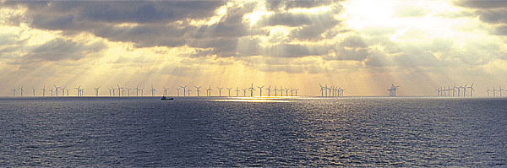
Offshore Wind Farms
Nysted Wind Farm
8-12 miles offshore Denmark in the North Sea.
2003: 72 turbines, 166 MW total capacity = 140,000 Danish homes
2010: 207 MW, 90 turbine extension
Annual Generation of 1,370 GWh

Slide 14
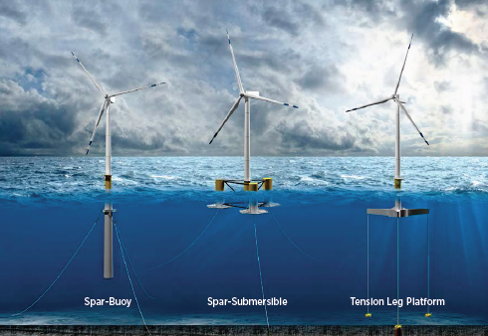
Offshore Wind
European Union: Total installed capacity reached 6.6 GW at the end of 2013
-About 0.7% of total electricity consumption in the EU
-Plans for offshore wind plants totaling more than 133 GW
Worldwide: more than 200 GW in the works at the end of 2012
Notes:
2 – 5 MW capacity turbines used, over 60m tower height

Slide 15
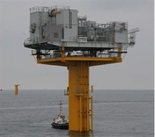
Transporting Energy: ESPs
Electric Service Platform (ESP)
  Located within the array
  Each turbine connected to an ESP by a power cable
  Electrical collection point
  High voltage cables buried under the seabed transmit power to onshore substation
  Power integrated into grid from onshore substation
Bureau of Ocean Energy Management

Slide 16
Benefits of Wind Energy
Clean, zero emissions
  NO_{x}, SO₂, CO, CO₂
  Heavy metals
  Climate change
  Conserves water
  No negative health impacts due to poor air quality
Renewable & Secure
  Reduce fossil fuel dependence
  Energy independence
  Domestic energy—national security
  No fuel-price volatility
Stimulates Economy
  New jobs in wind and supporting industries
  Revenues from land and offshore lease payments
  Annual property tax payments

Slide 17
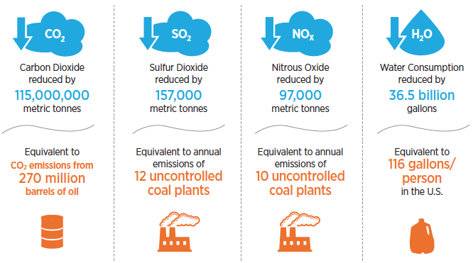
Benefits of wind generation in 2013
US DOE Wind Vision Report

Slide 18
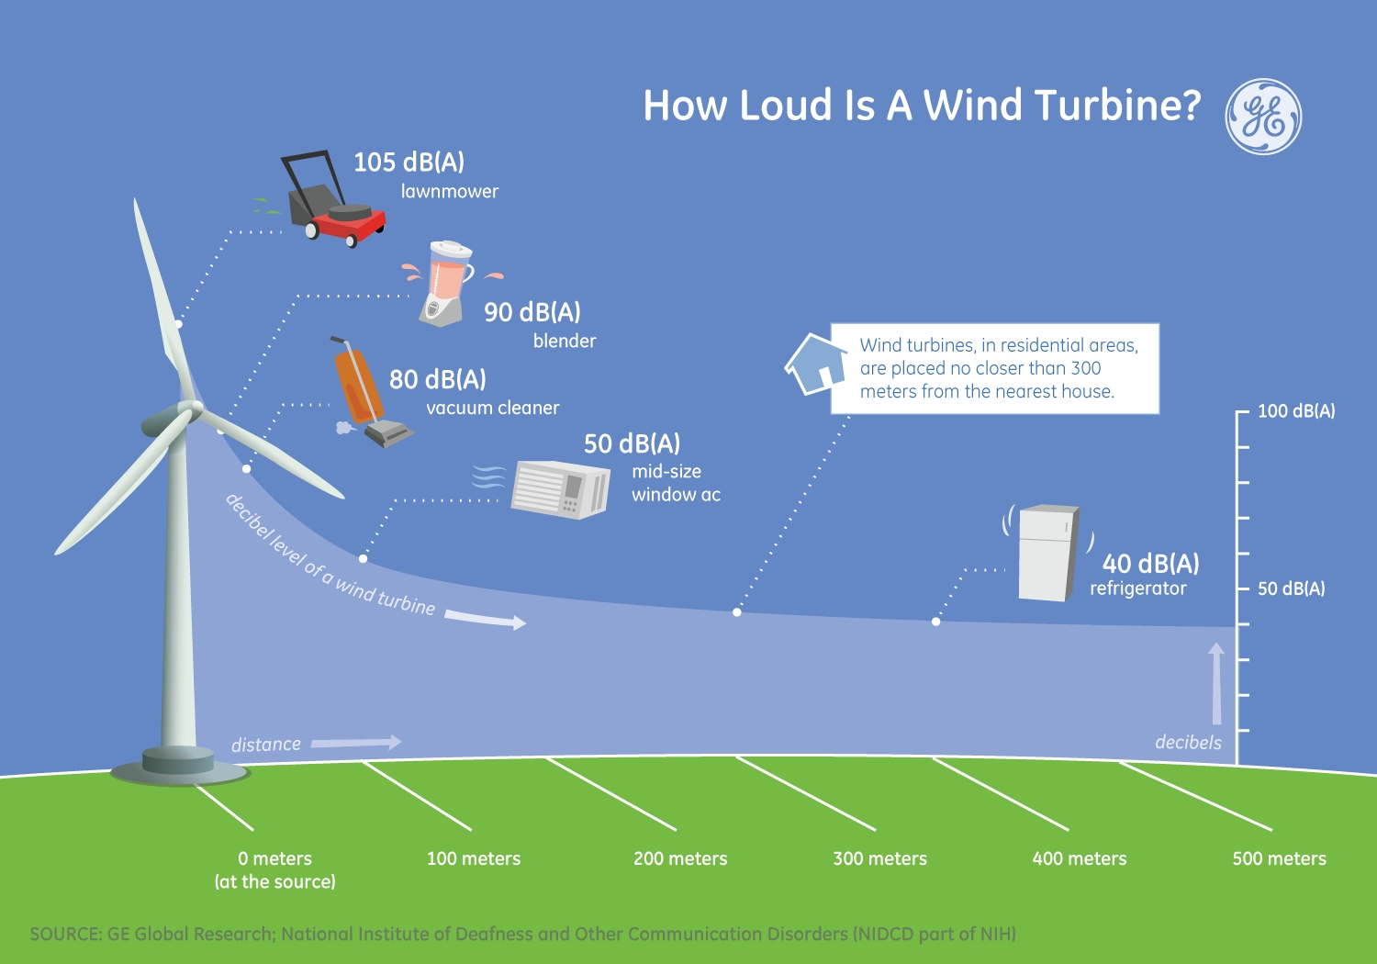

Slide 19
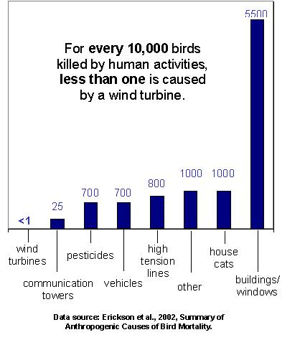
Wildlife Impacts
Notes:
Steps to reduce wildlife mortality include wildlife studies during the siting of wind farms to avoid major migration routes or high concentrations of bird and bat populations. Today’s turbines are designed with slower moving blades and are on monopoles which do not encourage birds to roust on the towers.

Slide 20
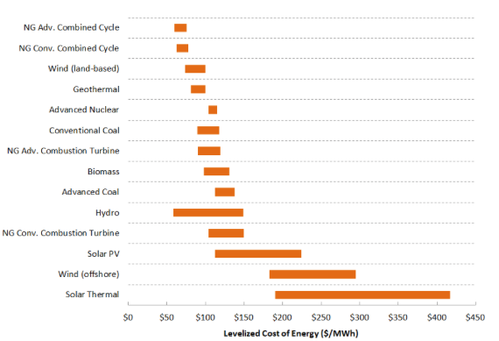
Wind is cost-competitive
AWEA

Slide 21
U.S. Electricity Generation from Non-Hydro Renewables
Exploring Wind Energy, National Energy Education Development (NEED)
Notes:
One of the fastest growing energy sources in the world.

Slide 22
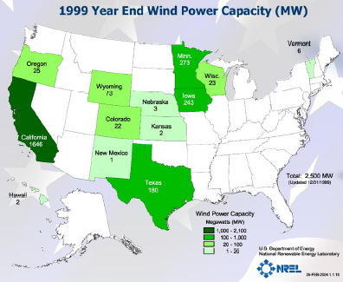
Installed Wind Power Capacity in 1999: 2,500 MW

Slide 23
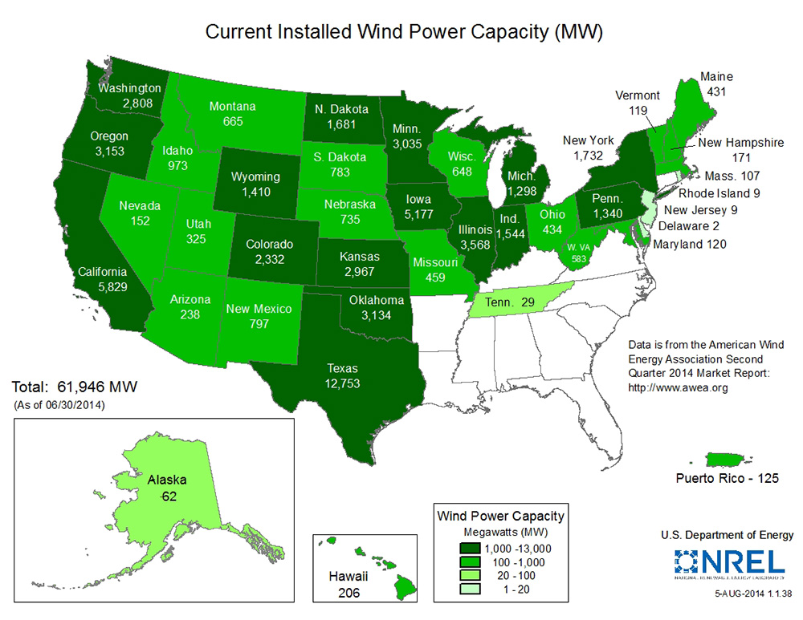
As of June 30, 2014: ~62,000 MW
  Wind power generation has increased from 1.5% of annual electricity end-use demand in 2008 to 4.5% in 2013

Slide 24
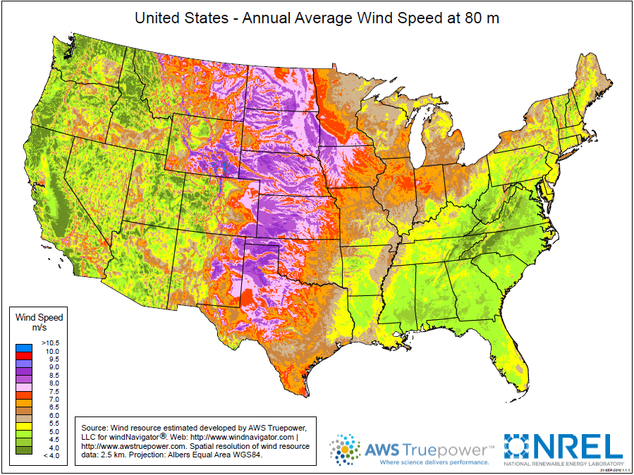
Wind Resource Map
Classes 6-7
3-5
Notes:
The upper Midwest state of North Dakota has been called the Saudi Arabia of wind. Although there are large wind resources in the state, large population centers are far away and transmission lines are small, making it difficult and costly to transport large amounts of energy from North Dakota to other places.
The Southeast has very little wind development and also has low wind resources. Offshore wind may bring additional installations to coastal states in the future.

Slide 25
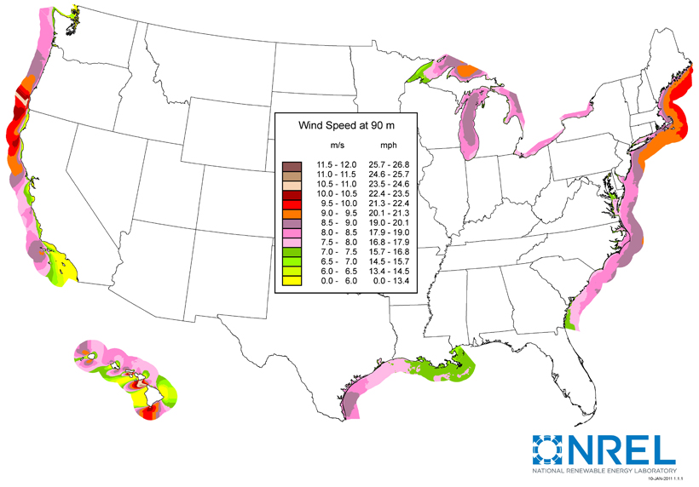
Offshore Wind Resources
Class 3

Slide 26
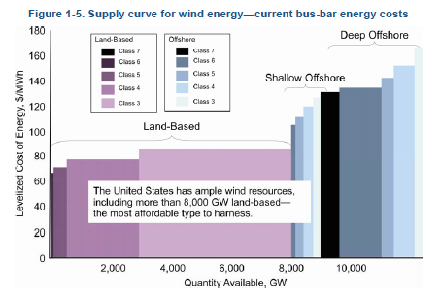
U.S. Wind Supply
U.S. DOE 20% Wind Energy by 2030

Slide 27
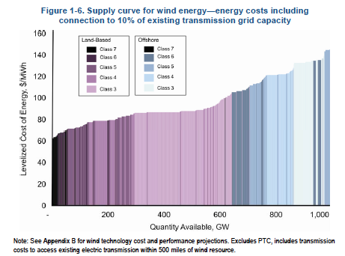
U.S. DOE 20% Wind Energy by 2030

Slide 28
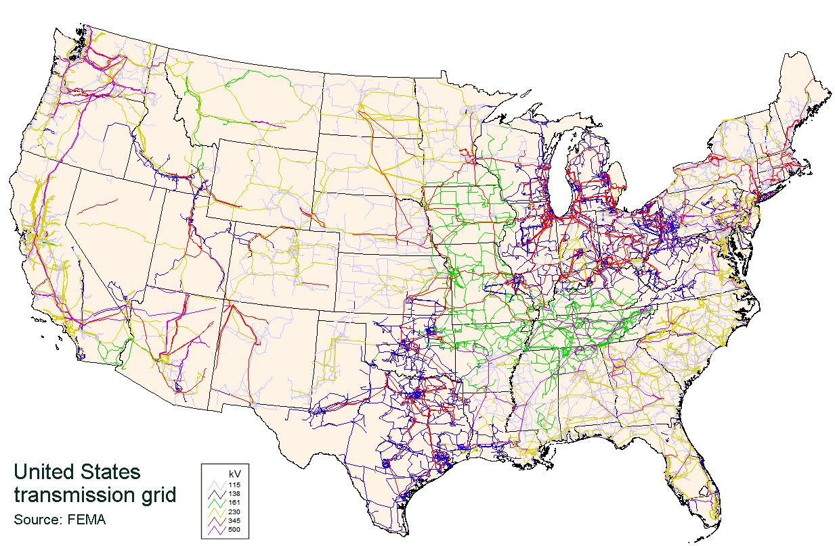
Wind energy is limited by transmission
Notes:
It is a long and expensive process to build new transmission lines, but some of the best wind resources are in areas with smaller populations and limited transmission capability.

Slide 29
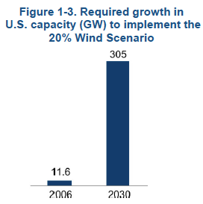
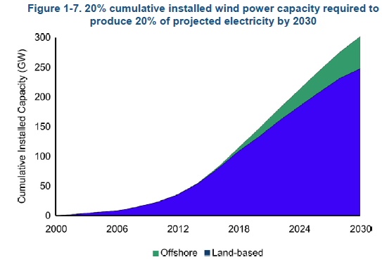
Can the U.S. reach 20% wind by 2030?
…perhaps
U.S. DOE 20% Wind Energy by 2030
Notes:
2030: 202 GW land, 22 GW offshore

Slide 30
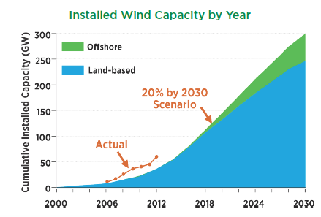
U.S. Planned for 20% Wind by 2030: Will reach that goal 5 years early
35% by 2050
U.S. DOE Energy Efficiency & Renewable Energy
Notes:
2030: 202 GW land, 22 GW offshore
2050: 318 GW land, 86 GW offshore

Slide 31
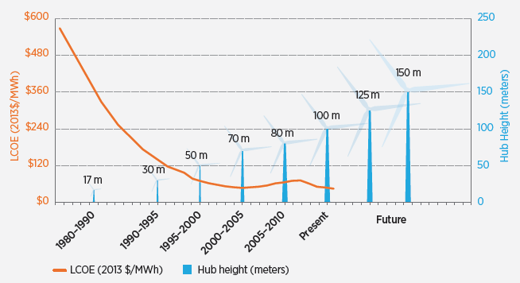
Enabling Growth
Cost to produce electricity:
1979
40 cents/kWh
2000
4-6 cents/kWh
2004
3-4.5 cents/kWh
2011
Less than 5 cents/kWh
US DOE Wind Vision Report
Notes:
The rapid growth in wind power can be attributed to two things–reduction in cost of electricity produced and more interest in renewable technologies. Between 2004 and 2011, an increase in price can be attributed to higher rates of demand than supply of turbines and rising commodity prices including a rise in the price of steel.

Slide 32
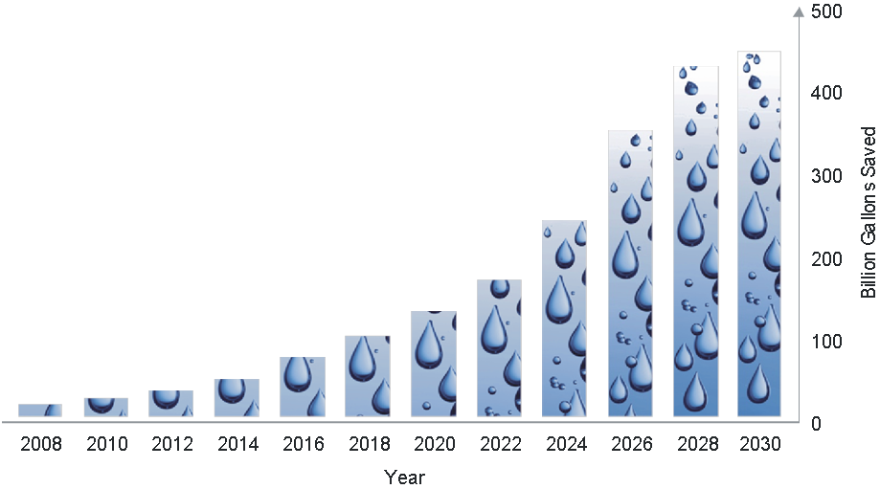
Water Conserved
20% wind in 2030: 11% less water consumption by electric sector
- 4 trillion gallons saved through 2030
35% wind in 2050: 23% less water consumption by electric sector
U.S. DOE 20% Wind Energy by 2030

Slide 33
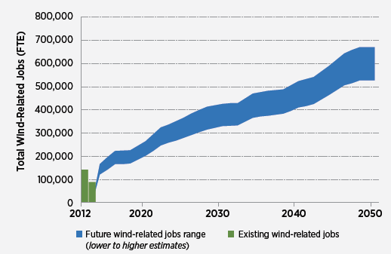
Economic Growth
US DOE Wind Vision Report
Notes:
2050: 12-15% On-Site jobs; 42-45% Supply chain; 43% Induced jobs

Slide 34
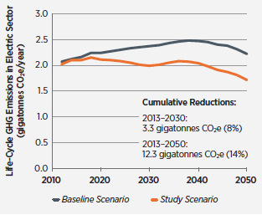
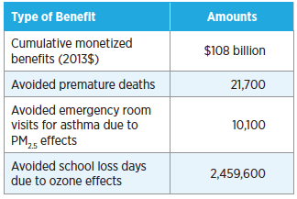
Health and Climate Benefits by 2050
*Less than 1.5% of contiguous land area of the U.S. occupied by wind power plants in 2050
US DOE Wind Vision Report

Slide 35
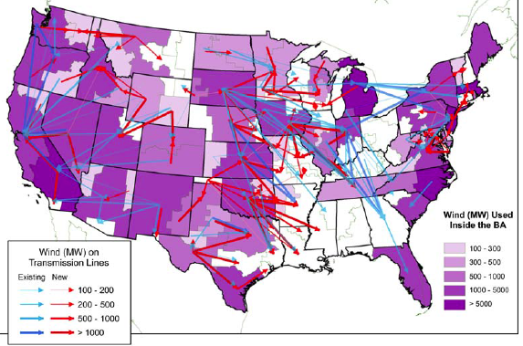
Transmission expansion needed to meet 20%-35% wind
U.S. DOE 20% Wind Energy by 2030
Notes:
2.7x incremental transmission by 2030; 4.2x by 2050
10 million MW-miles transmission capacity by 2030 (29 by 2050)

Slide 36

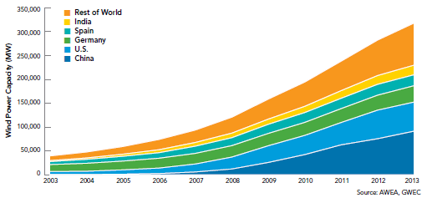
Total Installed Generating Capacity (MW) Globally
Top 5 Countries for 2013
New Installed Capacity
China
Germany
United Kingdom
India
Canada
Notes:
Germany generates 22% of its electrical power via wind power (34,000 MW wind capacity installed)
In 2013 the UK installed 1883 MW new wind capacity, accounting for more than 20% growth and surpassing new installed wind power in the U.S.
China added 16,100 MW new capacity in 2013, which is 21.4% annual growth
China has more than double the wind generating capacity than any other country other than the U.S.

Slide 37
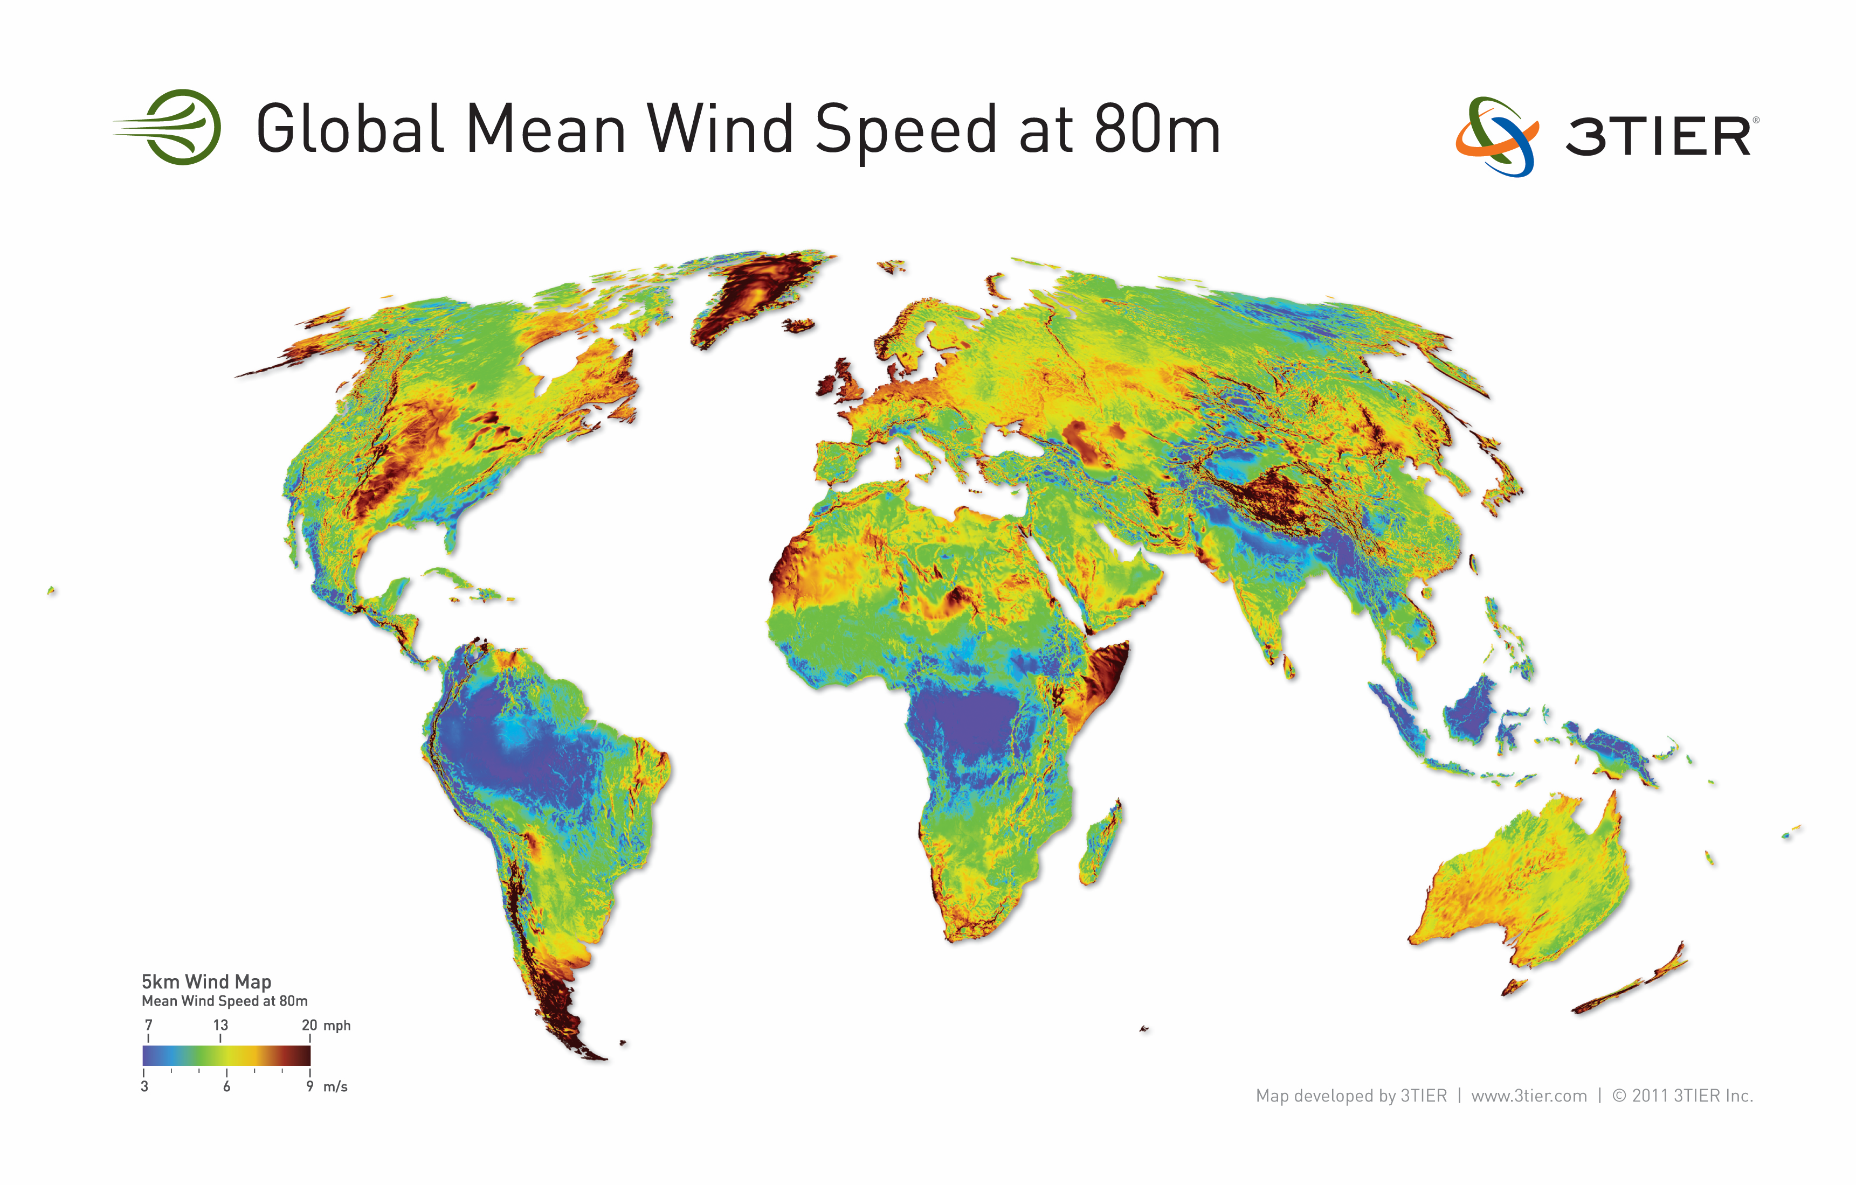
Global Wind Resource Map
Class 3

