Slide 1
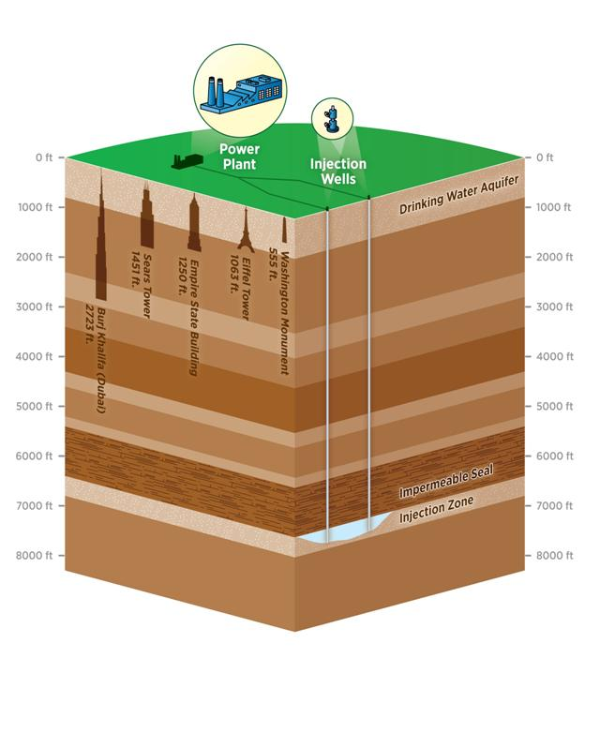
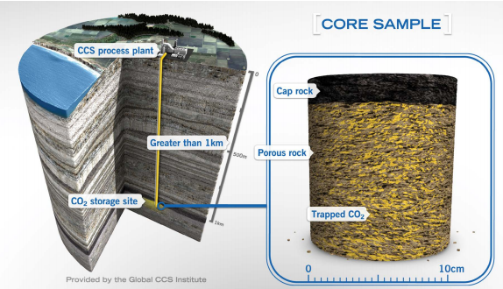
Carbon capture and geological sequestration:
Notes:
Intermediate use co2, EOR coal bed methane, natural gas etc, mineral storage , terrestrial sequestration

Slide 2
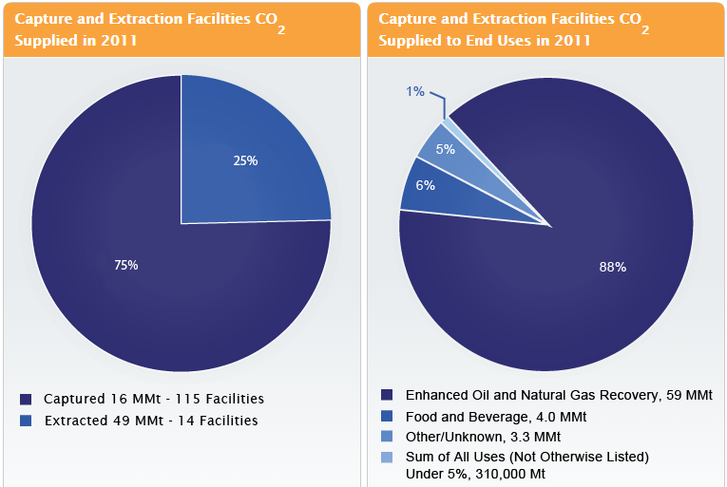
Some numbers
40 % carbon emissions from power plants
90 % emission reduction proven operationally
Eg. Geological sequestration coupled with 500 MW coal plant (3MPTA to 0.3 MPTA) – same as a terrestrial sequestration of 62 million trees planted and grown over 10 years
2 degrees celsius goal, 2 trillion dollar economic implication sans CCS
Notes:
Talk about revenue potential of EOR, no subsidies compa

Slide 3
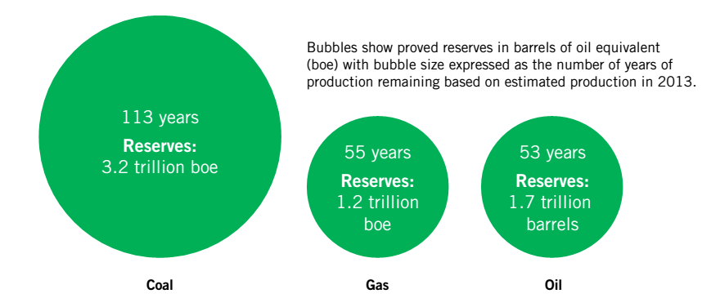
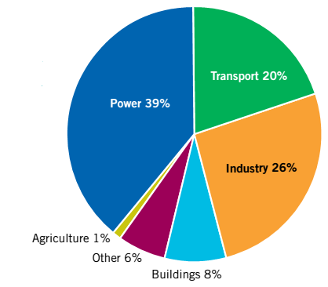
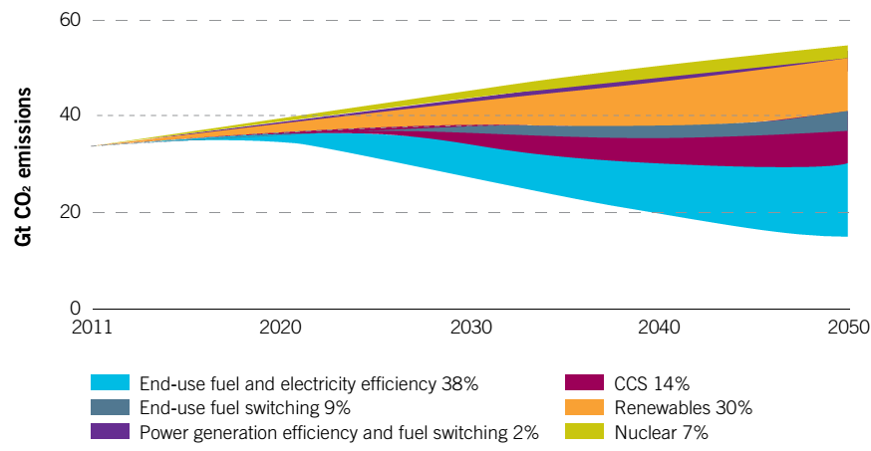
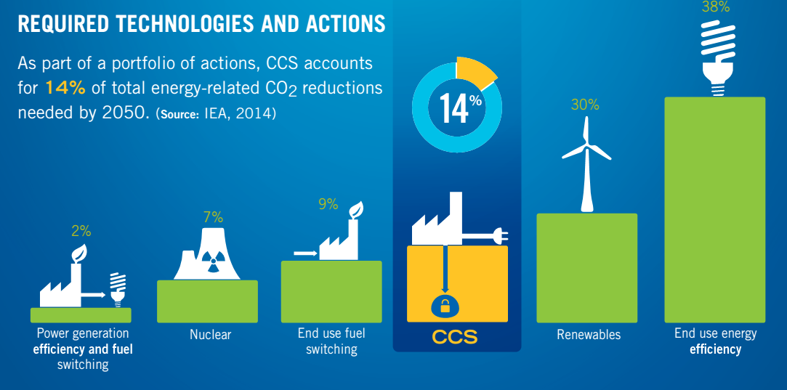
Some CCS numbers – IEA estimates
Notes:
Cheaper right now where CO2 is separated as a part of production either from the gases eg co2 stripped from methane rich sales gas component - natural gases or as a pure stream of co2 as in fertlixzres
Complicated in power plants – post combustion

Slide 4
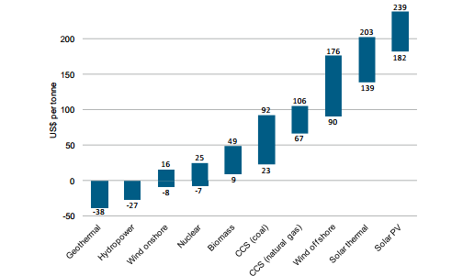
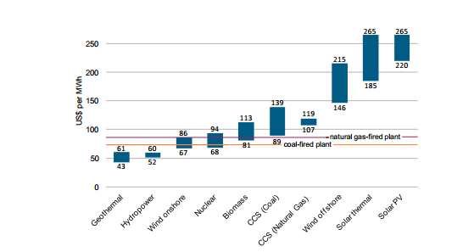
Cost comparison for emission reduction, LCOE
Notes:
Like for like comparison – cost of CO2 avoided – susbsidies not included

Slide 5
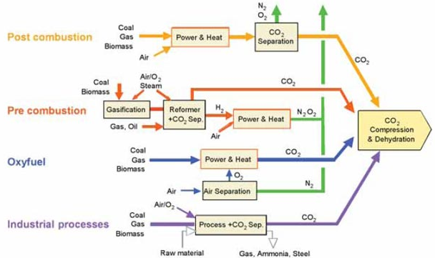
Types of capture
Notes:
Similarly, the same kind of impermeable cap rocks that keep oil and gas underground and prevent it migrating to the surface can be expected to trap CO2 over geological timescales
Explain efficiency of each of the processes
Exploration research and upraisal needed

Slide 6
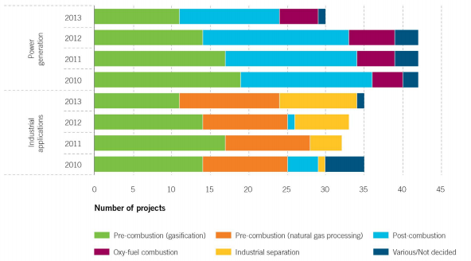
Operational and planned projects cost distribution

Slide 7
Issues of transportation
Scalability
International safety standards
Truck and rail transport capabilities from food grade research for small scale CCS, ship transportation for saline area injection, gas pipelines , large scale shipment similar to LPG lines (safety)
100 times larger infra than present (6000 km) is needed in next 35 years to meet 2050 target
Cost variability due to length, co2 volume, labor and economic cost of infra – what costs included?
Lake Nyos disaster – Non periodical volcanic activity based CO2 release
Notes:
Public perception not so good
Corrosion (external and internal (water based – 840 ppm, dehydration needed)
Gas processing, hydrogen plants produce pure dry CO2 so no need for corrosion protection
Phase transition to be avoided – to use supercritical CO2 (relatively low temperature and pressure)
Emergency shut down valves, if there is a pressure drop
Crack arrestors – greater wall thickness at joints, use of periodic non metallic elements , improved hoop stress etc
Hydrostatic testing to be done
Relief valve failure, valve /gasket/weld failure etc
Continuous monitoring to be done – pipeline pigging
Trenching, pipe lenth material, distance, refilling of earth, engineering, booster stations, pigging etc, offshore cots are the highest per unit length although less public outrage

Slide 8
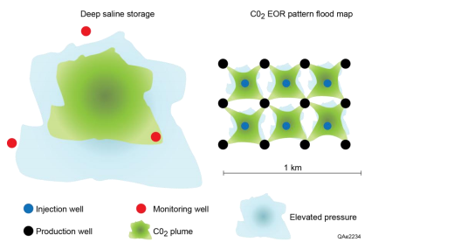
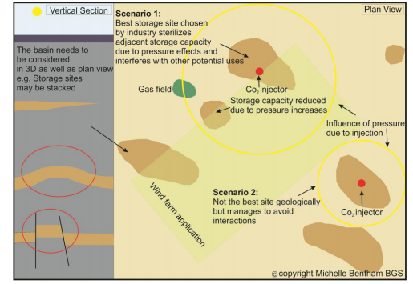
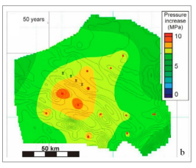
Injection and sequestration readiness
Co2 storage licensing on a first come first served basis subject to availability, pressure interferences, public concerns, priorities etc
Storage possibilities: Saline formations, depleted oil and gas reservoirs, unmineable coal areas
\\
Notes:
sufficient space is available on or near the site to accommodate carbon capture equipment
in the future;
• it is technically feasible to retrofit carbon capture technologies;
• a suitable offshore storage site exists;
• it is technically feasible to transport the captured CO
2
to the storage site; and
• it is economically feasible to link the plant to a full CCS chain within its operational life.
Think about the following:
Subsurface users:
• Hydrocarbon operations
• Gas storage
• Other CCS sites within the same geological formations
Surface users:
• Wind farms
• Dredging areas
• Pipelines
• Hydrocarbon and gas storage operations
• Environmental protection zones
• Shipping routes
• Fishing

Slide 9
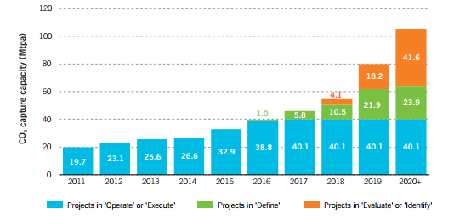
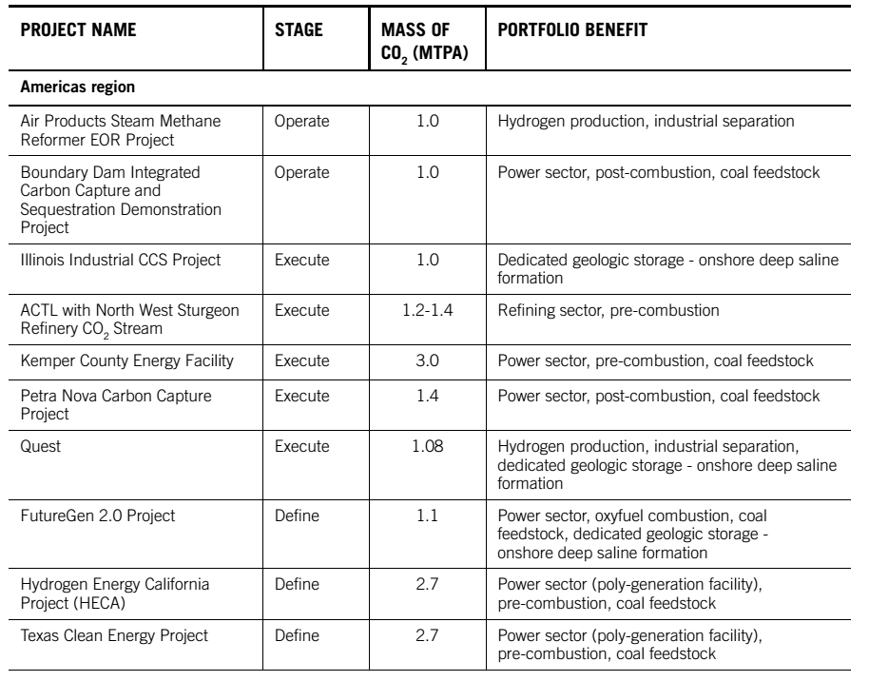
Important Projects
Power – coal - Saskatchewan boundary dam project –Operational post comb, Kemper – Mississipi and Petra nova texas
Non Power - Iron and steel Abu dhabi CCS project
Commercial EOR- Lack of CCS in carbon intensive stuff like cement, chemicals etc
40 MPTA in operate and execute stage
A third of the projects in USA
CCS technologies at MIT

Slide 10
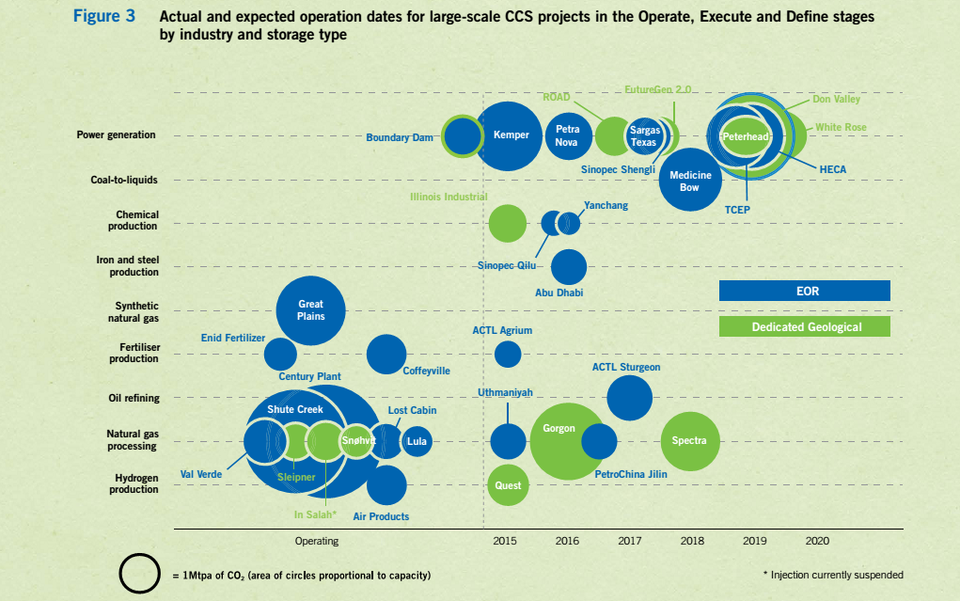
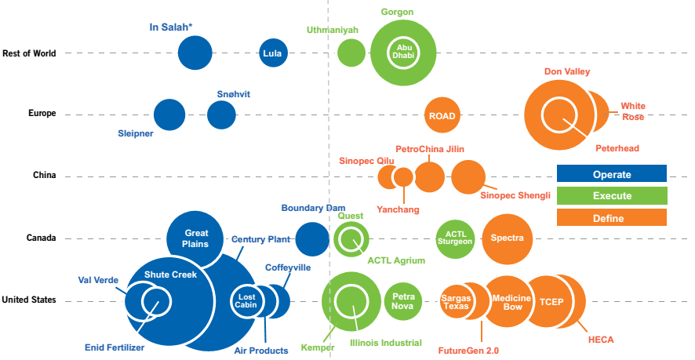
Stage of functioning of projects by region
Global CCS institute
Notes:
Industry – 9 % of global emissions, still no carbon capture intensivity
EOR offers revenue potential that is why US, Canada concentration – Sales of CO2 for EOR
Taking the experience gained is very important
Except china no big projects planned in energy intensive nations – concern
Government policy uncertainty a hugeissue
70 % HAS to happen in non OECD countries

Slide 11
Which one to do preferably
Power sector/iron and steel Industry/ chemicals??
Where are the costs lower, emissions higher?
Whether to promote coal, natural gas with CCS? ; Is biomass with CCS the answer ?!!
Notes:
Separation from a nitrogen rich exhaust gas is needed
Valuable experience in deep saline formation storage has been gained from large-scale projects in Norway (the Sleipner and Snøhvit CO2 Storage Projects) and in Algeria (the In Salah CO2 Storage Project) and a range of pilot test facilities around the world, such as Lacq in France, Ketzin in Germany and Otway in Australia.
15 % emissions in iron and steel

Slide 12
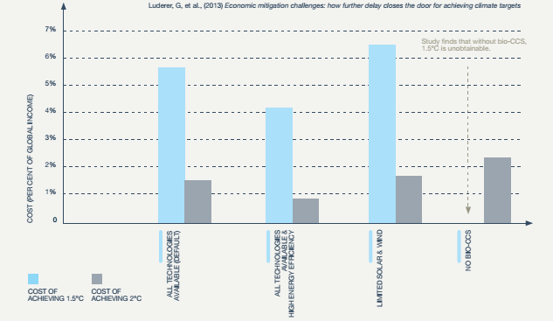
Why CCS with biomass
Notes:
1.5 C v 2 C goal (1.5 C goal half of the 2 C goal)
Negative emissions in the longer term
Biodiversity, food and feed prices at risk

Slide 13
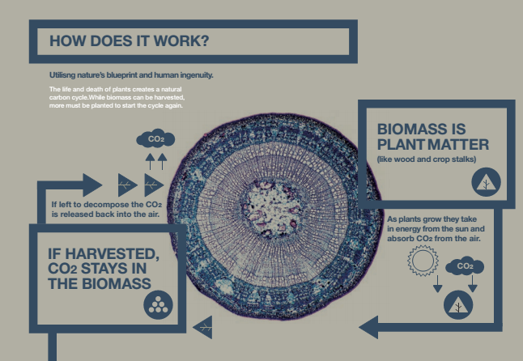
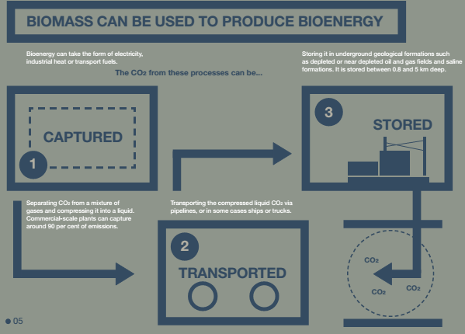
CCS with biomass

Slide 14
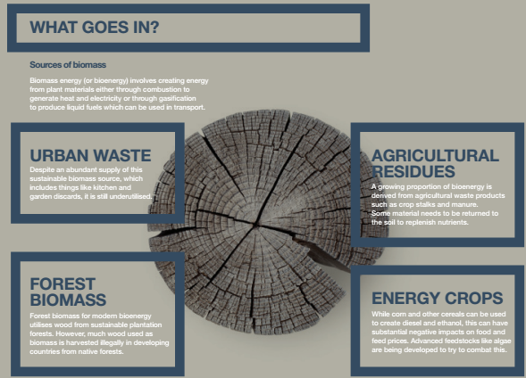
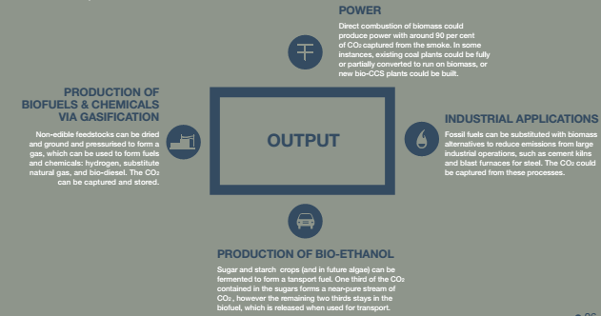

Slide 15
Recommendations
A mix of CCS and other renewables is needed for 2 C rise prevention goal, promoting CCS with coal in developing countries
Subsidizing at similar scales for CCS compared to other renewables
Using research by coupling CCS with coal and CC-EOR in existing operating projects and using it for CCS- biomass
CCS is the only technology that can contribute to emission decrease from energy intensive iron and steel and cement – to be promoted
Notes:
Simultaneously starting CCS with biomass in americas
Regulatory policies for CCS operational power plant
Regulatory policy – CCS with carbon pricing

